Slide 1
MIS2501
Enterprise IT Architecture

Slide 2
Doyle
30+ years industry experience
E-mail: MDoyle@Temple.Edu
Office: Speakman 209H
Telephone: (215) 204-4684

Slide 3
My Background
Education
  BS Computer Science
  MS Computer Information Systems (a.k.a. MIS)
Pre-Temple
  Computer Sciences Corporation
  IBM
  Martin J. Doyle, Inc.
  Rohm and Haas
    Company’s 1st IT Technical Fellow
    Chief Technology Architect
    Basis Team Lead
Adjunct Faculty
  Holy Family University, Temple University
Full-Time Faculty
  Temple University – Undergraduate, Graduate, OMBA, IMBA & EMBA

Slide 4
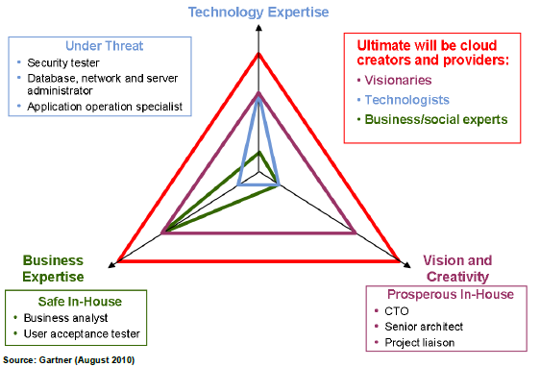
Notes:
Research done by Gartner. Looks at skills across three dimensions, technology expertise, business expertise, vision/creativity.
Under Threat – This is closely aligned with what we have been teaching in significant portions of the existing curriculum.
Safe In-House, Prosperous In-House, and Ultimate will be Cloud Creators and Providers – This is where we are headed with the new curriculum.

Slide 5
Should I Drop this Course Now?
Very different from any other “technology” course out there
  Could be the best course you’ve ever taken
  Could be the worst course you’ve ever taken
  If something doesn’t look quite right, get over it!
Non-traditional
  Non-traditional lectures
  Non-traditional exams
  No textbook that has the “right” answer
  Better be comfortable trying something new!
Consistent messages from Advisory Board members
  This is how we learn in the IT field! This is what we do!

Slide 6
Give a man a fish and he'll eat for a day. Teach a man to fish, and he will sit in the boat and drink beer all day.
Teach a man to fish and you feed him for a lifetime. Unless he doesn't like sushi — then you also have to teach him to cook.
Teach a man to fish and he learns to covet your boat.
Give a man a fish
, feed him for a day; teach a man to fish, feed him for a lifetime.
…
Give a man a fish and he'll eat for a day. Teach a man to fish and you can sell him fishing equipment.
Give a man a fish and he'll eat for a day. Give a man a fishing rod and he'll break it in two for firewood - or exchange it for a fish.
Give a man a fish and he'll eat for a day. Teach a man to fish and you have fed him for a lifetime. Teach a man to sell fish and he eats steak.
Give a man a fish and he'll eat for a day. Teach a man to fish and you will not have to listen to his incessant whining about how hungry he is.

Slide 7
Enterprise IT Architecture
Flash Research
Quickly and effectively:
Analyze a scenario
Identify and describe the key capability of a technology
Articulate the business case for investing in a technology
Hands-On Tech Challenges:
Learn about technologies the way IT professionals learn about technologies
Develop hands-on, marketable skills with mainstream technologies
2-Part Course

Slide 8
Flash Research Paper
Audience – CIO of a large company
  Knows a bit about technology
  Is really interested in creating business value
Body of paper 1 page or less
Additional pages for
  diagrams (optional)
  references (3 required)
Not collected/graded but this is the only thing that will prepare you for the exams!

Slide 9
Body of Paper
1 Page Max!
The Hook – Tell me why I just have to read the rest of this paper!
Tech Summary – What are the key capabilities of this technology that make it so compelling
Business Case – What is the core premise of the business case you would use to justify investing in this technology

Slide 10
Exam Grading Rubric
Item | Unacceptable | Below Average | Average | Excellent
The Hook – How well did you engage the reader and entice them to read more? | 0 | 1 | 2 | 3
Tech Summary – How well did you identify and summarize the key capabilities which make the technology so compelling? | 0 | 1 | 2 | 3
Business Case – How well did you articulate the business case for making investments in this technology? | 0 | 1 | 2 | 3
Writing – Grammar, spelling, punctuation, organization, sentence structure, etc. | 0 | 1 | 2 | 3
3 = 100%, 2 = 70%, 1 = 50%, 0=0%

Slide 11
“You can lead a horse to water but…”
Will I know if you don’t…
  do your reading?
  do your web research?
  write your non-graded flash research papers?
You will be at a serious competitive disadvantage if you don’t!

Slide 12
Business Communications Center
106 Speakman Hall
I strongly encourage you to visit these people and have them review each flash research paper!
You will “crash and burn” on the exams if you don’t!

Slide 13
Extra Credit
Average exam grades will be in the D+ to C- range
Visit the Business Communication Center and have your paper critiqued by a tutor
Hand in original critiqued paper, feedback from tutor, and updated paper and post to your e-Portfolio to earn 1 extra credit point on your final grade
See syllabus for schedule

Slide 14
Extra Credit (cont.)
“No-Show” policy
No critiques on day of exam

Slide 15
Hands-On Tech Challenges
Six Tech Challenges throughout the semester
  Demonstration in the classroom
  Hands-on experience in the classroom
  Personal exploration outside of the classroom
Exam 1 and exam 4 will require competency with these technologies so make the time to work with and explore these technologies!

Slide 16
Tech Challenge Scenario
You have recently been hired as the “IT guy” by FoxPharma. FoxPharma is a small
start-up that is developing new drugs for cancer treatments. Being a start-up,
you’re not just the “IT guy”, you’re the entire IT department. FoxPharma has just
launched. In terms of the systems they need to support their new business they
have nothing. Figuring out what they need is your job. Planning, deployment and
support of these systems is your job.
Being a start-up, cash is tight. The business does not have the capital to build a datacenter
and purchase all of the gear that a larger more established organization might have.
As a result of this you have decided to utilize cloud technology and will build out the
infrastructure that your organization needs using Microsoft’s Azure technology.
Here is what you will build…

Slide 17
Microsoft Azure
Exam 4
Exam 1

Slide 18
MIS Portfolio Requirement
MIS majors only
Intended to drive engagement in/out of classroom
  Work an internship
  Get involved in AIS
  Work on projects above and beyond normal course expectations
Earn points for each achievement
  Must earn 1,000 points before graduation
  Must earn 200 points to complete this class

