Slide 1
Vertical Studios in MIS Education
Mart Doyle
mdoyle@temple.edu
Richard Flanagan
ryflanag@temple.edu
James Moustafellos
jamescm@temple.edu
AMCIS 2015 Annual Conference: Presented August 15, 2015
Session: Technology Enhanced Collaborative Learning II

Slide 2
Agenda
Who we are
Studio courses
Vertical studios
The results
The problem identified

Slide 3
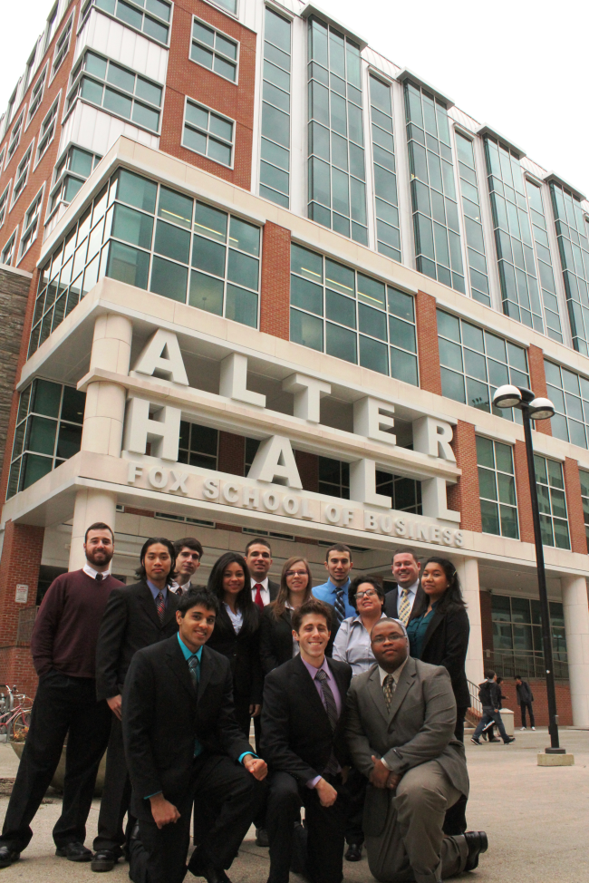
Who we are
Fox School of Business
Established in 1918
7,000 students
Largest business school in Philadelphia
Public, urban university
60,000+ alumni
Department of Management Information Systems
Established in 2000
367 majors, 343 minors
18 full-time faculty
BBA in MIS ranked 13th in US
MBA in ITM ranked 16th in US
Ranked #1 for MIS research in the world

Slide 4
What is the learning gap?
“The average student was able to mimic simple problems but did not have the ability to apply the ideas to new problems or situations”
(Jones-Wilson, 2005 on Organic Chemistry)
“Students were not yet able to be either analytical or creative in their thinking about the materials I presented, and I did not know what to do about developing their thinking.”
(Moreland-Young, 1983 on Political Science)
From: http://3.bp.blogspot.com/_oJiC4AmR4UU/S4FlHotJBJI/AAAAAAAAAhk/F2SumCCPquk/s640/2420328820_d4e152ae6e_o.jpg

Slide 5
What is the Mgmt gap?
“We don’t understand users; we don’t understand clients; we don’t understand other people really well. We don’t teach students about visualizing and imagining something that does not now exist that would take care of users’ needs. We don’t teach them about prototyping, giving the product to the consumer and then improving it and improving it some more. We don’t do any of that.”
David Dunne and Roger Martin [Dean, Rotman] (2006) Design Thinking and How It Will Change Management Education: An Interview and Discussion, AMLE, p 515

Slide 6
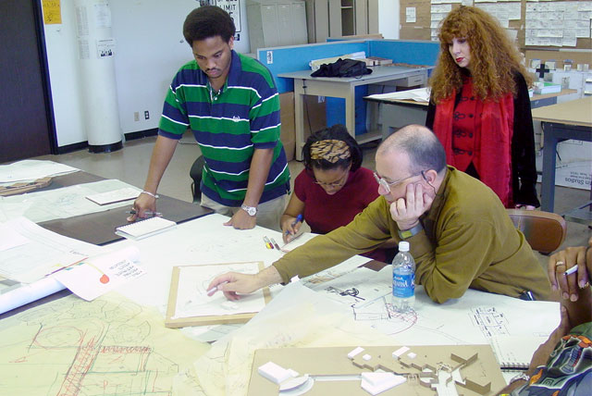
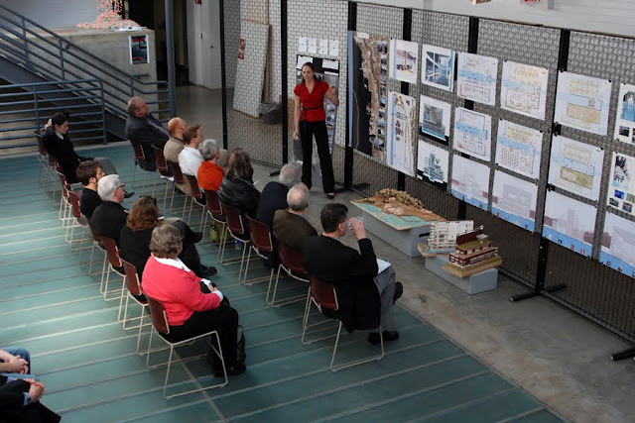
What are Design Studios?
Interactive and experiential learning
Limited lecture content
Learning-by-doing
Project based
Visual thinking + Prototyping
Collaborative
Desk crit / design jury
“The pedagogical core of the design studio is the ‘desk crit’, a collaborative activity where the teacher and the student do design work together, discussing and sketching possibilities and imagining the consequences of design choices.” (Mewburn, 2010)
Top: http://hbculifestyle.com/hbcu-architecture-and-design/
Bottom: http://3.bp.blogspot.com/_oJiC4AmR4UU/S4FlHotJBJI/AAAAAAAAAhk/F2SumCCPquk/s640/2420328820_d4e152ae6e_o.jpg

Slide 7
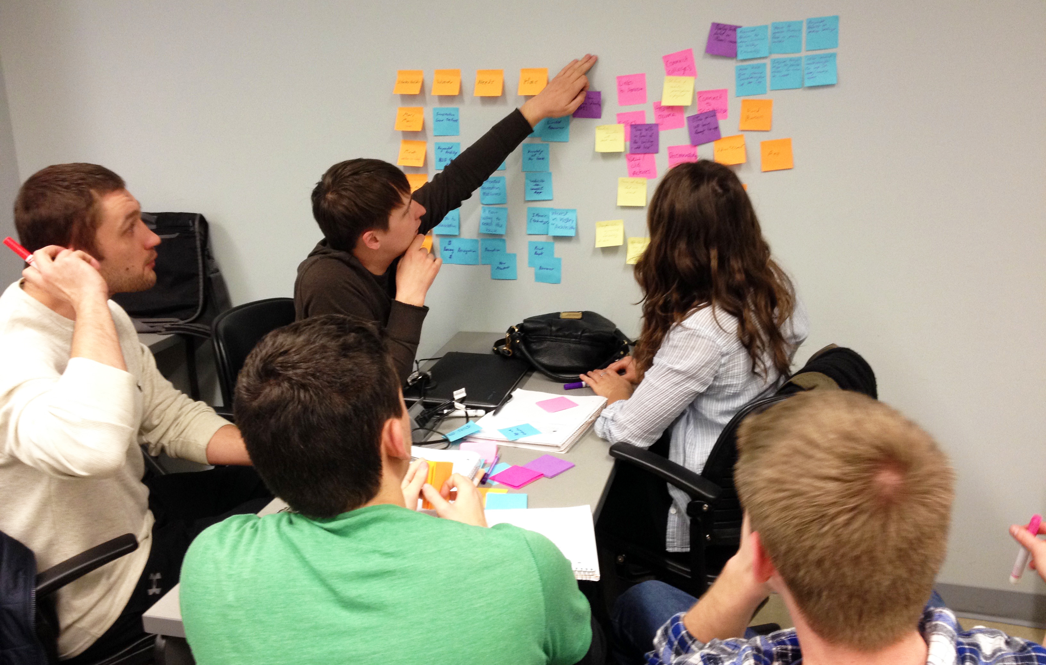
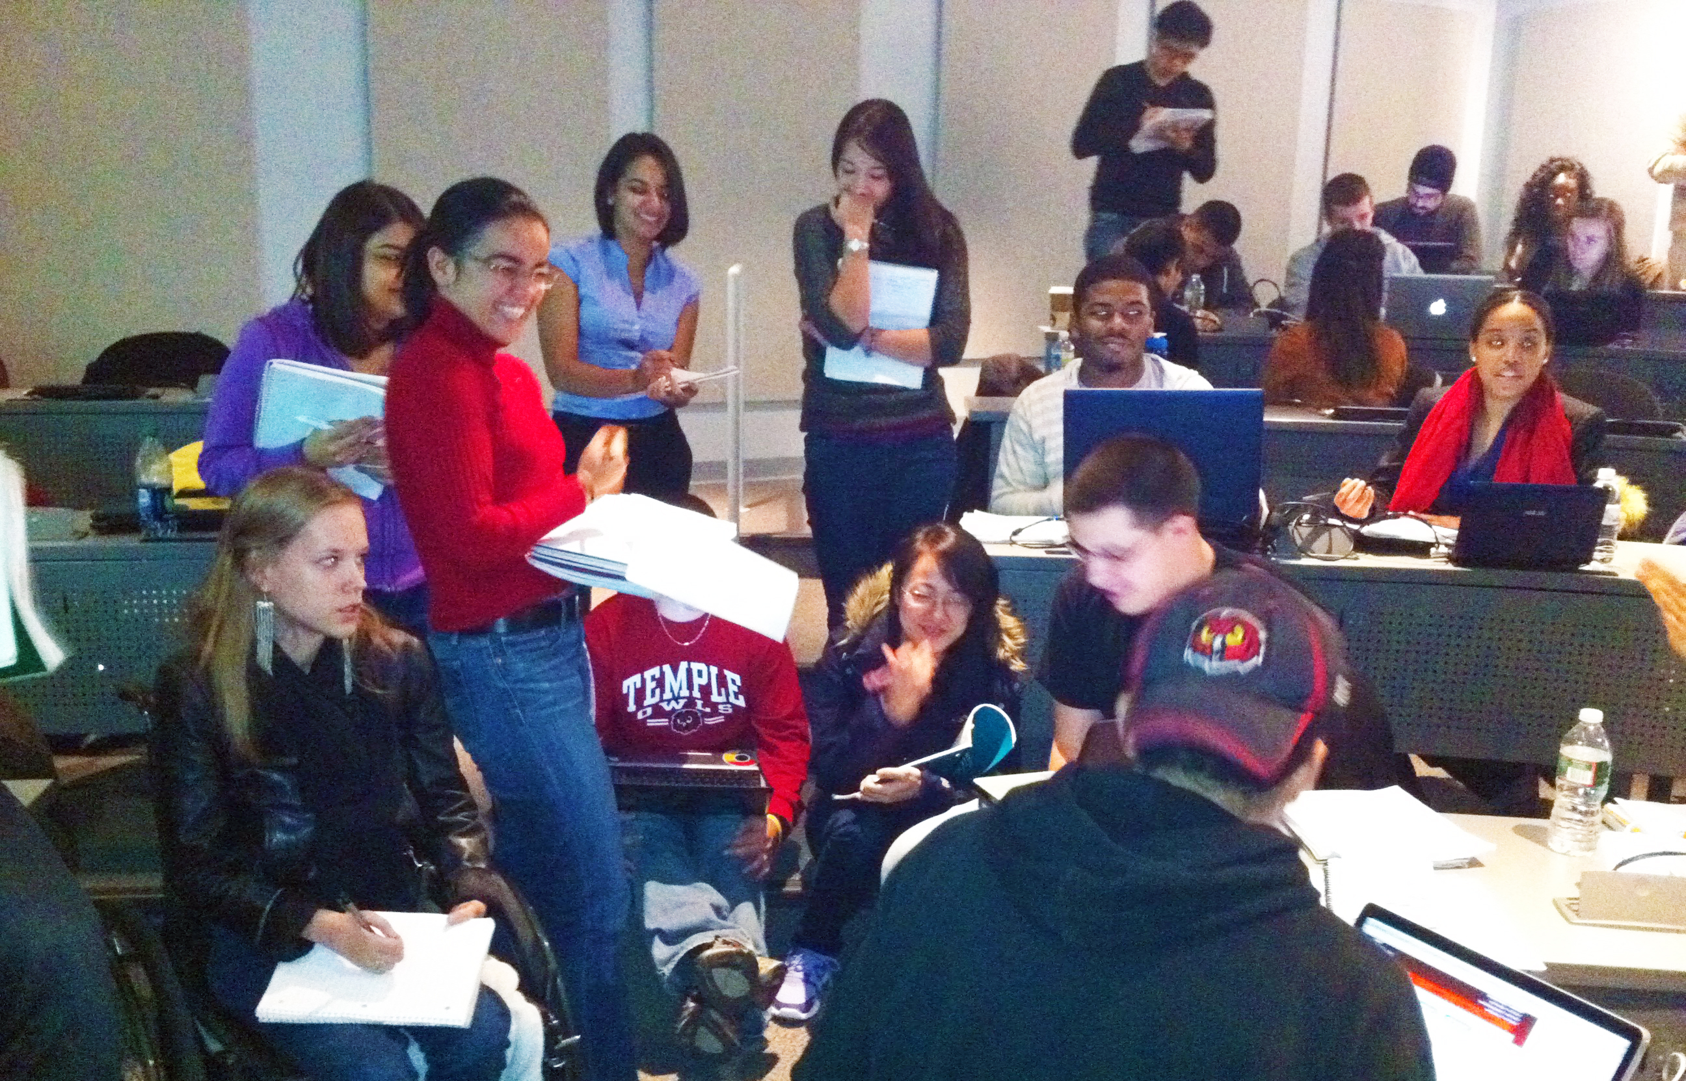
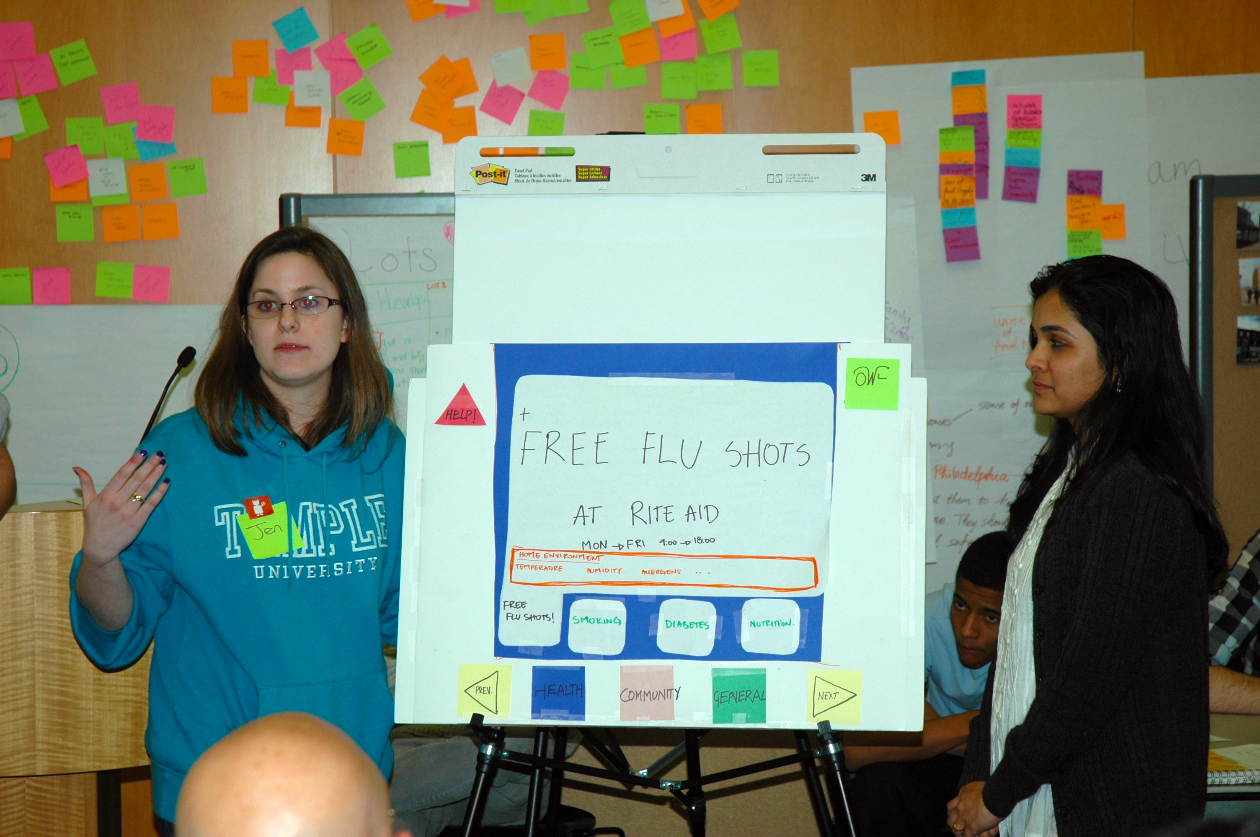
Why a Studio format?
Unlike the many “course in a box” classes we have taken, the studios promote an open environment to seek answers instead of statically defined information. – Mike Belli, student

Slide 8
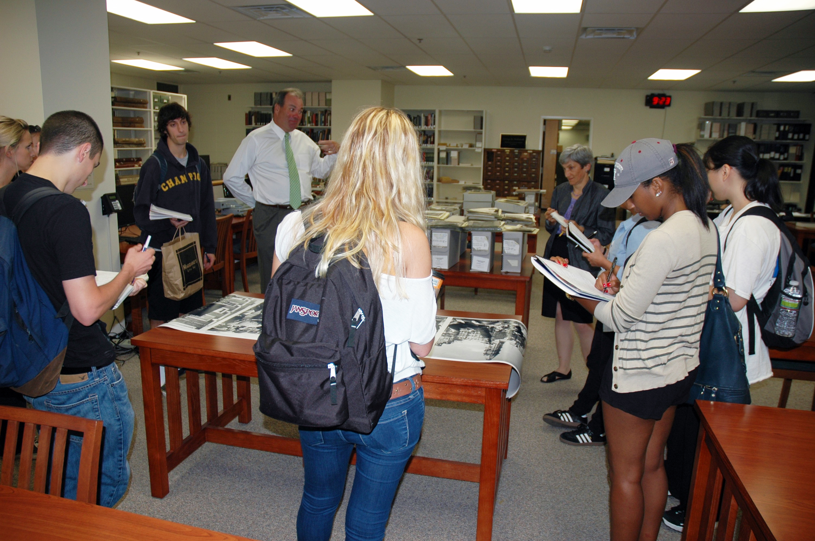
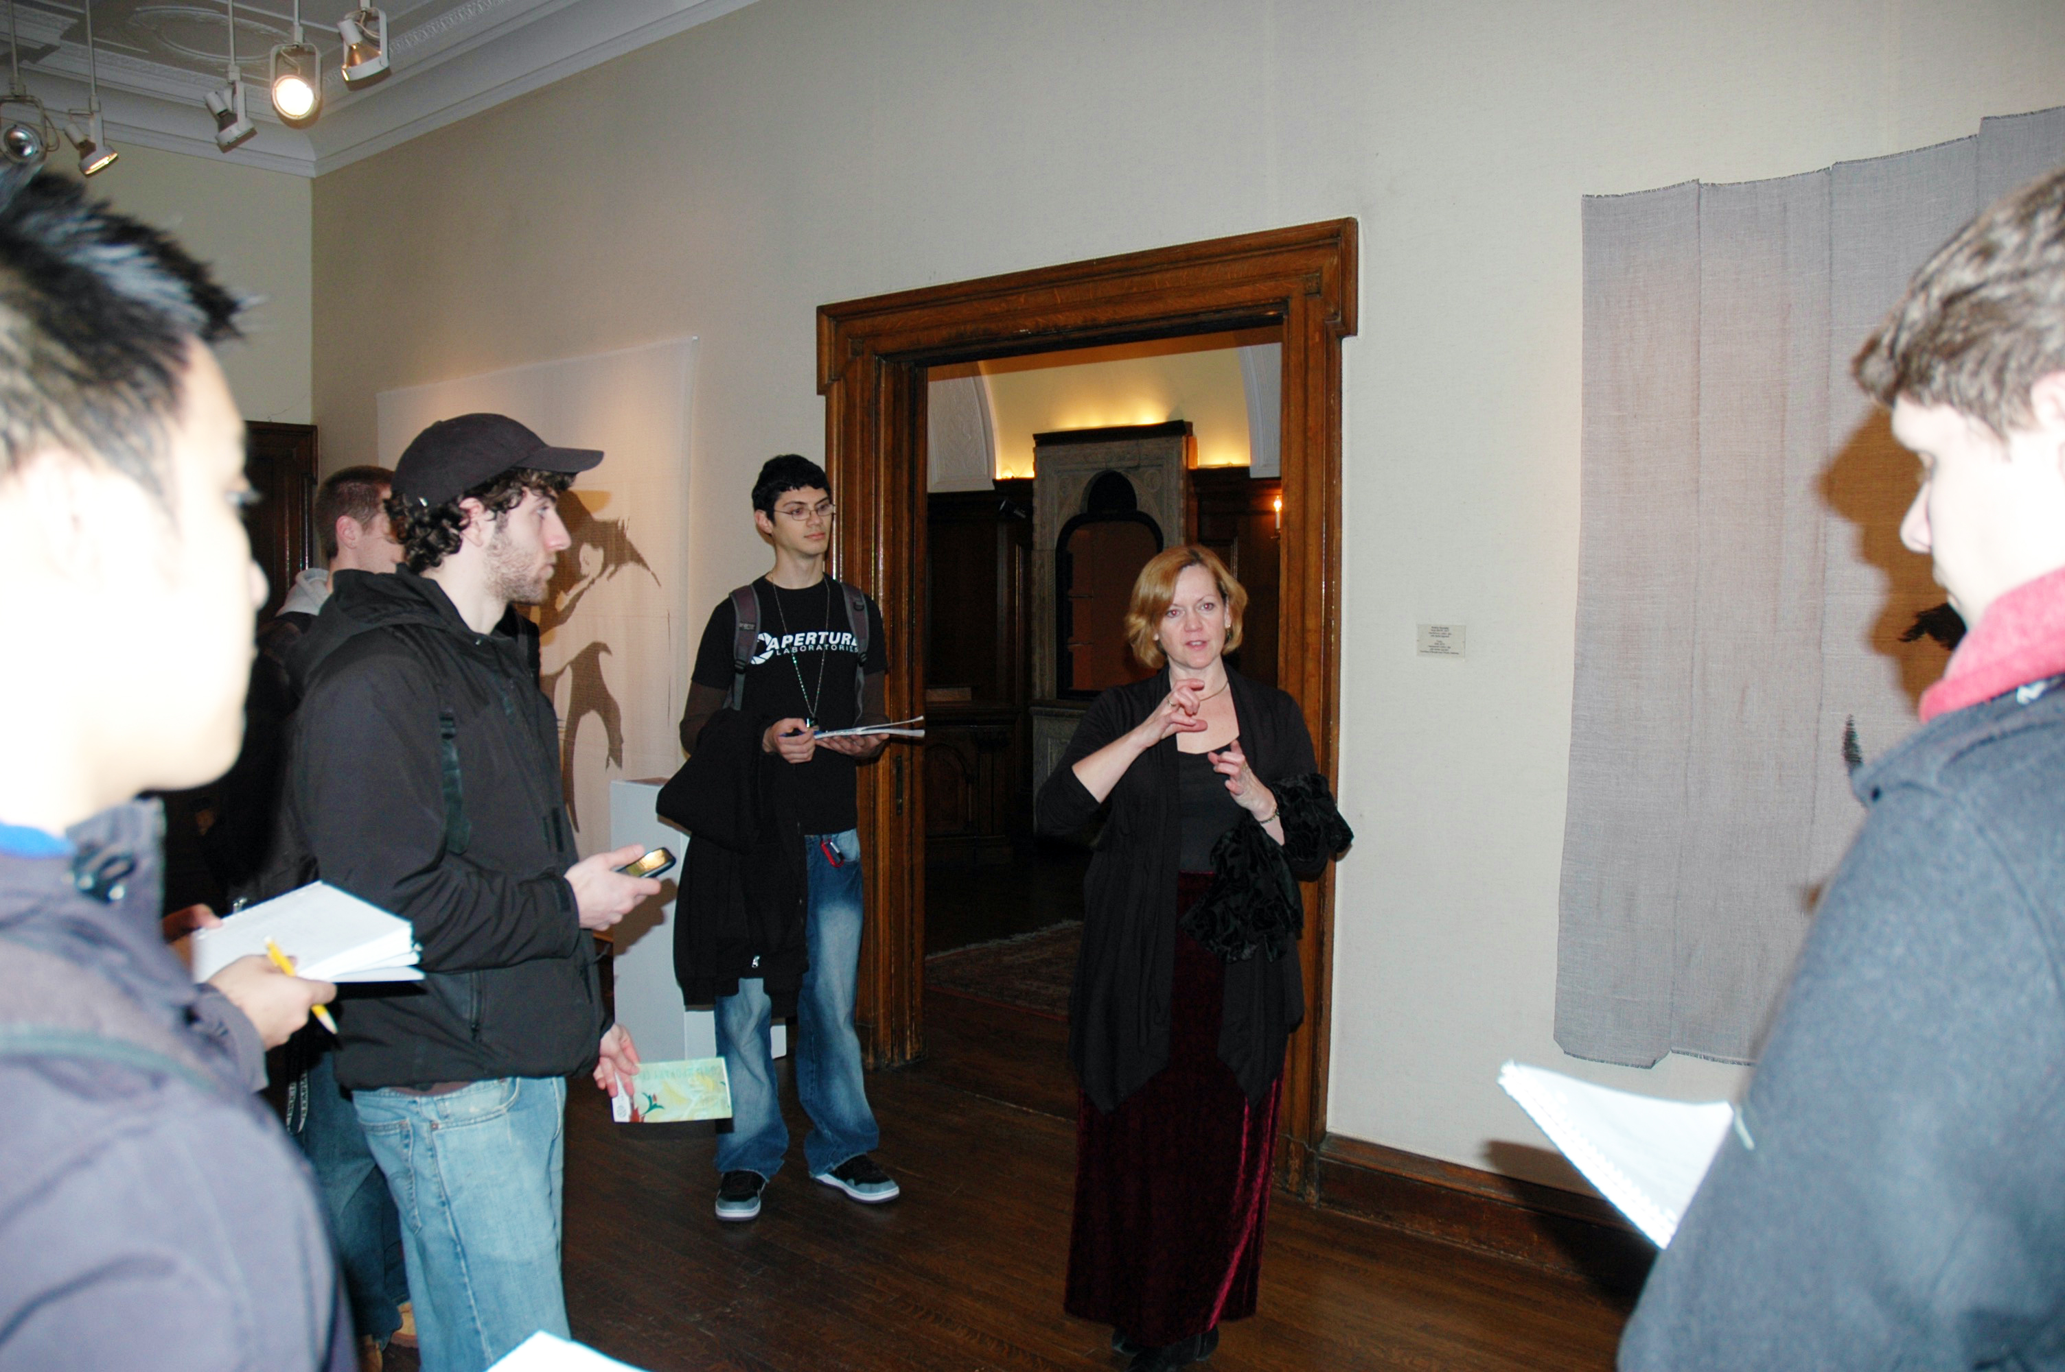
Why a Studio format?
“…Studios ensure, learning and collaboration continues outside of the classroom.” – Mike Belli, student
I think one of the biggest takeaways after MIS 3504 class was the “experience.” Interacting with a real client, analyzing their problems and developing a potential solution is something consultants do, and that’s exactly what we did in the class as well. – Abhay Kshirsagar, student

Slide 9
What are Vertical Studios?
Combines advanced with novice students
Experience combined with enthusiasm
Mutually beneficial
“… the vertical or elective studio system mirrors the reality of practice, which is a nonlinear, iterative, and unpredictable process for finding solutions to design problems within a very complex cultural setting. The vertical studio mandates personal responsibility at multiple levels, requires independence of thought and action, and generates mature thinking, all essential attributes of the successful professional designer.” (Barnes, 1993)
MIS 2502
Data Analytics
MIS 3501
Data-centric
Application
Development
MIS 3504
Digital Design
& Innovation
MIS 2501
Enterprise IT
Architecture
MIS 3535
Leading Global
Digital Projects
MIS 3502
Pre-Req: 3501
Application
Integration &
Evaluation
MIS 4596
IT Value and
Service Delivery

Slide 10
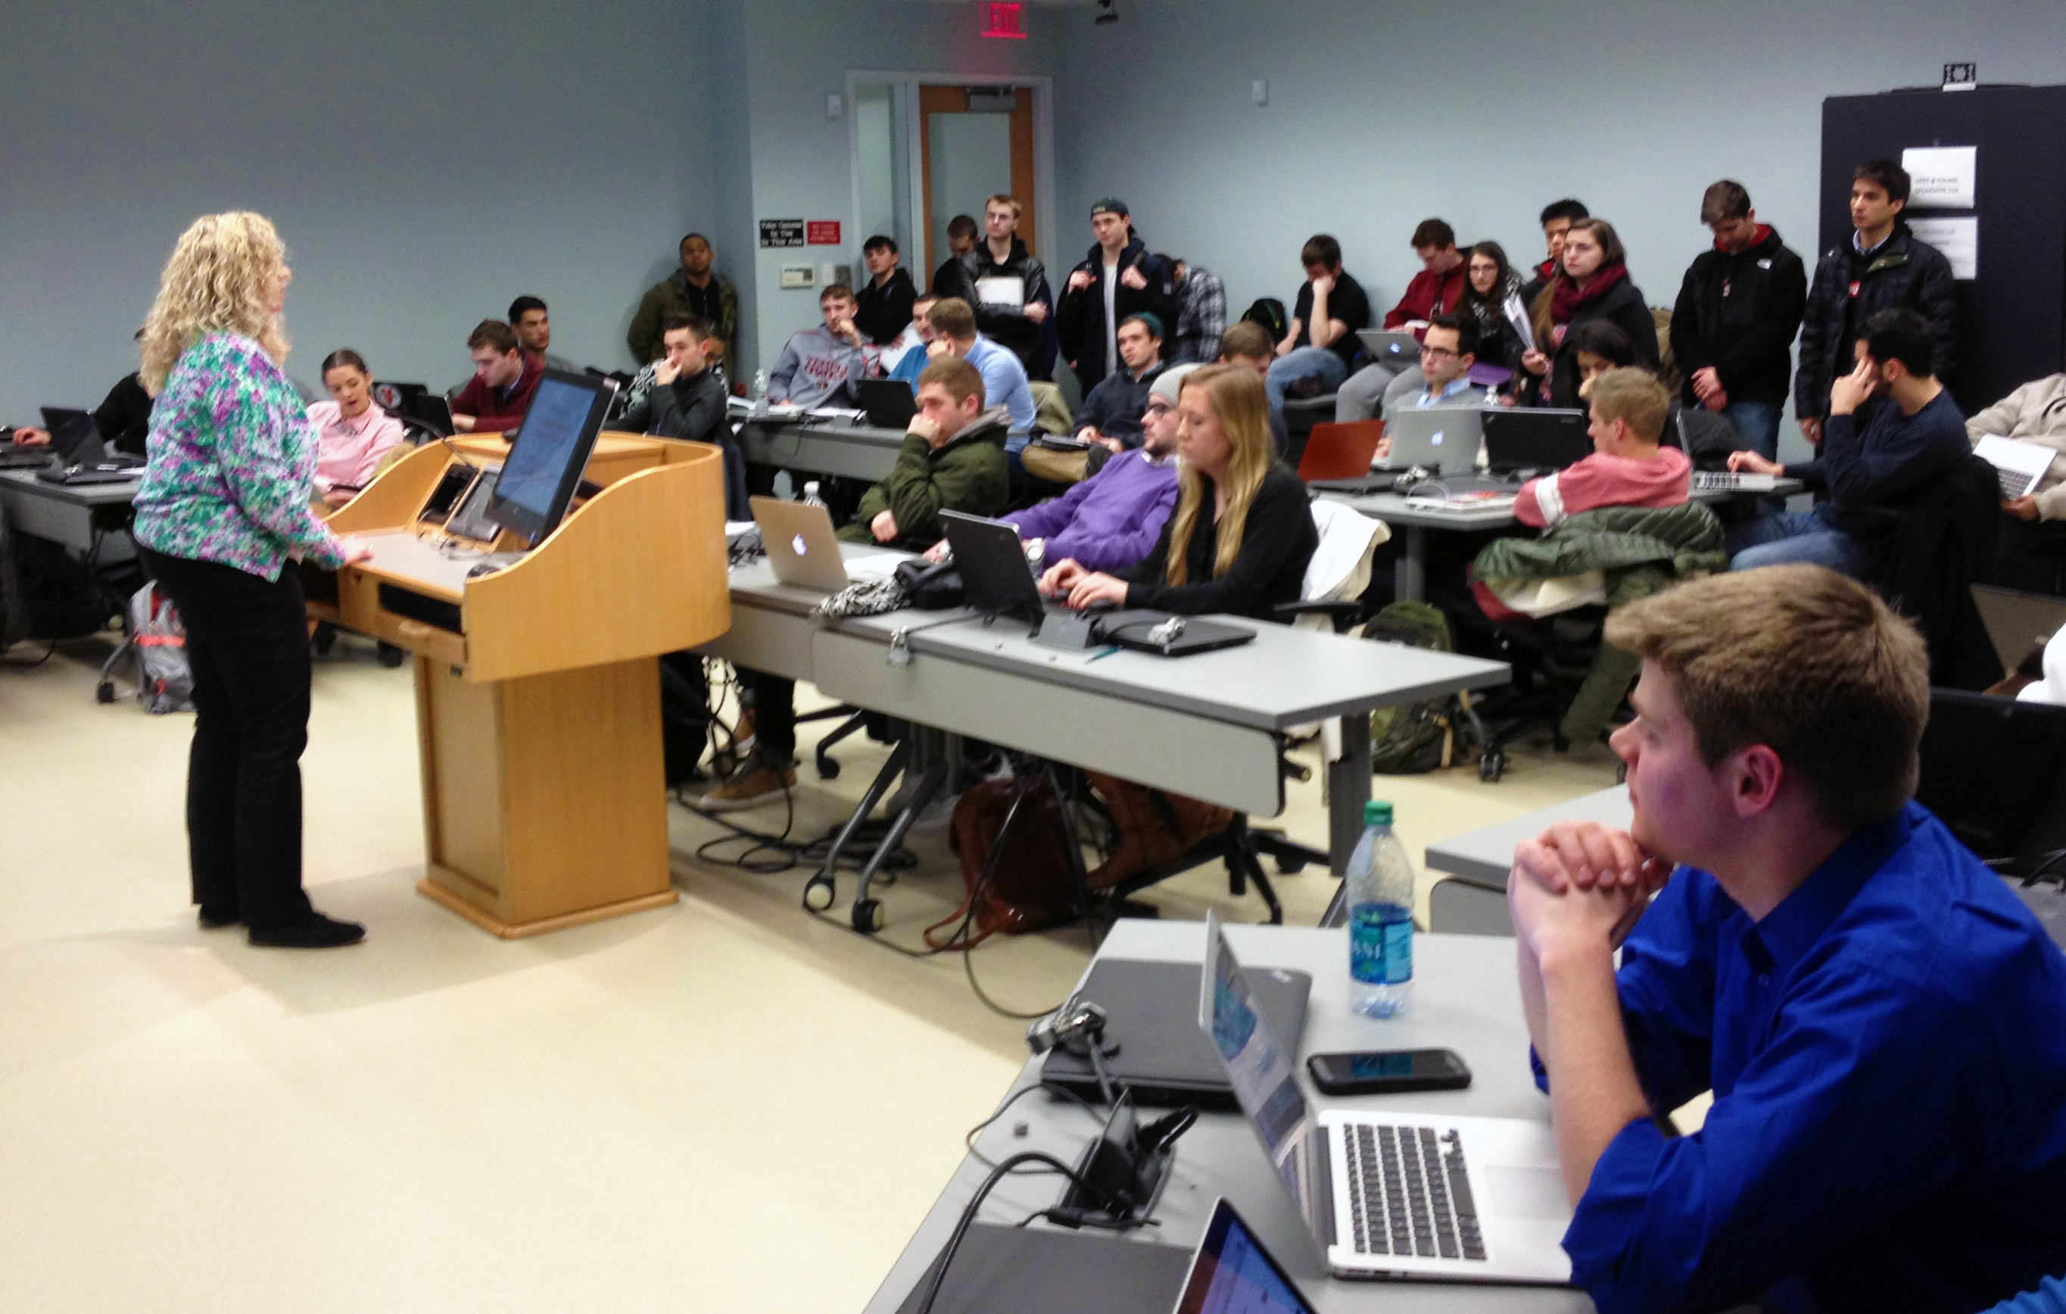
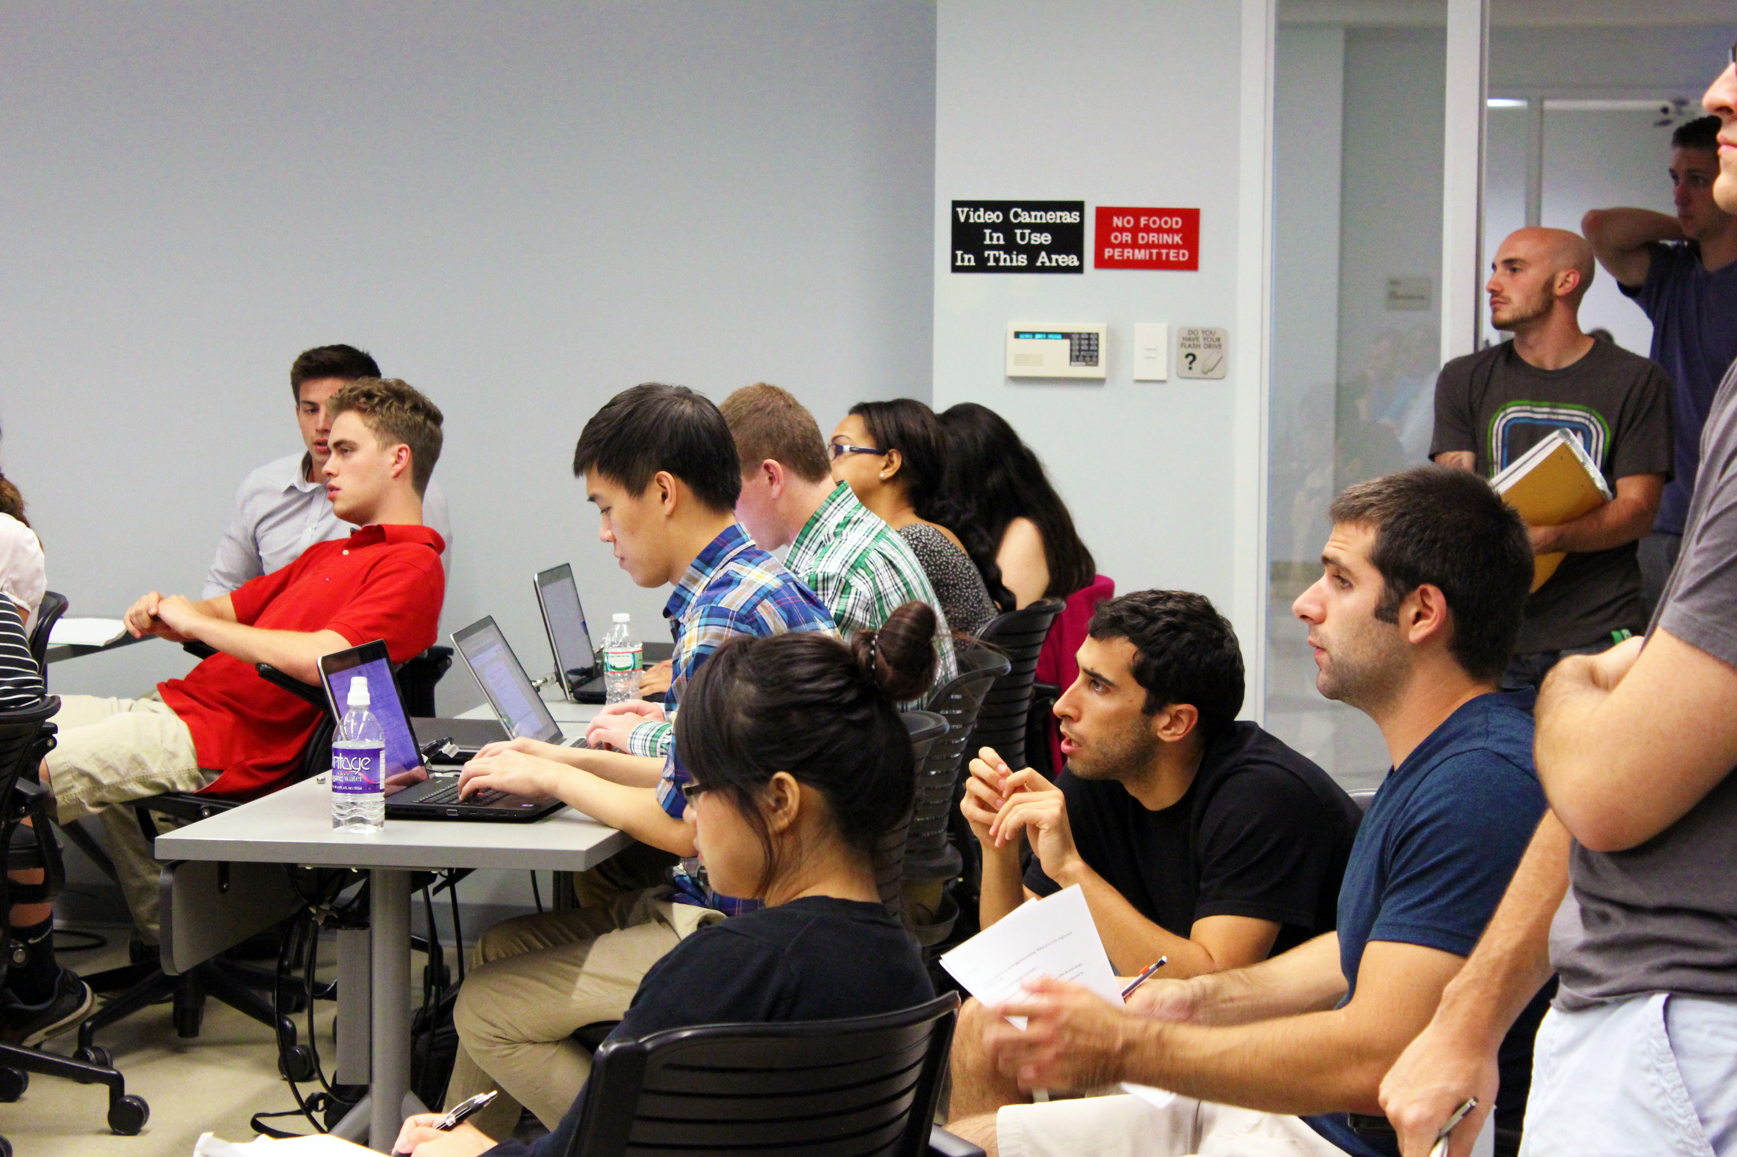
Value of Vertical Studios
BAs
Managers
“. . . MIS 3504 was very valuable to me because I was able to work with a team that included people that already had experience with the expectations of the project.” Nicolas Hurtado
“Collaborating with PMs in 3535 gave our team insight into . . . expectations along with career advice from peers.” Michael O’Malley
“Although my team did not have a good experience with our project managers, we learned how to work and succeed under poor management, an extremely useful skill that I have come to learn.” Ciara Murphy

Slide 11
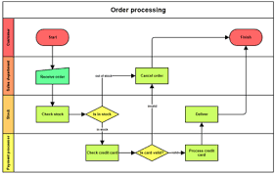
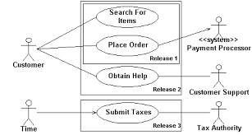
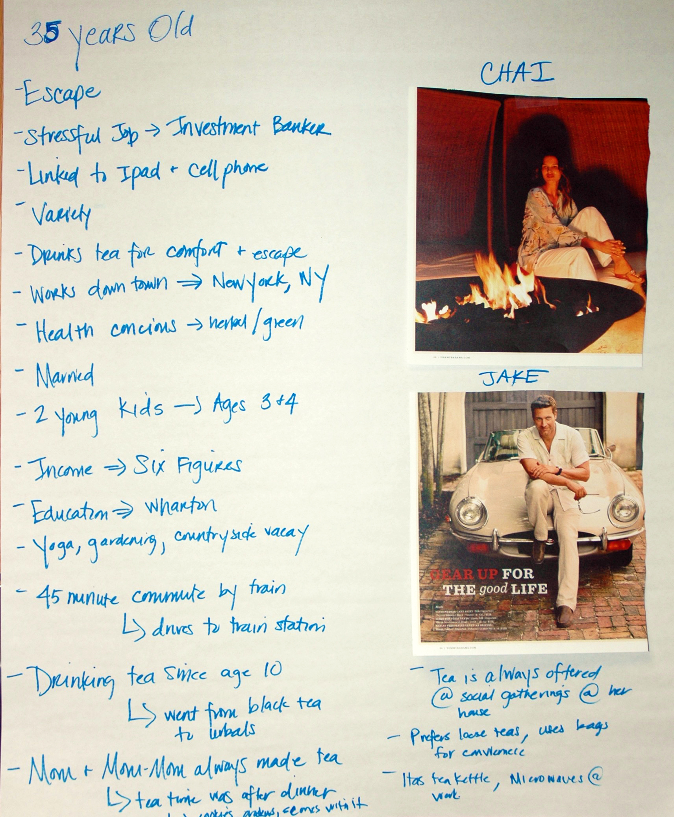
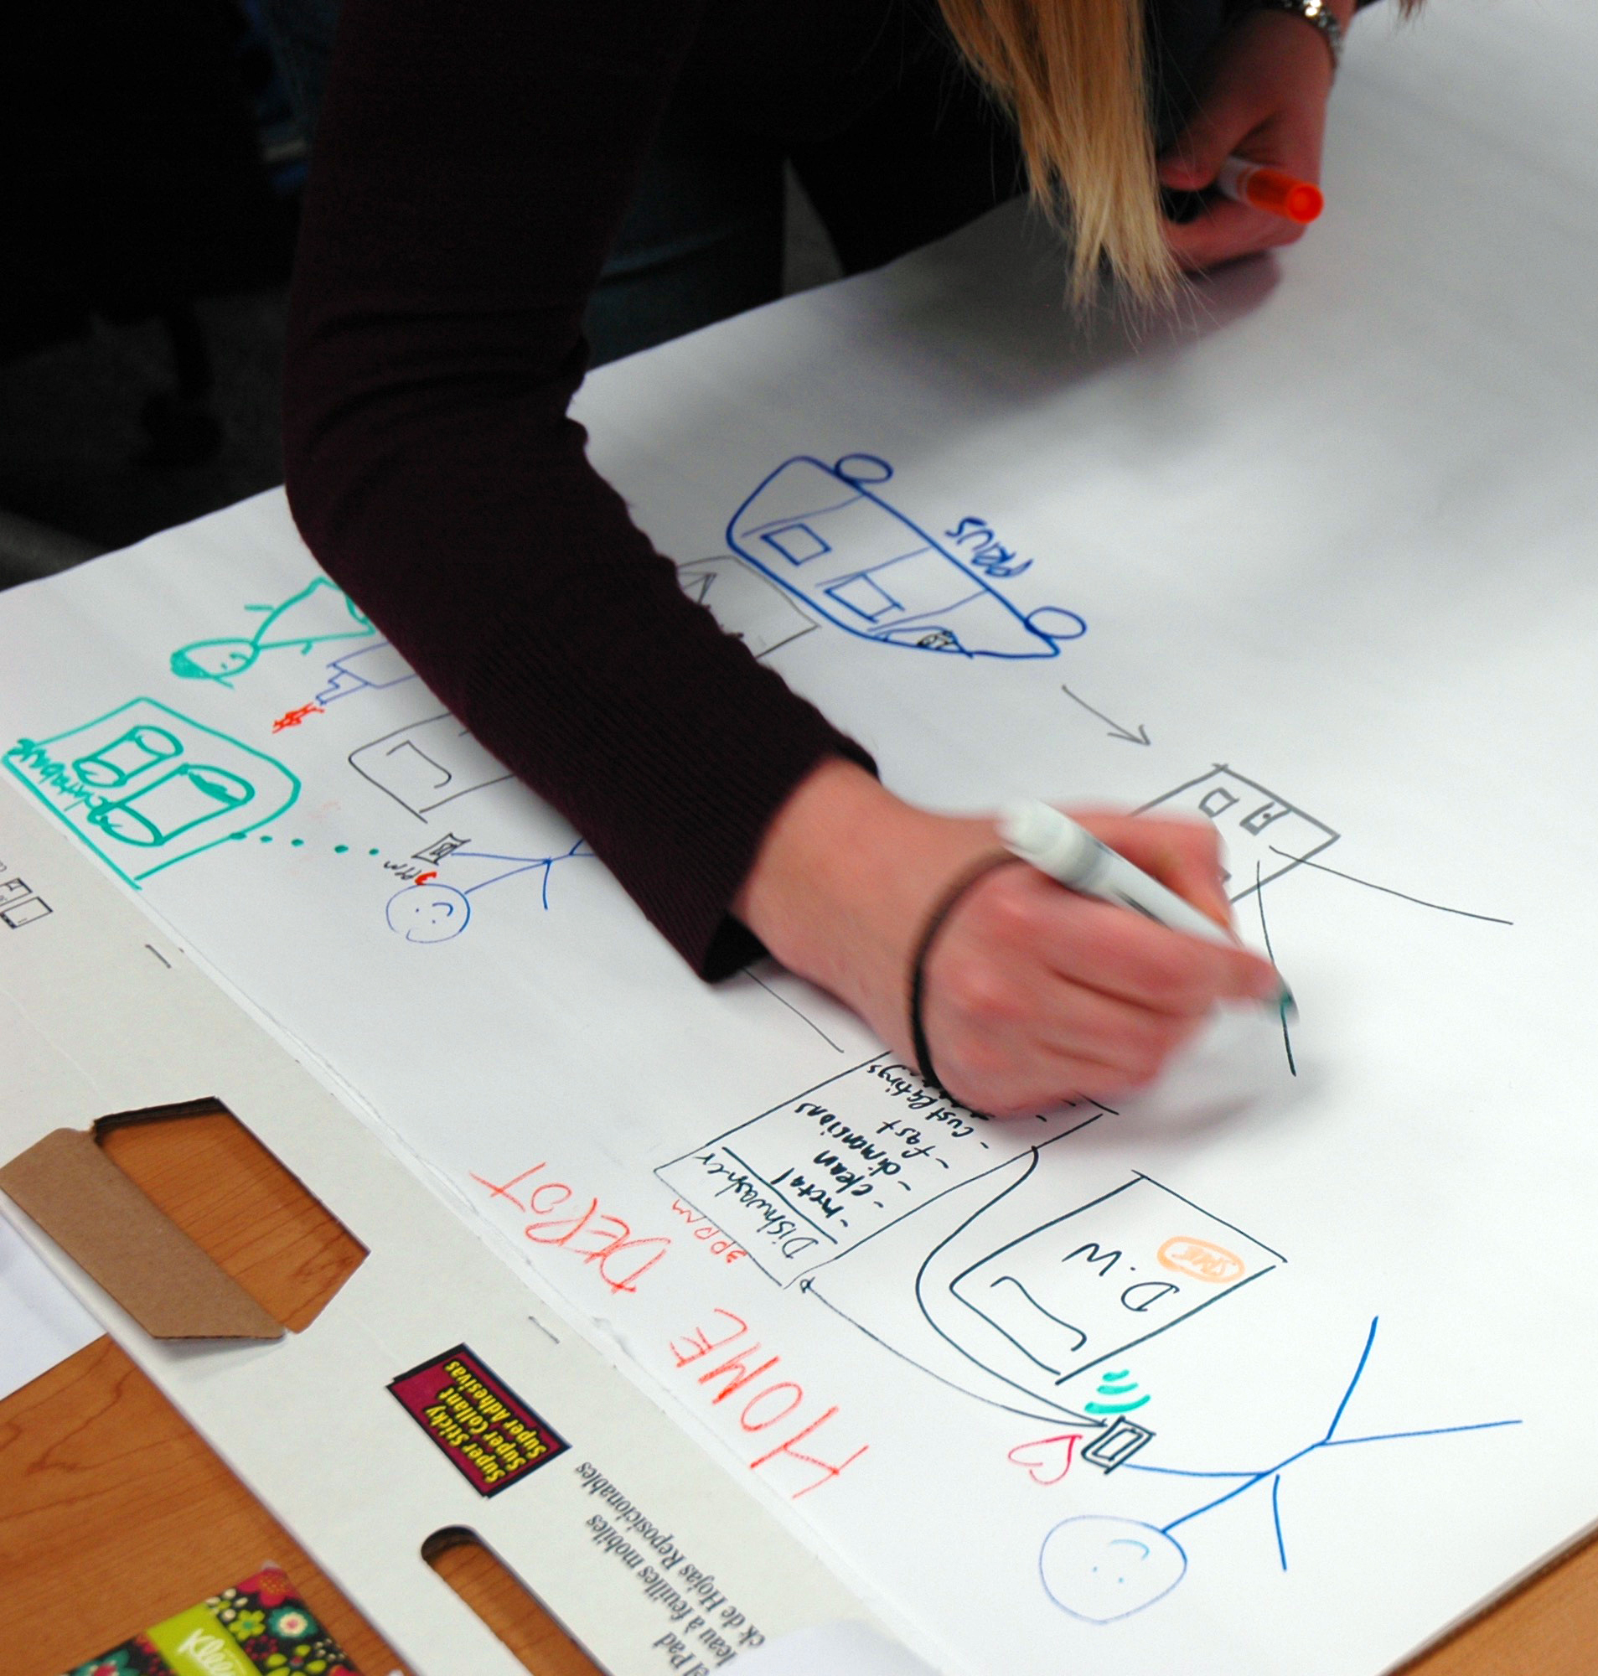
MIS3504
Project Scoping
Stakeholder Analysis
Requirements Elicitation (Especially interviewing)
Requirements Analysis (Process, Data, Business Rules)
Design Thinking and Creativity
Personas and Scenarios
Prototyping (As a way to specify requirements)
Selling the Client

Slide 12
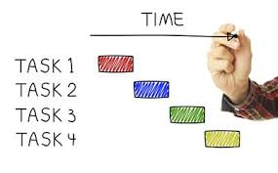
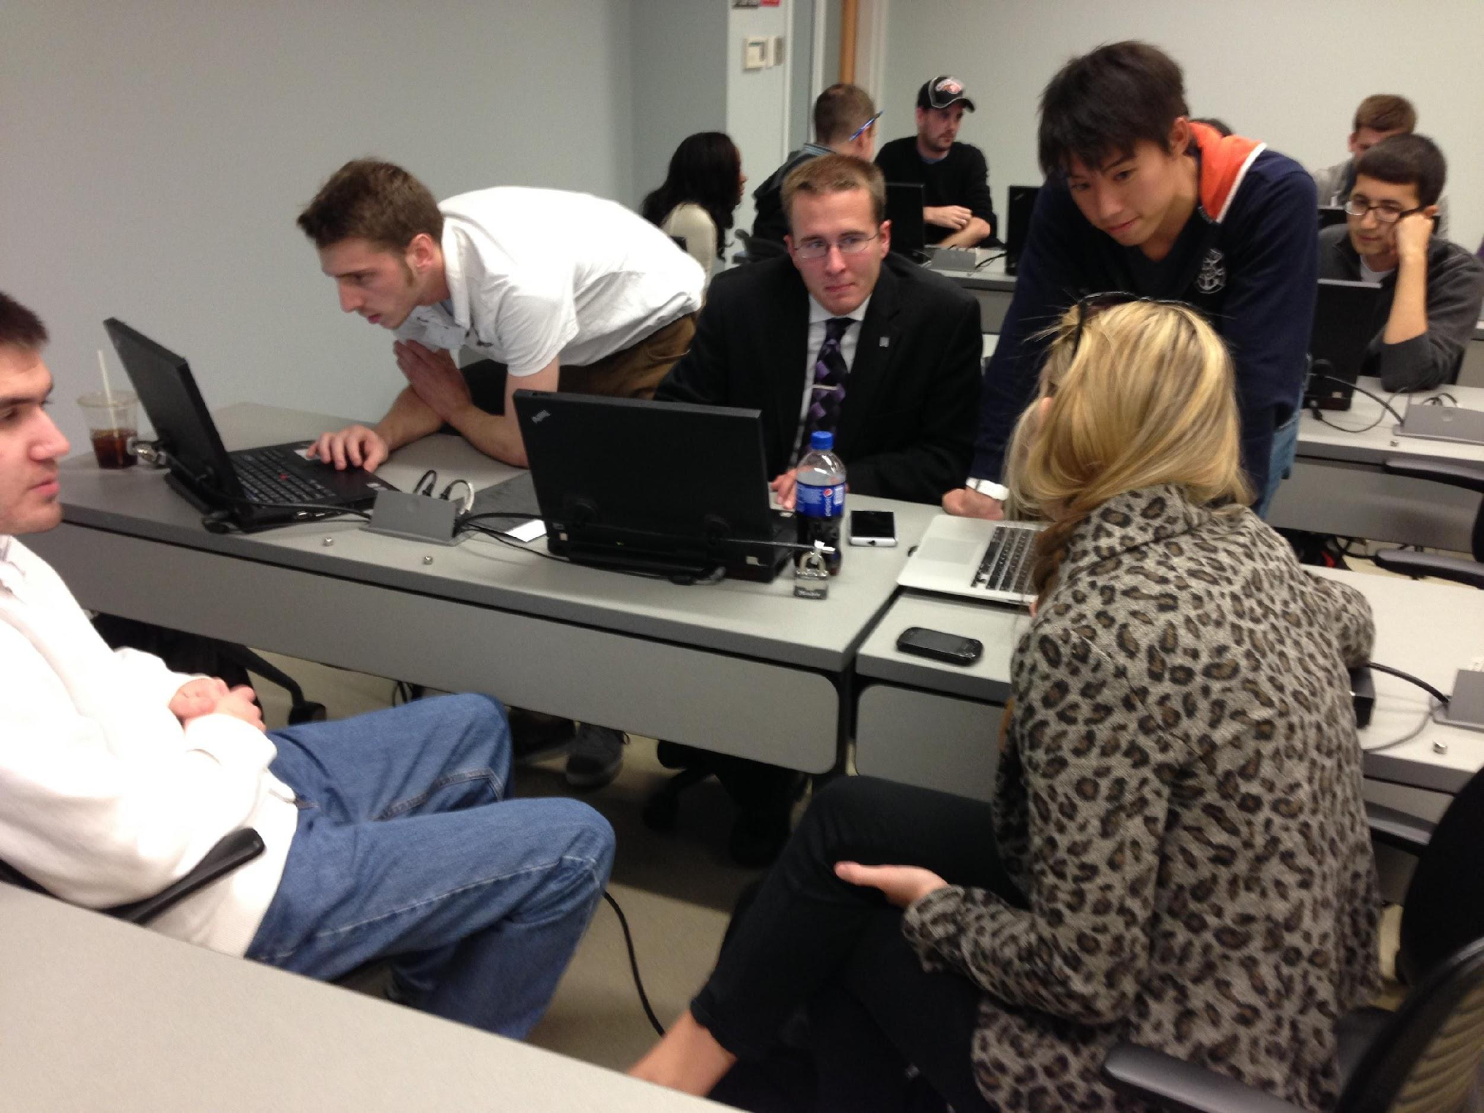
MIS3535
Traditional Project Management
Scope
Time
Cost
Quality
Human Resource
Communications
Risk
Procurement
Integration Management
Change Leadership
“…taught key ideas that one cannot learn from a book.”
– Jeff Naparstek

Slide 13
Forming Teams
BAs assigned highest to lowest GPA / PMs assigned lowest to highest GPA
360 degree peer feedback of BAs and PMs
Influences final grade
“Being able to teach your peers is empowering and pushes you all to succeed. ”– Mike Belli
“The relationships that form are lasting and grow your network.”
– Mike Belli
“. . . I strongly strongly suggest that the Groups should not be by GPA. GPA is not everything and we should not be publicly displayed with our position and our intelligence in the classroom. It’s humiliating in a way. . . .” - K.I., student

Slide 14
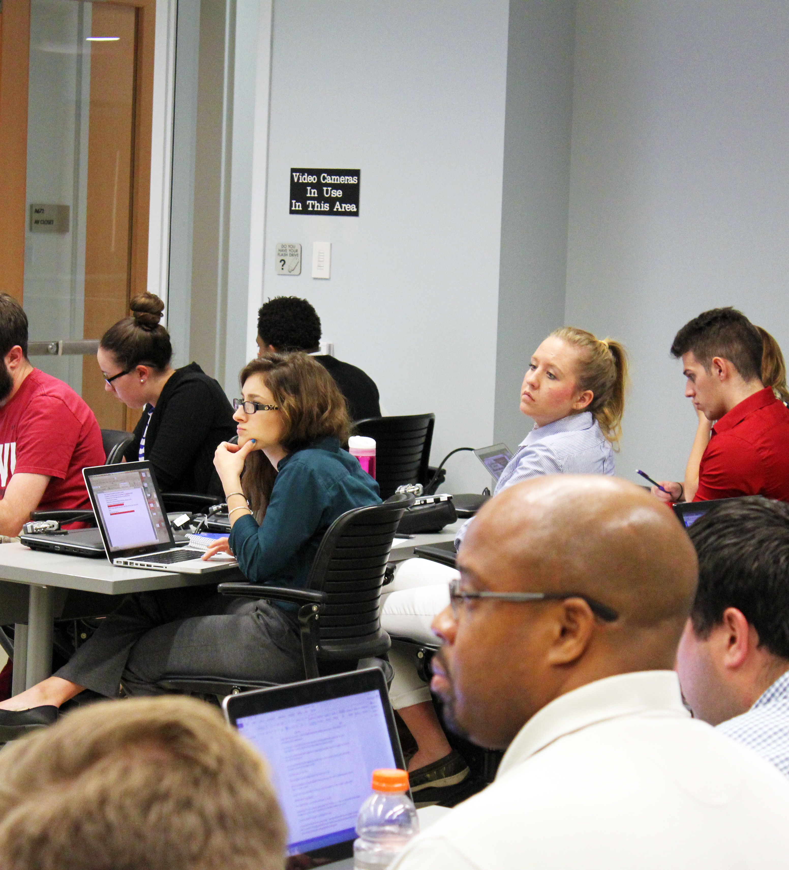
Interesting Observations
Real life = retention and real learning
Drama Creates Learning Opportunities
Things get even better every semester
Highest Performing Teams/Individuals vs. GPA
Less(content) is more (learning)

Slide 15
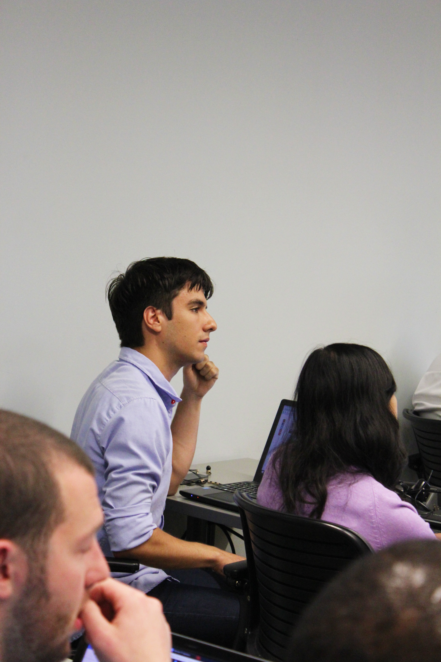
Next steps?
Questions?
Suggestions for improving education?
Suggestions for further research?

Slide 16
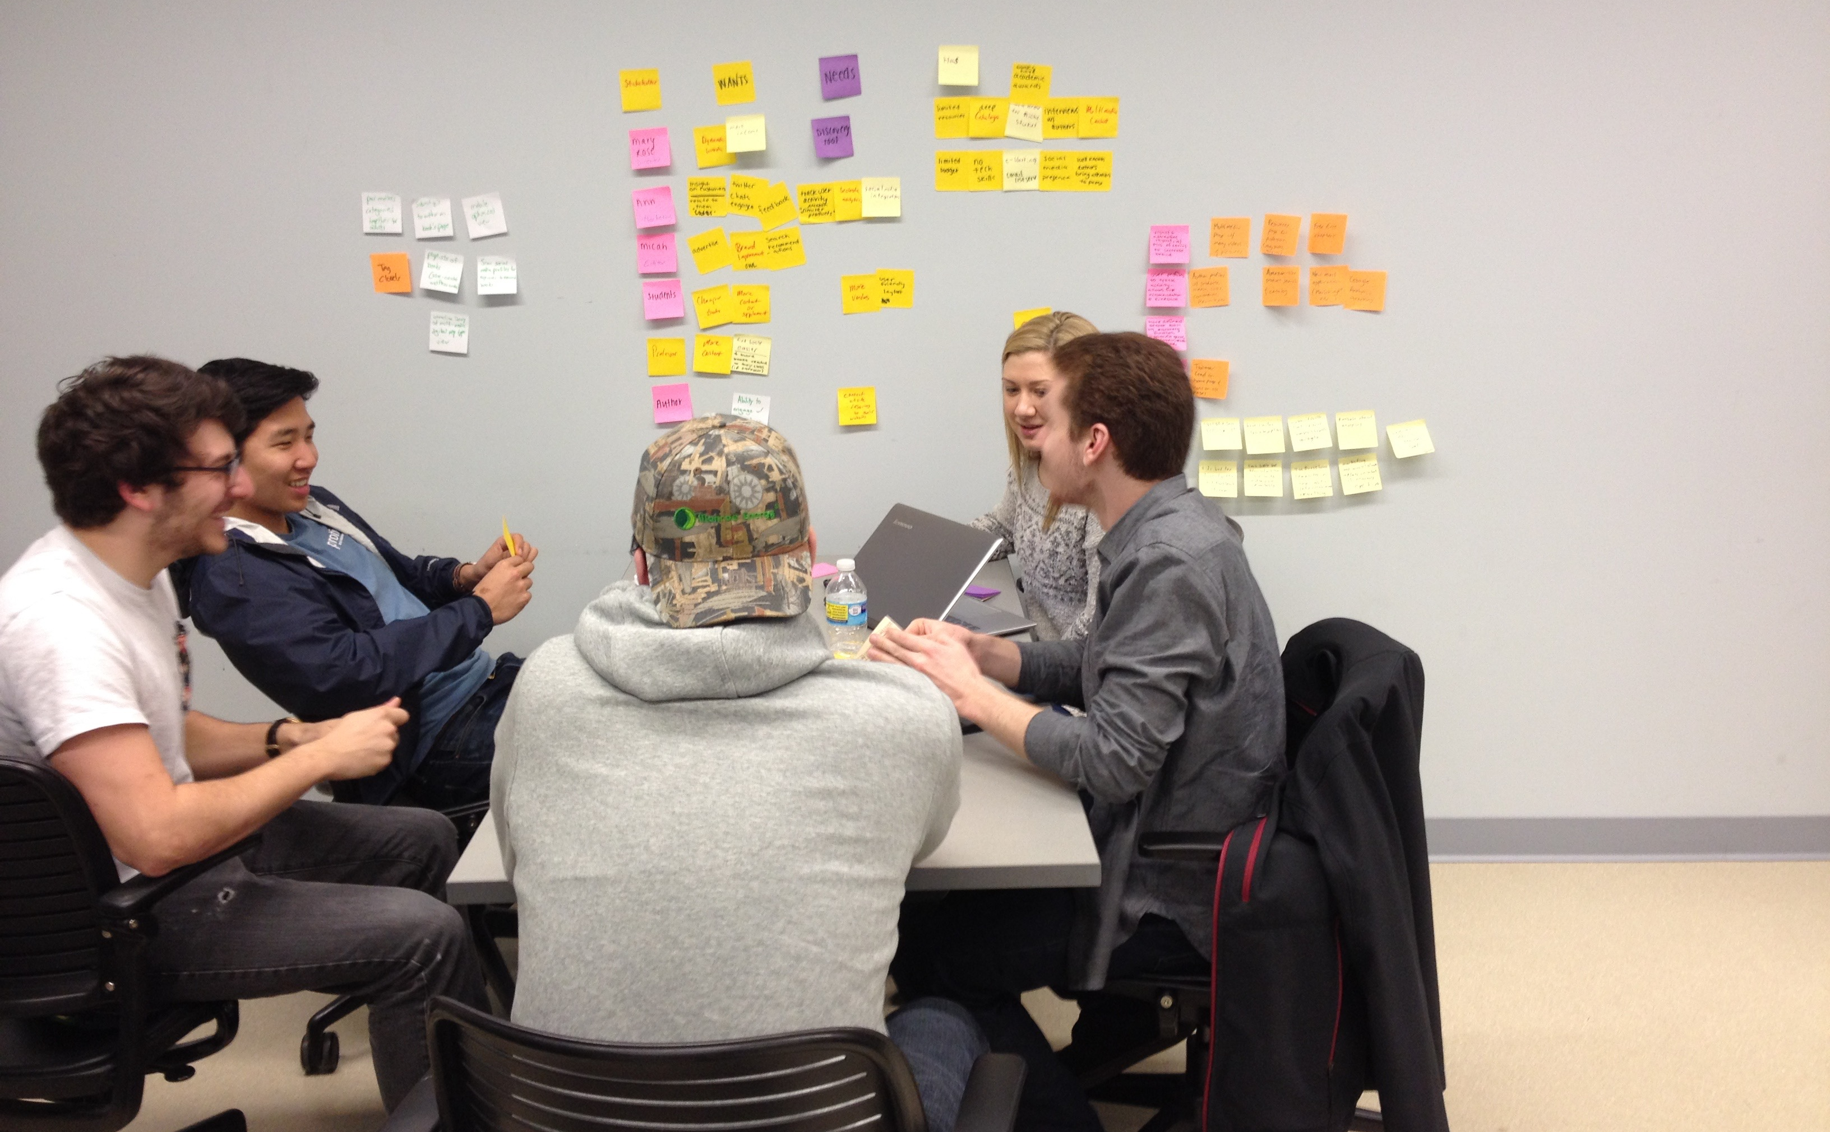
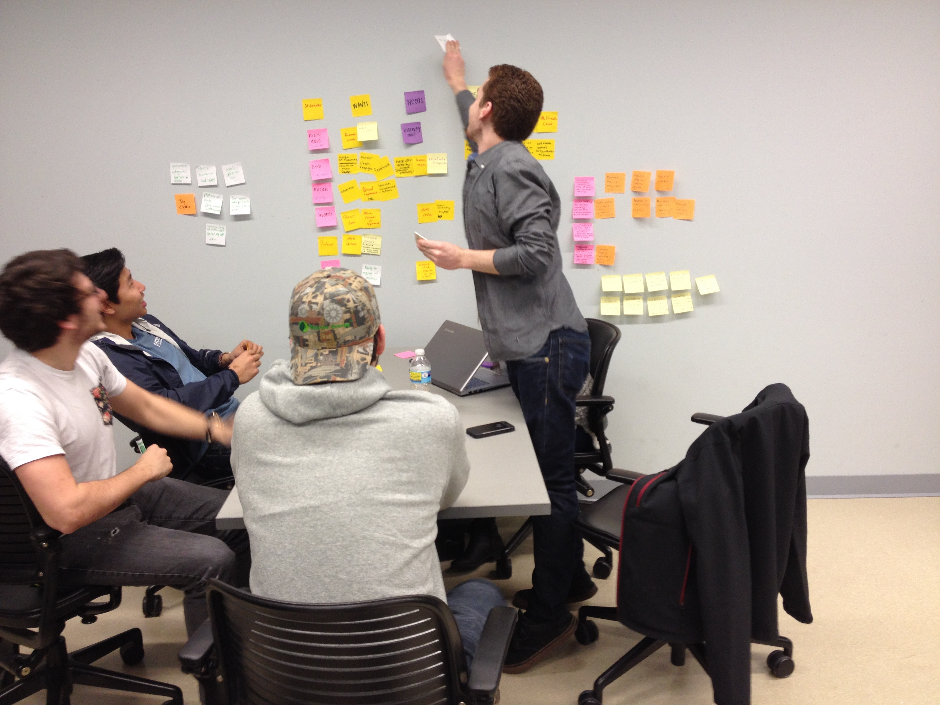
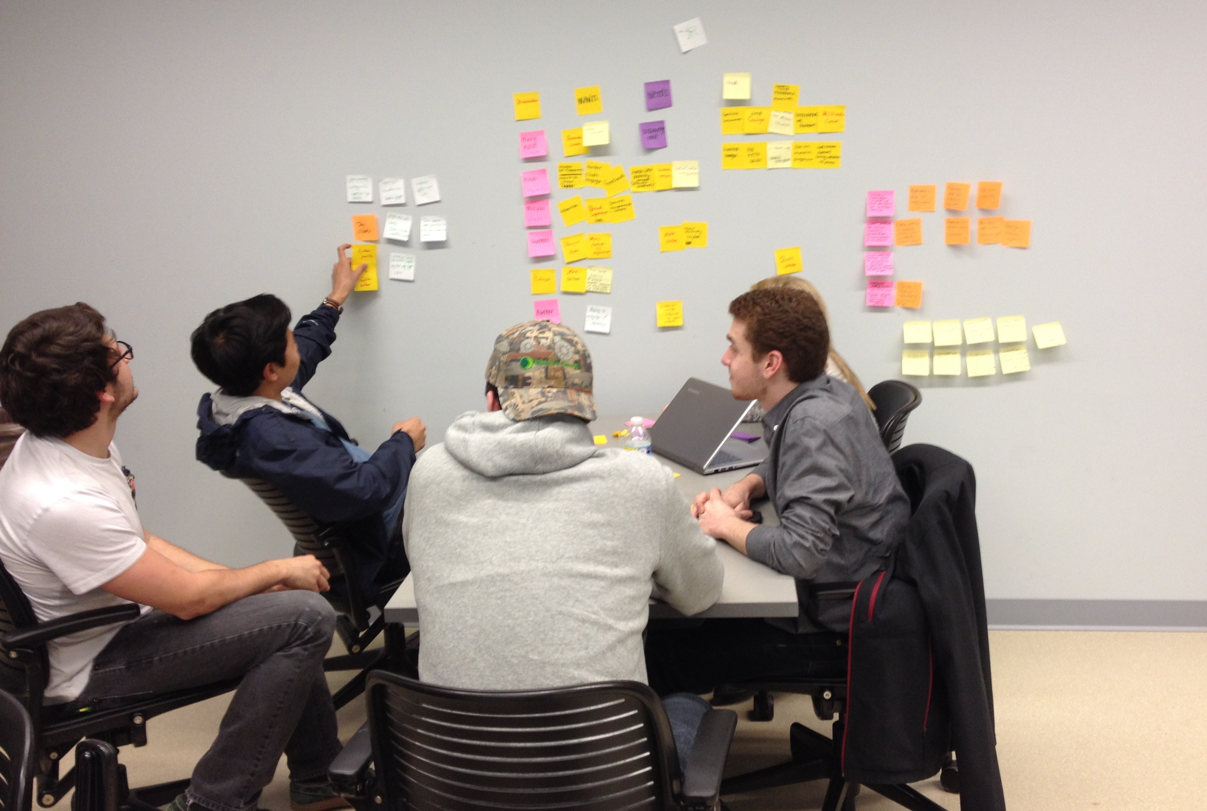
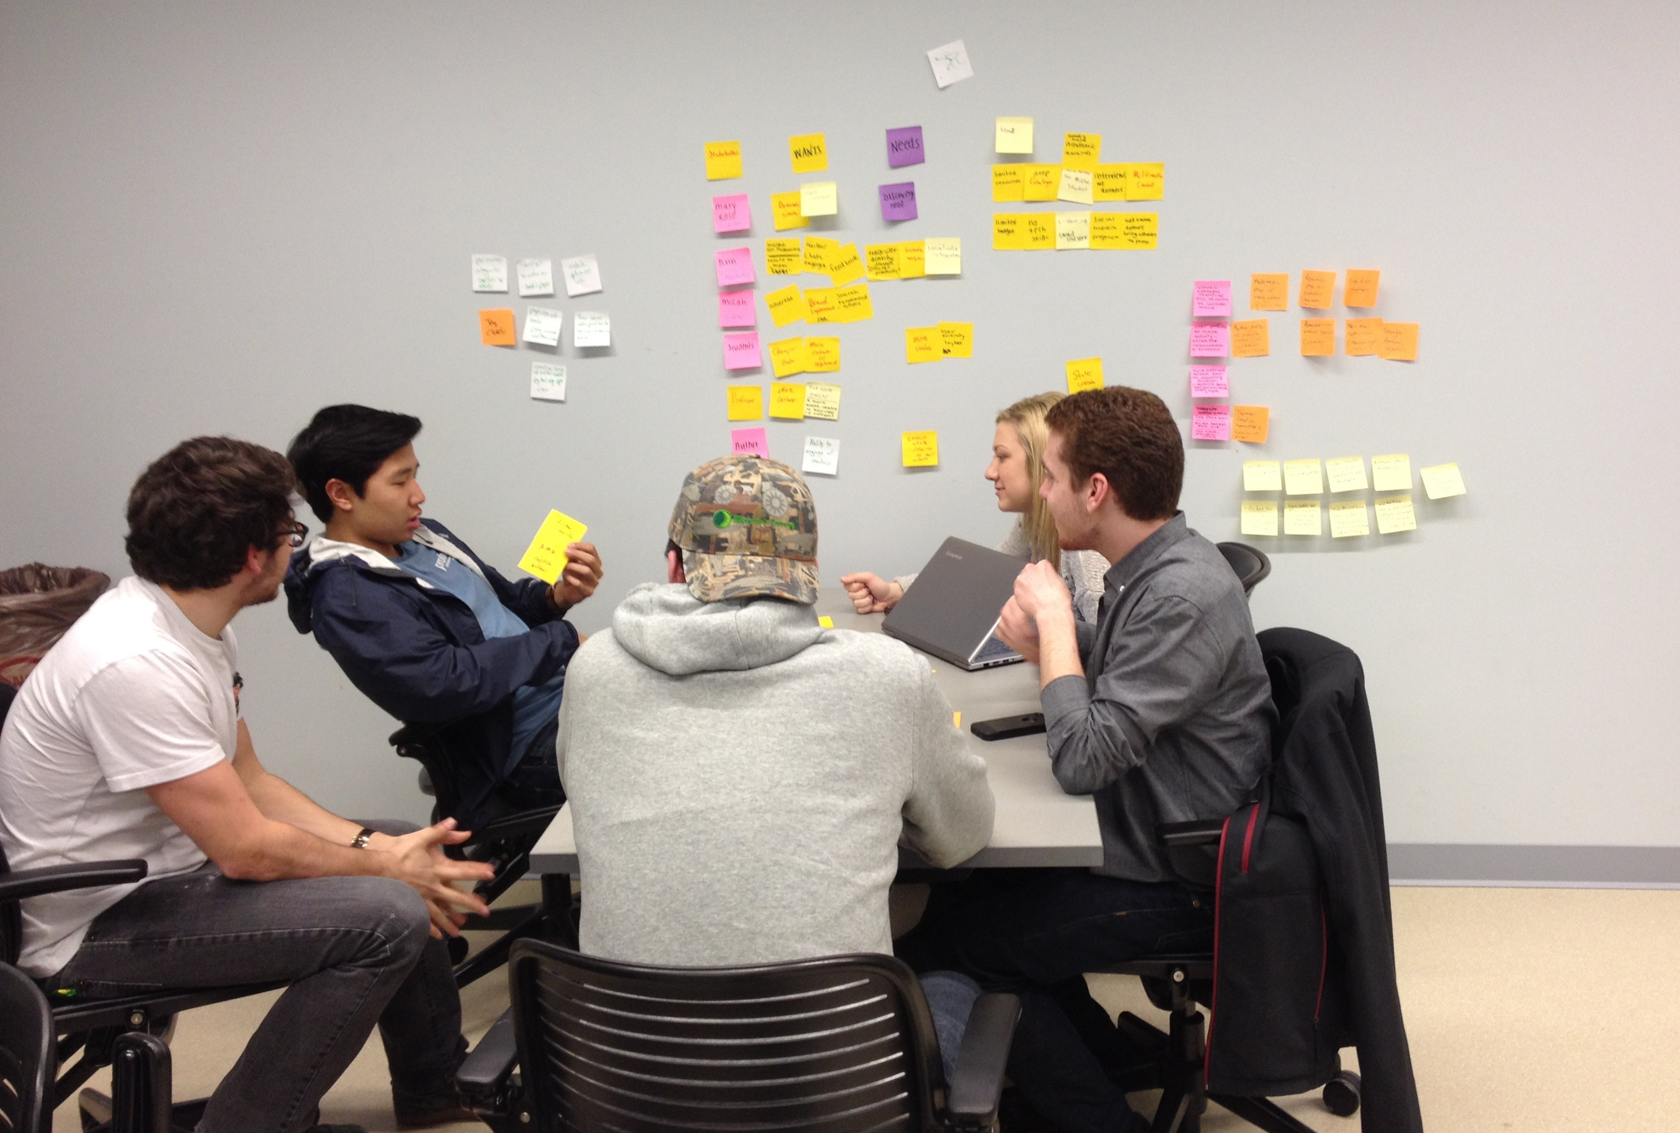
Thank you.

Slide 18
MIS3504
Quotes from students:
“Working directly with clients in 3504 gave me vital experience designing a solution with a distinct customer and need in mind. . . . These skills were vital to my success at my Business Intelligence internship at Walmart this past summer. . .”
Maggie Scanlon
“Working on a real project with real clients prepared me for project-work in my summer internship. The real world situations and responsibilities in MIS 3504 allowed me to jump right into a real project during my summer internship at QVC.” Michael O’Malley
“The pressure of preparing a presentation/final product for a real client taught me a lot about business and how the real world operates. . . . 3504 directly impacted my success handling real world responsibilities in my career.” Ben Kates
“Having students as PMs was great because they were able to share how they navigated 3504 and what they learned along the way.” Ben Kates

Slide 19
The Results
“The teaching method, learning by doing, of the vertical studios taught me the most relevant skills for the internship I'm currently working as a end user services specialist. Within the first week at Campbell Soup, I was asked to make swim-lane diagrams, interview SME's about the processes they work on, and create a procedures manual. Without taking these courses I would have struggled to do this effectively.” – John Stewart
The “learning by doing” element of the course was imperative to my success and realization of the skills and concepts taught in class.” Ben Kates
“I currently intern at PWC. . . So many things, such as swim lane diagrams or the way we are taught to think and brainstorm, are directly (and I mean directly) what many of the projects require us to do. I have seen so many things from the course here tha I just simply could not believe how useful and directly related the course is.” Khaleque Ismail, student

