Slide 1
Medication Adherence Solution
Team Members
Michael Ingram Jr, Heather Makwinski, Joshua Michalik, Samantha Taylor Talarico

Slide 2
BACKGROUND: The Business Case
01
Medication non-adherence can have negative implications for the patient, the doctor/hospital, and insurance company.
Patients
02
The patients who are non-adherent put their health at risk while insurance companies pay for the additional medical expenses.
03
How can the patient’s medication regimen be an integrated experience for the patient, caretakers, pharmacies, doctors and health insurance companies?
Health Insurance
Companies
Doctors

Slide 3
NON-ADHERENCE: A Multi Billion Dollar Problem
80%
of patients make errors when taking medication
$300B
Annual costs related to non-adherence
51%
of insured Americans take at least one medication
125,000
40%
of nursing home admissions related to non-adherence
Annual deaths caused by non-adherence
10%
of prescribed doses of any
medications are missed daily
According to the National Center for Biotechnology Information (NCBI)
Notes:
*add where the information came from

Slide 4
CURRENT PROCESS: Ends in Additional Medical Expenses
STEP 1
STEP 3
STEP 5
Patient is treated by their doctor and discharged from hospital
Patient forgets to or makes errors when taking their medications
Patient incurs additional medical expenses
STEP 2
STEP 4
Patient picks up their medications
Patient starts to experience original symptoms

Slide 5
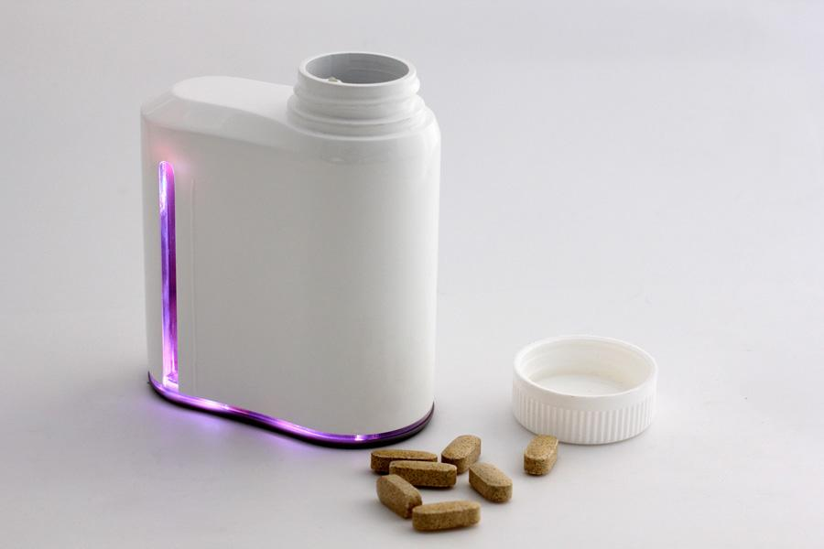
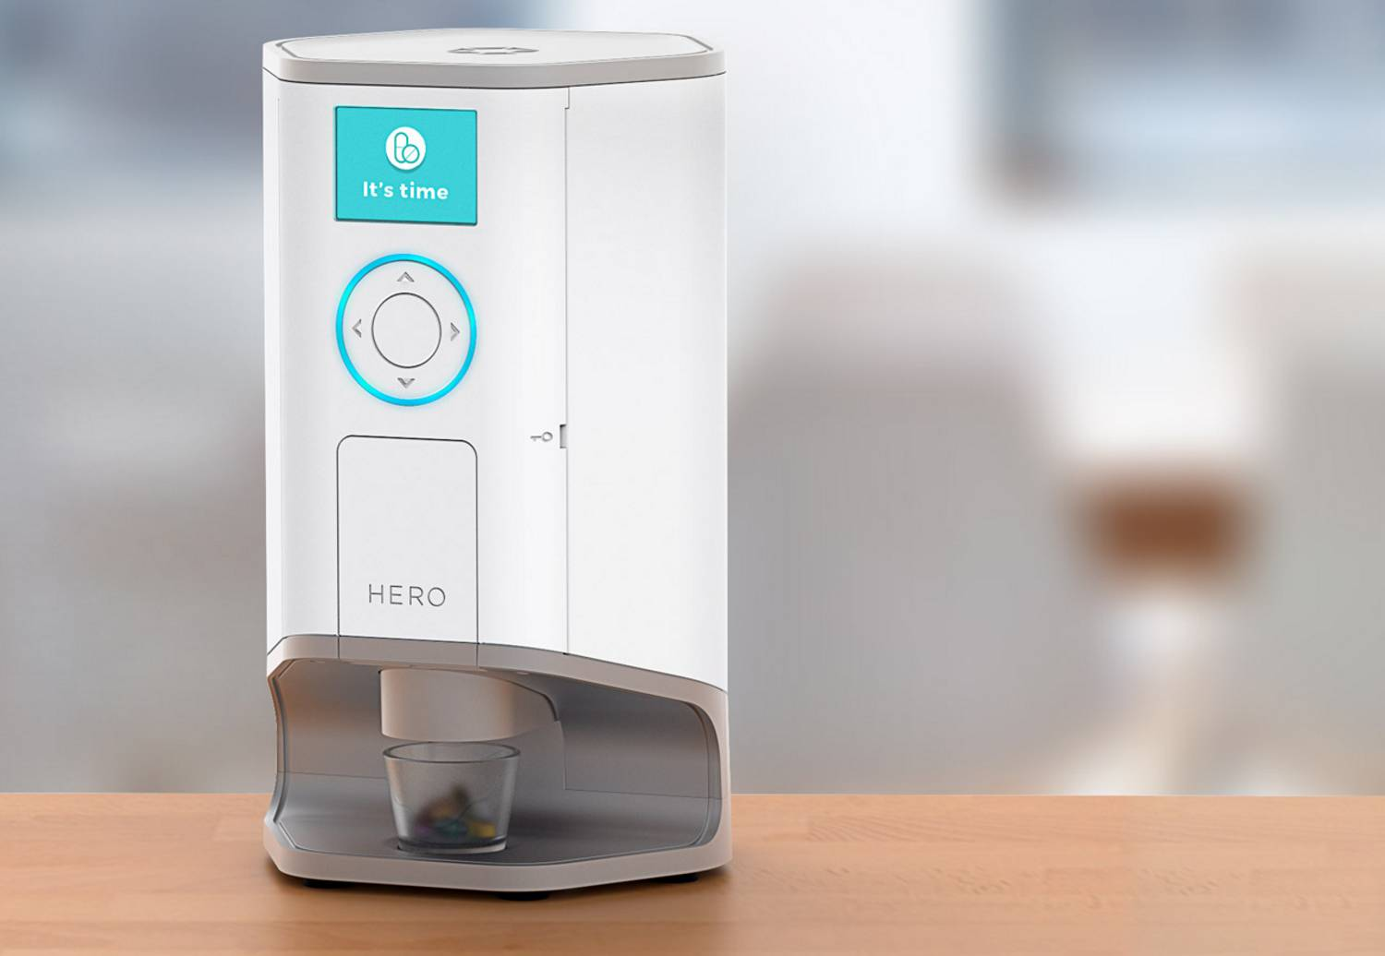
MARKET ANALYSIS: Available Solutions
Problems with current solutions:
Puts the burden on the patient
Leaves room for error
Not useful when taking multiple meds
Expensive to purchase
Does not integrate the caregiver, insurer, pharmacy, or doctor
Provides no visibility into the patient's adherence habits
Does not track if the pill was removed
Smart Pill Bottles
Smart Pill Dispensers

Slide 6
GOALS: Our Solutions Desired Outcomes
Increase patient adherence
Connect the players in the patient's health care system
Provide cost savings for the insurer and patient
Boost sales for the pharmacy by creating relationships with patients
Increase visibility into a patient’s medication regimens by providing adherence data to the patient, doctor, pharmacy, and insurer

Slide 7
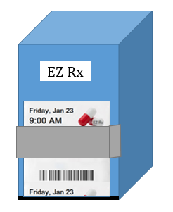
OUR SOLUTION: Three Parts for a Better Outcome
Medication Packaging
Tracking Dispenser
Application

Slide 8
NEW PROCESS: Avoid Costs That Result from Non-adherence
STEP 1
STEP 3
STEP 5
Patient receives an Rx from their doctor
Patient is reminded by the app to take their medications
Adherence data is shared with patients care community
STEP 2
STEP 4
STEP 6
Patient has their medications delivered
PBox records adherence data when patient takes their medications
Patient and insurer avoid costs associated with non-adherence
How does the new process effect each party?

Slide 9
New for: PATIENTS
Watch in app videos or read articles that will help them understand their medication regimen
Better
Educated
Easier Way
To Contact
Doctor
Use app to ask their Doctor a question and rate how they are feeling on their medications
Lower co-pays or deductibles for following medication regimen and refilling prescriptions
Financial
Incentive
Caregiver
Support
Caregiver or family member can monitor patient medication compliance

Slide 10
New for: DOCTORS
Industry now paid based on outcome readmission will count against them
Incentive for Patient Compliance
Higher Reimbursements
Do not have to wait until patient’s next visit to confirm medication compliance
Real-time
Compliance
Monitoring
Real-time
Compliance
Tracking
Resources
Better Allocated
More resources/staff available for patients with emergent conditions
Resources
Better
Allocated
Data
Analytics
Access to patient reactions to medication and can effectively alter regimens where necessary

Slide 11
New for: PHARMACIES
Patients will fill more prescriptions
Increased Sales
Resources
Better
Allocated
Staff will no longer have to answer phone calls from doctors to verify if patients picked up their medications
Notes:
increase stickiness, pharmacies are competing with each other… why go to one pharmacy vs. another… trying to find ways to keep customers coming back (preferred pharmacy)

Slide 12
New for: HEALTH INSURANCE COMPANIES
Reduce costs incurred from patient non-adherence
Lower
Costs
More medications taken by patients
Reduce
Waste
Data
Analytics
Use patient data to tailor coverage and research non-adherence patterns

Slide 13
Questions?

Slide 14
SOURCES
http://www.medscape.com/viewarticle/409940 ^{[1]} http://www.pharmacytimes.com/news/increased-medication-adherence-reduces-health-care-costs ^{[2]} http://www.healthworkscollective.com/ashish-varshneya/300471/medication-non-adherence-290-billion-unnecessary-expenditure ^{[3]} http://www.acpm.org/?MedAdherTT_ClinRef^{[4]}
http://www.pharmatherapist.com/articles/4-key-reasons-for-medication-non-compliance^{[5]}
https://intermountainphysician.org/intermountaincme/Documents/13.%20Olson,%20Winter,%20Rickard%20(use%20at%20all%20conferences)Medication%20Adherence%20Workshop_final.pdf^{[6]} http://www.medscape.com/viewarticle/409940 ^{[7]}
http://phrma-docs.phrma.org/sites/default/files/pdf/PhRMA_Improving%20Medication%20Adherence_Issue%20Brief.pdf ^{[8]} https://www.ncbi.nlm.nih.gov/pmc/articles/PMC3234383/ ^{[9]}

