Slide 1
INDONESIA Marketing Plan
Michele Dakota
Bruce Martin
Anastasia Mokin
Richard Reichert
Jennie Quattrocchi

Slide 2
Why Indonesia?
Total Population: 240 million people
Target Market: children and teenagers
Ages 0-14 and 15-29
Rapid economic growth
GDP $846 billion
5% annual growth
Consistently growing
Age Distribution in Indonesia

Slide 3
Important Considerations
Religion
More than 80% Muslim
Important for dietary considerations
Environment
Prone to natural disasters
Buying behavior
Prefer local, trusted brands
Prefer certifiably halah products

Slide 4
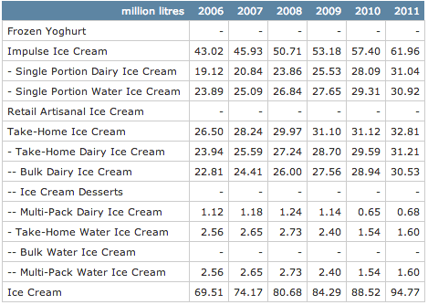
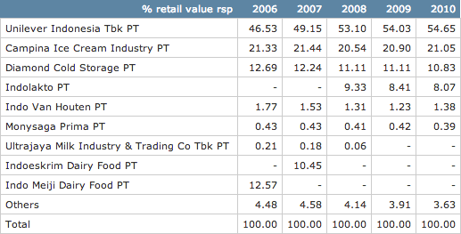
Ice Cream Market Size
356 million dollars in 2010
Impulse: 61.9 million liters
Take Home: 32.8 million liters
Unilever holds 55% of the market share
Growth rate of 9%
Single portion dairy increased 18%
31.04 million liters sold in 2011
Children and teens make up the largest consumer group of ice cream sales

Slide 5
Jakarta
Our distribution location:
59% of Indonesia’s population (137 million)
Located on the island of Java
10 million people (1.2% of Indonesia’s population)
Young population
50% under 25
30% under 14

Slide 6
Joint Venture
Walls Ice Cream
Owned by Unilever Indonesia
55% of market share
Shared distribution channel and business network
Well-trusted brand
No current product like It’s-It

Slide 7
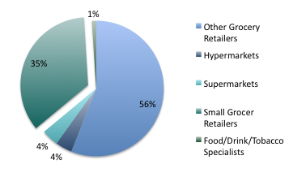
Distribution
Walls distribution center in Jakarta
Small bicycle vendors
Small grocery stores
3,968 mini-markets in Jakarta
35% shop at small grocery retailers

Slide 8
Vision and Message
Trusted brand
Hygienic products
“Certifiable Halah”
Sharing, togetherness, and family
Message:
“Healthy, local, cool, sweet. Family or social treat.
Together it’s a perfect fit. The Original It’s It. Sharing family &
social occasions with It’s-It scrumptious frozen treat.”

Slide 9
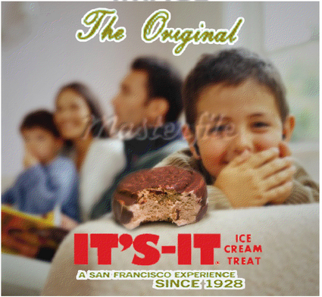
Image

Slide 10
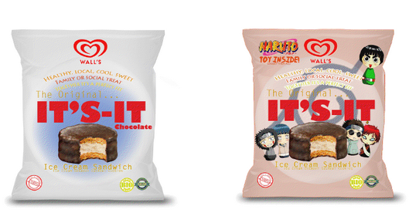
Package
Adapted to Indonesia culture
Red and white and yellow
Bahasa labeling
“Halah Certified”
Prepared hygienically

Slide 11
Advertising and Media Strategy
Television
Commercial
Internet
Facebook, Twitter, IndoFace
Small-Scale advertisements
Social media, magazines, radio, etc.
Marketing Tool | Frequency | Total Annual Budget
Magazines | Monthly | $124,800.05
Social Networks (advertisements) | Weekly | $150,000
Radio | Weekly | $62,400.02
Television | Daily (52 weeks) | $500,132.60
Website | Ongoing | $187,200.07
TOTAL ANNUAL |  | $1,024,532.75

Slide 12
Financial Projections
Unilever 60% of profit, we make 40%
Price of product
Retail Price: $1.00 (9,625 rupiah)
Cost of product
Base cost: $0.39 (Raw materials, manufacturing, packaging, service, etc.)
Unilever incurs $0.20 (51.3%)
We incur $0.19 (48.7%)
Unilever makes $0.366 per unit
We make $0.244 per unit

Slide 13
Cost of Business
Start-Up
$400,000
Advertising and Marketing
$1,000,000
Freight
$1,585,689

Slide 14
Profit and Growth
Year One
Year Two
Year Three
Year Four
Year Five
Growth: 32%
Profit: 3,938,289
Growth: 25%
Profit: 7,861,736
Growth: 25%
Profit: 13,109,914
Growth: 25%
Profit: 20,065,584
Profit: (267,365)

Slide 15
Volume Projections
Year One
Year Two
Year Three
Year Four
Year Five
22,652,700
Per Day: 62,062
Per Store: 15 units
29,448,510
Per Day: 80,680
Per Store: 20 units
36,810,638
Per Day: 100,851
Per Store: 25 units
46,013,297
Per Day: 126,064
Per Store: 32 units
57,516,621
Per Day: 157,580
Per Store: 40 units
Notes:
Based on how many outlets we are selling in, this is how many sold per day and how many per store per day

Slide 16
Risk Analysis
Competitive
Decreases with joint venture
Still major competitors
Rise in sweet and savoury snack industry
Currency
High
Weak balance of payments
Subject to currency changes
Political
High
Social and political instability
Reforms
Other
Failed partnership
Problems with Unilever as its own individual entity

Slide 17
Recommendation
YES
Economy is growing each year
Consumer spending is increasing

