Slide 1
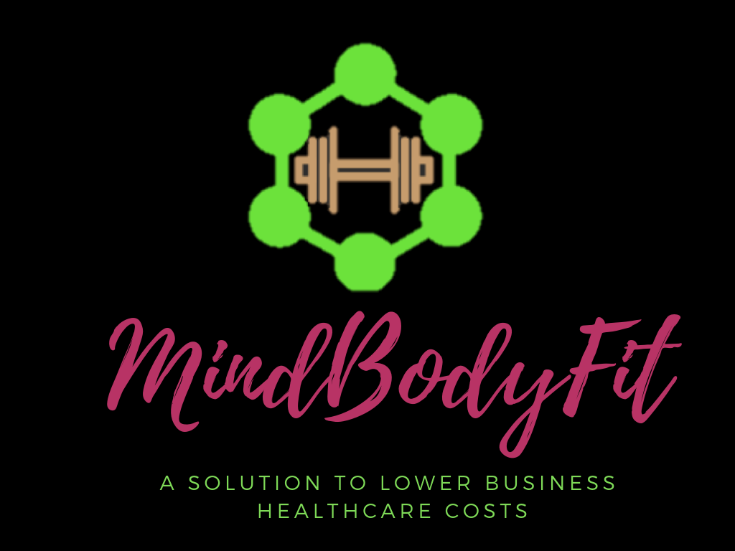

Slide 2
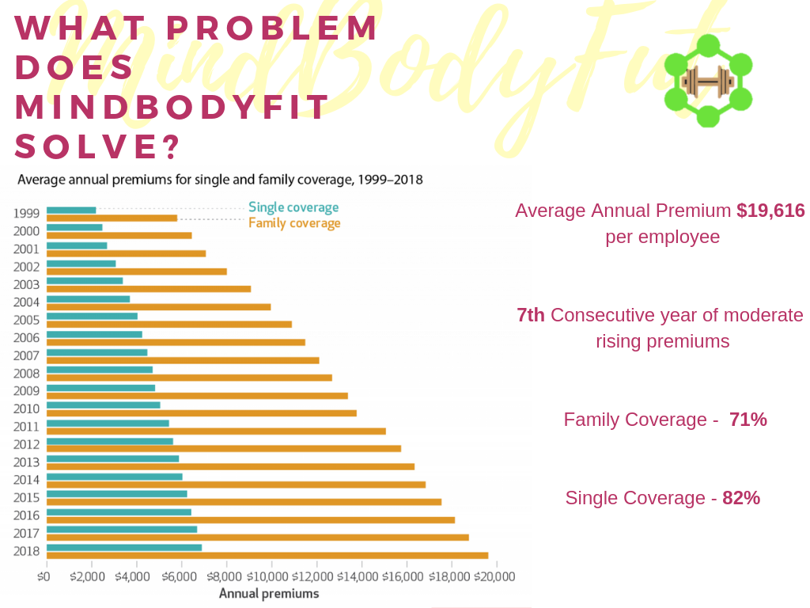

Slide 3
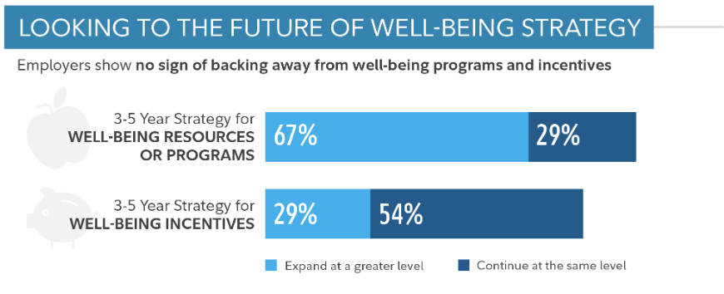

Slide 4
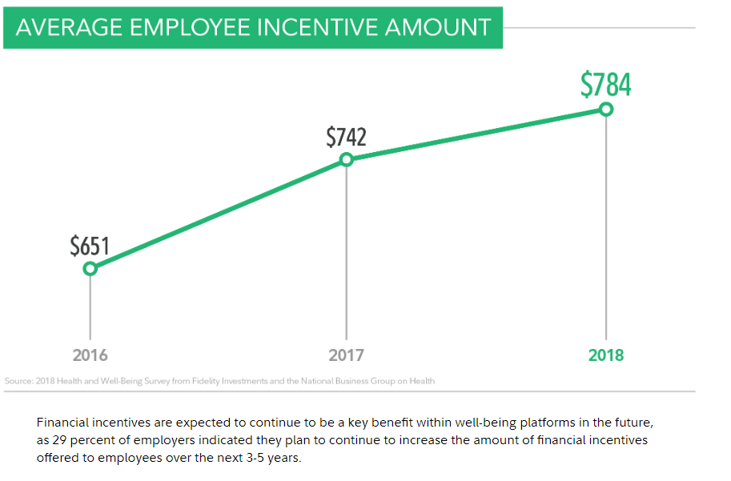

Slide 5
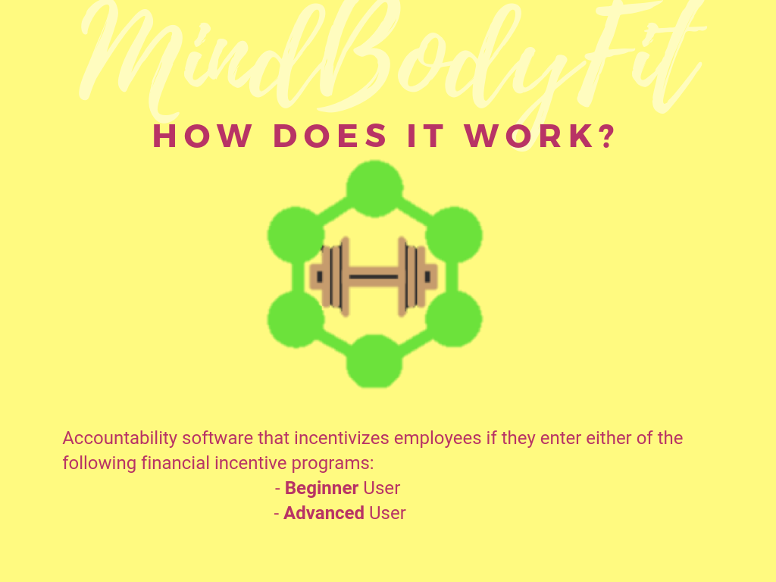

Slide 7
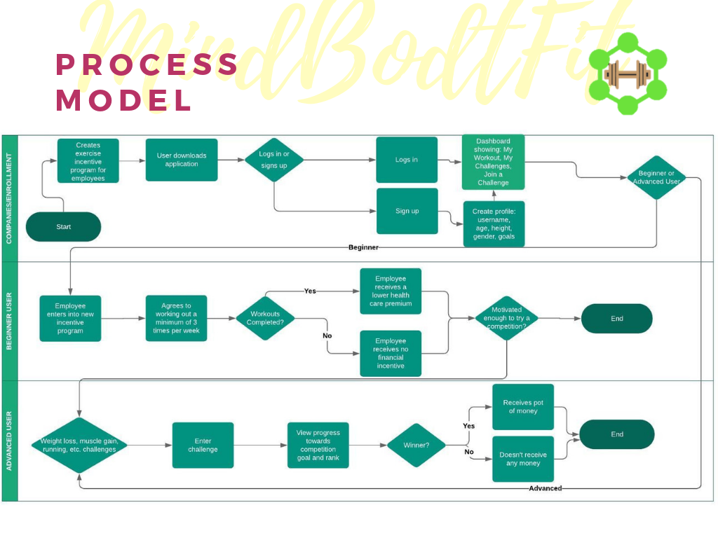

Slide 8
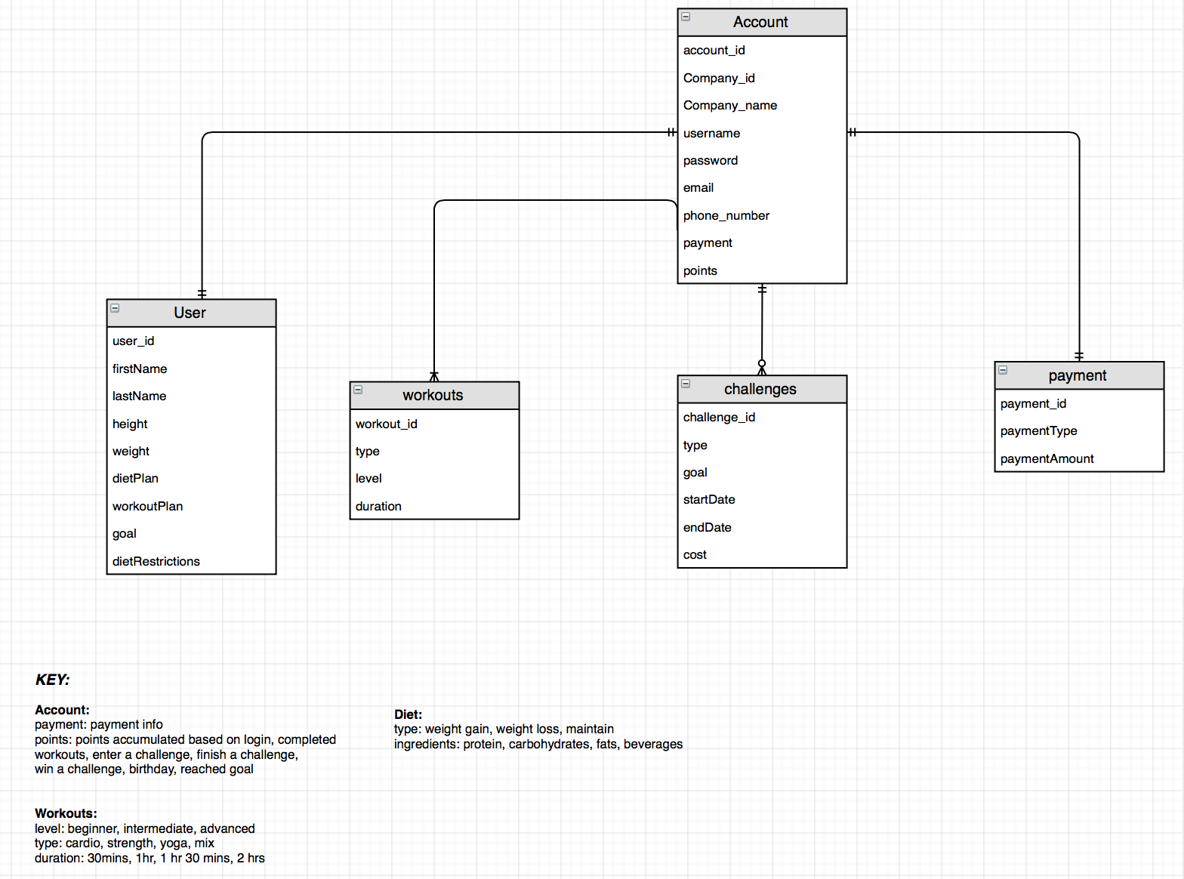

Slide 9
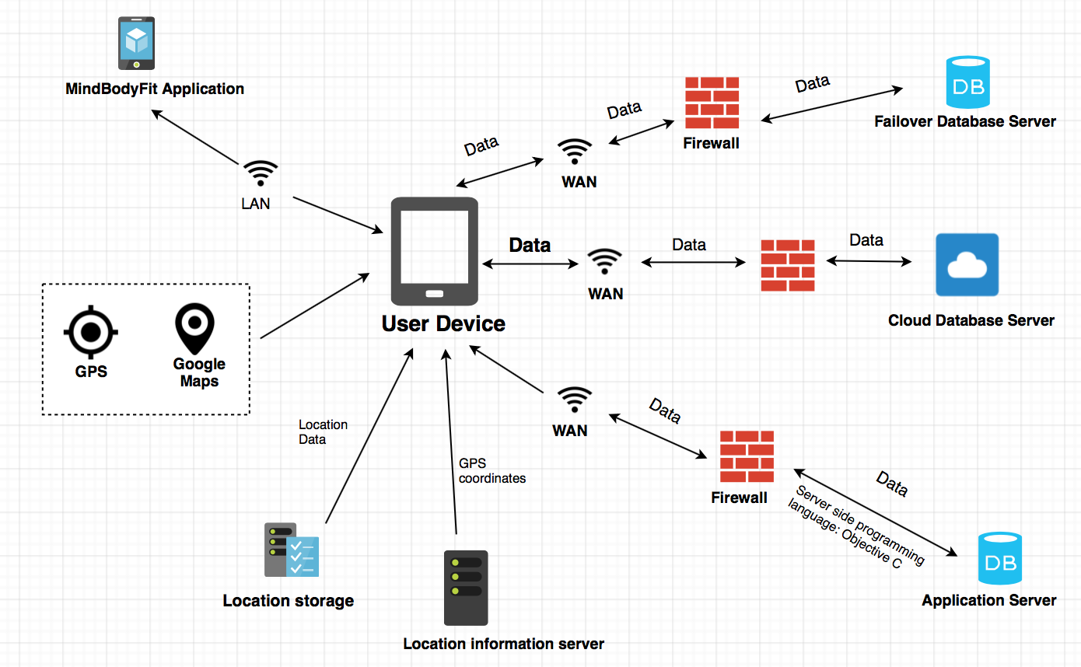

Slide 10
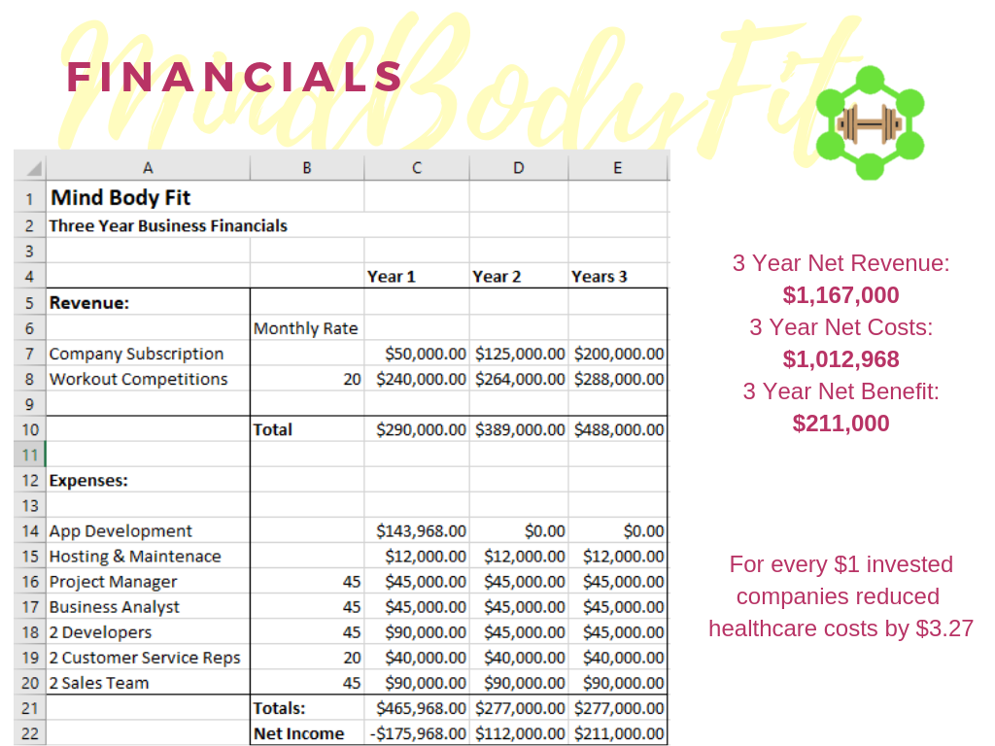

Slide 11
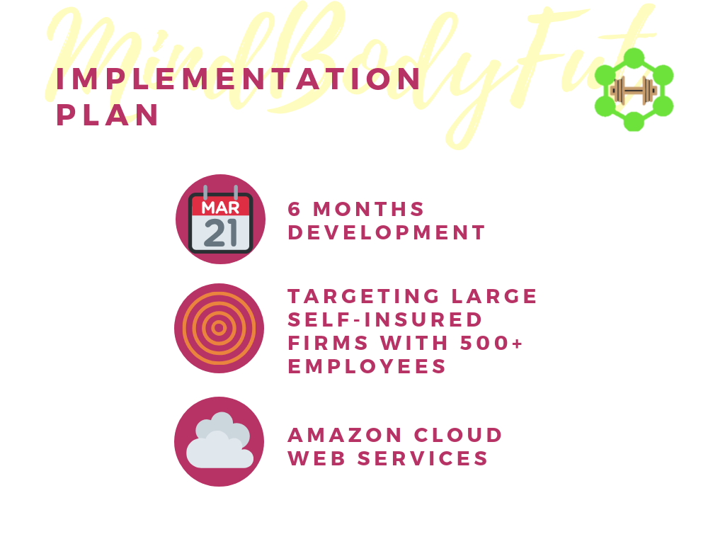

Slide 12
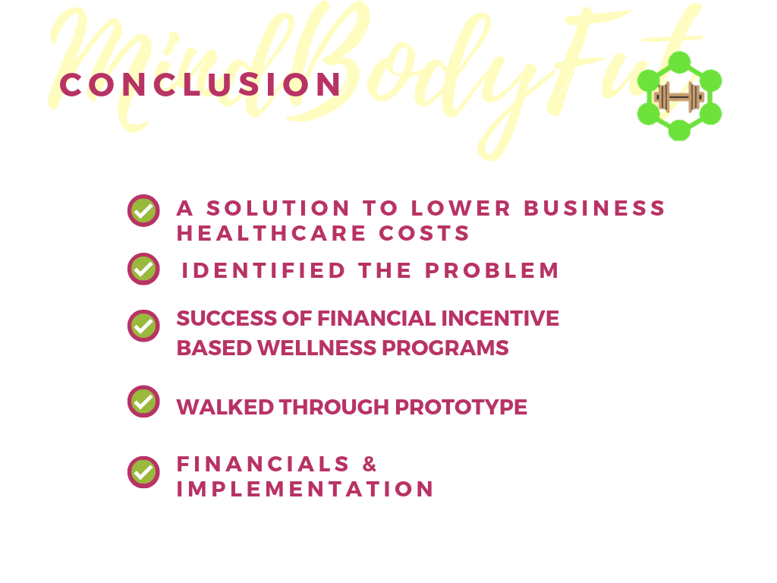

Slide 14
Works Cited
Baicker, Katherine, and David Cutler. “Workplace Wellness Programs Can Generate Savings.” The Physician Payments Sunshine Act, Feb. 2010, www.healthaffairs.org/doi/10.1377/hlthaff.2009.0626.
Emerman, Ed. “NBGH Press Release.” National Business Group on Health, 2018, www.businessgrouphealth.org/news/nbgh-news/press-releases/press-release-details/?ID=343.
“Health Benefits In 2017: Stable Coverage, Workers Faced Considerable Variation In Costs.” The Physician Payments Sunshine Act, Oct. 2017, www.healthaffairs.org/doi/10.1377/hlthaff.2017.0919.

