Slide 1


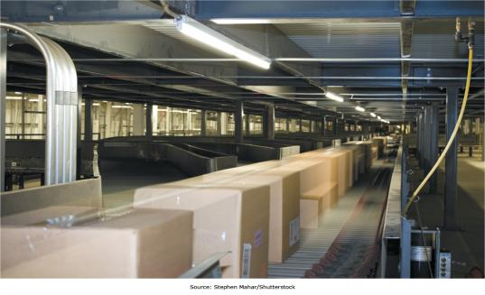
Chapter 1 - Managing in the Digital World
Managers are facing unique challenges as Digital Technologies permeate the workplace
Notes:
Managers are being confronted with new tools and challenges as Digital Technologies proliferate throughout the workplace. This chapter will introduce us to the Information age and lay a foundation for the rest of the term.

Slide 2
Chapter 1 Learning Objectives
Information Systems Today
Describe the characteristics of the digital world and the advent of the Information Age.
Evolution of Globalization
Define globalization, describe how it evolved over time, and describe the key drivers of globalization.
Information Systems Defined
Explain what an information system is, contrasting its data, technology, people, and organizational components.
IS Ethics
Describe how computer ethics impact the use of information systems and discuss the ethical concerns associated with information privacy and intellectual property.
The Dual Nature of Information Systems
Describe the dual nature of information systems in the success and failure of modern organizations.
Notes:
This chapter explores:
The emergence of the Information Age
It’s influence on globalization
What information systems are
How they can help or harm the organizations that attempt to employ them, and
Key ethical considerations regarding their use.

Slide 3
Information Systems Today
Information Systems Today
Learning Objective: Describe the characteristics of the digital world and the advent of the Information Age.
Evolution of Globalization
Define globalization, describe how it evolved over time, and describe the key drivers of globalization.
Information Systems Defined
Explain what an information system is, contrasting its data, technology, people, and organizational components.
IS Ethics
Describe how computer ethics impact the use of information systems and discuss the ethical concerns associated with information privacy and intellectual property.
The Dual Nature of Information Systems
Describe the dual nature of information systems in the success and failure of modern organizations.
Notes:
We start with the rise of the information age, how it builds on the prior ages, and current information age trends of significance.
Our learning objective for this section is for you to be able to describe, in your own words, the characteristics of the information age we live in.

Slide 4
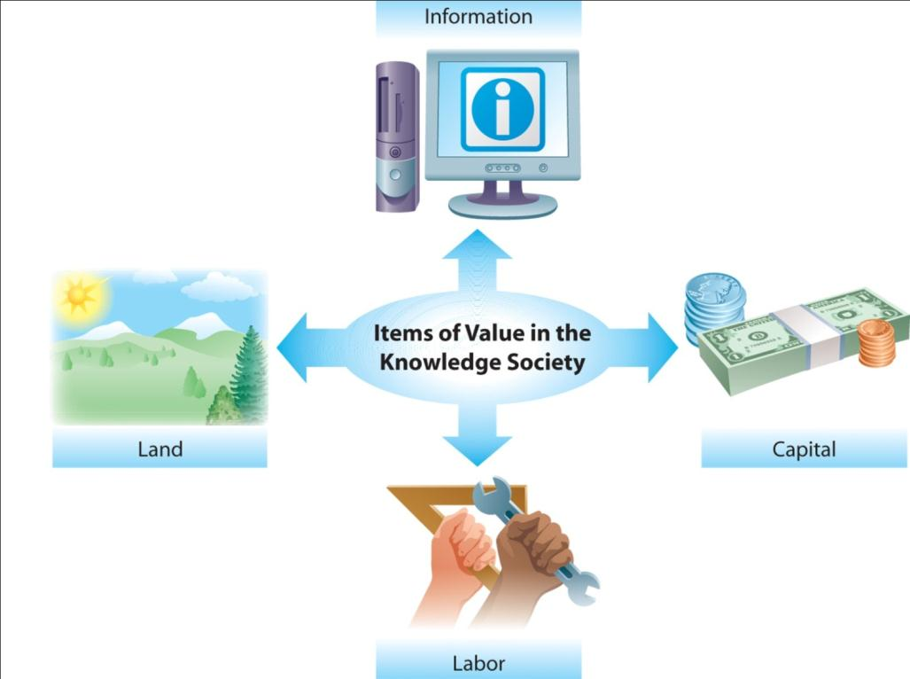
Information is a Valuable Resource
Notes:
While having the right information at the right time has always been valuable, we can now strategically gather and manage information in ways that were never before possible, allowing us to leverage it and create value with it much as we leverage and create value with land, labor, and capital.

Slide 5

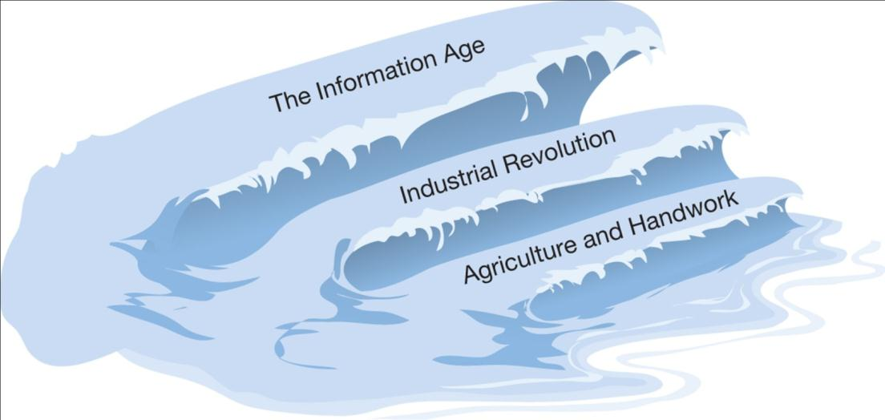
The Rise of the Information Age
Notes:
Each age has enabled the age that followed.
The Agricultural age provided the time and resources necessary for people to stay in one location and invent machines.
The Industrial Revolution provided the tools, such as the printing press, necessary to replicate information and widely disseminate it in a low cost manner.

Slide 6
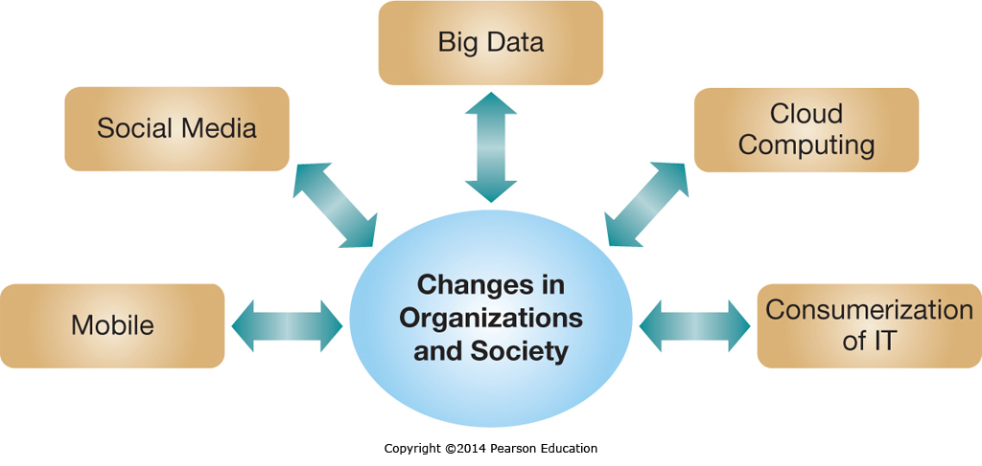
Five IT Megatrends in the Information Age
Notes:
The current confluence of emerging technologies and social events has created five significant trends that business managers need to manage and understand if they don’t want to be left behind.
Mobile Computing
Social Media
Big Data
Cloud Computing, and
the Consumerization of IT
Lets explore each of these individually in the next five slides.

Slide 7
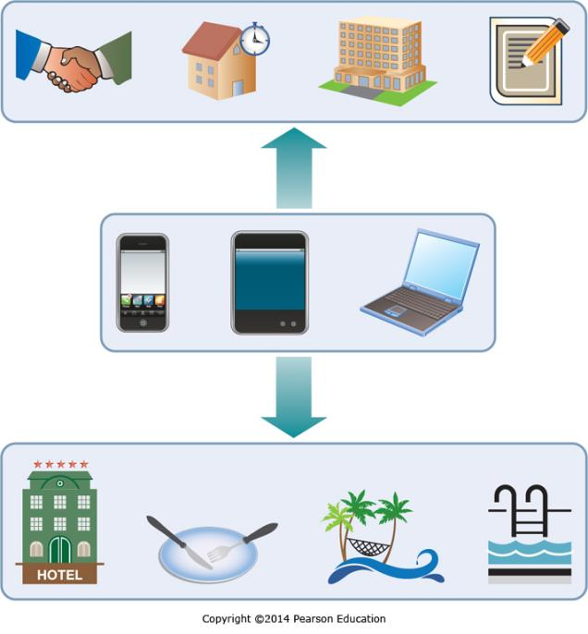
Five IT Megatrends in the Information Age:
Mobile Computing
Many believe that we’re living in a post-PC era.
In the developing world mobile devices often leapfrog traditional PCs.
Implications:
  Increased collaboration
  The ability to manage business in real time
  New ways to reach customers
Notes:
Mobile Computing is becoming pervasive, and many people are constantly connected to the digital world.
In developing nations, there is often a jump directly to mobile technologies, which avoids the high-cost infrastructure of traditional land based phone systems.
This can lead to both opportunities and challenges both for managers and for marketers.
Employees can conduct business almost anytime, anywhere.
Customers have their phones with them 24/7, allowing them to be reached throughout the day, wherever they may be.

Slide 8
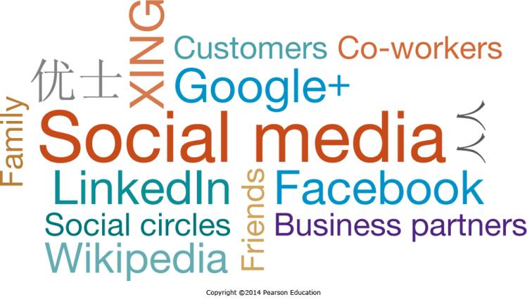
Five IT Megatrends in the Information Age:
Social Media
Over 800 million Facebook users share status updates or pictures with friends and family
Organizations use social media to encourage employee collaboration or to connect with their customers
Notes:
Social media has emerged as a dominant force in online socialization.
Businesses can leverage social media to communicate with customers.
Business Intelligence can be conducted, mining social media sites for good and bad sentiment towards a business and the factors driving it.
Chapter 5 will focus on Social Media.

Slide 9
Five IT Megatrends in the Information Age:
Big Data
IDC estimated that in 2011, 1.8 zettabytes of data were generated and consumed
How much is 1.8 zettabytes? 1.8 trillion gigabytes, or the equivalent of 57 billion 32GB iPads (IDC, 2011)
This number is forecast to grow by 50 times by 2020
Notes:
Businesses continue to gather ever larger quantities of data as they seek to have the proper data to manage their business effectively and efficiently.
This presents new opportunities if it can be properly analyzed and mined for information.
This data is often unstructured, such as natural language postings about a business.
The resources required to mine Big Data pose tremendous challenges for business.

Slide 10
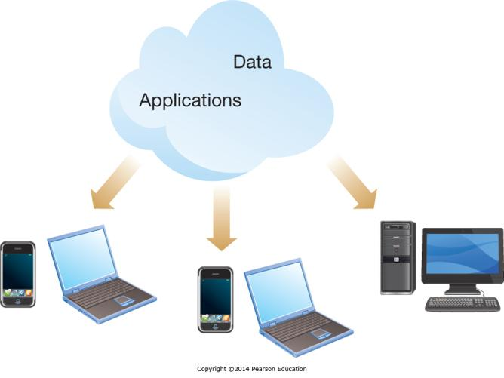
Five IT Megatrends in the Information Age:
Cloud Computing
Web technologies enable using the Internet as the platform for applications and data
Many regard cloud computing as the beginning of the “fourth wave”
  the applications but also the data reside in the cloud
Notes:
Cloud Computing is really about sharing technology resources and taking the pain out of using and sharing data and applications.
It requires connectivity to function, so the constant connectivity we see at work and play is a key enabler.
Mobile computing has further added to the value of the cloud metaphor.
It will be discussed in greater depth in Chapter 3.

Slide 11
Five IT Megatrends in the Information Age:
Consumerization of IT
Consumerization may be the most significant trend affecting organizational IT personnel
  Today’s employees bring their own devices to work
  Initially used for emails / social networking
    Now used for other important tasks such as enterprise resource planning
  Creates security concerns
  Opens up new opportunities
Notes:
Consumerization occurs when employees use consumer devices and/or software to facilitate their work.
An example might be using personal mobile devices to conduct customer service, or consumer focused social networking sites.
When corporate data is brought onto personal devices which might not be as secure as corporate resources it creates security concerns.
There are also many opportunities, as users know how to use their personal devices, and can also leverage their capabilities in and out of the workplace.

Slide 12
Evolution of Globalization
The Rise of the Information Age
Describe the characteristics of the digital world and the advent of the Information Age.
Evolution of Globalization
Learning Objective: Be able to define globalization, describe how it evolved over time, and describe key globalization drivers.
Information Systems Defined
Explain what an information system is, contrasting its data, technology, people, and organizational components.
IS Ethics
Describe how computer ethics impact the use of information systems and discuss the ethical concerns associated with information privacy and intellectual property.
The Dual Nature of Information Systems
Describe the dual nature of information systems in the success and failure of modern organizations.
Notes:
Globalization is next. We will look at the key factors enabling globalization and at outsourcing. Our learning objective for this section is for you to be able to describe globalization, key enablers, outsourcing, and information systems outsourcing.

Slide 13
Key Factors Enabling Globalization
The fall of the Berlin Wall
The Windows operating system
The Internet — release of the Netscape Web browser
Falling telecommunications costs
Notes:
With the end of the cold war, the Berlin Wall came down and millions of individuals started enjoying new freedoms, creating new opportunities for both the manufacture and sale of goods and services.
The Windows operating system became the de facto standard for computers around the world, simplifying and streamlining communication and information sharing.
The Internet and the invention of the Web browser created a new standard common for sharing information over a network in a simple fashion everyday people could readily grasp.
Falling telecommunication costs have enabled new types of communication and collaboration at very low cost.

Slide 14
The Rise of Information Systems Outsourcing
Outsourcing: moving of business processes or tasks to another company
  Facilitated by declining telecommunication costs
  Driven by cost reduction
    Reduced labor costs for low-skilled labor: Apple outsourcing manufacturing to China
    Reduced labor costs for relatively high-skilled labor: Boeing outsourcing 787 Aeronautical Engineering to Russia
Notes:
Outsourcing is when you take business process currently being performed internally by your company and have another company do them instead.
Outsourcing is typically driven by cost reduction, and is undertaken when another company can perform a process at a lower cost then yours.
Outsourcing doesn’t automatically imply moving work overseas.
The decline in telecommunication costs has significantly reduced the expenses in moving processes to businesses which are overseas.
Overseas companies may enjoy multiple competitive advantages, including lower labor costs.

Slide 15
The Rise of Information Systems Outsourcing:
Key Reasons for Outsourcing
To reduce or control costs
To free up internal resources
To gain access to world-class capabilities
To increase revenue potential of the organization
To reduce time to market
To increase process efficiencies
To be able to focus on core activities
To source specific capabilities or skills
Notes:
In addition to the help information systems give to outsourcing other business processes, information system processes are also subject to outsourcing.
Information systems outsourcing is done for the same reasons as other business processes.
The prime driver for information systems outsourcing is also cost reduction, just like for other types of outsourcing.
Other drivers include outsourcing to more effective companies and allowing a business to focus on its core business activities.

Slide 16
Opportunities of Operating in the Digital World
Falling Transportation Costs
  Shipping a bottle of wine from Australia to Europe merely costs a few cents
Falling Telecommunication Costs
  These have helped create shared perspectives of behavior, desirable goods, and even forms of government
Reaching Global Markets
Accessing a Global Labor Pool
  Highly skilled or low cost labor pools exist in many countries which are now economically accessible
Notes:
The emerging digital world creates many opportunities for companies to reduce costs through information system driven efficiencies and accessing lower cost labor. At the same time, companies can reach broader markets and sell products around the world, driven in part by falling transportation costs which are also being driven down through information systems technology.

Slide 17
Challenges of Operating in the Digital World
Government
  Political instability
  Regulatory: privacy, control, standards, censorship
Geopolitical
  Time zones, infrastructure
  Workforce: welfare, demographics, expertise
Cultural
  Working with, providing services too
Notes:
There are new challenges to operating in the Digital World as well as new opportunities. In addition to the expected challenges of culture, varying worker demographics, and political instability, there are additional challenges as different countries pass varying information system regulatory controls affecting privacy, standards, information ownership, and information censorship.

Slide 18
Information Systems Defined
The Rise of the Information Age
Describe the characteristics of the digital world and the advent of the Information Age.
Evolution of Globalization
Define globalization, describe how it evolved over time, and describe the key drivers of globalization.
Information Systems Defined
Learning Objective: Explain what an information system is, contrasting its data, technology, people, and organizational components.
IS Ethics
Describe how computer ethics impact the use of information systems and discuss the ethical concerns associated with information privacy and intellectual property.
The Dual Nature of Information Systems
Describe the dual nature of information systems in the success and failure of modern organizations.
Notes:
As we discuss information systems its important to know what they are, and what they aren’t. The learning objective for this section is for you to be able to explain what an information system is, including the components. A key part of this is the element of data, and the difference between data, information, and knowledge.

Slide 19
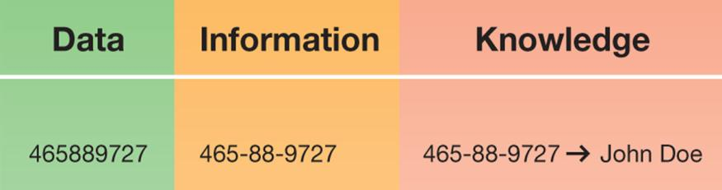
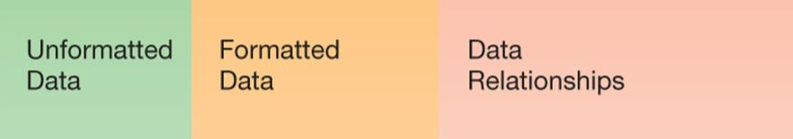
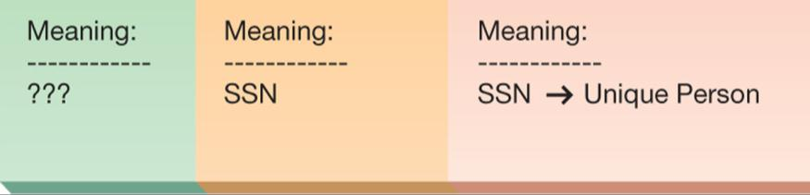
Data: The Root and Purpose of Information Systems
Data is analyzed and processed into information
When there is an ability to understand the information and make decisions using it, it becomes knowledge
Notes:
Data is the raw feedstock of information systems. Data is the raw information that we capture everyday.
Once it is processed and analyzed it becomes information. Even this isn’t enough to make decisions with.
To make decisions, we need to understand the context of the information and the environment in which we want to use it.
Knowledge is the ability to understand information, form opinions, and make decisions or predictions based on the information.

Slide 20
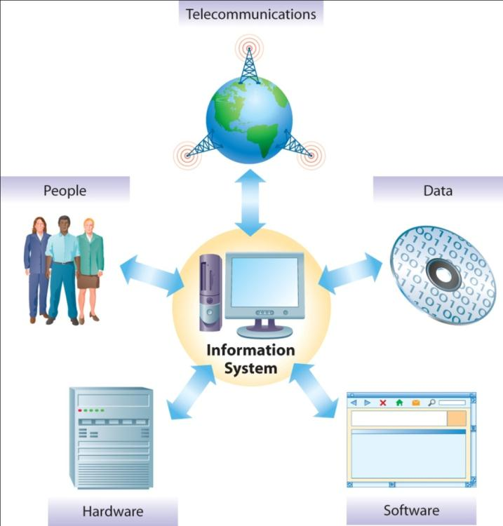
The Components of Information Systems
Five Components of Information Systems:
  People
  Telecommunications
  Hardware
  Data
  Software
Notes:
Information systems are made up of five key components:
People
Telecommunications
Hardware
Data, and
Software
These components need to all work together to make information systems effective and efficient.

Slide 21
People: The Builders, Managers, and
Users of Information Systems
An ecosystem of Users, Builders, Managers, and those who study information systems
As the use of information systems grows, so does the need for dedicated IS professionals
Growing demand focused on those with advanced and/or unique skills
Notes:
Since the first computers decades ago, an entire ecosystem has grown up surrounding the development, implementation, support, use, and maintenance of information systems.
This ecosystem includes multiple types of highly skilled professionals, and expanding use means that demand continues to grow for those with advanced or unique skills.

Slide 22
IS Positions Rank Among the
Best Jobs in America
Rank | Career | Job Growth (10-year forecast) | Median Pay
1 | Software developer | 32% | $82,400
2 | Physical therapist | 30% | $75,900
3 | Financial adviser | 30% | $93,900
4 | Civil engineer | 24% | $74,700
5 | Marketing specialist | 28% | $52,200
6 | Management consultant | 24% | $111,000
7 | IT consultant | 20% | $96,500
8 | Database administrator | 20% | $86,600
9 | Financial analyst | 20% | $62,600
10 | Environmental engineer | 31% | $81,200
Notes:
Of the best 10 positions in America, information systems professions rank 7 and 8, Information Technology Consultants and Database Administrators. In fact, the related profession of Software Developer ranks as number one.

Slide 23
Organizations: The Context of
Information Systems
Information Systems can help organizations
  Be more productive and profitable
  Gain competitive advantage
  Reach more customers
  Improve service to their customers
This holds true for all types of organizations—professional, social, religious, educational, and governmental
Notes:
Information systems don’t exist in a vacuum, they exist in the context of varying types of organizations. Information systems play multiple roles in organizations, ranging from automating business processes and driving down costs to reaching new customers and better servicing existing ones.

Slide 24
The Dual Nature of Information Systems
The Rise of the Information Age
Describe the characteristics of the digital world and the advent of the Information Age.
Evolution of Globalization
Define globalization, describe how it evolved over time, and describe the key drivers of globalization.
Information Systems Defined
Explain what an information system is, contrasting its data, technology, people, and organizational components.
IS Ethics
Describe how computer ethics impact the use of information systems and discuss the ethical concerns associated with information privacy and intellectual property.
The Dual Nature of Information Systems
Learning Objective: by able to describe the dual nature of information systems in the success and failure of modern organizations.
Notes:
Information systems hold great promise for organizations, but also pose significant risks. The learning objective for this section is for you to be able to describe the dual nature of information systems, how they may help and how they may harm.

Slide 25
Information Systems for Competitive Advantage
FedEx is just one firm using information systems for competitive advantage
  Firms of all types and sizes can use information systems to gain or sustain a competitive advantage over their rivals
  Whether it is a small mom-and-pop boutique or a large government agency, every organization can find a way to use information technology to beat its rivals
Notes:
Like FedEx, many organizations are leveraging information systems to do business more effectively and efficiently. This may simply improve the bottom line, or may give a significant business advantage to an organization and allow them to have an edge over their competitors. This type of leverage can be applied by organizations of all sizes and industries.

Slide 26
Why Information Systems Matter
Does IT matter?
  A classic article in 2003 pointed out many existing information system elements have become commoditized—argues focus will turn to pure cost reduction
  However, the continuous innovation still being seen in information systems has some companies realizing strategic advantage from the innovative uses thereof
  Still, such advantage can be fleeting, and companies using information systems for strategic advantage need to keep innovating
Notes:
There is a legitimate argument to be made that many of the aspects of information systems, such as hardware and off-the-shelf software, can’t create a competitive advantage on their own, as they are commoditized products anybody can buy and implement. However, some aspects of information systems are more difficult to replicate, such as the data and the people. In addition, how an organization uses its resources can be unique and create advantage at least until other companies duplicate and emulate it.

Slide 27
Coming Attractions
The Future of Cloud-Based Communications
By 2020, all sorts of our communications-related information could come to be stored in the cloud
This information could be analyzed
  Helping know where friends and family are
  Knowing how and when to reach them
The cloud could wind up knowing more about our lives then we do
Still, the benefits could be amazing
Notes:
As much of the underlying work of saving and using information is migrated to the cloud, it is inevitable that new applications will emerge to facilitate processes and communication. For example, instead of saving all our contacts on our phones, they could all be stored in the cloud and accessible anywhere, anytime. This becomes even more intriguing once this data is analyzed and allows us to leverage the information from past communications to make future communications more effective. However, at the same time this could allow unexpected consequences, such as location prediction, that individuals aren’t expecting and perhaps don’t desire.

Slide 28
IS Ethics
The Rise of the Information Age
Describe the characteristics of the digital world and the advent of the Information Age.
Evolution of Globalization
Define globalization, describe how it evolved over time, and describe the key drivers of globalization.
Information Systems Defined
Explain what an information system is, contrasting its data, technology, people, and organizational components.
IS Ethics
Learning Objective: Describe how computer ethics impact the use of information systems and discuss the ethical concerns associated with information privacy and intellectual property.
The Dual Nature of Information Systems
Describe the dual nature of information systems in the success and failure of modern organizations.
Notes:
IS Ethics are a critical part of managing information systems. The learning objective for this section is for you to be able to discuss the ethical concerns of information systems in general and particularly with respect to privacy and intellectual property.

Slide 29
Computer ethics
“Describes the moral issues and standards of conduct as they pertain to the use of information systems”
Collecting and analyzing user data may have negative impacts
  Social decay
  Increased consumerism
  Loss of privacy
Notes:
The definition of computer ethics is “moral issues and standards of conduct as they pertain to the use of information systems”.
There is a growing concern in society about computer ethics which is driven in part by growing concerns regarding individual privacy and how organizations will use the information they have lacking any code of conduct or effective regulation.

Slide 30
Richard O. Mason: “PAPA” Ethical Concerns -
Privacy, Accuracy, Property, and Accessibility
Privacy: What information should you have to reveal online or in the workplace?
Accuracy: Is the data regarding individuals accurate? Can individuals access their data and verify the accuracy thereof? What are the impacts of inaccuracies?
Property: Company owns the data/databases they keep on individuals, and can sell the information as long as it doesn’t violate stated privacy policies when gathering it.
Accessibility: This circles back to the Digital Divide. Who has access to information, and the skills to leverage it?
Notes:
Richard Mason wrote a classic article in 1986 describing emerging concerns in four key areas, which goes by the acronym PAPA.
Privacy
Accuracy
Property
Accessibility

Slide 31
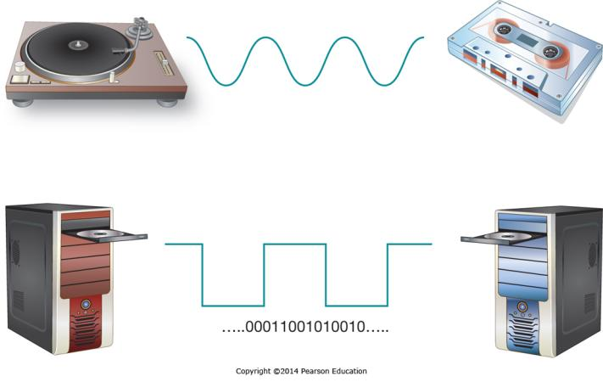
Intellectual Property
Copying digital music is almost effortless
In many non-Western societies, using someone else’s work is considered praise for the creator
Using another’s work without purchase or attribution has significant legal and ethical ramifications
Notes:
Intellectual Property is creating new ethical challenges as digital media can be copied endlessly with no loss of quality. However, many of the individuals who create intellectual property have a legal right to be the sole source for sales and are compensated for their creative work by receiving payment for each copy sold. This creates an ethical dilemma for individuals who own copies of the work and feel they should be able to use it as they see fit, including the duplication of it for a friend.

Slide 32
The Need for a Code of Ethical Conduct:
Computer Ethics Institute Guidelines
The guidelines prohibit:
  Using a computer to harm others
  Interfering with other people’s computer work
  Snooping in other people’s files
  Using a computer to steal
  Using a computer to bear false witness
  Copying or using proprietary software without paying for it
  Using other’s resources without authorization or compensation
  Appropriating other people’s intellectual output
The guidelines recommend:
  Review social consequences of programs and systems you design
  Use computers in ways that show consideration and respect for others
Notes:
A standard code of conduct removes ambiguity when situations come up that aren’t necessarily illegal, but which have the potential to cause individuals or organizations significant harm. This is particularly true where regulations regarding the use of information systems are playing “Catch-up” to the existing capabilities, such as editing a photo so it appears to represent something that wasn’t in the original. The Computer Ethics institute has created a widely quoted set of guidelines.

Slide 33
The Digital Divide
Many people are being left behind in the information age
  Strong linkage between computer literacy and a person’s ability to compete in the information age
  People in rural communities, the elderly, people with disabilities, and minorities lag behind national averages for Internet access and computer literacy
  The challenges in overcoming the digital divide are even greater in developing countries
Notes:
As information technology becomes more pervasive, the fundamental skills necessary to access and use it are becoming essential to success in business. When some people are left behind, either by choice or through lack of opportunity, it makes it difficult for them to achieve economic success.

Slide 34
End of Chapter Content

Slide 35
