Slide 1
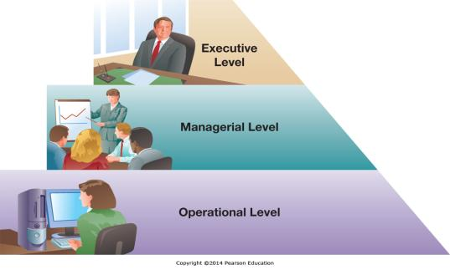
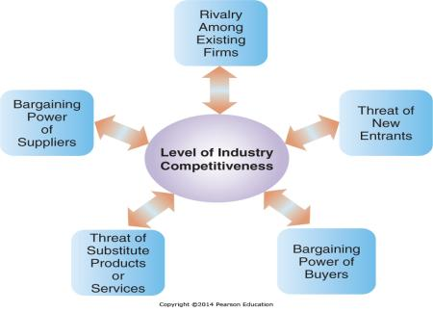
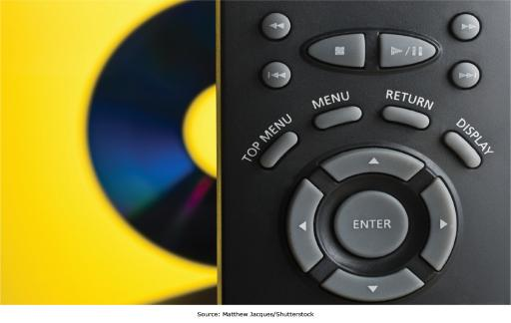
Chapter 2 - Gaining Competitive Advantage through Information Systems
A firm has competitive
advantage over rival firms when it
can do something better, faster,
more economically, or uniquely

Slide 2
Chapter 2 Learning Objectives
Enabling Organizational Strategy through Information Systems
Discuss how information systems can be used for automation, organizational learning, and strategic advantage.
International Business Strategies in the Digital World
Describe international business and IS strategies used by companies operating in the digital world.
Valuing Innovations
Explain why and how companies are continually looking for innovative ways to use information systems for competitive advantage.
Freeconomics: Why Free Products are the Future of the Digital World
Describe freeconomics and how organizations can leverage digital technologies to provide free goods and services to customers as a business strategy for gaining a competitive advantage.

Slide 3
Enabling Organizational Strategy through Information Systems
Enabling Organizational Strategy through Information Systems
Discuss how information systems can be used for automation, organizational learning, and strategic advantage.
International Business Strategies in the Digital World
Describe international business and IS strategies used by companies operating in the digital world.
Valuing Innovations
Explain why and how companies are continually looking for innovative ways to use information systems for competitive advantage.
Freeconomics: Why Free Products are the Future of the Digital World
Describe freeconomics and how organizations can leverage digital technologies to provide free goods and services to customers as a business strategy for gaining a competitive advantage.

Slide 4
Organizational Decision-Making Levels
Executive/Strategic Level
Upper Management
Managerial/Tactical Level
Middle Management
Operational Level
Operational Employees, Foremen, Supervisors
Notes:
Most businesses have three levels of management, with one or more layers of managers in each level.
The executive management includes top tier management focused on long-term strategic business decisions such as how to compete, price versus quality, and what countries to do business in.
Middle or tactical management is focused on running the organization to meet the strategic goals, and typically has a management timeframe of 3 to 12 months. Typical decisions might include where additional stores in existing markets should be opened.
Operational employees and management perform the day-to-day work of the organization, making decisions on a day-by-day basis.
A shift manager at a Wal-Mart would be Operational Management, while a Store manager at a Wal-Mart would be at the lowest level of Middle or Tactical Management.

Slide 5
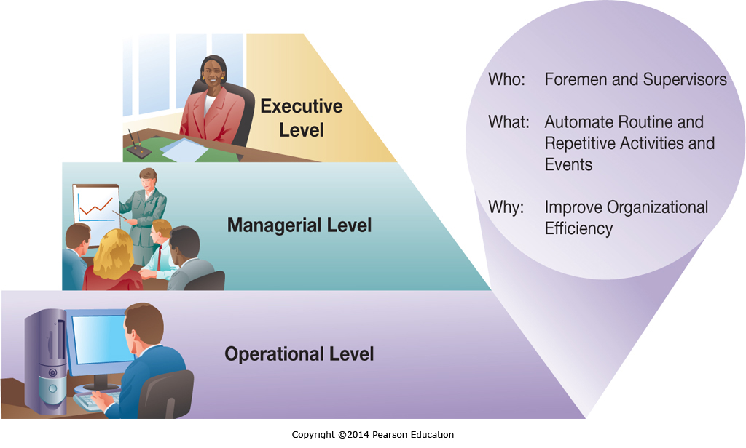
Organizational Decision-Making Levels: Operational Level
Notes:
Operational information systems primarily focus on process automation. This can include automating routine activities as well as automating and optimizing structured decisions (such as employee scheduling).

Slide 6
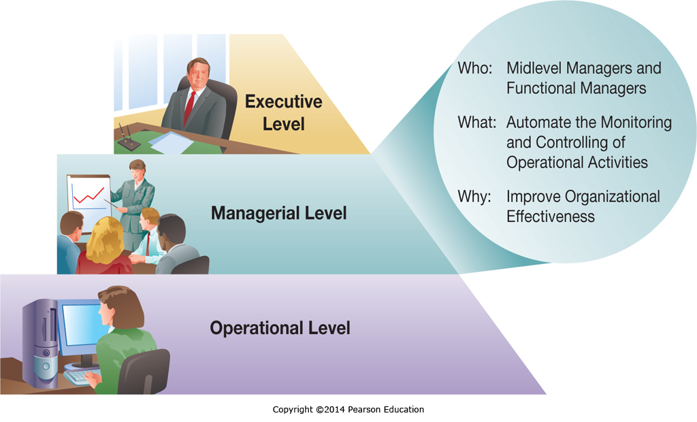
Organizational Decision-Making Levels: Managerial/Tactical Level
Notes:
Information systems at the Managerial, or Tactical level are focused on helping middle management exercise control more efficiently and effectively and on helping them make semi-structured decisions with better input and resources.

Slide 7
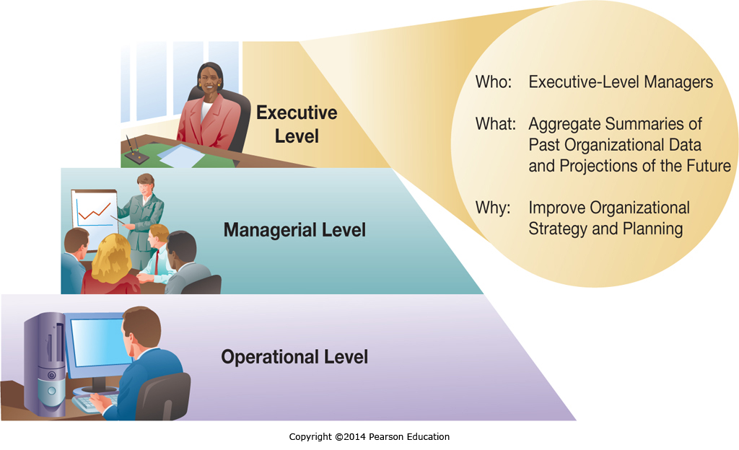
Organizational Decision-Making Levels: Executive/Strategic Level
Notes:
Information systems at the Executive level are focused on helping executing managers understand the current business status through:
executive information systems that often show aggregate business performance data, and
through tools to support executing decision making such as forecasting and planning tools.

Slide 8
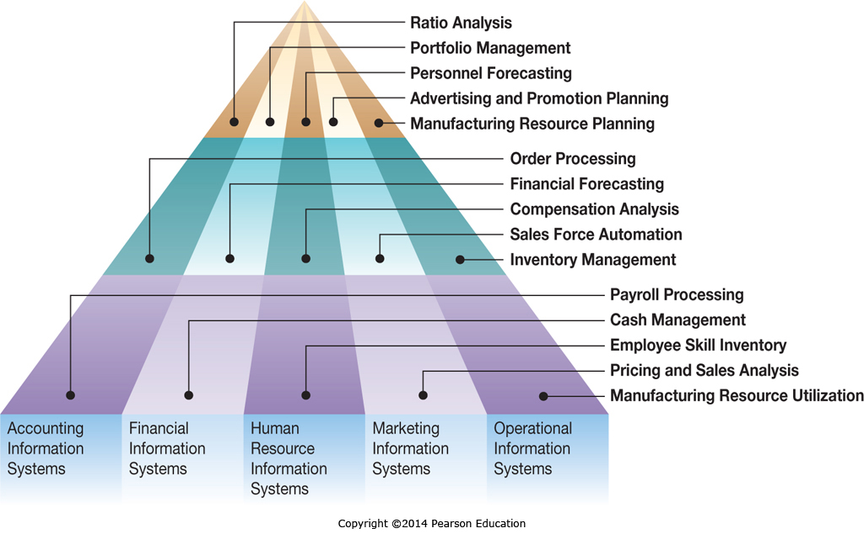
Organizational Functions and Functional Levels
Notes:
Organizations are organized along Functional boundaries as well as along managerial levels, and managers within each function at each organizational level have unique information system needs.

Slide 9
Information Systems for Automating: Doing Things Faster
Primary Activities of Loan Processing | Manual Loan Process | Technology-Supported | Fully Automated
Complete and submit application | Completed at home (1.5 days) | Completed at home (1.5 days) | Completed online (15 minutes)
Check application for errors | Done in batches (2.5 days) | Done in batches (2.5 days) | Computerized (3.5 sec)
Input data into the information system | NA some paper handling (1 hr) | Done in batches (2.5 days) | NA (already done)
Assess loan apps under $250K | Done by hand (15 days) | Computer assisted (1 hr) | Computer processed (1 sec)
Committee decides if loan over $250k | (15 days) | (15 days) | (15 days)
Applicant notified | Batches (5 days) | (1 day) | E-mail (3.5 sec)
Total time | 25 to 40 days | 5 to 20 days | 15 min to 15 days
Notes:
Computers can automate existing business processes to varying degrees. Depending on the process, this may or may not be significant. In the above example, going from a manual process to a fully automated process changed the total time for loans under $250k from 25 days to 15 minutes.

Slide 10
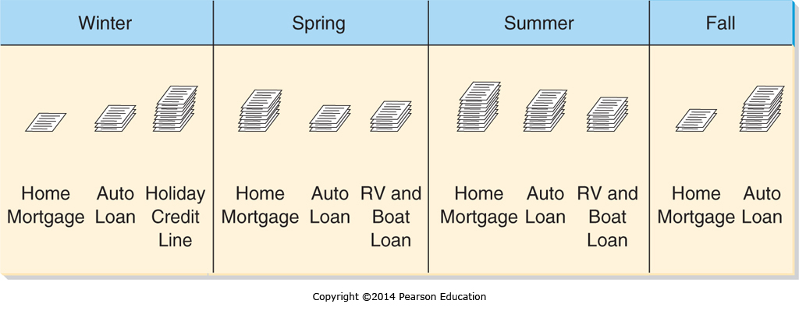
Information Systems for Organizational Learning: Doing Things Better
Information systems can track and identify trends and seasonality
Managers can use this to plan staffing levels and cross-training
Notes:
Information systems can track information and identify how the business is functioning in general and at different times of the year.
Managers can learn from this information and utilize it to run the business more efficiently, planning in advance how they handle seasonal demand fluctuations, or change business processes which are flawed and generating problems, such as approving loans that will be defaulted.

Slide 11
Information Systems for Supporting Strategy: Doing Things Smarter
Firms have a competitive strategy
Information Systems should be implemented that support that strategy
Low cost strategy implies information systems to minimize expenses
High quality strategy implies information systems to support ensuring excellent quality and minimal defects
Notes:
While automating and learning are good approaches to information systems, ensuring that expenditures are for systems that match the corporate strategy is also critical.
It wouldn’t make sense for a low cost car manufacturer to implement a highly sophisticated and very expensive quality control system that rivaled the quality control systems of Mercedes, because that isn’t why customers are buying their cars and the system wouldn’t generate an appropriate return in investment.

Slide 12
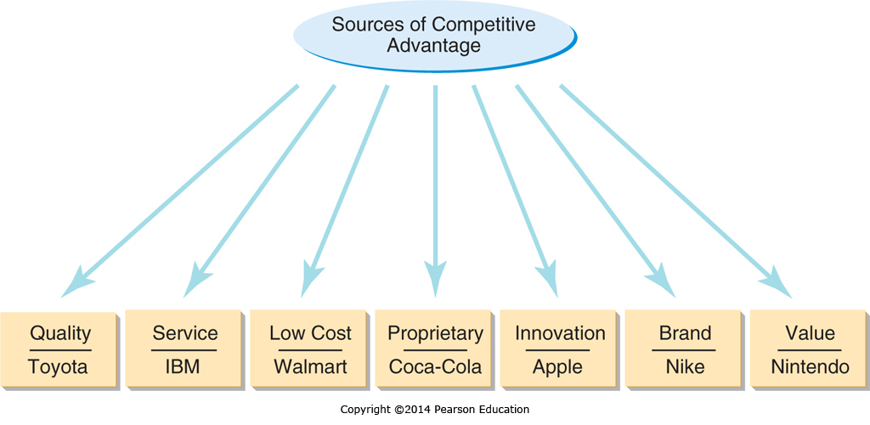
Sources of Competitive Advantage
Notes:
When a company does or is perceived by customers to do something distinctively better then the competition, it has a competitive advantage based on that distinctive feature.
Many firms seek unique positioning to increase their products marketability. Information systems that help a firm achieve a distinct position can help create competitive advantage.

Slide 13
Identifying Where to Compete: Analyzing Competitive Forces
Notes:
Companies need to understand the forces acting within the industry and on their organization. Michael Porter created a framework for this in 1979 that is still widely used to this day.

Slide 14
Using IS to Combat Competitive Forces Table 2.2
Competitive Force | Implication for Firm | Potential Use of Information Systems
Rivals within your industry | Competition in price, product distribution, and service | Reduce costs, use the Internet to increase service
New entrants | Reduced prices and market share | Inventory control to manage excess capacity, Internet to differentiate products
Customers’ bargaining power | Reduced prices, demand for better quality and service | CRM to improve service, CAD/CAM
Suppliers’ bargaining power | Increased costs and reduced quality | Use internet to work with new distant suppliers
Threat of substitute products | Decreased market share, customer loss | Better assess customer needs, use CAD to design better products
Notes:
Information Systems can help offset many competitive forces, such as Computer Aided Design and Manufacturing to help firms meet customer demands when customers have a high degree of bargaining power.

Slide 15
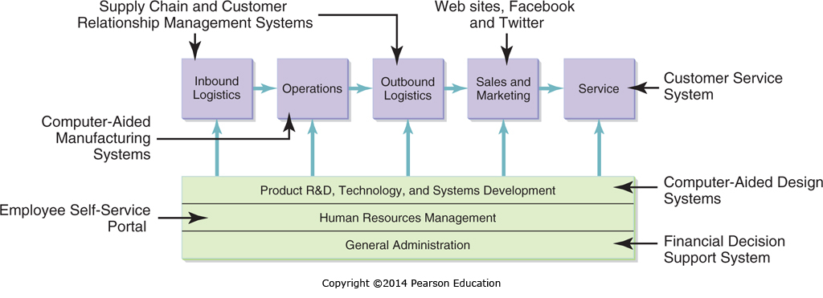
Identifying How to Compete: Analyzing the Value Chain
Notes:
Value chain analysis can highlight opportunities in which information systems implementation can make an organization more effective and efficient, and secure a competitive advantage.
By identifying your cost structure at each level of the value chain and benchmarking against your competitors you can identify changes that will enhance your performance.

Slide 16
The Technology/Strategy Fit
There are never enough resources to implement every possible IS improvement
There are usually never enough resources to implement every financially beneficial IS improvement
Companies that focus on the improvements and business process changes that help their value creation strategy the most will see the greatest competitive benefit
Notes:
It is important that when firms are choosing technologies to implement they make sure the technologies support the business strategies already in place.
While many projects may appear to be justified, limited resources require careful selection.
By making sure that the projects selected are focused on helping the company meet its core business objectives, a company can help ensure that the projects are adding value.

Slide 17
Assessing Value for the IS Infrastructure
Economic Value
Direct financial impact
Architectural Value
Extending business capabilities today and in the future
Operational Value
Enhancing ability to meet business requirements
Regulatory and Compliance Value
Complying with regulatory requirements
Notes:
Information systems add value to companies in several ways.
There are both direct financial impacts, and indirect impacts such as enabling an organization to make changes in the future or strengthening the business processes so organizations are readily able to meet business requirements without having to constantly make exceptional efforts. Finally there is the value of meeting current and future regulatory requirements.

Slide 18
Putting It All Together: Developing a Successful Business Model
A business model reflects the following:
What does a company do?
How does a company uniquely do it?
In what way (or ways) does the company get paid for doing it?
What are the key resources and activities needed?
What are the costs involved?
Notes:
How a company answers these questions dictates:
what industry the company is competing in
how competitive it is in that industry
what if any competitive advantage the company enjoys, and
how profitable the company is or can be.

Slide 19
International Business Strategies in the Digital World
Enabling Organizational Strategy through Information Systems
Discuss how information systems can be used for automation, organizational learning, and strategic advantage.
International Business Strategies in the Digital World
Describe international business and IS strategies used by companies operating in the digital world.
Valuing Innovations
Explain why and how companies are continually looking for innovative ways to use information systems for competitive advantage.
Freeconomics: Why Free Products are the Future of the Digital World
Describe freeconomics and how organizations can leverage digital technologies to provide free goods and services to customers as a business strategy for gaining a competitive advantage.

Slide 20
International IS Strategies
There are four international business strategies
Home Replication
Global
Multidomestic
Transnational
Each has pros and cons in terms of complexity, cost benefits, local responsiveness, and control
Notes:
The four different types of international business strategy are Home Replication, Global, Multidomestic, and Transnational. These strategies are designed to address different needs for local responsiveness, simplicity, and cost minimization. We will discuss each of them in depth in the next four slides.

Slide 21
Home-Replication Strategy
Focused Domestically
Exporting products to generate additional sales
Secondary emphasis on international operations
Information Systems not a significant factor in facilitating international export sales
Notes:
The home replication strategy is essentially focused on making products for the domestic market, and then selling them as exports to anyone who wants to buy them internationally regardless of how the products may or may not be suited for that different market.

Slide 22
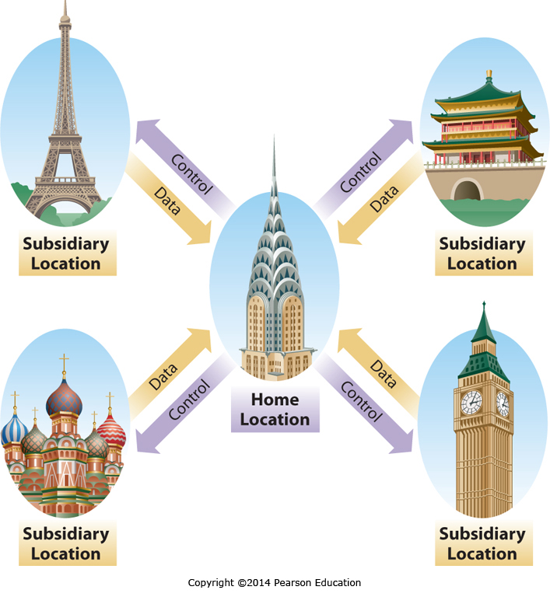
Global Business Strategy
Notes:
When companies are pursuing a Global business strategy, their products are deliberately developed for a global market.
This is differs from the home-replication strategy, where products are developed for the home market then offered up for export.
In the global strategy the product is intended for a global audience and designed to appeal across the global audience.
This requires subsidiaries providing extensive feedback to the home office to ensure an understanding of how the product is being received.
This strategy doesn’t allow for localization of the product to appeal to specific markets, the focus is rather a global product appealing across many markets.

Slide 23
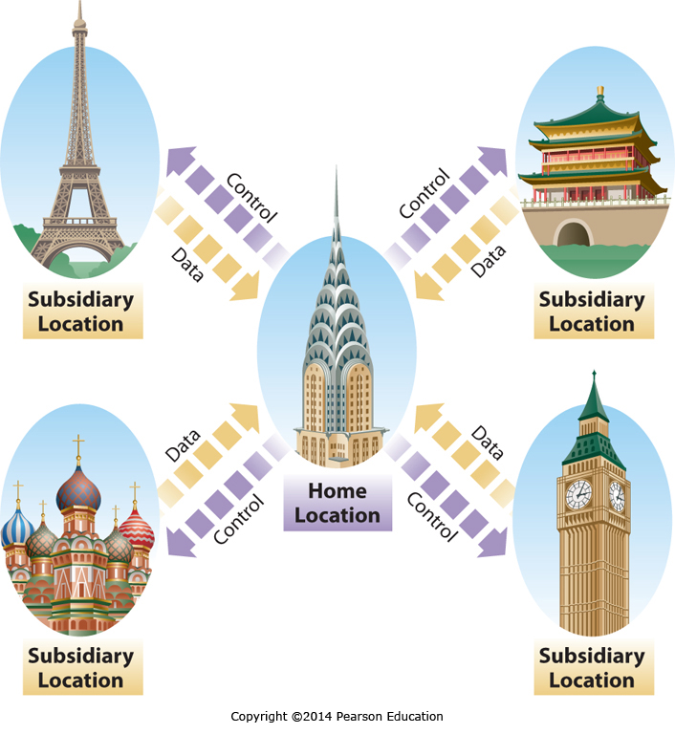
Multidomestic Business Strategy
Notes:
Multidomestic companies take a decentralized approach to running different subsidiary locations. Each location typically has a great deal of latitude in meeting local market needs. While multidomestic companies can successfully operate in very different cultures, there tends to be little sharing of lessons learned and best practices throughout the company, resulting in inefficiencies. The information systems of multidomestic companies also tend to be run by individual IS departments within each subsidiary.

Slide 24
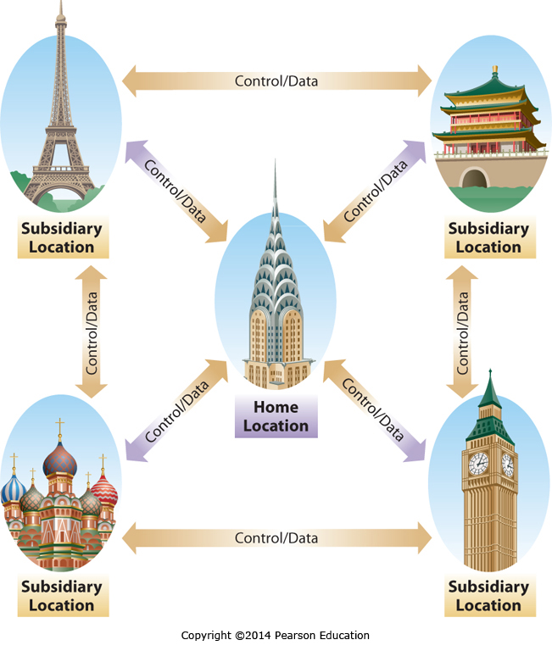
Transnational Business Strategy
Notes:
Transnational companies take a federated approach to management, meaning some aspects of the company are centralized, while other aspects are decentralized. What portions of the company are centralized and which are decentralized is based on what approach is necessary to maximize the return on shareholder investment, with products requiring significant localization to be successful often decentralized, while products or business functions that gain efficiencies from economies of scale and standardization being centralized. Different parts of the company may even be centralized in different countries to take advantage of cost savings. The Transnational strategy is sophisticated and complex, requiring extensive information sharing between different subsidiaries as well as between each subsidiary and the home location or locations. This communication is facilitated by information systems and the Internet.

Slide 25
Valuing Innovations
Enabling Organizational Strategy through Information Systems
Discuss how information systems can be used for automation, organizational learning, and strategic advantage.
International Business Strategies in the Digital World
Describe international business and IS strategies used by companies operating in the digital world.
Valuing Innovations
Explain why and how companies are continually looking for innovative ways to use information systems for competitive advantage.
Freeconomics: Why Free Products are the Future of the Digital World
Describe freeconomics and how organizations can leverage digital technologies to provide free goods and services to customers as a business strategy for gaining a competitive advantage.

Slide 26
The Need for Constant IS Innovation
“The most important discoveries of the next 50 years are likely to be ones of which we cannot now even conceive” John Maddox
Transformation Technologies are difficult or even impossible to see coming
Think of the Internet in 1999
Many of the critical discoveries in the next 50 years will be in areas we don’t see coming
Notes:
If a company wants to stay ahead of the competition, it needs to stay on top of the changing environment.
This can require constant innovation, as the technologies in the world we live in keep changing in new and unexpected ways.
Just as many companies in 1999 couldn’t conceive of the Internet as it is today, we may be unable to conceive of how the Internet will look in 2020 or 2025.

Slide 27
Successful Innovation Is Difficult
Innovation Is Often Fleeting
The pace of change is fast
Smart rivals quickly adopt any advantage
Innovation Is Often Risky
Competing Technologies result in a winner and a looser (e.g.: Blu-Ray and HD DVD)
Innovation Choices Are Often Difficult
It is impossible to pursue all opportunities
It is hard to predict which opportunities will lead to success
Notes:
Innovation can bring great rewards, but it typically isn’t easy. Some innovations only give a short term advantage, readily copied by competitors once they see it works. And when there are competing technologies, there is no guarantee that the one a company chooses to embrace will become the market standard, making large investments risky. Finally, companies often have to choose a limited set of options to pursue out of a wealth of opportunities. Resources are constrained, time is limited, and the information about the different options is imperfect.

Slide 28
Organizational Requirements for Innovation
Process Requirements
Focus on success over other objectives
Resource Requirements
Employees with knowledge, skill, time & resources
Partner with appropriate requirements
Risk Tolerance Requirements
Tolerance for risk
Tolerance for failure
Notes:
Innovation isn’t something every company can do. The company has to have an organization and process that allows innovation to move forward and not get caught up in office politics and competing agendas. If a company decides to pursue innovation, it either needs the resources in-house or needs to contract with a partner that has the appropriate resources. Finally, a company that doesn’t allow risk taking and the occasional failure will punish people who try to take risks and innovate, and will soon stifle any possibility of innovation.

Slide 29
Predicting the Next New Thing
Many innovations can be copied
Limited time span of any advantage
May become a requirement for staying competitive
Some innovations deliver longer advantages
Unique customer service based on customer data
High levels of customer investment in proprietary systems – high switching costs
Technologies that are very difficult to copy
Notes:
It is difficult to predict the next innovation that will provide a long term competitive advantage, but there are a few things to keep in mind. Innovations based on a purchased technology can often be purchased by competitors, and those based on a developed technology can be imitated or copied. To provide long term advantage the innovation needs to form the basis for or incorporate something that competitors can’t readily acquire or develop. This could be something based on customer data that competitors can’t readily acquire, such as unique customer service. Sometimes a company can develop a technology that customers buy into and then are locked into with high switching costs. While this can be effective, some customers will view it as a trap and avoid it. Finally, companies can develop sophisticated technologies that are very difficult to copy or have a very high cost to duplicate. All of these can result in a company having a long term competitive advantage.

Slide 30
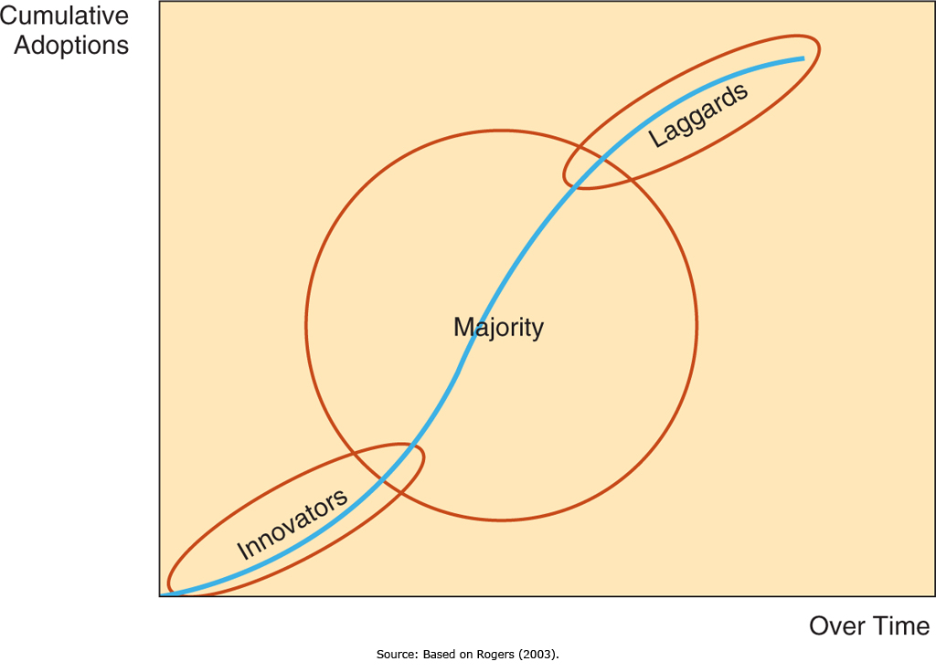
The Diffusion of Innovations
Notes:
Typical innovations are often slow to take off, then are rapidly adopted, and finally there is a long tail of late adopters who slowly change over. The innovators may be adopting technology just to see if it’s beneficial, while the majority are adopting it to take advantage of its benefits, and the laggards are slow to adopt despite the benefits they would see. While many technologies go through this cycle, disrupting innovations, discussed next, are different.

Slide 31
Disruptive Innovations Examples from Table 2.8
Disruptive Innovation | Displaced or Marginalized Technology
Digital photography | Chemical photography
Online stock brokerage | Full-service stock brokerages
Online retailing | Brick-and-mortar retailing
Distance education | Classroom education
Unmanned aircraft | Manned aircraft
Semiconductors | Vacuum tubes
MP3 players and music downloading | Compact discs and music stores
Smartphones | MP3 players, dedicated GPS navigation
Tablets | Notebook computers
Notes:
Disruptive Innovations can completely replace the technology they are disrupting, and a failure to recognize that a disruptive innovation is changing the market can easily lead to a companies demise. With a disruptive innovation, companies may not be given the opportunity to be laggards.

Slide 32
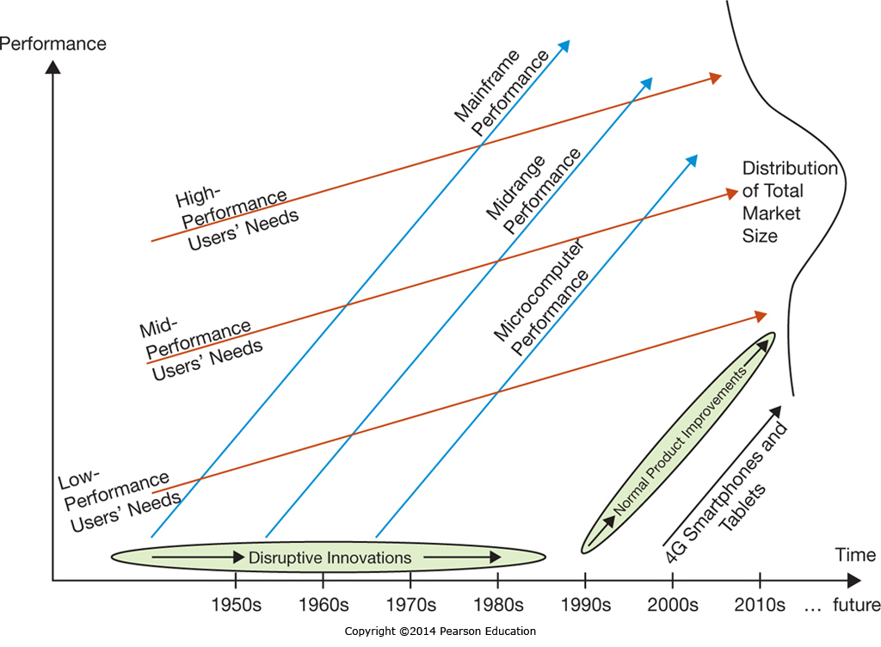
The Innovator’s Dilemma
Notes:
In many different industries the capabilities of the lowest performing category of the market improve faster then the needs of the lowest need users. This is especially true in the computing industry, where the capabilities of computer systems continues to increase at a breakneck pace. When the lowest performing technology that is useful becomes powerful enough, it starts to meet the needs of additional users, and can often replace higher cost technology options. Thus Microcomputers pushed id-range computers out of the workplace, but some midrange computers pushed high-end computers out as well. The lowest performing technology that is useful may now itself be threatened by other technologies that couldn’t meet the needs of users in a segment before, but which now can. Cell phones and tablet computers are now powerful enough to be a disruptive technology threatening microprocessor-based computers.

Slide 33
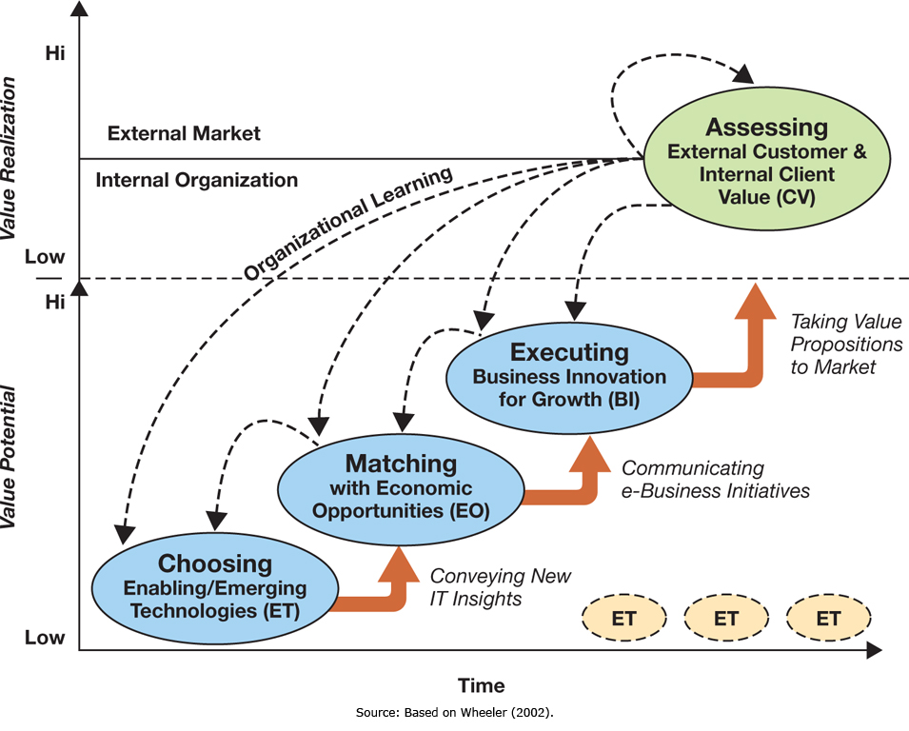
Executing Innovation
Notes:
The e-business innovation cycle is based on choosing technologies, matching them to opportunities, and executing against the opportunity. After each execution there is an assessment phase where learning occurs, and then the process stares again.
The most difficult part of the cycle is in Choosing the enabling/emerging technologies, which can be exceptionally difficult. Matching the selection with business opportunities is the next most difficult phase.

Slide 34
Freeconomics: Why Free Products are the Future of the Digital World
Enabling Organizational Strategy through Information Systems
Discuss how information systems can be used for automation, organizational learning, and strategic advantage.
International Business Strategies in the Digital World
Describe international business and IS strategies used by companies operating in the digital world.
Valuing Innovations
Explain why and how companies are continually looking for innovative ways to use information systems for competitive advantage.
Freeconomics: Why Free Products are the Future of the Digital World
Describe freeconomics and how organizations can leverage digital technologies to provide free goods and services to customers as a business strategy for gaining a competitive advantage.

Slide 35
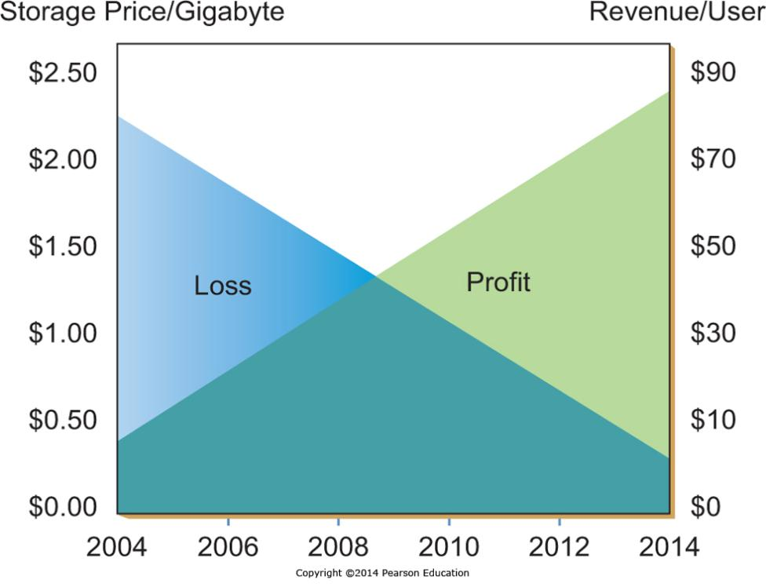
How Freeconomics Works
Notes:
As the market for digital goods and services increases, the total and marginal per-user costs decrease. Competition forces companies to pass these reduced costs on to customers to maintain competitiveness. Over time these constantly decreasing costs approached ‘free’, and offering them to the consumer for free may be the only way to get the consumer to take advantage of them as compared to a competitors offerings.

Slide 36
The Freeconomics Value Proposition
Free doesn’t mean no profit
Google gives away search
Users give Google search results their attention
This can include attention to sponsored links
Google sells space for sponsored links
Advertisers pay Google for that attention to sponsored links
Some users convert into customers
Customers pay advertising firms for their products
Notes:
While someone gets something for free in Freeconomics, that doesn’t mean no one is paying for anything. There are multiple approaches to making freeconomics work, many of which result in significant profits for successful companies. The classic example is online search engines. The functionality of the search engines is given to users for free, but the use of the search engine Web site gives the search engine companies the opportunity to sell advertising to companies. The sale of advertising by the search engine can be particularly valuable because the advertising shown can be targeted based on the content of the desired search, making it more relevant for the user exposed to it.

Slide 37
Applying Freeconomics in the Digital World
Approach | What it Means | Examples
Advertising | Free services are provided to customers & paid for by a third party | ▪ Yahoo!’s banner ads ▪ Google’s pay-per-click
Freemium | Basic services are free, a premium is charged for special features | ▪ Skype ▪ Dropbox.com
Cross subsidies | Sale price of one item is reduced in order to sell something else of value | ▪ Free cell phone with two-year contract
Zero Marginal Cost | Products are distributed to customers without an appreciable cost to anyone | ▪ iTunes music distribution ▪ Software distribution ▪ YouTube Video content
Labor Exchange | The act of customers using free services creates value | ▪ Yahoo! Answers ▪ Answers.com
Gift Economy | People participate and collaborate to create value for Everyone | ▪ Open source software ▪ Wikipedia
Notes:
There are multiple ways companies implement Freeconomics, many of which still drive revenue.
Advertising is very common, such as the search engine example from the previous slide.
Cross subsidies allow one item to be given away or sold at a reduced price to drive sales of another item.
Some items have no additional cost to duplicate, such as digital music, allowing companies to give them away without incurring expense.
There are also freeconomics at play in the gift economies and labor exchanges, where people participate for various reasons which are not monetarily based.

Slide 38
End of Chapter Content

Slide 39
Managing in the Digital World: The Business of Merging “Groups” and “Coupons”
Groupon created a new business model
Heavily discounted deals for grouped buyers
Advertising value for sellers
Groupon’s business model is easily duplicated, and has been, repeatedly
Groupon does have a first mover head start
Groupon has purchased many competitors
However, Groupon has no sustainable competitive advantage as currently positioned

Slide 40
Brief Case: For Sale By Owner: Your Company’s Name.com
Domain names can be purchased by anyone, whether they own the trademark for that name or not
Businesses have had to pay premium prices for their own trademarked names
Legislation to prevent Domain Squatting has stalled in congress
Some names are rented to businesses for lucrative amounts
Common misspellings now lead to advertising sites

Slide 41
When things go wrong: The Pains of Miscalculating Groupon
Groupon sales are heavily discounted, and can cost companies more then they bring in
Groupon takes 40% of the discounted sale
Groupon sales unprofitable unless they grow the repeat business customer base
Some sales are one-time (eye laser surgery)
Businesses forget to cap the number of sales
A large number of unprofitable sales can lead to large losses for small companies

Slide 42
Who’s Going Mobile: Mobile Operating Systems
Market share battle
Rapid growth in cell phone operating systems
Market share can change rapidly
Some Operating Systems are proprietary, but Google took an open approach with Android

Slide 43
Coming Attractions: Google’s Project Glass: A Pair of Glasses
Project Glass: an embedded display in eyeglasses
Augments reality
Displays time/space relevant information
Current schedule
Directions
Weather forecasts
Information about what is being looked at
Still under development / research

Slide 44
Key Players: The Global Elite
Largest Non-US Based Technology Companies
Rank | World Rank | Company | 2011 Sales (US$ m) | HQ | Founded | Primary Markets
1 | 1 | Samsung | 133,780 | South Korea | 1969 | Electronics, IT
2 | 3 | NTT | 124,330 | Japan | 1985 | Telecomm
3 | 5 | Hitachi | 112,400 | Japan | 1910 | IT, Telecomm, Other
4 | 9 | Panasonic | 104,880 | Japan | 1918 | Electronics
5 | 10 | Siemens | 96,590 | Germany | 1847 | Electronics, Engineering
6 | 11 | Sony | 86,640 | Japan | 1946 | Electronics
7 | 12 | Deutsche Telekom | 82,650 | Germany | 1996 | Telecomm
8 | 13 | Telefónica | 80,830(2010) | Spain | 1924 | Telecomm

Slide 45
Ethical Dilemma: Underground Gaming Economy
Virtual worlds have virtual economies with goods and currency (often virtual gold)
Players are now buying and selling virtual goods with real money
Some companies hire people to ‘farm gold’ which they sell
Estimated 400,000 gold farmers world wide
90% in China, often work 12 hour days
Buying assets in a game creates advantages over players who can’t or won’t, changing the game
Some companies ban gold farmers for life to protect the integrity of the game for other players

Slide 46
Industry Analysis: Banking Industry
With 1970s banking deregulation, banks can operate across state lines and internationally
Online banking is now the norm
Mobile banking is rapidly growing
Industry in a state of transition
Security concerns remain

