Slide 1
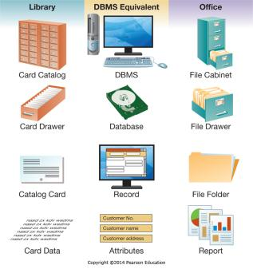
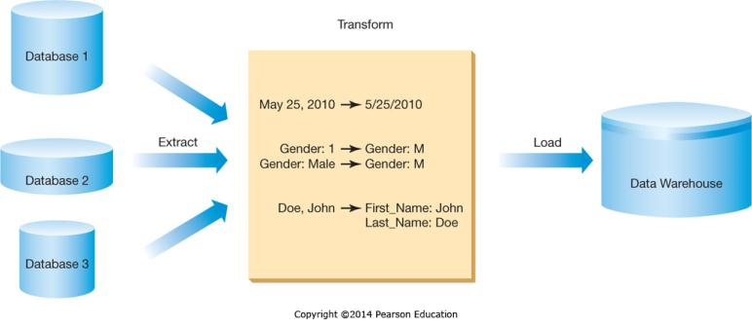
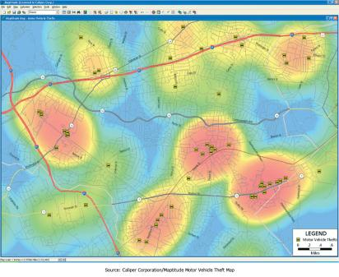
Chapter 6 - Enhancing Business Intelligence Using Information Systems
Managers need high-quality and timely information to support decision making

Slide 2
Chapter 6 Learning Objectives
Business Intelligence
Describe the concept of business intelligence and how databases serve as a foundation for gaining business intelligence.
Business Intelligence Components
Explain the three components of business intelligence: information and knowledge discovery, business analytics, and information visualization.

Slide 3
Business Intelligence
Business Intelligence
Describe the concept of business intelligence and how databases serve as a foundation for gaining business intelligence.
Business Intelligence Components
Explain the three components of business intelligence: information and knowledge discovery, business analytics, and information visualization.

Slide 4
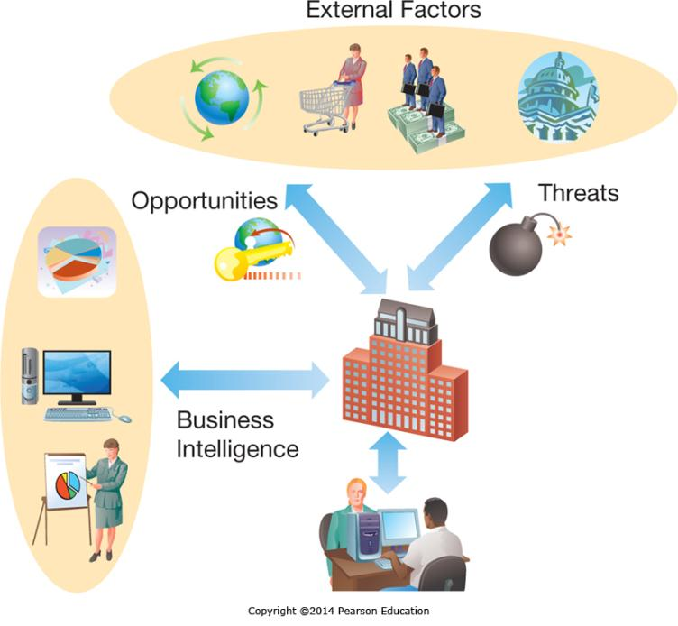
Why Organizations Need Business Intelligence: Threats and Opportunities
Notes:
External factors in the business environment, such as changes in consumer demand, competitive pressures, and changing regulations can create both threats and opportunities businesses need to respond to.
The more rapidly businesses can recognize changes and move to account for them the more competitive they will be in today’s every-changing business environment.

Slide 5
Why Organizations Need Business Intelligence: Understanding Big Data
Businesses are dealing with the challenge of “Big Data”
High Volume
Unprecedented amounts of data
High Variety
Structured data
Unstructured data
High Velocity
Rapid processing to maximize value
Notes:
Organizations face unprecedented volumes of information, both structured and unstructured, which require rapid processing and analysis to maximize its value.

Slide 6
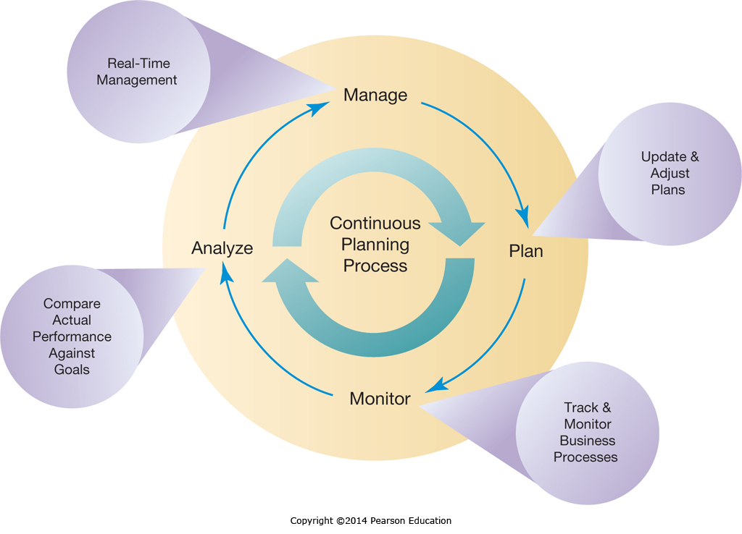
Why Organizations Need Business Intelligence: Continuous Planning
Notes:
Businesses were used to planning and executing in an annual cycle.
Now businesses are changing to a continuous planning/execution model.
This requires continuous monitoring to ensure organizations have the information to make ongoing, forward-looking adjustments and updates to business plans.

Slide 7
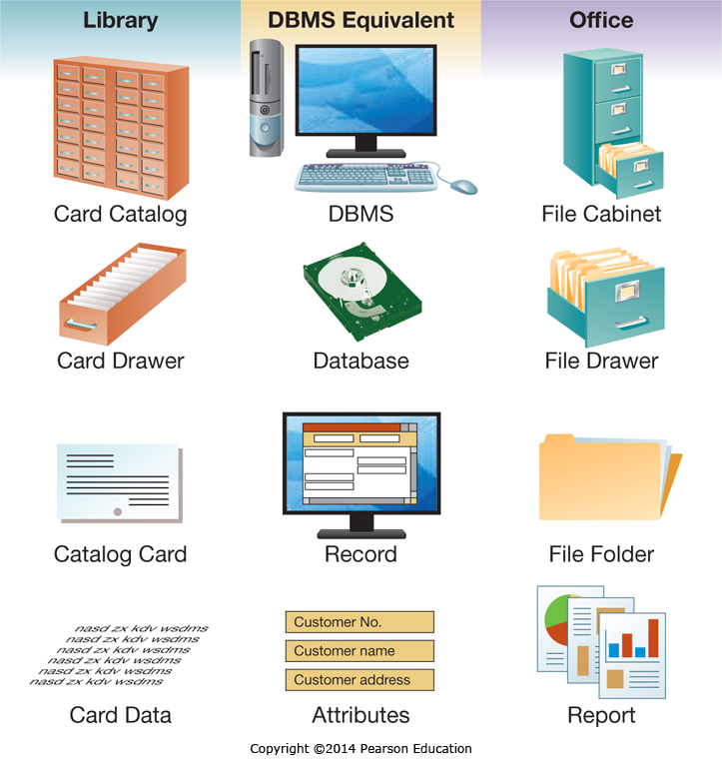
Databases: Terminology
Notes:
Databases are the digital equivalent of hierarchical paper-based filing systems.
Like an office filing system where file cabinets hold drawers, and drawers hold folders, and folders hold individual items, databases are comprised of a Database Management System which equates to the paper filing system. The DBMS manages the database, which is a store of data, much like a file drawer may contain all the files on a specific topic.

Slide 8
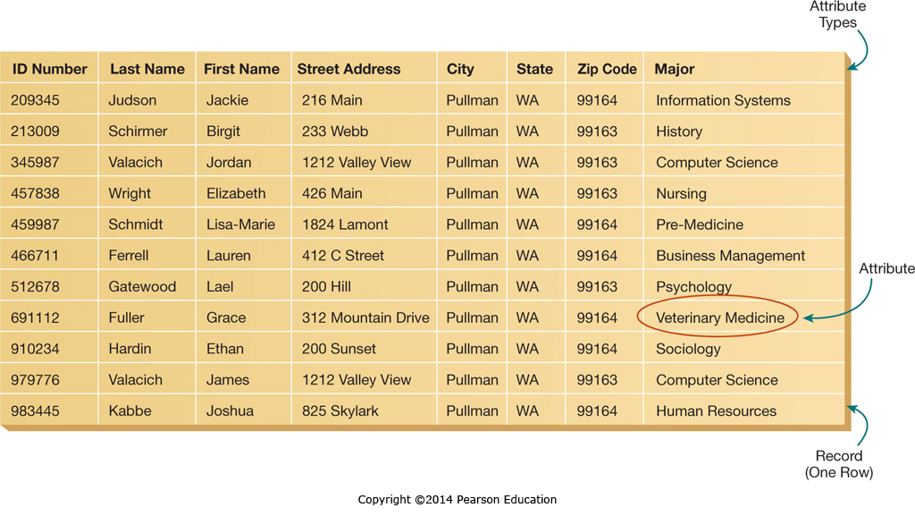
Databases: Tables and Records
Notes:
Databases are made up of one or more tables, where each table contains multiple records. The records are all of the same type, for example they may be records of students. Typically we show each record on one row of the table, and each column in the table represents a different attribute, such as the student’s street address. We generally assign a unique identifier to each record so we can readily reference it, in this case the identifier is the ID Number.

Slide 9
Databases: Advantages
Advantages | Description
Program-data independence | Programs and data are separated by the DBMS
Minimal data redundancy | There is a single copy of the data
Improved data consistency | Eliminating redundancy improves consistency
Improved data sharing | The DBMS allows sharing between programs
Application Development | Data standards simplify program development
Standards Enforcement | Centralized data management standardizes rules
Increased security | Simplifies enforcement of access restrictions
Improved data quality | Centralized control, minimized redundancy, and improved data consistency enhance data quality
Improved data accessibility | Centralized, standardized access
Reduced program maintenance | Changes in data replicate seamlessly
Notes:
Databases provide many advantages stemming from the centralized, standardized approach and the elimination of data redundancies.

Slide 10
Databases: Effective Management
The Data Model
What data will be captured
How the data will be represented
The Data Dictionary
Document of database metadata
Attribute name
Type of data
Valid values
Business rules
Notes:
When designing a database, it is important to first create a Data Model.
The data model specifies what data will be in the database, and how it will be represented. This might include the length of name fields, for example.
After the data model is complete a Data Dictionary is developed. The data dictionary specifies how the data will be implemented in the database.
It also includes any business rules affecting the data, such as how the data will be validated to ensure consistency.

Slide 11
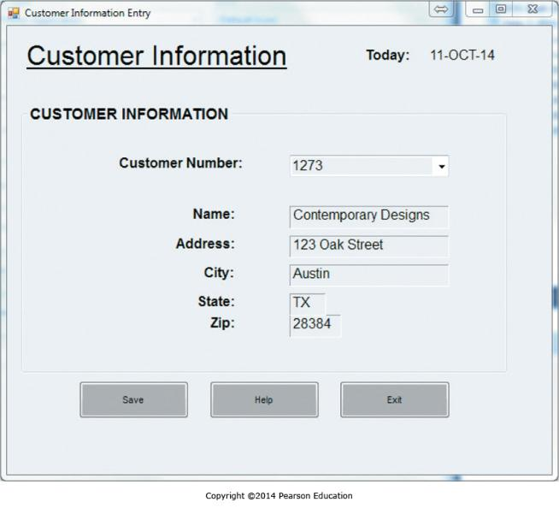
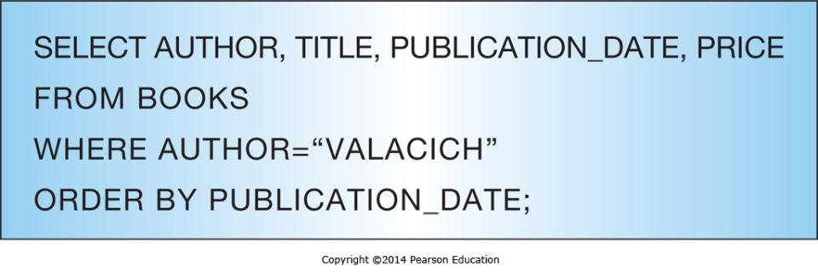
Databases: Entering and Querying Data
Notes:
Data in information systems and their underlying databases are typically managed through the use of forms.
Form can be used to enter new data, update or delete existing data, or create reports.
The systems interact with the database by sending SQL commands to the Database Management System, which then executes those commands to make the change or return the requested information.

Slide 12
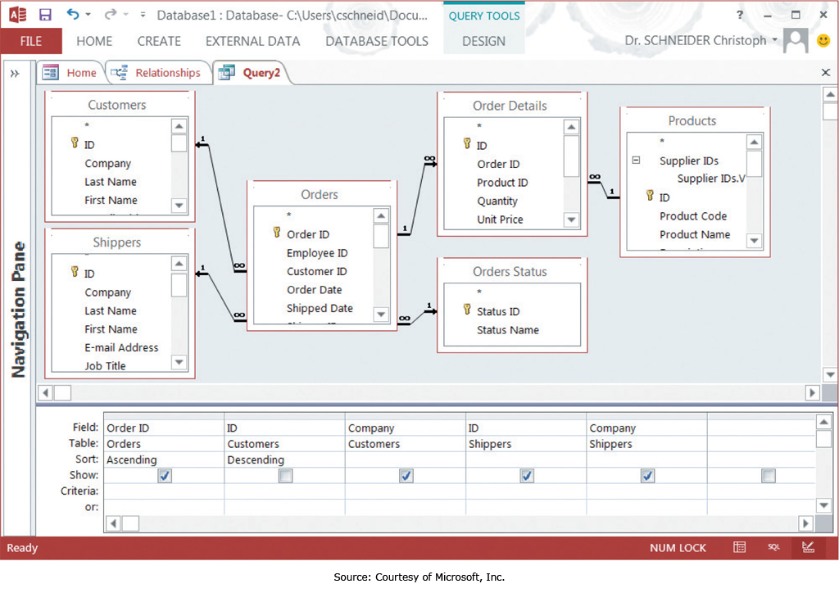
Databases: Query by Example
Notes:
When managers need ad-hoc information, they can use a “Query by Example” approach so they don’t have to learn the intricacies of the SQL language that many Database Administrators have to know.
Creating queries using a visual tool simplifies the process and lets managers directly query the database.

Slide 13
Business Intelligence Components
Business Intelligence
Describe the concept of business intelligence and how databases serve as a foundation for gaining business intelligence.
Business Intelligence Components
Explain the three components of business intelligence: information and knowledge discovery, business analytics, and information visualization.

Slide 14
Information and Knowledge Discovery: Common Reports and Queries
Report/Query | Description
Scheduled reports | Reports produced at predefined intervals—daily, weekly, or monthly—to support routine decisions
Key-indicator reports | Reports that provide a summary of critical information on a recurring schedule
Exception reports | Reports that highlight situations that are out of the normal range
Drill-down reports | Reports that provide greater detail, so as to help analyze why a key indicator is not at an appropriate level or why an exception occurred
Ad hoc queries | Queries answering unplanned information requests to support a non-routine decision; typically not saved to be run again
Notes:
There are a variety of reports and queries that managers need to have the information necessary to manage a company.
Some of these are routine and/or standardized, while sometimes unusual ad hoc reports are required to address special circumstances.
The Information Systems need to have the capability of serving all the different reports and queries needed.

Slide 15
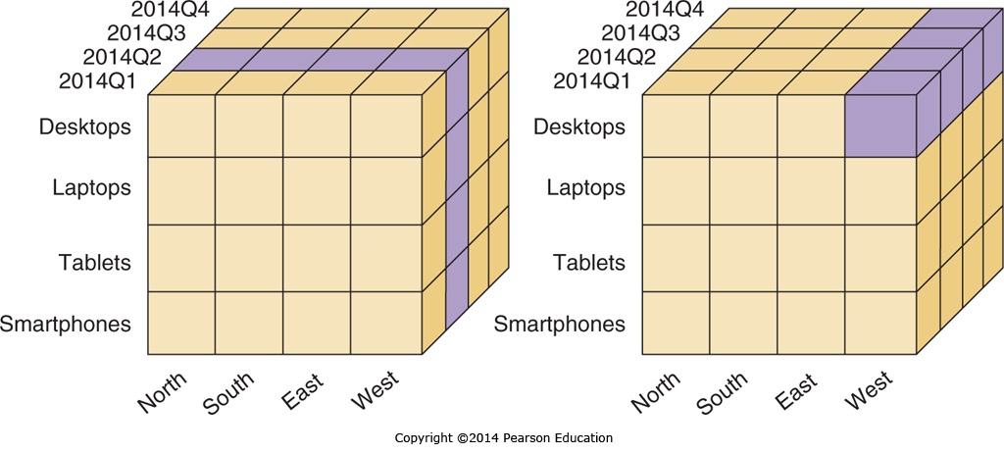
Information and Knowledge Discovery: Online Analytical Processing
Notes:
Managers often like to “drill down” to look at specific subsets of data as part of the process of understanding how the business is currently performing.
We call the different types of subsets that analysis can be narrowed on “dimensions”, and the processes of narrowing down the data “slicing and dicing”.

Slide 16
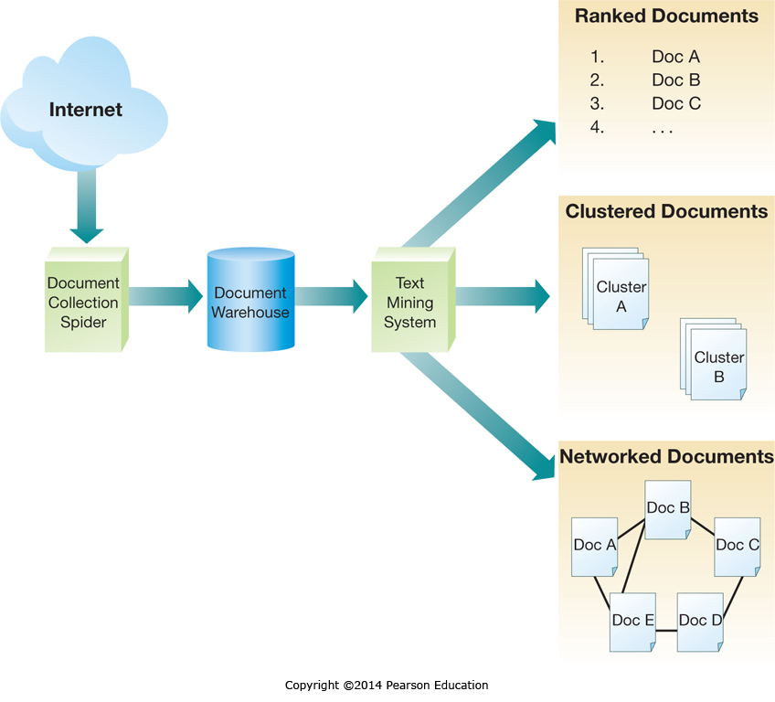
Information and Knowledge Discovery: Unstructured Data Analysis
Notes:
The Internet contains a wealth of valuable information, such as customer product reviews, that is typically unstructured and difficult to analyze.
The process of gathering and processing this unstructured data is called “text mining the Internet”, and companies that are effective at performing it can assess customer sentiment and increase customer satisfaction.

Slide 17
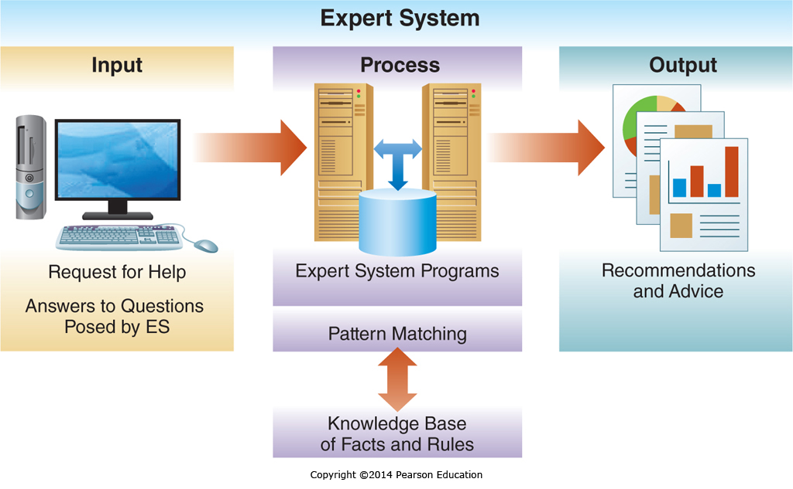
Business Analytics to Support Decision Making
Notes:
The basic systems model is composed of input, process, and output.
Decision Support systems are no different, with the inputs being the data, the processes including knowledge discovery and data analysis, and the output being reports both textual and visual.
The knowledge discovery and data analysis processes typically use multiple forms of business models to perform the analysis, such as revenue models to create sales forecasts.

Slide 18
Information Visualization
Dashboards
Comprised of Key Performance Indicator’s (KPIs)
Visual display of Summary information
Aids in situational awareness and decision making
Visual Analytics
Interactive graphics for complex analysis
Geographic Information Systems
Visualizing geographic information
Notes:
Information can be visualized through Digital Dashboards, which are similar to a car dashboard, only in this case they display the Key Performance Indicators necessary to understand how the company is operating.
Companies also use Visual Analytics to help with the comprehension and analysis of large data sets.
Finally, geographic information systems show information in the context of space and geography.

Slide 19
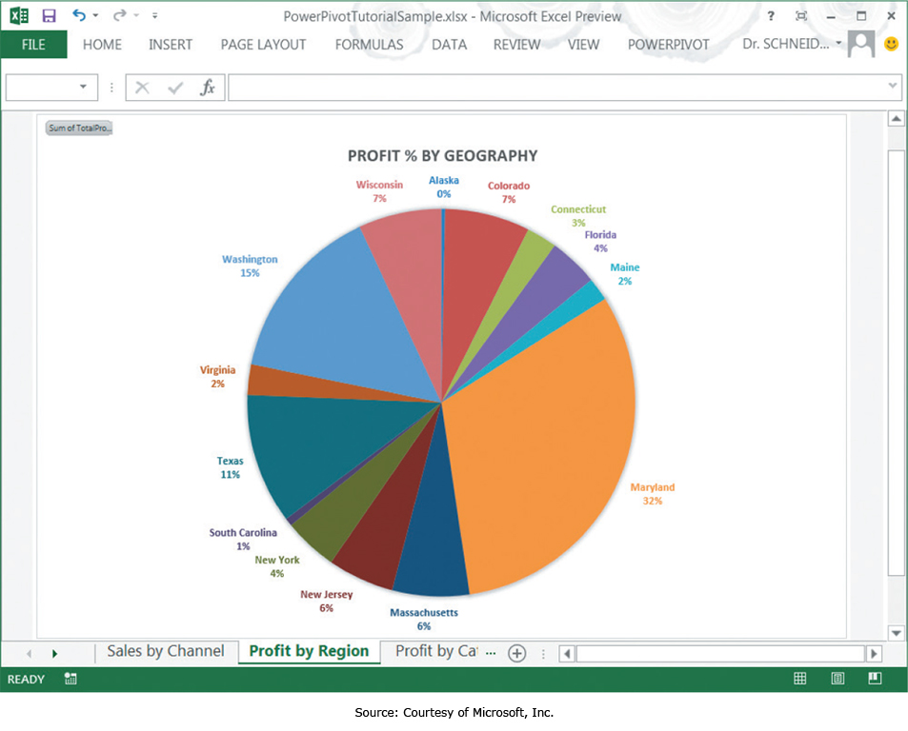
Information Visualization: Digital Dashboard of Business Data
Notes:
This is an example of a Digital Dashboard showing profits by Sales Region. Digital Dashboards often integrate analytical tools and allow users to “drill down” to ore granular data by clicking on a chart or graph.

Slide 20
Information Visualization: Geographical Data
Notes:
Geographical data is often best represented on a map, which simplifies comprehension and allows users to focus on what the data means, over putting it into specific context.

Slide 21
End of Chapter Content

Slide 22
Managing in the Digital World: FBI and CIA—Gathering Intelligence Using Social Media
Users post a wealth of information online
Companies can monitor comments and complaints about products
Government agencies can monitor public sentiment around the world
The government is developing tools to forecast key events; revolutions, upheavals, economic changes
All the data creates a Big Data problem
Companies and agencies don’t have the infrastructure to capture, process, and analyze all the available data

Slide 23
When Things Go Wrong: Twitter Fever—Where Good Conscience Meets Bad Intelligence
Twitter allows very rapid dissemination and sharing of information
People often retweet something they find touching without verifying it’s accuracy first
The shortness of Tweets also limits background and context, so information is easily distorted
Stories can gain rapid momentum regardless of truth or fact, and have damaging consequences

Slide 24
Coming Attractions: The Internet of Things
Originally the Internet had computers connected to the network
Now many non-computer devices and sensors are connected
Home sensors & appliances
Health devices
Vehicles, cars, traffic related sensors
Almost anything that can generate useful information
The Internet has had to change it’s addressing to allow so many new devices to connect

Slide 25
Brief Case: Princess D, Yoda, and Quality Assurance through Call Recording
Different customer personalities relate better to different customer service approaches
Eloyalty software can classify a customer and direct a customer service repetitive how to handle the call
This can lower call center costs by 20% as they become more productive by handling calls more appropriately

Slide 26
Ethical Dilemma: Are You Being Tracked?
Mobile Phones emit a Temporary Mobile Subscriber Identifier (TMSI)
Software known as Footpath can triangulate this TMSI and track customers as they walk through malls
This tracking can shed light on shoppers individual tastes, tapping into their shopping patterns

Slide 27
Key Players: SAS, MicroStrategy, and other Business Intelligence Leaders
Business Intelligence is becoming big business
Independent Pure Play analytic companies
SAS
MicroStrategy
Larger integrated companies
IBM
SAP
Oracle
Microsoft
Specialized companies also exist that focus on very specific aspects of Business Intelligence

Slide 28
Who’s Going Mobile: OpenStreetMap
Street maps normally come from commercial entities
Google pays companies for it’s data
Low volume users use Google for free, but Commercial users have to pay
OpenStreetMap is a community based alternative
Maintained through crowd sourcing
Users can both use and update as they go

Slide 29
Industry Analysis: Health Care
Health care providers and insurance companies are turning to Information Systems
Electronic medical records and prescriptions
Digital imaging systems
Telemedicine
Robotic surgery
Consumers are turning to Web Sites for health information
Dedicated sites such as WebMD
Social media postings related to a condition or symptoms

