Slide 1

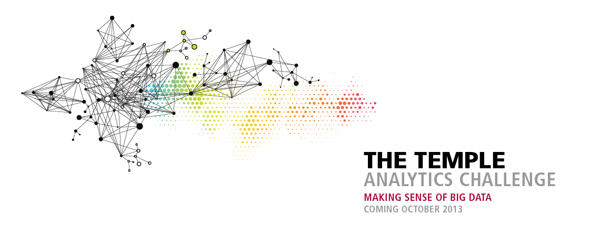
2015
ibit.temple.edu/analyticschallenge

Slide 2
University-wide/National student competition
Real-world problems for Merck / QVC / PA BAllet
Opens October 1, entries due October 30th
$10,000 in prizes for winning entries / First Prize $2,500
Use any tool. Workshops throughout October
Work in teams or individually

Slide 3

The Challenges
Will an Ebola vaccine change world heath?
Who is the best audience for cultural institutions?
Can TV and digital jointly increase sales?

Slide 4
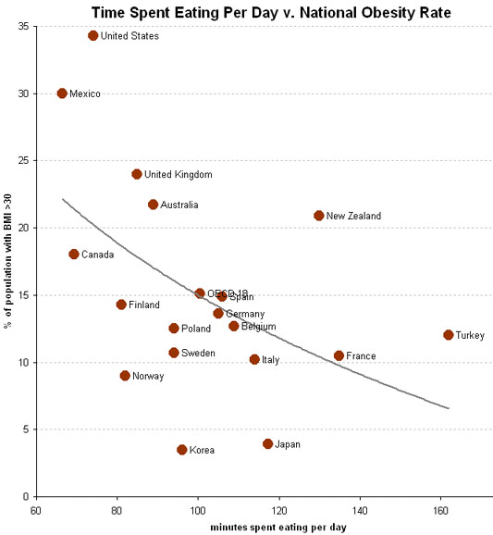
A good graphic tells a story

Slide 5
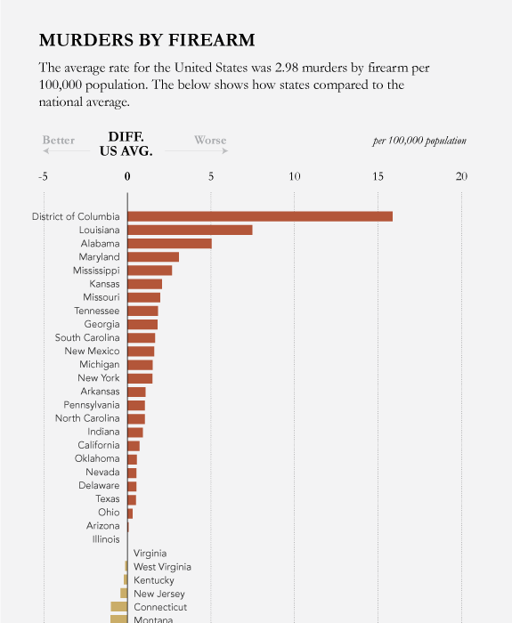
Good graphics help compare large amounts of data easily

Slide 6
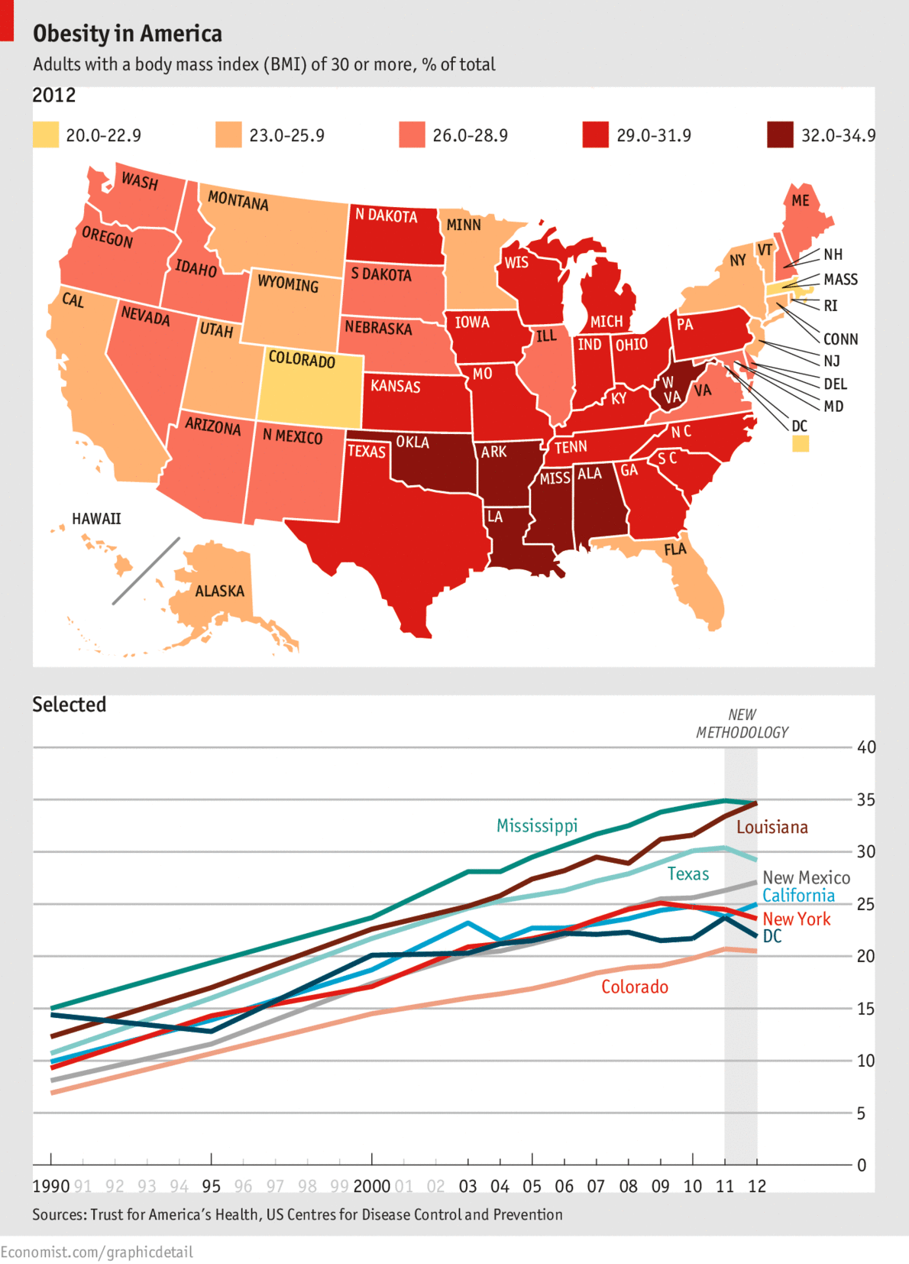
They look at data from multiple angles…

Slide 7
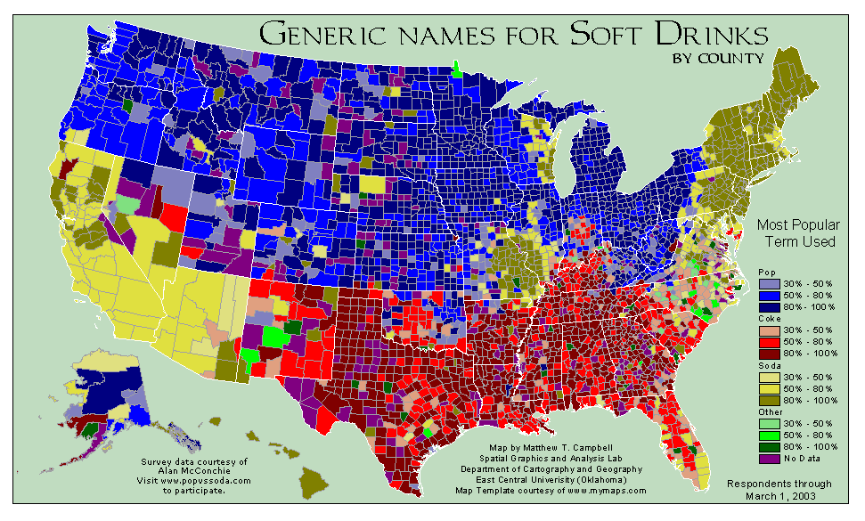
It’s also about choosing the right data…

Slide 8
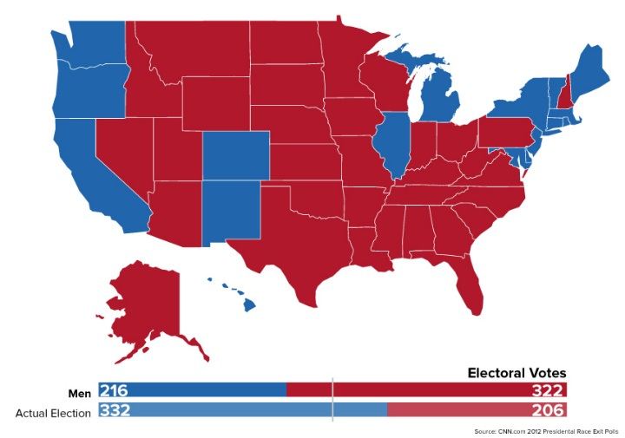
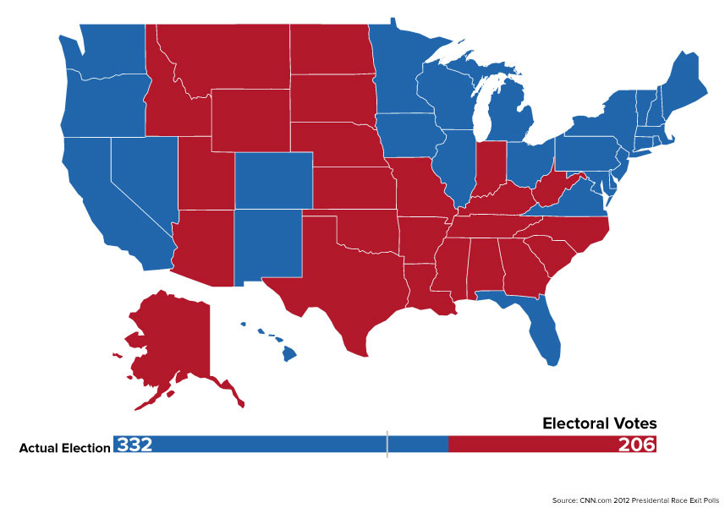
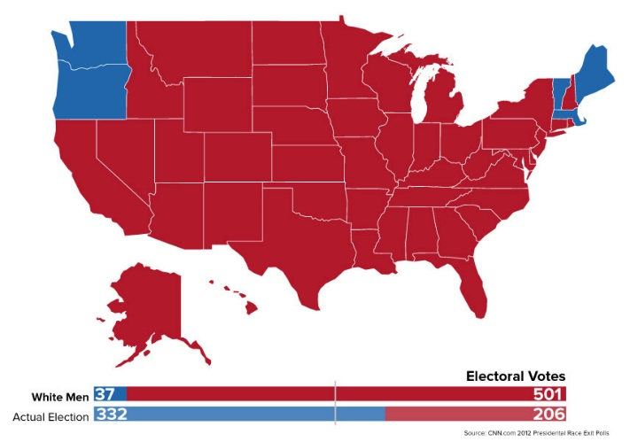
Good graphics provide meaningful insight
Under pre-1920 rules: men only
The electoral result of the 2012 election
Under 1850 rules: white men only

Slide 9
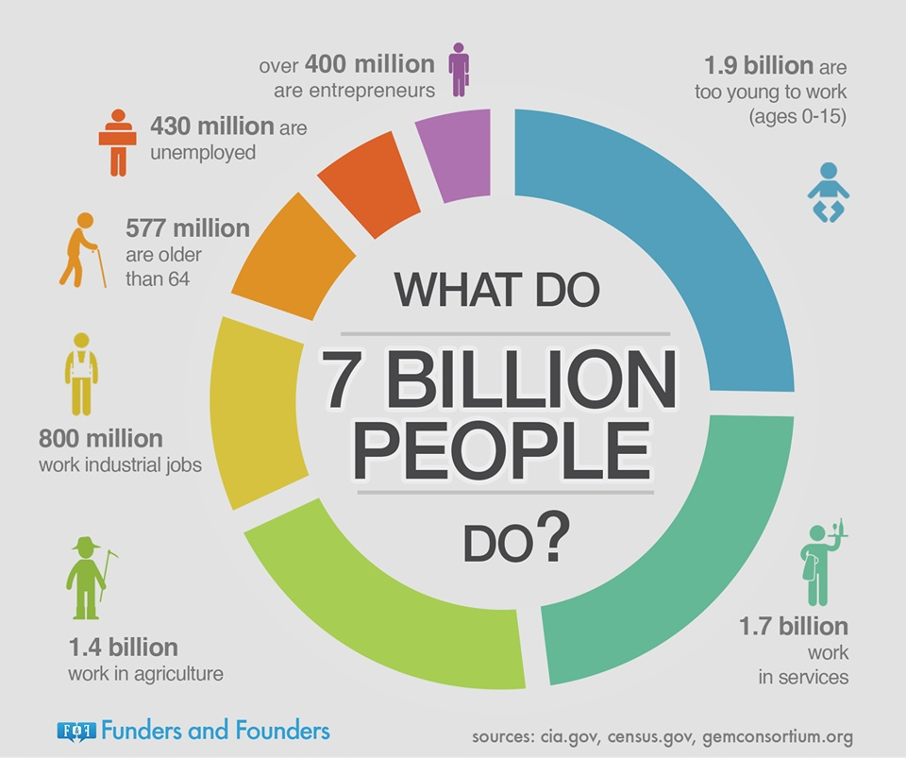
Infographics:
They can be simple

Slide 10

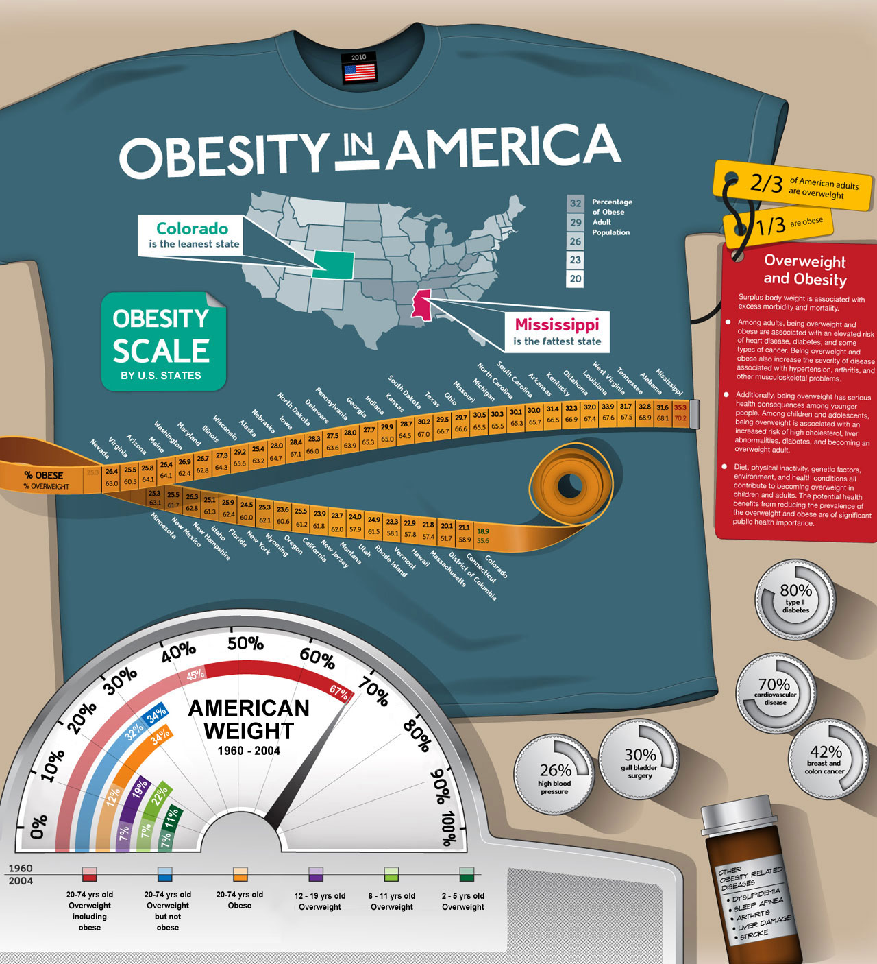
Or they can be more complex, combining several types of data

Slide 11
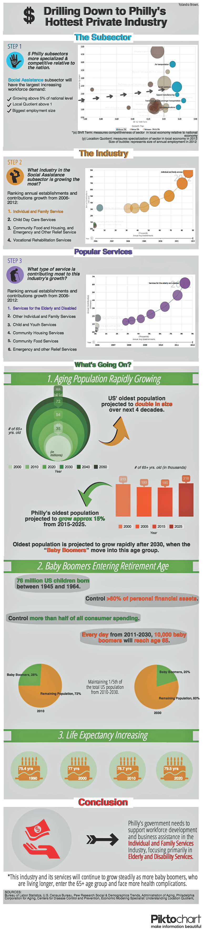
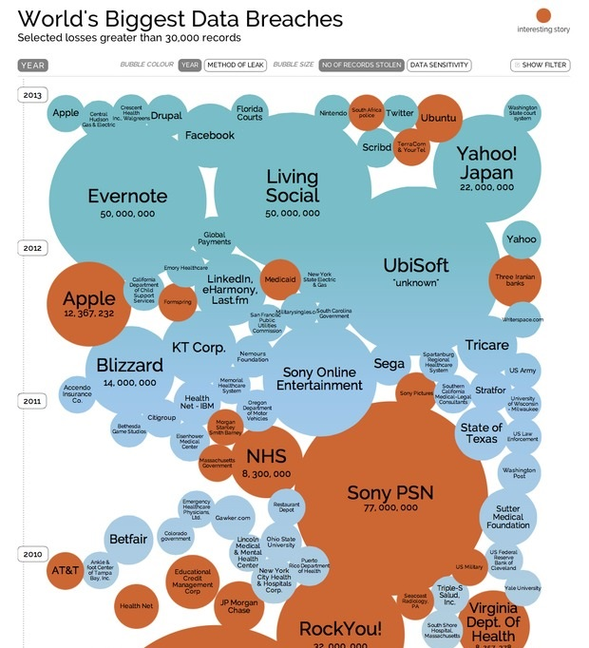
Infographics tell a story using data and images

Slide 12
For more information, visit
ibit.temple.edu/analyticschallenge

