Slide 1
Enterprise Cloud Computing
Computing On Demand

Slide 2
Enterprise Cloud Computing
Technology as a “utility”
Capital Expenditures become Operating Expenditures
Enables universal, global, & mobile collaboration
Source: http://www.dailytech.com/Cloud+Computing+Changing+IT+in+Small+Business+World/article33635.htm

Slide 3
Big Players in Cloud Computing
Amazon Web Services (AWS)
Google Cloud Platform
Oracle
And many others

Slide 4
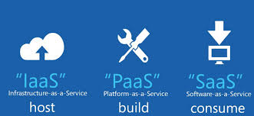
Cloud Computing Models
IaaS: Infrastructure as a Service
PaaS: Platform as a Service
SaaS: Software as a Service
Various other models exist (XaaS)

Slide 5
IaaS, PaaS, SaaS Explained
IaaS: “host” – you pay for the infrastructure but you are responsible for all application development and deployment and support activities.
PaaS: “build” – you pay for the infrastructure and for a developing platform that supports many areas of deployment so you can just focus on programming your application.
SaaS: “consume” – you pay for an entire solution that is fully built, deployed, and distributed over the web for you to consume on demand. You have no infrastructure, development, deployment, or support responsibilities.

Slide 6
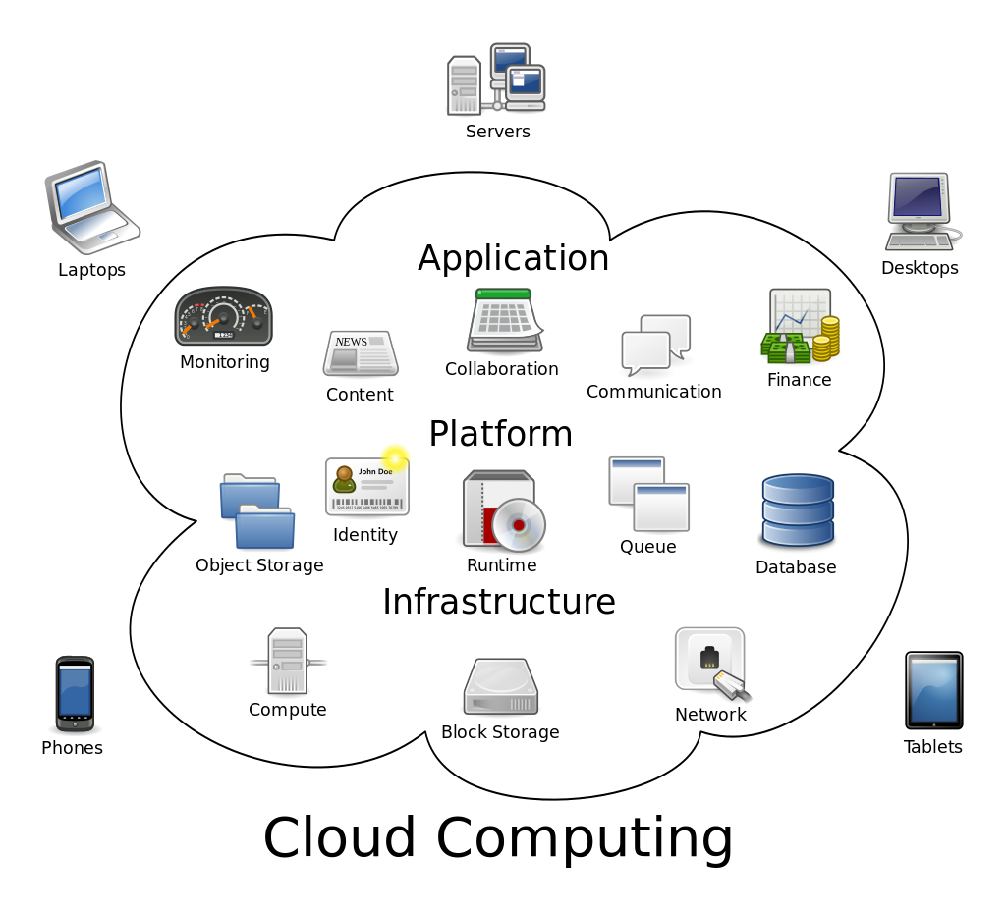

Slide 7
Which environment would be best if you need a simple, rapid, high-availability solution to answer a standard business problem?
Which environment would be best if your use case requires a lot of customization and proprietary code to support a unique business model, and you have a big budget and plenty of developing, back-end, and support talent?
Which environment would be best if you need to rapidly deploy your own application but need the support of a developing environment and automated support to your code?

Slide 8
IaaS (Infrastructure as a Service)
“Online services that abstract user from the detail of infrastructure like physical computing resources, location, data partitioning, scaling, security, backup, etc.”
The user is responsible for installing and maintaining the operating system and the application software.
Pay for resources allocated and consumed, much like a utility service.

Slide 9
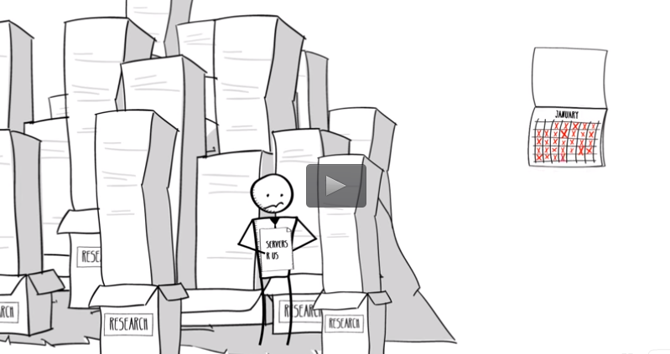
IaaS: Amazon Web Services: EC2
The gold standard in IaaS
Many services you use run on AWS
Hundreds of success stories
Click image to watch demo

Slide 10
AWS Case Study: Johnson & Johnson
Click image to watch video

Slide 11
AWS Case Study: Johnson & Johnson
What we learned from watching the video:
What are J&J main product offerings (pharmaceuticals and medical devices)
How J&J have achieved global growth (M&A)
Forces in the competitive landscape: demand for efficiency, transparency, healthcare reform, emerging markets (Sounds like Michael Porter 5 Forces)
What AWS did for J&J’s technology architecture (hard and soft benefits?)
Servers on demand & Virtualization
Compliance with FDA, HIPPA, CMS
Insights (how does big data create value by providing insights?)
BYOD trend

Slide 12
AWS Case Study: Netflix
<< Click image to watch video
Questions based on the video:
How has AWS solved Netflix’s technology needs?
What are virtualization instances?
What are the benefits of scalability in architecture?
What are some other potential uses for web services?

Slide 13
Google Cloud Platform: Compute Engine
Built on the same infrastructure as Google search engine, Gmail, YouTube: “Powered by Google”
Scalable virtualization on demand
Pay per consumption, like a utility, cents per hour of usage
Each virtual machine instance is equipped with resources like disk, network, firewall, etc.

Slide 14
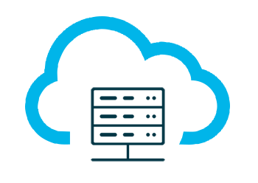
PaaS (Platform as a Service)
Build and deploy applications to the web quickly and without the significant capital expenditures and complexity of investments in infrastructure and support layers
Platform includes security layers, databases, operating systems, and developing/execution environments
Rapid deployment
Automatic Scaling
Integration with developing tools
Pay for what your application consumes

Slide 15
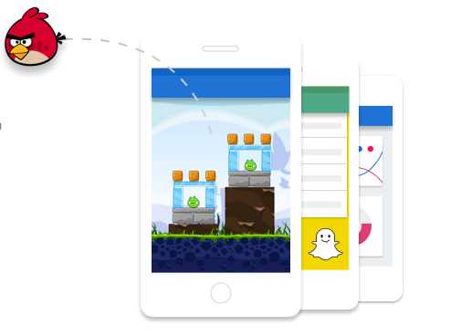
PaaS: Google App Engine (2008)
The gold standard in PaaS
Supports Python, Java, PHP, and Go
Includes free quotas
Pay per application consumption
Hundreds of apps built and deployed

Slide 16
GCP Case Study: Snapchat
<< Click image to watch video
Snapchat has been valued at ~$15 Billion
All it offers is an app to share temporary, fleeting images
Why is scalability so important?
How might demand surge during events like Superbowl, Academy Awards, Elections, etc.?

Slide 17
PaaS: AWS Elastic Beanstalk (2011)
Launched 3 years after (and in response to) Google App Engine
Supports more programming languages than Google
Uses similar quotas and pay per consumption model
Click image to watch demo

Slide 18
SaaS (Software as a Service)
Cloud based software
Central, multi-tenant or virtualization architecture supports scalability
Distributed via web browsers; available anywhere with an internet connection
Compatible with multiple operating systems and devices
Easy to use, collaborate, update, and sync
Revenue model is subscription based

Slide 19
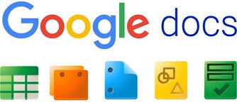
Examples of SaaS
SalesForce
CRM tool
NetSuite
CRM and ERP combined service
Constant Contact
Marketing automation tool
GoToMeeting
Conferencing solution
Google Docs
Collaboration tool
DropBox
Storage solution
Adobe Creative Cloud
Suite of creative solution
Microsoft 365
Suite of creative solutions

Slide 20
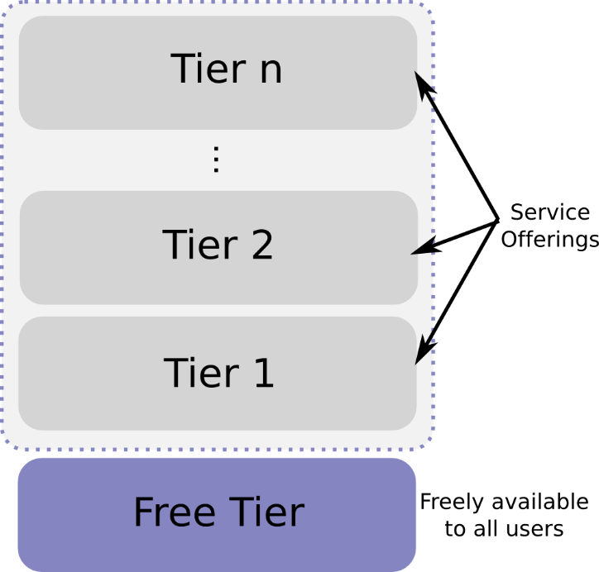
SaaS Subscription Types
Monthly billing
Term billing
Freemium: limited version free forever (usually very low conversion rate)
Free Trial: full version free for a period (conversion rates should be higher)
Paywall: similar to free trial, content blocked by quota
Freemium

Slide 21
Bibliography
https://en.wikipedia.org/wiki/Cloud_computing#Infrastructure_as_a_service_.28IaaS.29
http://searchaws.techtarget.com/news/2240232700/Google-PaaS-has-a-leg-up-on-AWS-Elastic-Beanstalk
https://aws.amazon.com/solutions/case-studies/netflix/
https://aws.amazon.com/solutions/case-studies/johnson-and-johnson/
http://www.businessinsider.com/snapchat-is-built-on-googles-cloud-2014-1
https://www.expeditedssl.com/aws-in-plain-english
https://cloud.google.com/compute/
https://en.wikipedia.org/wiki/Google_Compute_Engine
http://sixteenventures.com/freemium-or-free-trial

