Slide 1
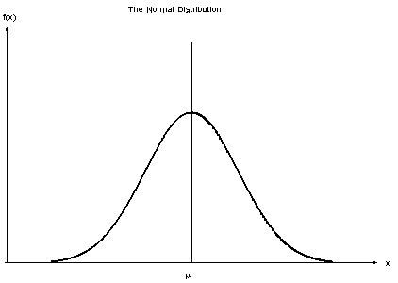
Normal Distribution
J. C. F. Gauss
Cental Limit Theorem
Symmetry around μ
μ is the confluence of the mean, median, and mode of the data and splits the data in half

Slide 2
Pareto Principle (80/20 Rule)
80% of output comes from 20% of producers
20% of peapods produce 80% of peas
20% of inventory produces 80% of sales
20% of customers produce 80% of sales
20% of people own 80% of wealth
20% of people consume 80% of resources
20% of time spent working produces 80% of work produced (time management)

Slide 3
Pareto Principle (80/20 Rule)
Problems:
It doesn’t always apply
It is a pre-information age model

Slide 4
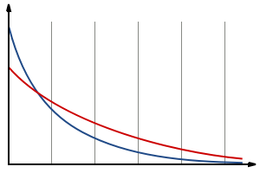
Long Tail Distribution
Variety > bestsellers
Netflix
Amazon
iTunes
There’s money in the tail
Advertising products
Google
Yahoo
Bing
Travel bookings
How does a company “fatten the tail?”

Slide 5
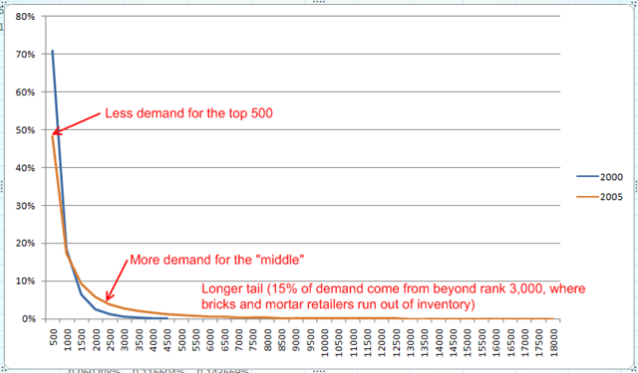
Netflix Long Tail
“…gets most of its profits from a large number of infrequently requested movies rather than from few large and profitable movies.”

Slide 6
In Class Activity
If link doesn’t work, go to
http://www.boxofficemojo.com/yearly/chart/?page=1&view=releasedate&view2=domestic&yr=2015&p=.htm

Slide 7
Results
Title | Rank | Gross Sales
Jurassic World | 1 | $652,071,496
Ant-Man | 10 | $179,527,466
Taken 3 | 25 | $89,256,424
McFarland USA | 50 | $44,482,410
Ex Machina | 75 | $25,442,958
Testament of Youth | 150 | $1,822,250
The Hunting Ground | 225 | $405,917
Cambodia | 300 | $133,443
Charlie's Country | 375 | $42,937
Eastern Boys | 450 | $16,831
The Riot Club | 525 | $6,041
United Passions | 600 | $607

Slide 9
Analysis
Average | $ 13,618,695.42
Median | $ 130,162.50
Mode | $ 2,710.00
Top Movie | $ 652,071,496.00
Movies 80 through 604 (524 movies) | $ 656,358,114.00
Movies 1 through 17 (17 movies) | $ 4,097,664,448.00
Movies 17 through 604 (587 movies) | $ 4,128,027,585.00

Slide 10
Bibliography
http://epilepsygenetics.net/2013/03/14/the-pareto-principle-versus-the-long-tail/
http://google.about.com/od/googleforbusiness/f/longtailfaq.htm
http://www.longtail.com/the_long_tail/
http://www.boxofficemojo.com/yearly/chart/?page=1&view=releasedate&view2=domestic&yr=2015&p=.htm

