Slide 1
Trends in Technology
The Consumer Electronics Association (CEA) has announced its
5 Technology Trends to Watch for 2015

Slide 2
Big Data

Slide 3
Big Data
Insurance underwriting based on monitoring
Credit rating based on indicators
Purchase habits
iBeacon – shopping behavior
How we talk it (plain English, please!)
Unstructured data
So many sources

Slide 4
Big Data: Analytics
^ Click image to watch video

Slide 5
Big Data: Analytics
If Muhammed will not go to the mountain, the mountain will go to Muhammed.
Bring the processors to the data instead of bringing the data to the processors.

Slide 6
Big Data: Analytics
Parallel Processing
ETL (Extract, Load, Transform)
Evolution of data generation
MapReduce
Social
Mobile
Weblog
Sensors
Monitors
Satellite
Employees, Companies
Consumers, Web 2.0
Machine- generated
?

Slide 7
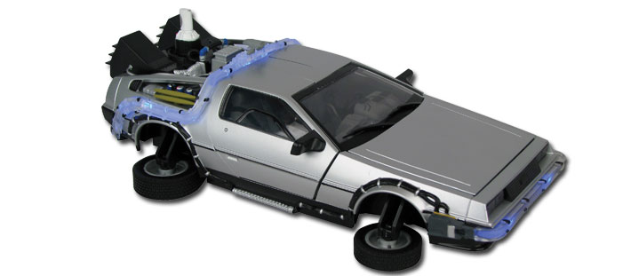
Robotics
Roads? Where we’re going, we don’t need roads.
Autonomous cars
Drones
Cleaning robots (Roomba)
MobileEye
Automated pet care
Lawn and garden robots
Robots for child care?

Slide 8
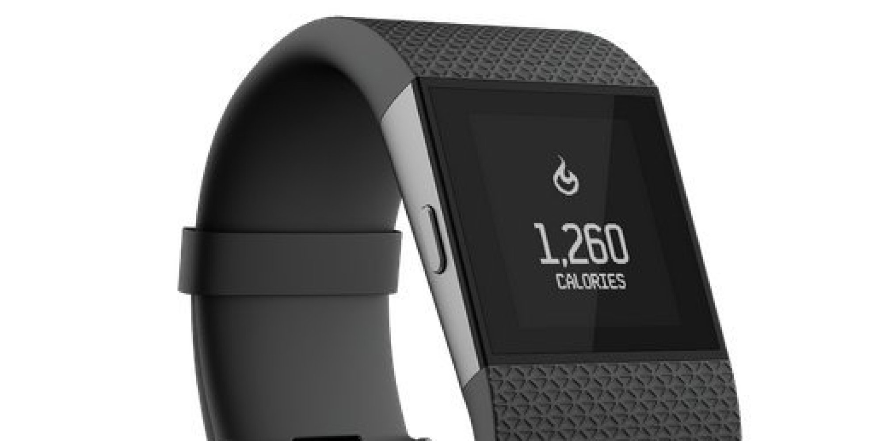
Digital Health & Self Monitoring
FitBit
Apple Watch
Insulin pump
Seizure-monitoring app

Slide 9
Entertainment, Gaming, & Immersion
D-Box entertainment theatres simulate motion & feel
Guitammer Company and ESPN2 broadcast in 4D
Simulate feel, look, sound, and vibration of the experience
Experience the game from the player’s perspective
Kinect
Wii
Project Holodeck
Oculus Rift virtual reality
^ Click image to view link

Slide 10
Fantasy Sports
Great for:
Live viewership
Advertising
Content Providers
Real money in imaginary games

Slide 11
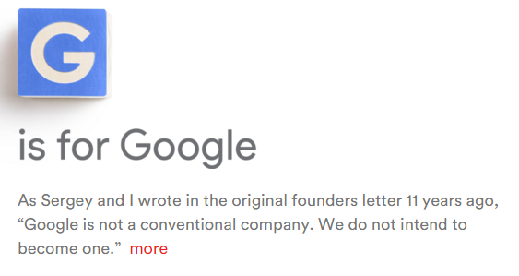
Business Innovation
Scalability
Lower barriers of entry
Lower switching costs
Network effect
Increasing returns to scale
Shift to services
Think of SaaS
Software > hardware
Multi-sided platforms
Uber
App Dev
Big companies need to think about how they innovate
Alphabet as an example
Open Innovation as a model

Slide 12
Bibliography
http://www.usatoday.com/story/sports/2015/01/01/daily-fantasy-sports-gambling-fanduel-draftkings-nba-nfl-mlb-nhl/21165279/
http://www.stuff.tv/news/five-mind-blowing-new-gaming-technologies-coming-soon
http://www.cepro.com/article/ceas_5_tech_trends_for_2015_from_immersive_entertainment_to_disruptive_busi/D2/

