Slide 1
Information Systems in Organizations 2.1 Analyzing organizations as systems and processes

Slide 2
Course Topics Overview
Unit 1: Introduction
Unit 2: Systems Analysis
Unit 3: Organizational Systems
Unit 4: Consumer Systems

Slide 3
Unit 2: Systems Analysis
2. Systems analysis: what makes a system tick?
2.1. Analyzing organizations as systems and processes
2.1.1. Process decomposition: swim lane diagrams
2.1.2. Data modeling: entity relationship diagrams
2.2. Systems architecture: devices, network, data, apps
2.2.1. Visualizing architecture: conceptual diagramming
2.2.2. Ex. of legacy, contemporary, and future information systems

Slide 4
?
Problem Solving Technique
Business Process
What is the problem?
What is “systems analysis”?
What is “systems architecture”?
What is the solution?
Modeling
Decomposition

Slide 5
Systems Analysis
"Systems analysis is a problem solving technique that decomposes a system into its component pieces for the purpose of the studying how well those component parts work and interact to accomplish their purpose" - Wikipedia[
"the process of studying a procedure or business in order to identify its goals and purposes and create systems and procedures that will achieve them in an efficient way“ – Merriam-Webster Dictionary
So what does a systems analyst do?

Slide 6
Concepts in Systems Analysis
Data Model
Database

Slide 7
Concepts in Systems Analysis
Feasibility Study
Scope Definition
Problem Analysis
Requirements Analysis
Requirements Gathering
Logical Design
Decision Analysis
User Experience Planning
Waterfall Model
Phased Approach

Slide 8
Systems Architecture
Systems Architecture is a generic discipline to handle objects (existing or to be created) called "systems", in a way that supports reasoning about the structural properties of these objects. Systems Architecture is a response to the conceptual and practical difficulties of the description and the design of complex systems. – Boris Golden
Once a systems analyst understands the business problem, they architect a solution

Slide 9
Systems Architecture
A Blueprint for Action
Planning
Design
Procurement Build
Installation
Configuration
Testing
Roll out

Slide 10
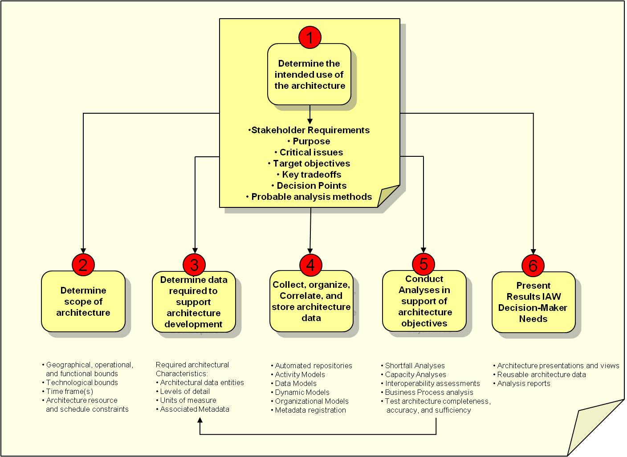
DoDAF

Slide 11
SDLC
Plan
Analyze
Design
Build
Maintain

Slide 13
SDLC
Initiate
Conceptualize
Plan
Analyze
Design
Develop
Integrate
Test
Implement
Roll Out
Maintain
Dispose

Slide 14
?
How is a process performed?
What happens after?
When do they do it?
What is a “swim lane diagram”?
What happens before?
Who does what?

Slide 15
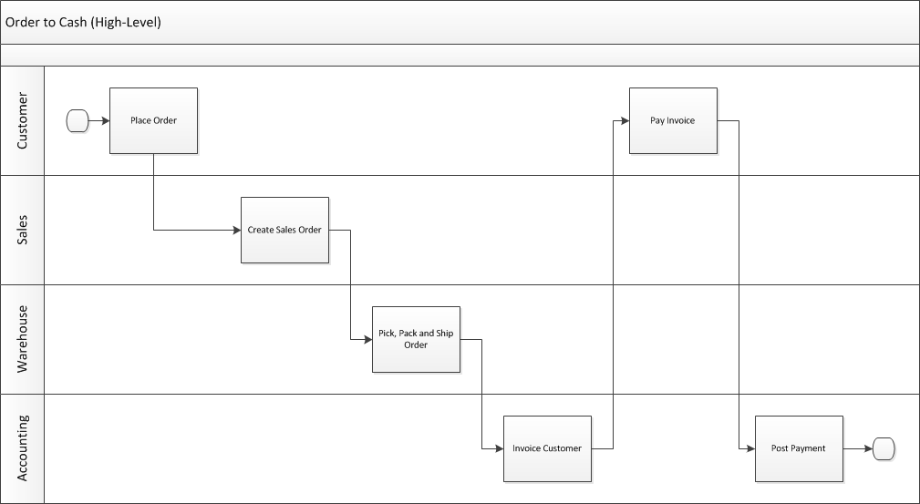
Swim Lane Diagram Who does what and when?
Notes:
This high-level diagram basically shows who does what and when as part of the order to cash process. On the next slide we will have a much more detailed diagram.

Slide 16
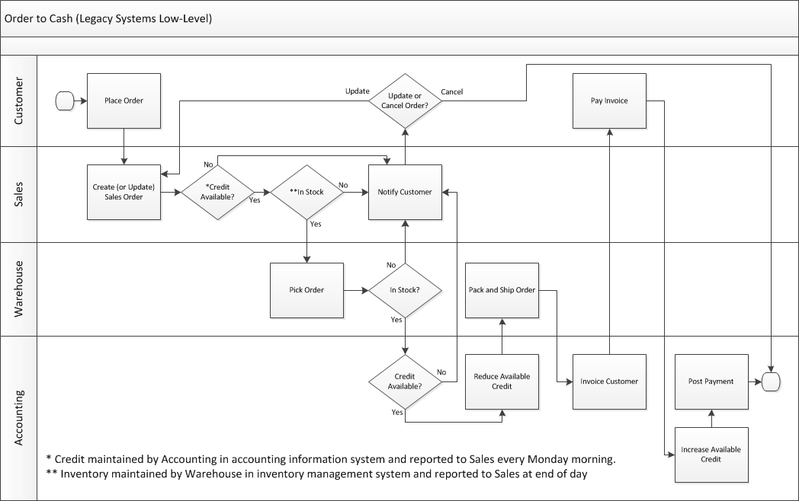
Notes:
This more complex swim lane diagram will be used again when we cover ERP systems. This represents the O2C process when they still used separate legacy systems for order processing, order fulfillment and accounting. While each of these separate systems made each team more efficient, they don’t optimize the process for the organization as a whole. There is lots of non-value added work in here which are a result of these legacy systems.
The biggest issues have to do with maintaining credit limits in the accounting information system and sending a report to Sales about credit limits every Monday morning. The credit information gets stale and Sales is possibly accepting orders and picking orders (only to be stopped before the order is packed and shipped) from customers who have over-extended their credit or denying sales to customers who have paid their bills.
The other issue is that inventory is maintained by the Warehouse in the inventory management system and sending reports to Sales at the end of every day. Sales may be selling inventory that was already sold earlier in the day.
The purposed of this slide is to show the students a more complex swim lane diagram and to show that it can clearly document a more complex process. We can introduce the story of this dysfunctional O2C process here and then come back to it during the ERP section of the course.

Slide 17
?
Entity = Noun
Attribute = Characteristic
What is an “entity relationship diagram”?
Data Model
Relationship = Verb

Slide 18
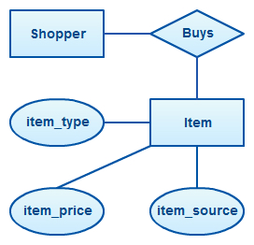
Entity Relationship Diagram (ERD)

Slide 19
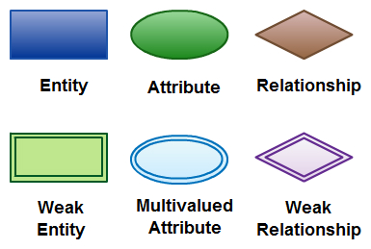
Primary ERD Symbols

Slide 20
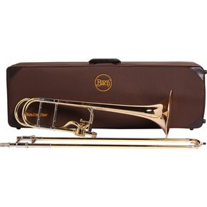
Inventory Item Attributes
ID
Name
Description
Unit of Measure
Weight
Serial #

Slide 21
Inventory Item Attributes
Internal ID
Name
Display Name
Description
Purchase Description
Vendor Name
Store Display Name
Store Description
Units Type
Stock Unit
Purchase Unit
Sale Unit
Display in Web Site
Purchase Price
Preferred Vendor
Base Price
List Price
Online Price
Income Account
Asset Account
Expense/COGS Account
Costing Method
On Special
Tax Schedule
On Hand
Available
On Order
Committed
Back Ordered
Reorder Point
Preferred Stock Level
Reorder Multiple
Drop Ship Item
Special Order Item
Copy SO Description
Weight
Weight Units
Class
Business Unit
Date Created
Last Modified

Slide 22
Unit 2: Systems Analysis
2. Systems analysis: what makes a system tick?
2.1. Analyzing organizations as systems and processes
2.1.1. Process decomposition: swim lane diagrams
2.1.2. Data modeling: entity relationship diagrams
2.2. Systems architecture: devices, network, data, apps
2.2.1. Visualizing architecture: conceptual diagramming
2.2.2. Ex. of legacy, contemporary, and future information systems

