Slide 1
Information Systems in Organizations 2.2 Systems Architecture: Devices, Network, Data and Apps

Slide 2
Course Topics Overview
Unit 1: Introduction
Unit 2: Systems Analysis
Unit 3: Organizational Systems
Unit 4: Consumer Systems

Slide 3
Unit 2: Systems Analysis
2. Systems analysis: what makes a system tick?
2.1. Analyzing organizations as systems and processes
2.1.1. Process decomposition: swim lane diagrams
2.1.2. Data modeling: entity relationship diagrams
2.2. Systems architecture: devices, network, data, apps
2.2.1. Visualizing architecture: conceptual diagramming
2.2.2. Ex. of legacy, contemporary, and future information systems

Slide 4
?
Sell the idea
Refined Later
Marketing View
What is “conceptual diagraming”?
Big Picture
Guide the Architect
Informal/Lightweight

Slide 7
?
Examples of Conceptual Diagrams?
Also known as “Concept Maps”
Notes:
Class exercise. Sketch out a conceptual diagram describing a system that could support the automation of the process you sketched out last week.

Slide 8
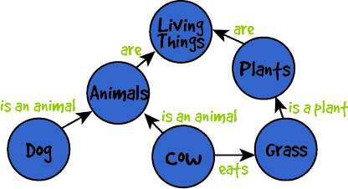
Concept Diagram (Concept Map)

Slide 9
Concept Diagram (Concept Map)

Slide 10
Payment
Customer
Vendor
Item
Network
Agency
Notes:
Let’s think through some of the relationships between these objects.
A customer orders or buys an item
A vendor stocks and sells an item
A vendor orders an item from a supplier (also a vendor)
A customer makes a payment to the vendor
A vendor collects payment
More involved: a sales clerk collects a payment, a manager sends a batch to HQ, an accountant posts payments and sales to GL
A customer may review the item or vendor in a network or on social media
A vendor may use an agency to promote items, reach new customers, or send defaulted accounts to collections

Slide 11
?
How have healthcare IT systems evolved over the years?

Slide 12
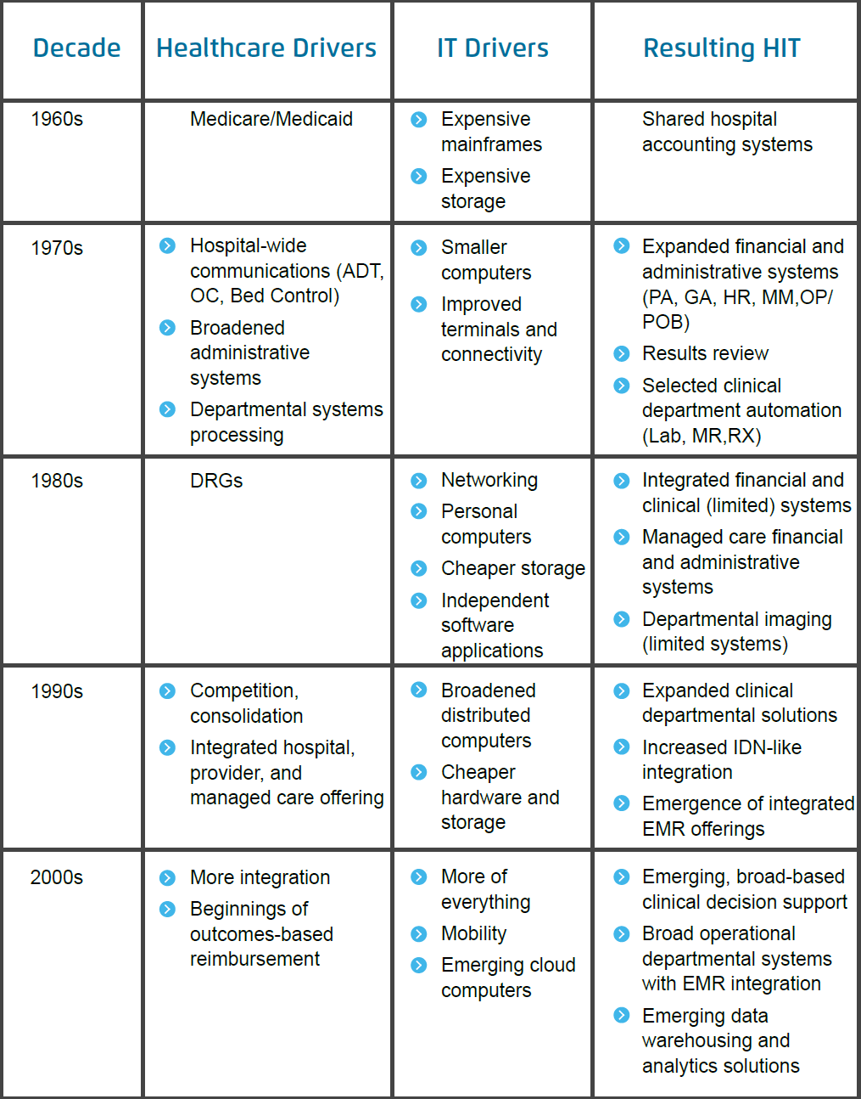

Slide 13
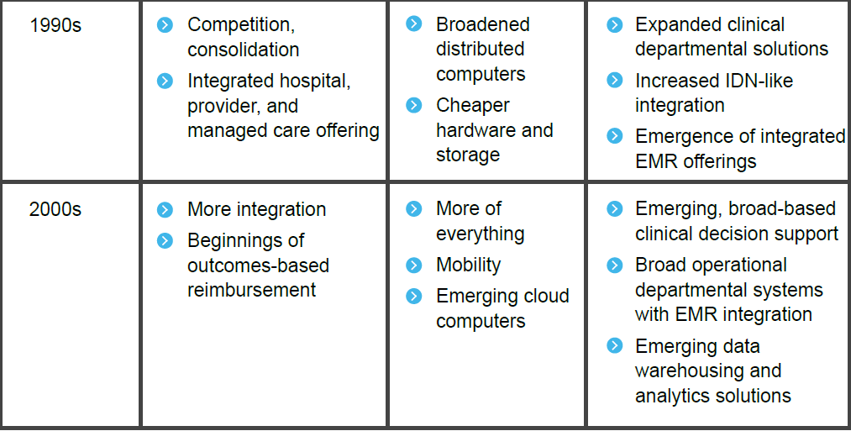

Slide 14
Evolution of Computing Technology
Mainframe
PC
Mobile
?
Big machines requiring own room or warehouse. Heavy, clunky, slow input, process, & output speeds
Distributed office network comprised of personal computers and local or remote servers. Improved speed.
Globally connected network comprised of fast mobile devices. “Invisible” servers. Nimble and lightweight.
A.I.?

Slide 15
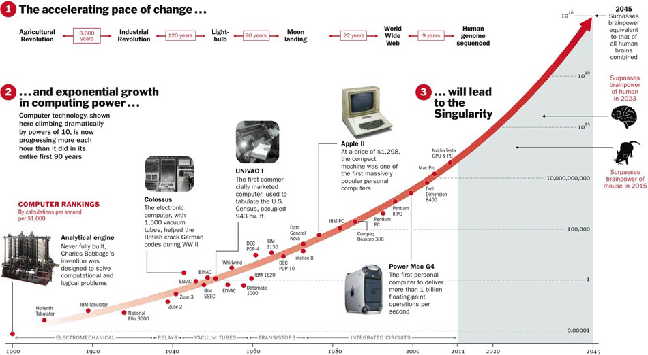
Moore’s Law

Slide 16
?
How have the systems that support a major university evolved over the years?
Notes:
This is a class discussion. Show your age. Describe the systems that were in place for the university you attended as an undergrad. How did you register for classes? How did you get your grades? Etc. What did these systems do and how did they help the university.
Now talk about the systems the students use today and discuss how they have evolve and the benefits we have today.

Slide 17
Unit 2: Systems Analysis
2. Systems analysis: what makes a system tick?
2.1. Analyzing organizations as systems and processes
2.1.1. Process decomposition: swim lane diagrams
2.1.2. Data modeling: entity relationship diagrams
2.2. Systems architecture: devices, network, data, apps
2.2.1. Visualizing architecture: conceptual diagramming
2.2.2. Ex. of legacy, contemporary, and future information systems

