Slide 1
Information Systems in Organizations
3.1.1 Running the Business: Enterprise Systems (ERP)

Slide 2
Course Topics Overview
Unit 1: Introduction
Unit 2: Systems Analysis
Unit 3: Organizational Systems
Unit 4: Consumer Systems

Slide 3
Unit 3: Organizational Systems
How do large firms function today?
3.1. Types of systems in organizations
  3.1.1. Running the business: enterprise systems (ERP)
  3.1.2. Managing the business: decision-making (analytics, BI, dashboards)
  3.1.3. Growing the business: knowledge management, R&D, and social business

Slide 4
Unit 3: Organizational Systems
3.2. Systems management
  3.2.1. Business analysis, requirements, and systems acquisition
  3.2.2. Developing systems: programming, testing, and deployment
  3.2.3. Systems integration: standards, interoperability, and external collaboration
  3.2.4. Managing risk: security, hackers, and privacy

Slide 5
Unit 3: Organizational Systems
3.3. Digital business innovation
  3.3.1. Generating IT value
  3.3.2. Competitive advantage of digital business models

Slide 6
?
Business processes that span multiple functional areas
Change
Risks
Central Database
Costs
Executive Support
What is an ERP system?
Business Intelligence
Single view of data
Many modules
Integration Partner
Benefits
SAP, Oracle and Microsoft
Single System
Notes:
Get students talking about ERP systems. Focus on business processes like order-to-cash and purchase-to-pay that span multiple functional areas.

Slide 7
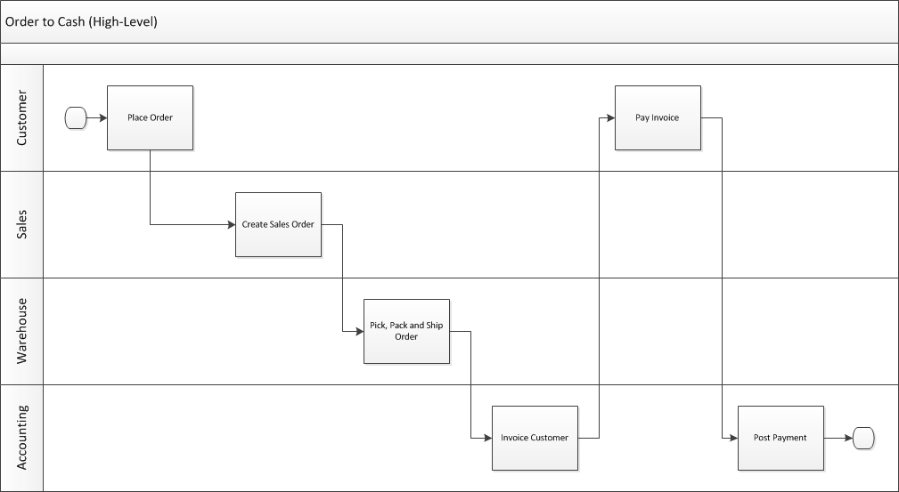
Remember Swim Lane Diagram?
Who does what and when?
Notes:
Remind students of the O2C process using the same swim lane diagram they saw a few weeks ago.

Slide 8
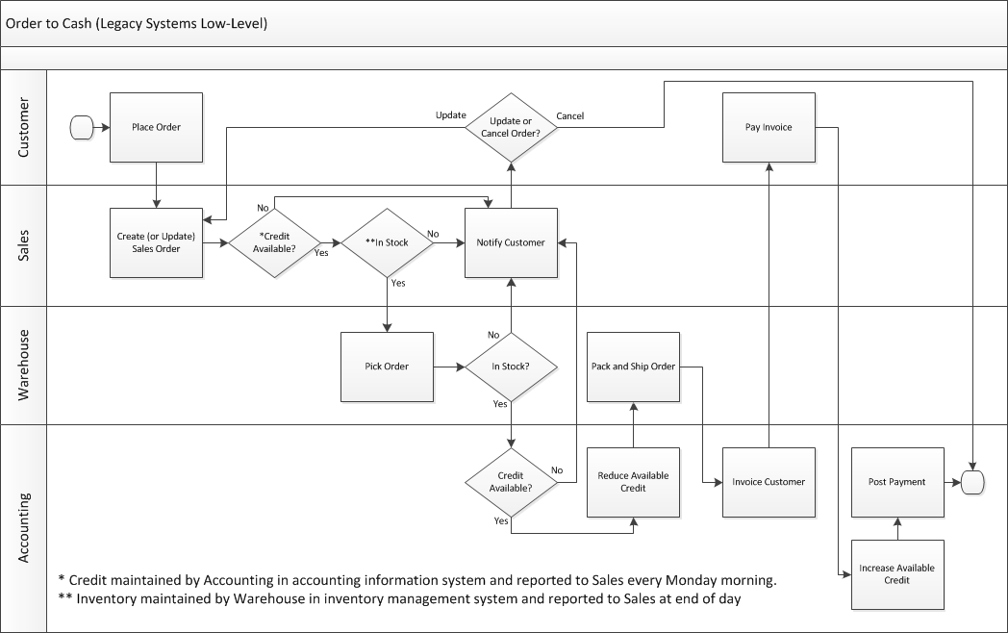
Notes:
Show them the more detailed swim lane diagram and review it quickly.

Slide 9
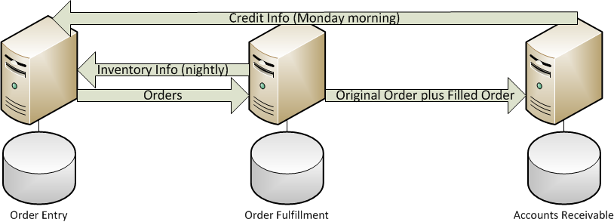
Legacy Systems
Sales
Warehouse
Accounting
Notes:
Show them the legacy systems that support the O2C process. Highlight that they are separate systems that really do make each of the individual functional areas more efficient/effective but point out some of the problems with legacy systems.
Problems with legacy systems:
Standalone systems – Not designed to work with each other.
Make each functional area more efficient/effective but not organization as a whole.
Multiple copies of data can make decision making a challenge.
You must build and support the system interfaces.
System interfaces must run like clockwork of chaos ensues.
Different computing platforms can be a challenge.
Every system interface can be designed differently.

Slide 10
Does your customer view your organization as the “well oiled machine”?
What kind of non-value added work is created when inventory data or credit data is old?
Notes:
Talk about the chaos that occurs when we make decisions based on old data like mistakenly accepting an order when the customer has exceeded their credit limit or mistakenly rejecting an order when we think a customer is exceeding their credit limit but just paid their invoices. Talk about the chaos that occurs when you accept an order but you’re actually out of stock.
What kind of image does your customer get when you can’t even take an order without some sort of chaos?

Slide 11
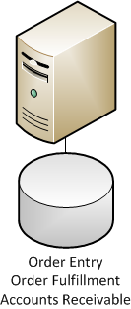
Enterprise System
Sales + Warehouse + Accounting
How many copies of data do I have?
How much non-value added work do I eliminate when inventory and credit data are current?
How much better is my decision making with a single copy of all data?
How much happier are your customers when they are dealing with the “well oiled machine”?

Slide 12
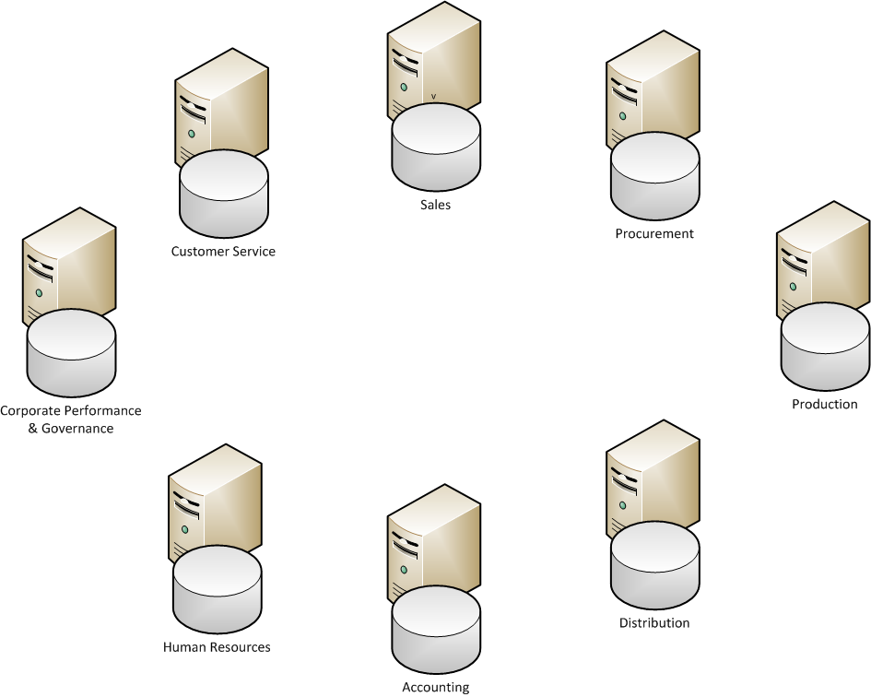
Notes:
On the following slide, have student identify all of the systems that need to talk to each other. Start drawing lines until it is a mess.

Slide 13
Notes:
This is an example of a system interface map for a global Fortune 500 company (Rohm and Haas) before they implemented SAP. Each dot is a system. Each line is an interface.
Companies get like this over a few decades adding one system after another until they have this mess.
90+% of the IT organization’s budget was spent simply keeping these systems and these interfaces up and running. There wasn’t any money left over to do interesting and innovative things that could really help the business.

Slide 14
Notes:
This is the system interface map after Rohm and Haas implemented SAP. The collection of boxes in the middle is actually a single SAP system (each box is a separate module in this single system).
There are still quite a few systems but far fewer and all of the interfaces work the exact same way making support MUCH easier and MUCH less expensive.
In the end the organization spent far less money keeping systems and interfaces up and running and could invest much more money on projects that created value for the organization.

Slide 15
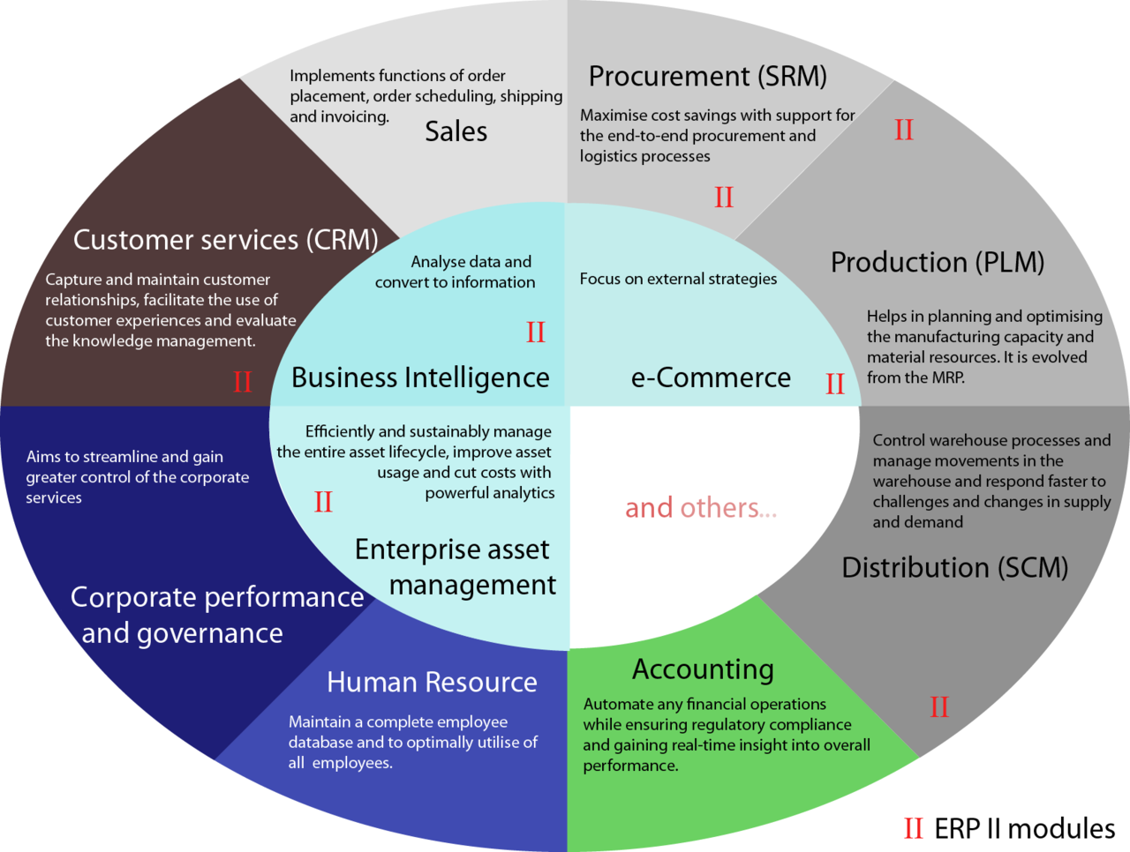

Slide 16
Enterprise Resource Planning (ERP)
Single view of data = one database
Multiple applications or modules that drive various business activities
Large businesses as well as SMB
Track enterprise resources in real-time:
Cash
Raw materials
Inventory
Production capacity
Accounts receivable
Accounts payable
Other liabilities
Central database

Slide 17
HR
Project
CRM
AR
SCM
AP
Central database
Sales
Procure

Slide 18
Functions of ERP Systems
Transaction database
Dashboard
Record transactions
Create reports
Produce documents
Financial indicators
Notes:
Record transactions: depending on what module you are in, an ERP is where you record transactions. Examples are sales orders, purchase orders, time sheets, payments, jounals, fulfillments, receipts. This is the input and process aspects of IPO.
Produce documents: this again depends on the module and can include: receipts, order confirmation, sales order or purchase order document (remember these are legally binding contracts between the seller and the buyer), fulfillment tickets, invoices, bills, journal entries. This is part of the output aspect of IPO.
Reports: another output aspect of IPO is reports, which are a view at aggregate or summary statements about the data in the system. Some key reports produced in an ERP system are accounting statements, such as the balance sheet, P/L, income statement, tax reports, cash flow statement, but also sales reports by department or region, accounts payable, accounts receivable, orders to fulfill, etc.
Reports drive financial indicators and financial ratios: executives tend to make decisions based on aggregate information that is represented in some way that is meaningful to them. This is often expressed as financial indicators, such as return on assets, current ratio, inventory valuation, pipeline analysis, borrowing base, etc.

Slide 19
The Evolution of ERP Systems
Regulatory:
Generally Accepted Accounting Principles (GAAP)
Sarbanes-Oxley
HIPPA?
Business model:
Product offerings for small and midsize businesses (SBM)
More cloud-based options
Increased focus on analytics
The question is no longer how do we get a handle of big data, but rather how to we best leverage big data and make it actionable?

Slide 20
ERP Challenges
Adoption – People HATE change!
Configuration is extremely complex
  Vanilla (config change only) vs. Customization
Implementation is extremely complex
Costs
  Rohm and Haas spend $300 million over a period of three years
  What else could they have done with $300 million?
Risks
  Mega-failures with ERP implementations in the mid-90s
  Many companies went out of business as a result
Internally focused
  Need supply chain and customer relationship management too

Slide 21
ERP Benefits
A single database providing superior, real-time, data-driven decision making
Standardizing business processes based on industry best practices
  Force business process reengineering
Reduced operating costs
  Rohm and Haas saved $200 million/year

Slide 22
Leaders in the ERP Space
SAP
Oracle
Microsoft Dynamics
New cloud based ERP providers?

Slide 23
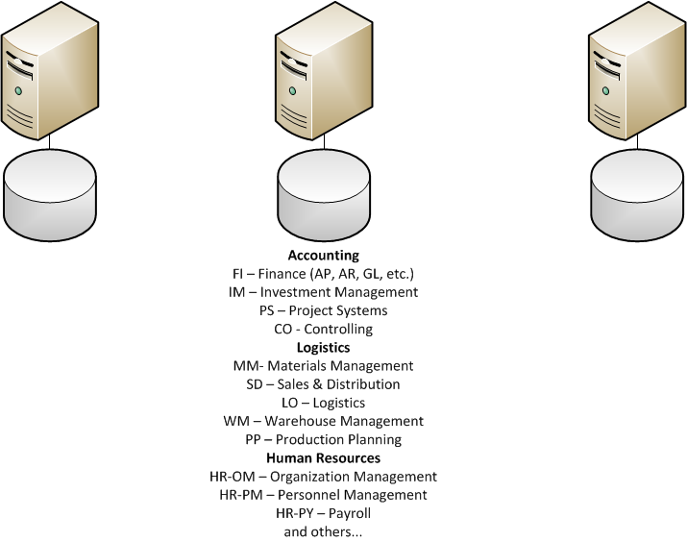
SAP SCM
SAP ERP
SAP CRM

Slide 24
Making it Happen
Executive Sponsor
Driven by the business, not by IT
Requires experts from all of the functional areas
Top-tier Integration Partner
Training, training, training
Testing, testing, testing
Don’t cut corners!
  It could cost you a fortune
  It could cost you your business

Slide 25
Unit 3: Organizational Systems
How do large firms function today?
3.1. Types of systems in organizations
  3.1.1. Running the business: enterprise systems (ERP)
  3.1.2. Managing the business: decision-making (analytics, BI, dashboards)
  3.1.3. Growing the business: knowledge management, R&D, and social business

Slide 26
Unit 3: Organizational Systems
3.2. Systems management
  3.2.1. Business analysis, requirements, and systems acquisition
  3.2.2. Developing systems: programming, testing, and deployment
  3.2.3. Systems integration: standards, interoperability, and external collaboration
  3.2.4. Managing risk: security, hackers, and privacy

Slide 27
Unit 3: Organizational Systems
3.3. Digital business innovation
  3.3.1. Generating IT value
  3.3.2. Competitive advantage of digital business models

