Slide 1
Information Systems in Organizations 3.1.2. Managing the business: decision-making 3.1.3. Growing the business: knowledge management, R&D, and social business

Slide 2
Course Topics Overview
Unit 1: Introduction
Unit 2: Systems Analysis
Unit 3: Organizational Systems
Unit 4: Consumer Systems

Slide 3
Unit 3: Organizational Systems
How do large firms function today?
3.1. Types of systems in organizations
3.1.1. Running the business: enterprise systems (ERP)
3.1.2. Managing the business: decision-making (analytics, BI, dashboards)
3.1.3. Growing the business: knowledge management, R&D, and social business

Slide 4
Unit 3: Organizational Systems
3.2. Systems management
3.2.1. Business analysis, requirements, and systems acquisition
3.2.2. Developing systems: programming, testing, and deployment
3.2.3. Systems integration: standards, interoperability, and external collaboration
3.2.4. Managing risk: security, hackers, and privacy

Slide 5
Unit 3: Organizational Systems
3.3. Digital business innovation
3.3.1. Generating IT value
3.3.2. Competitive advantage of digital business models

Slide 6
Notes:
This is a great movie that gets people thinking about data driven decision making. Using Sabermetrics (data analytics driven from SABR), a team gears up for unprecedented wins. Instead of using traditional selection methods, players are selected only for their On-Base-Percentage (OBP). If a baseball team can do this and dramatically improve their standings, how can a business to do these sorts of things and dramatically improve their balance sheet?

Slide 7
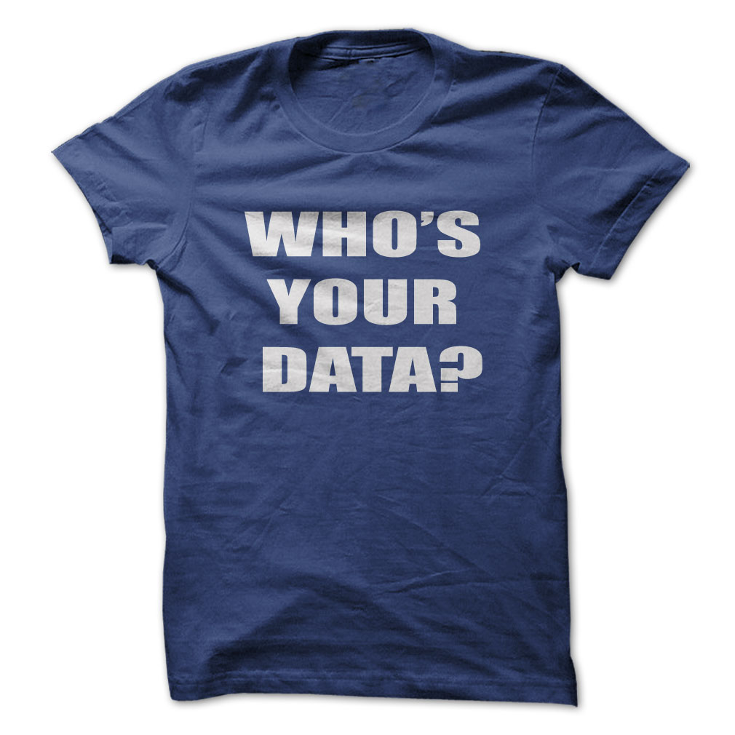
What is Data Analytics?
Notes:
Just get students talking about Data Analytics

Slide 8
What to do with all this Data?
Data
Information
Knowledge
Data analytics is the art and science of examining raw data for the purpose of gaining insight and drawing actionable conclusions about business problems (Alalouf).
Big data analytics is the process of examining big data to uncover hidden patterns, unknown correlations and other useful information that can be used to make better decisions (SAS).

Slide 9
Data Analytics
Track consumer behavior
What do consumers buy?
How do users interface with a web site?
How do you identify design problems?
Predictive metrics
What will consumers buy? (Better yet, what do they want that they don’t know about yet?)
When will demand surge?
Credit card companies can predict divorce

Slide 10
Google Analytics
Tracks web site metadata & user engagement
# of sessions
Average session duration
Number of pages visited and duration at each
Bounce rate
Conversion
Notes:
Conversion is the most important metric for users of Google Analytics. It tracks how many users of a web site make a certain desirable action, for example, fill out a contact form, subscribe to a feed, or purchase an item.

Slide 11
Paytronix
Paytronix provides loyalty programs, CRM tools, and data insights to restaurants
Why do we care about loyalty?
What are CRM tools?
How does Paytronix work?
Sales
Product
Technology Consulting
Engineering
Notes:
How does paytronix work – the operational organization is divided into functional departments: Product, Engineering, Technology Consultant, Sales. The product people are in charge of envisioning and launching new products, maintaining existing products for updates and improvements, and monitoring profitability issues of existing products. The engineers are the technology geeks of the organization and they spend all day writing and fixing code to maintain existing products and build new products. The technology consultants are the quintessential MIS guys – interfacing between consumers (in this case restaurants, like Panera), the product department, and the engineers. The sales department is in charge of generating and recording revenue. Etc.

Slide 12
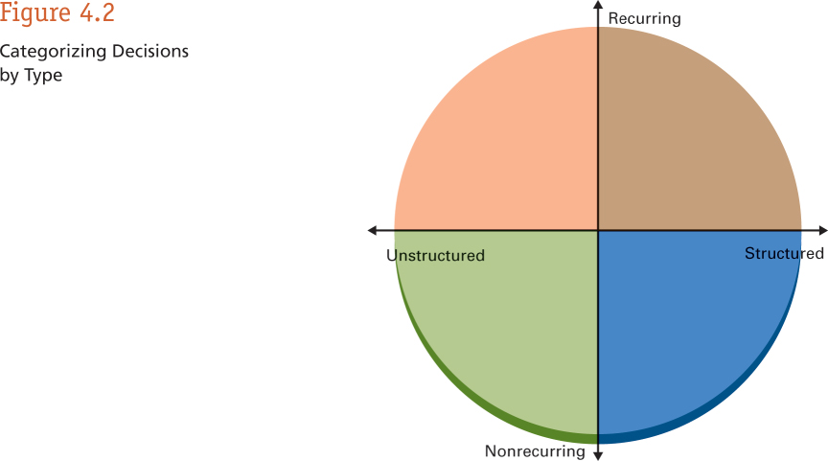
Types of Decisions You Face
Notes:
Business professionals need to make lots of different types of decisions. The more structured and more often the recur, the easier they are to make. The less structured they are and the less frequently they recur, the more difficulty they are to make. Decision Support Systems (DSS) can utilize Data Analytics to help improve your decision making when it comes to less structured, infrequently made decisions.
Ask students for examples of the types of decisions that they make at work (probably more structured and recurring) as well as the decisions the senior leadership in their organization (probably less structured and less frequently recurring) make and plot them on this graphic.
Structured, recurring: what to buy to replenish inventory (warehouse, purchasing clerk, sales clerk), what bills to pay, what reports to look at
Structured, non-recurring: Implement ERP or financial system, create departments, create GL accounts, etc. Resolve one-time balance sheet discrepancies
Unstructured, recurring: communicate with executive management about company performance. Create a marketing campaign. Design new material and collateral.
Unstructured, non-recurring: identify a business opportunity and create a business model. Identify weak spots in company performance based on big data. Create a new product model. Identify a new product line you want to distribute.

Slide 13
Scenario – Warehouse Manager
You know you have too much cash tied up in inventory. You want to reduce inventory levels.
You get a lot of heat when orders are placed and you can’t fill the order from inventory.
What information do you need, how would you like to see it and how do you make decisions about adjusting inventory levels?
Are these structured or unstructured decisions?
Notes:
LogsPlus Implementation:
$200 million tied up in inventory
Spend $1 million on new system to safely reduce inventory levels 10%
New system would actually be a better job at reducing “stock outs”
Use that $20 million to put more salespeople out in the field.
What could your organization do with that $20 million?

Slide 14
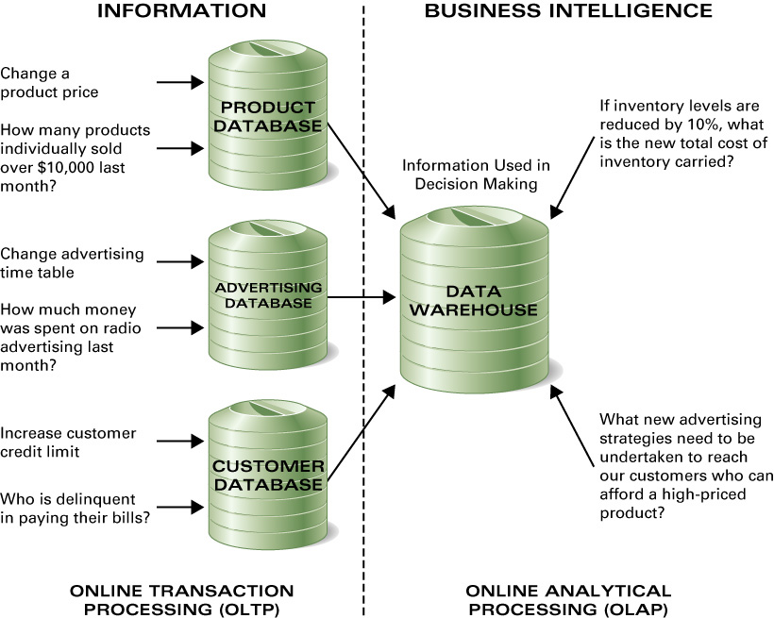
Databases & Data Warehouses
Notes:
Talk about the world of OLTP and Operational Databases and how they feed our Data Warehouses, the realm of OLAP, DSS and Data Analytics. What would this look like in an ERP world?

Slide 15
OLTP
Online transaction processing, or OLTP, is a class of information systems that facilitate and manage transaction-oriented applications, typically for data entry and retrieval transaction processing.
OLTP is characterized by a large number of short on-line transactions (INSERT, UPDATE, DELETE). The main emphasis for OLTP systems is put on very fast query processing, maintaining data integrity in multi-access environments and an effectiveness measured by number of transactions per second. In OLTP database there is detailed and current data, and schema used to store transactional databases is the entity model.

Slide 16
OLAP
OLAP is an acronym for online analytical processing, which is a computer-based technique of analyzing data to look for insights. The term cube here refers to a multi-dimensional dataset, which is also sometimes called a hypercube if the number of dimensions is greater than 3.
OLAP is characterized by relatively low volume of transactions. Queries are often very complex and involve aggregations. For OLAP systems a response time is an effectiveness measure. OLAP applications are widely used by Data Mining techniques. In OLAP database there is aggregated, historical data, stored in multi-dimensional schemas.

Slide 17
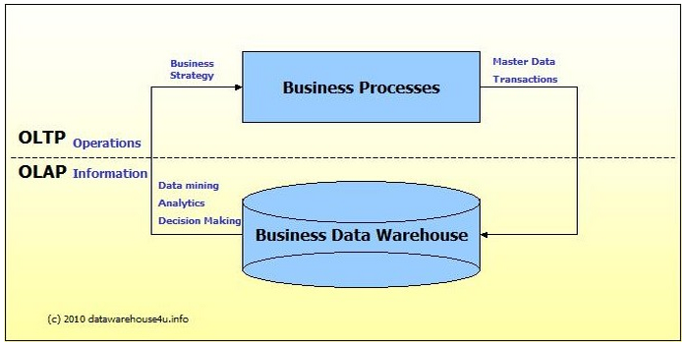
Source: http://datawarehouse4u.info/OLTP-vs-OLAP.html

Slide 18
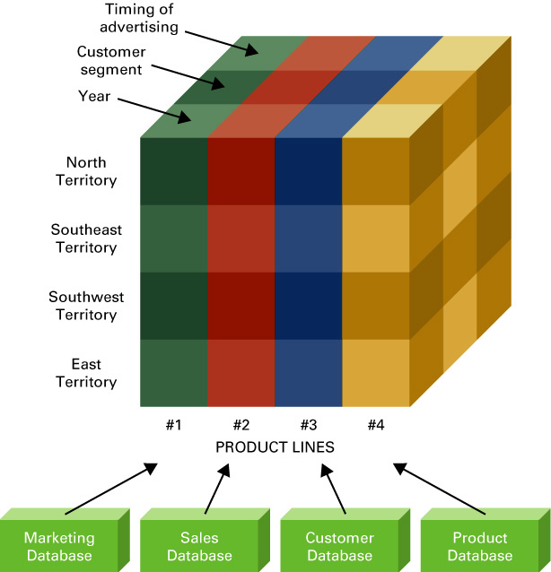
What Is a Hypercube?
Multi-dimensional “cubes” of information that summarize transactional data across a variety of dimensions.

Slide 19
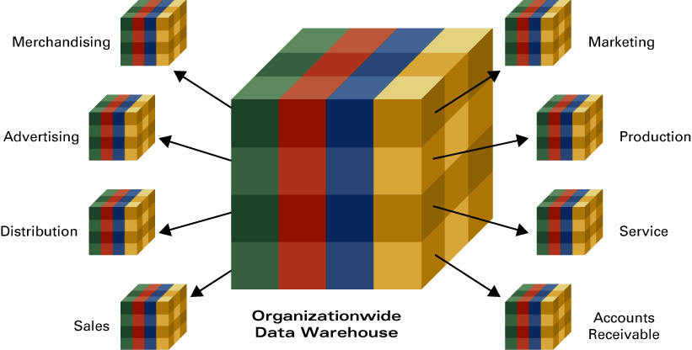
Data Marts

Slide 20
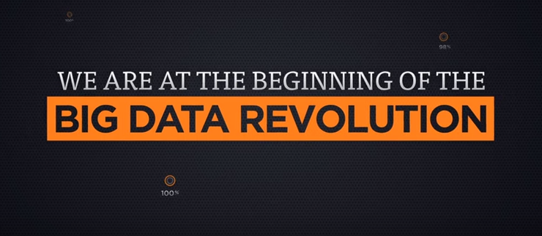
Notes:
Just a quick video to get students thinking that they need to leverage big data.

Slide 21
Notes:
Credit goes to informationisbeautiful.net

Slide 22
?
What is “Knowledge Management”?
Knowledge management (KM) is the process of capturing, developing, sharing, and effectively using organizational knowledge. It refers to a multi-disciplinary approach to achieving organizational objectives by making the best use of knowledge.

Slide 23
Tacit Knowledge
Tacit knowledge (as opposed to formal, codified or explicit knowledge) is the kind of knowledge that is difficult to transfer to another person by means of writing it down or verbalizing it.
Using language
Solving algebra
Playing an instrument
Riding a bike
Carpentry
Facial recognition
Cooking and baking
Manufacturing
Resolving discrepancies in a balance sheet
Distinguished from explicit knowledge (discrete knowledge about questions like ‘where is Paris?’, ‘how much does an iPhone cost?’)

Slide 24
Question
What is a “Baby Boomer” and how many of them are in the workforce today?
How many will be in the workforce 10 years from now?
Why is this keeping CEOs awake at night?
Is there technology that we can use to help with this?

Slide 25
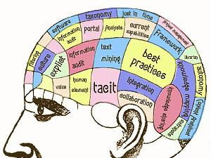
Notes:
Talk about all of the important information that is stored in the heads of people and ask how the organization can leverage these assets when they are stored in people’s heads.

Slide 26
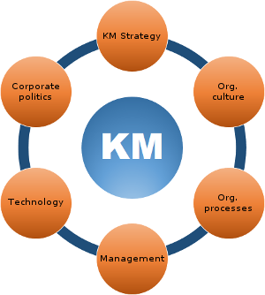
What are the benefits of Knowledge Management?
What are best practices?
What is a community of practice?
What are the challenges of Knowledge Management?
Notes:
Talk about knowledge management.
The goal is to capture, organize and leverage knowledge (our most important asset) with technology.
Ask the students to list some of the benefits of doing this?
Ask students to list some of the challenges?
Employee buy-in
Knowledge overload
Information obsolesce
Being enamored by the technology and forgetting the goal

Slide 27
Knowledge Transfer
In organizational theory, knowledge transfer (KT) is the practical problem of transferring knowledgefrom one part of the organization to another. Like knowledge management, knowledge transfer seeks to organize, create, capture or distribute knowledge and ensure its availability for future users.

Slide 28
Unit 3: Organizational Systems
How do large firms function today?
3.1. Types of systems in organizations
3.1.1. Running the business: enterprise systems (ERP)
3.1.2. Managing the business: decision-making (analytics, BI, dashboards)
3.1.3. Growing the business: knowledge management, R&D, and social business

Slide 29
Unit 3: Organizational Systems
3.2. Systems management
3.2.1. Business analysis, requirements, and systems acquisition
3.2.2. Developing systems: programming, testing, and deployment
3.2.3. Systems integration: standards, interoperability, and external collaboration
3.2.4. Managing risk: security, hackers, and privacy

Slide 30
Unit 3: Organizational Systems
3.3. Digital business innovation
3.3.1. Generating IT value
3.3.2. Competitive advantage of digital business models

