Slide 1
Exam 1 Review

Slide 2
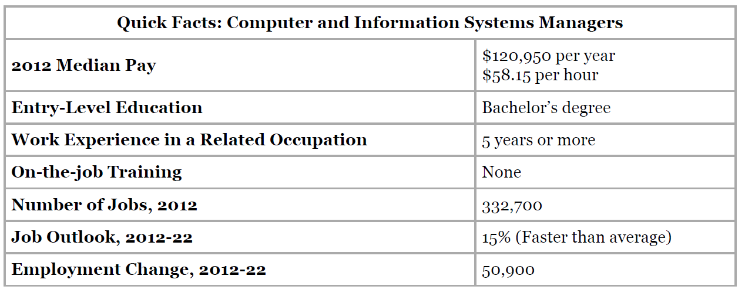
Jobs in MIS
Bureau of Labor Statistics, U.S. Department of Labor, Occupational Outlook Handbook, 2014-15 Edition, Computer and Information Systems Managers. Updated 1/8/2014

Slide 3
Important Skills in MIS
Analytical Skills
Communication Skills
Decision-Making Skills
Leadership Skills
Organization Skills

Slide 4
Systems Analysis
"Systems analysis is a problem solving technique that decomposes a system into its component pieces for the purpose of the studying how well those component parts work and interact to accomplish their purpose" —Wikipedia
"the process of studying a procedure or business in order to identify its goals and purposes and create systems and procedures that will achieve them in an efficient way“ —Merriam-Webster Dictionary
Core concepts:
Feasibility study
Scope definition
Requirements gathering
Logical design
User experience (UX)

Slide 5
Concepts in Systems Analysis
Data Model
Database
Why is it important to model data?
Why are modeling tools so helpful?

Slide 6
Concepts in Systems Analysis
Feasibility Study
Scope Definition
Problem Analysis
Requirements Analysis
Requirements Gathering
Logical Design
Decision Analysis
User Experience Planning
Waterfall Model
Phased Approach

Slide 7
Systems Architecture
Systems Architecture is a generic discipline to handle objects (existing or to be created) called "systems", in a way that supports reasoning about the structural properties of these objects. Systems Architecture is a response to the conceptual and practical difficulties of the description and the design of complex systems. – Boris Golden
Once a systems analyst understands the business problem, they architect a solution

Slide 8
Systems Architecture
A Blueprint for Action
Planning
Design
Procurement
Build
Installation
Configuration
Testing
Roll out

Slide 9
SDLC
Plan
Analyze
Design
Build
Maintain

Slide 11
SDLC
Initiate
Conceptualize
Plan
Analyze
Design
Develop
Integrate
Test
Implement
Roll Out
Maintain
Dispose

Slide 12
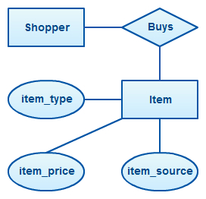
Entity Relationship Diagram (ERD)

Slide 13
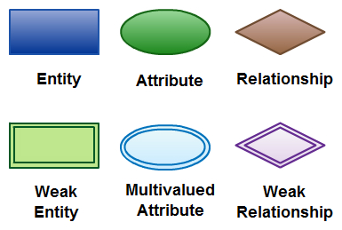
Primary ERD Symbols

Slide 14
Inventory Item Attributes
ID
Name
Description
Unit of Measure
Weight
Serial #

Slide 15
Inventory Item in an ERD
Inventory Item
PK | Internal ID
 | Name
 | Description
 | Unit of Measure
 | Weight
 | Serial #

Slide 16
Complete ERD for a Sales Order
Customer
PK | Customer ID
 | Name
 | Phone
 | Email
 | Address
 | Credit card
Employee
PK | Employee ID
 | Name
 | SSN
 | Pay rate
 | Address
FK | Supervisor
Sales Order
PK | Transaction ID
 | Date
FK | Customer ID
FK | Sales Person
FK | Department
 | Shipping Address
 | Payment Method
Order Detail
FK | Transaction ID
FK | Inventory Item
 | Quantity
 | Price
 | Discount
 | Total
Inventory Item
PK | Internal ID
 | Name
 | Description
 | Unit of Measure
 | Weight
 | Serial #
JOIN

Slide 17
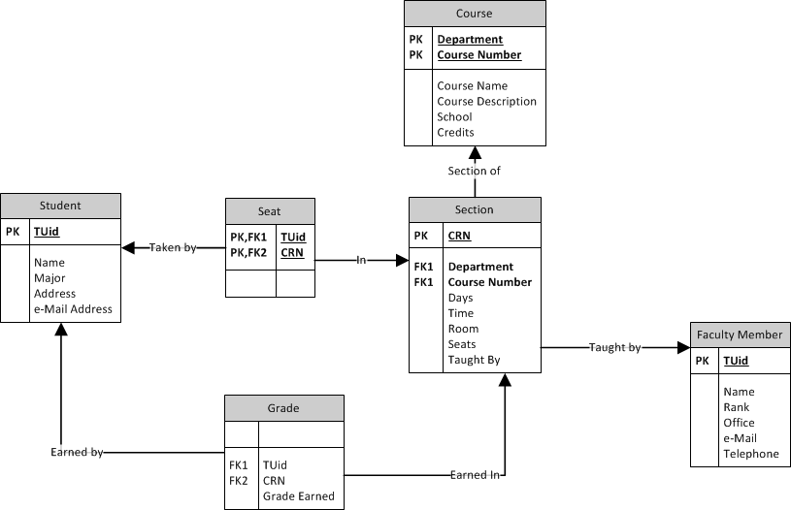

Slide 18
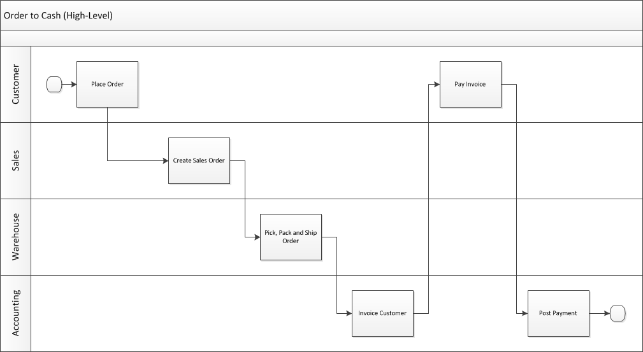
Swim Lane Diagram Who does what and when?
Notes:
This high-level diagram basically shows who does what and when as part of the order to cash process. On the next slide we will have a much more detailed diagram.

Slide 19
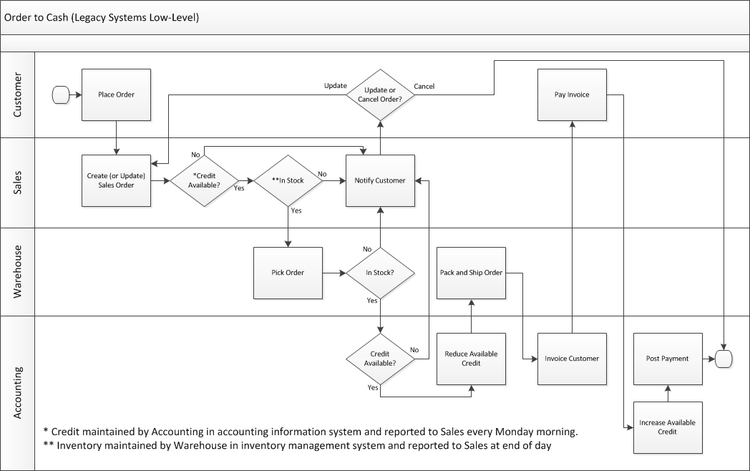
Notes:
This more complex swim lane diagram will be used again when we cover ERP systems. This represents the O2C process when they still used separate legacy systems for order processing, order fulfillment and accounting. While each of these separate systems made each team more efficient, they don’t optimize the process for the organization as a whole. There is lots of non-value added work in here which are a result of these legacy systems.
The biggest issues have to do with maintaining credit limits in the accounting information system and sending a report to Sales about credit limits every Monday morning. The credit information gets stale and Sales is possibly accepting orders and picking orders (only to be stopped before the order is packed and shipped) from customers who have over-extended their credit or denying sales to customers who have paid their bills.
The other issue is that inventory is maintained by the Warehouse in the inventory management system and sending reports to Sales at the end of every day. Sales may be selling inventory that was already sold earlier in the day.
The purposed of this slide is to show the students a more complex swim lane diagram and to show that it can clearly document a more complex process. We can introduce the story of this dysfunctional O2C process here and then come back to it during the ERP section of the course.

