Slide 1
MIS 2101 Exam 1 Review

Slide 2
Advice
Review the slide decks
Review the assigned readings/videos
Review MaxLabs
How to prepare…

Slide 4
Introduction & Systems Analysis
Topics and Required Reading Acquiring Information Systems And Services Systems Architecture Systems Analysis
Required Viewing What is MIS? The Modern Organization System Systems Analysis & Systems Architecture

Slide 5
Collection of Systems
Systems = People + Process + Technology
Manipulation of information = value
Managed by MIS professionals
Systems surround us 24/7
Application Program Interface (API’s)
“Information System – an integrated set of components for collecting, storing, and processing data and for providing information, knowledge and digital products.”

Slide 6
Collection of Technologies
Including:
Hardware
Software
Policies
Education Tools
API’s

Slide 7
Designing UX (User Experience)
Four Steps
Problem Definition
Documenting Business Processes
Process Decomposition
Data Modeling

Slide 8
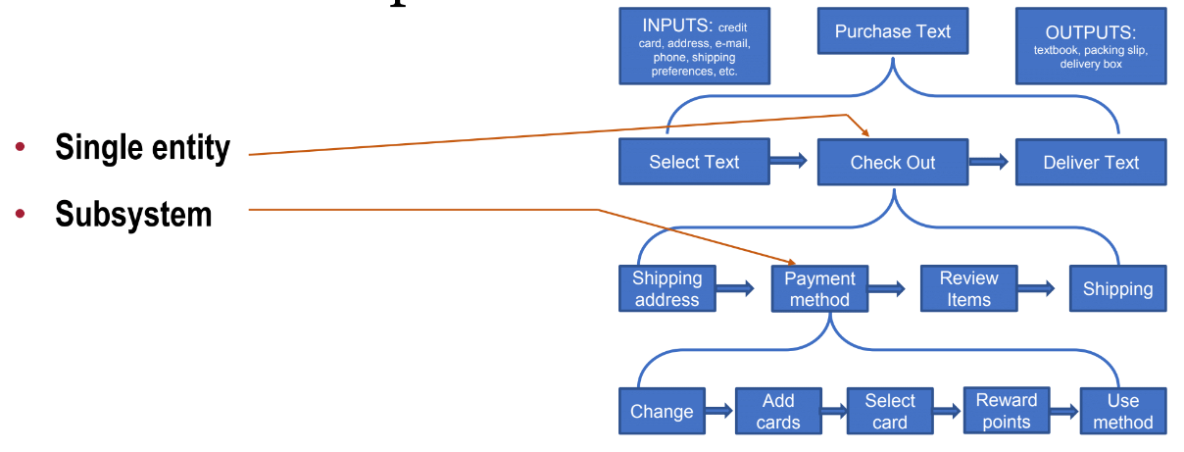
Process Decomposition

Slide 9
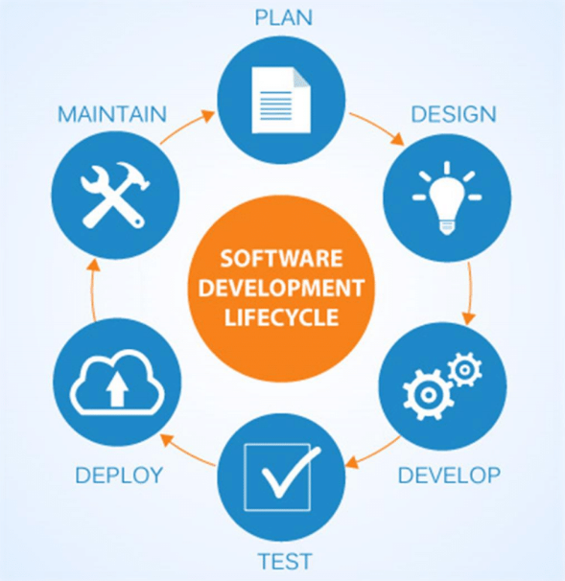
SDLC Methodologies
Waterfall
Agile
Lean
Scrum
DevOps

Slide 10
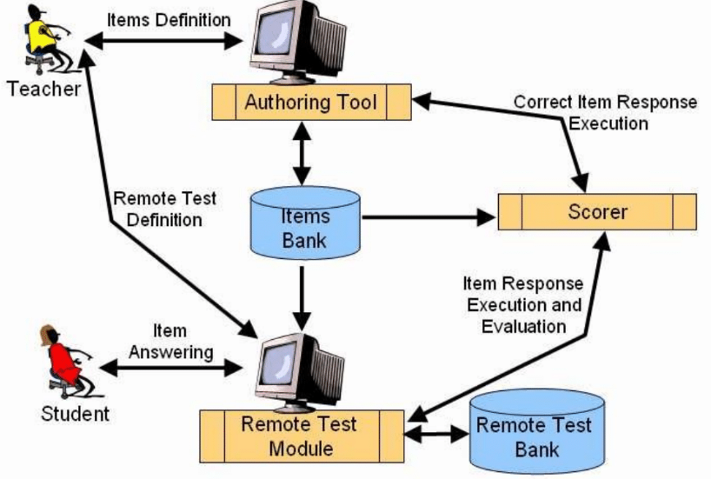
Systems Architecture
Conceptual Diagram
Structural Components
Identify/Solve Problems
Existing or New
Communication Tool

Slide 11
Introduction to Process Mapping
Topics and Required Reading An Introduction to Swim Lane Diagrams
Required Viewing Process Mapping with Swim Lane Diagrams

Slide 12
Process Mapping
What
Visual Representation
Why
Identify Problems
How
Draw the “as-is”

Slide 13
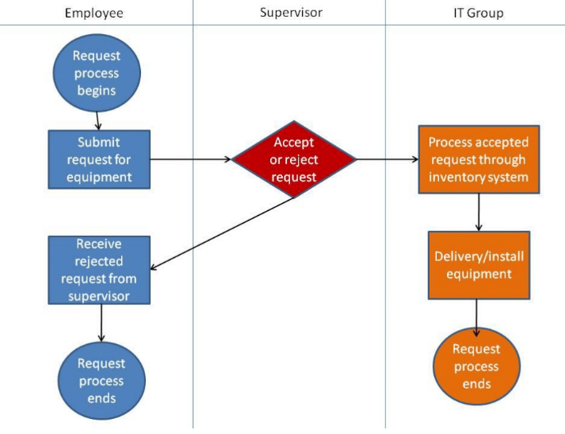
Swim Lane Diagrams
Advantages
Identifies who does what & in what order
Logical & Chronological
Indicates hand-offs
Versatile
Applied to other diagrams
Training Tool

Slide 14
Swim Lane Diagrams - Symbols
Circle : signifies the starting and ending of an event in the process
Rectangle : represents an activity in the process
Diamond : represents a decision that must be made
Arrow : indicates the flow of the process
Cylinder : represents stored data

Slide 15
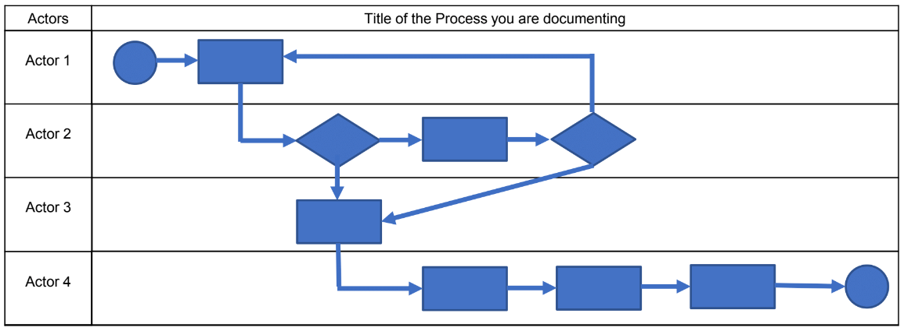
Swim Lane Diagrams – Create your own

Slide 16
Digital Product Management
Topics and Required Reading Max Labs Pre-Flight
Required Viewing Digital Product Management Max’s Story Concepts of Max Labs

Slide 17
Why Salesforce?
A great platform to deliver cloud-based systems products
Enables & Enhances Business
Used by Industry Fortune 100’s
Across all business function areas
Enabling Organizations
Technology enables organizations to work faster/smarter/more efficient
See how it works
Understand how it used by industry

Slide 18
Max Labs – Pre-Flight
A great platform to deliver cloud-based systems products
Professional Development
Developing a professional brand
Innovation
Scalability & new markets
Business & Digital Models
B2B (Business to Business)
Used to managed their relationships to customers
Data/Databases/Apps/Platforms
Platform: a collection of tools & services you can piece together to build a database and apps

Slide 19
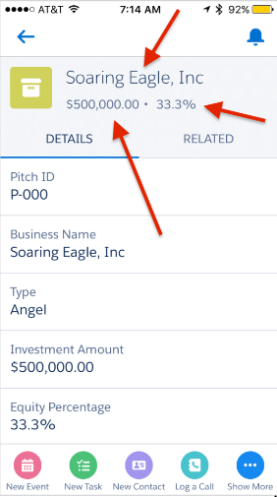
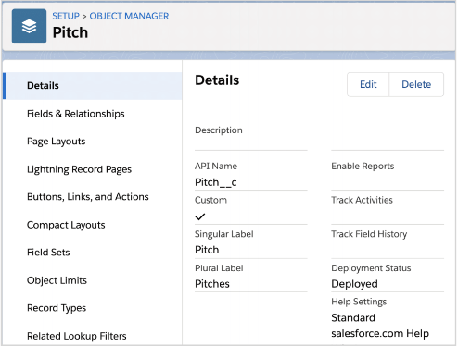
Max Labs – 1a
Creating Databases (objects)
Why do we need these lists?
Determining Data Needs
Max’s needs for creating the “Pitch”
Page Layouts
What information do we want to show?
Mobile App

Slide 20
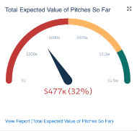
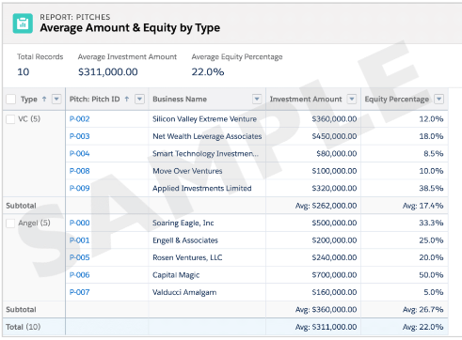
Max Labs – 1b
Digital Business Models
Share & Communicate
Monetize Max’s Blog
Pitch Data File
CSV Files, organization
Generating Reports
Visualizing the data
Dynamic Dashboards

Slide 21
Information Systems - Part 1
Topics and Required Reading What is ERP? 5 ERP Trends What is CRM? Missing the Most Important Part of CRM CRM vs. ERP: What’s the Difference? 3 CRM Use Cases
Required Viewing What is ERP ERP Challenges and Benefits

Slide 22
What is ERP?
Enterprise Resource Planning
Software or a System that
Integrates functions
Streamlines processes
Manage core business

Slide 23
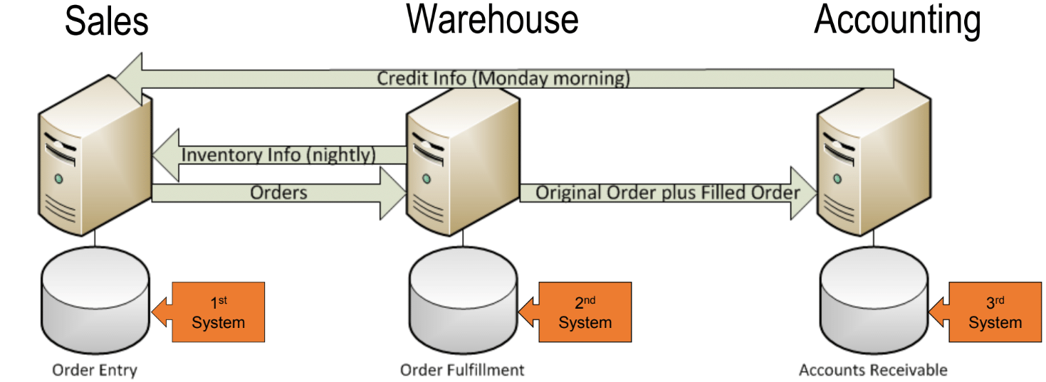
Legacy Systems

Slide 24
ERP – Key Takeaways
How does ERP create value?
Integrated Database
One copy of data
Collaboration
Improves decision making
Flexibility & Mobility
Access anywhere/anytime
Lower costs

Slide 25
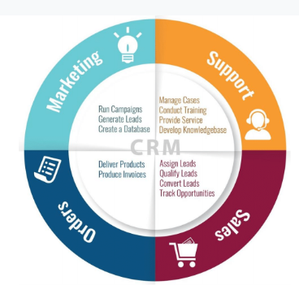
What is CRM?
Customer Relationship Management
Who uses CRM?
Sales
Marketing
HR
Accounting

Slide 26
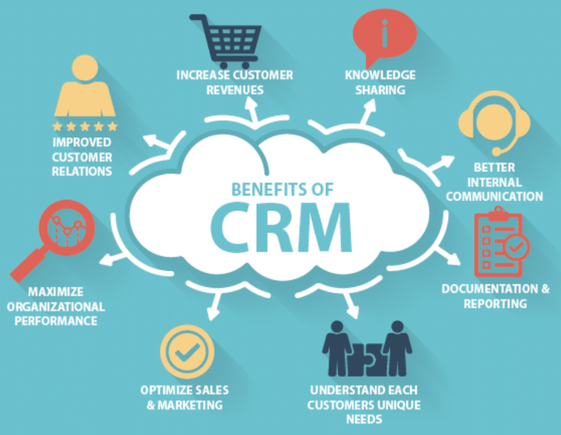
CRM Benefits
Maximize Profits
Understand Your Customer (data)
Analyze buying patterns
Problem solve
Accountability
Customer Communication

Slide 27
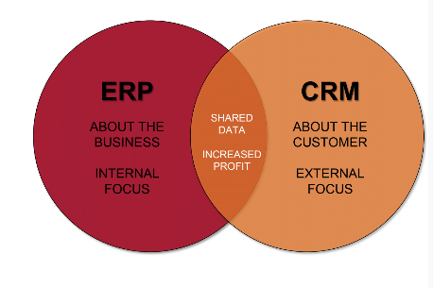
ERP & CRP
What’s the difference?

Slide 28
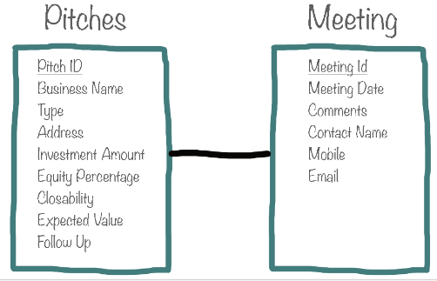
Max Labs – 2a
Managing Data Corruption
Validation Rules
Data Redundancy
Data Integrity
Entity Relationship Diagrams (ERD’s)
Relationship between Pitches - Meeting

Slide 29
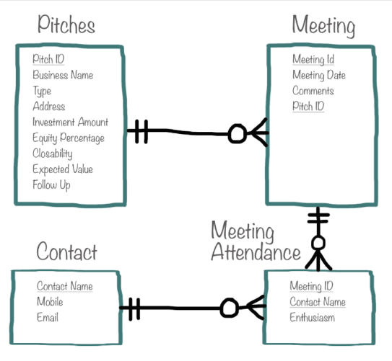
Max Labs – 2b
Importing Data
Creating Tables
Avoiding Redundancy
Avoiding Redundancy
Data Normalization
Understanding Relationships
ERD’s
Database Relationships

Slide 30
Questions?

