Slide 1
Information Systems in Organizations
2.1 Analyzing organizations as systems and processes

Slide 2
Course Topics Overview
Unit 1: Introduction
Unit 2: Systems Analysis
Unit 3: Organizational Systems
Unit 4: Consumer Systems

Slide 3
Unit 2: Systems Analysis
2. Systems analysis: what makes a system tick?
2.1. Analyzing organizations as systems and processes
    2.1.1. Process decomposition: swim lane diagrams
    2.1.2. Data modeling: entity relationship diagrams
2.2. Systems architecture: devices, network, data, apps
    2.2.1. Visualizing architecture: conceptual diagramming
    2.2.2. Ex. of legacy, contemporary, and future information systems

Slide 4
?
Problem Solving Technique
Business Process
What is the problem?
What is “systems analysis”?
What is “systems architecture”?
What is the solution?
Modeling
Decomposition

Slide 5
Systems Analysis
"Systems analysis is a problem solving technique that decomposes a system into its component pieces for the purpose of the studying how well those component parts work and interact to accomplish their purpose" - Wikipedia[
"the process of studying a procedure or business in order to identify its goals and purposes and create systems and procedures that will achieve them in an efficient way“ – Merriam-Webster Dictionary
So what does a systems analyst do?

Slide 6
Systems Architecture
Systems Architecture is a generic discipline to handle objects (existing or to be created) called "systems", in a way that supports reasoning about the structural properties of these objects.
Systems Architecture is a response to the conceptual and practical difficulties of the description and the design of complex systems. – Boris Golden
Once a systems analyst understands the business problem, they architect a solution

Slide 7
?
How is a process performed?
What happens after?
When do they do it?
What is a “swim lane diagram”?
What happens before?
Who does what?

Slide 8
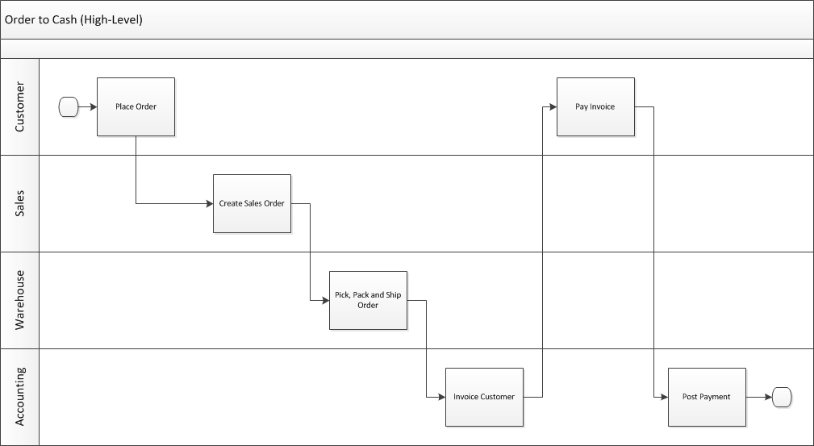
Swim Lane Diagram
Who does what and when?

Slide 9
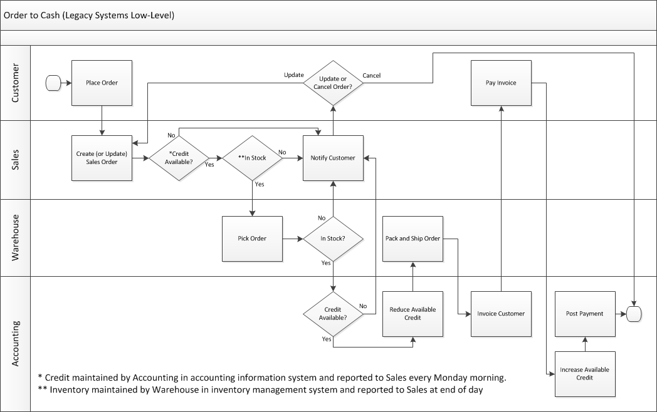

Slide 10
?
Give me a process and let’s make a swim lane diagram…

Slide 11
Learn IT #2
The deliverable for this assignment is a one page swim lane diagram for drive-through ordering at a fast food restaurant.

Slide 12
?
Entity = Noun
Attribute = Characteristic
What is an “entity relationship diagram”?
Data Model
Relationship = Verb

Slide 13
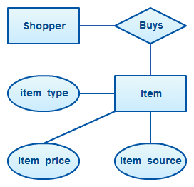
Entity Relationship Diagram (ERD)

Slide 14
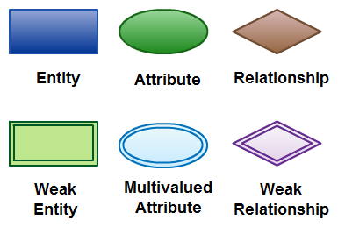
Primary ERD Symbols

Slide 15
?
Let’s model the data that is used by the process we modeled earlier…

Slide 16
Unit 2: Systems Analysis
2. Systems analysis: what makes a system tick?
2.1. Analyzing organizations as systems and processes
    2.1.1. Process decomposition: swim lane diagrams
    2.1.2. Data modeling: entity relationship diagrams
2.2. Systems architecture: devices, network, data, apps
    2.2.1. Visualizing architecture: conceptual diagramming
    2.2.2. Ex. of legacy, contemporary, and future information systems

