Slide 1
Information Systems in Organizations 2.2 Systems Architecture: Devices, Network, Data and Apps

Slide 2
Administrative
Next week is exam number one
The exam is 50 minutes
There are two sections.
Swimlanes / ERDs
Traditional MC
Samantha Talarico and Sean Walsh are holding a study session
Alter 748, Feb. 9th, 3:00-4:00PM

Slide 3
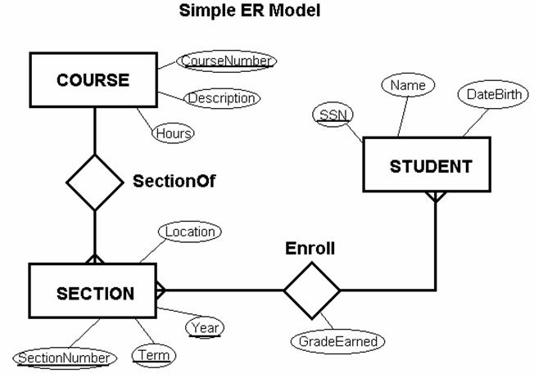
Where are We?

Slide 4
Agenda
Dive deeper into diagramming
Specifically focus on how we can diagram at a higher level
We will also do some general technical background (how the internet works)

Slide 5
?
Sell the idea
Refined Later
Marketing View
What is “conceptual diagraming”?
Big Picture
Guide the Architect
Informal/Lightweight

Slide 6
Build Your Own Study Guide Concept map
What are 3 key points from this reading?
What are 3 important details from this reading?
Students will be called upon at random

Slide 7
Build Your Own Study Guide What is a Concept Map?
What are 3 key points from this reading?
What are 3 important details from this reading?
Students will be called upon at random

Slide 8
Build Your Own Study Guide Investigative Architecture: The Conceptual Diagram
What are 3 key points from this reading?
What are 3 important details from this reading?
Students will be called upon at random

Slide 9
Defined
Diagram that depicts suggested relationships between concepts.
It’s a map of visualized relationships
Goal is to explain the connections between individual contexts in order to show the whole
In software this is often done with UML to model structure, activity, or interaction

Slide 10
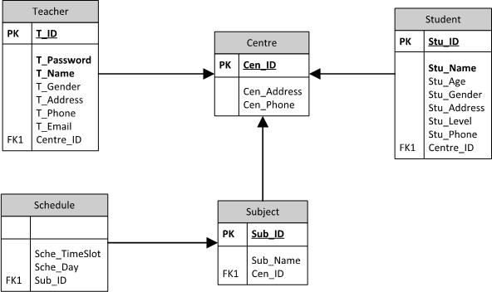
Recall
This is very much what we were doing with ERDs and swimlanes
However, these diagrams do not allow us to model the entirety of the organization
This may be one of our goals

Slide 11
Why would we want to do this?
Identify waste in the organization
Opportunities to replicate the use of resources
Documentation
Always a good thing
Identify synergies
Where has the company not realized potential
Sales and Communication

Slide 12
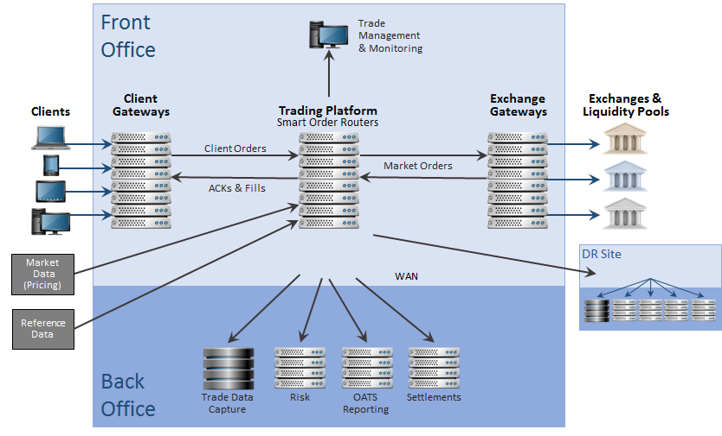
Case in Point (Trading Platforms)
Electronic trading systems are typically proprietary software (etrading platforms or electronic trading platforms), running on COTS hardware and operating systems, often using common underlying protocols, such as TCP/IP.
Exchanges typically develop their own systems (sometimes referred to as matching engines), although sometimes an exchange will use another exchange's technology (e.g. e-cbot, the Chicago Board of Trade's electronic trading platform, uses LIFFE's Connect system), and some newer electronic exchanges use 3rd-party specialist software providers (e.g. the Budapest stock exchange and the Moscow Interbank Currency Exchange use automated trading system originally written and implemented by FMSC, an Australian technology company that was acquired by Computershare, and whose intellectual property rights are now owned by OMX).
Exchanges and ECNs generally offer two methods of accessing their systems –
an exchange-provided GUI, which the trader runs on his or her desktop and connects directly to the exchange/ECN, and
an API which allows dealers to plug their own in-house systems directly into the exchange/ECN's.
From an infrastructure point of view, most exchanges will provide "gateways" which sit on a company's network, acting in a manner similar to a proxy, connecting back to the exchange's central system.
ECNs will generally forego the gateway/proxy, and their GUI or the API will connect directly to a central system, across a leased line.
Many brokers develop their own systems, although there are some third-party solutions providers specializing in this area. Like ECNs, brokers will often offer both a GUI and an API (although it's likely that a slightly smaller proportion of brokers offer an API, as compared with ECNs), and connectivity is typically direct to the broker's systems, rather than through a gateway.
Investment banks and other dealers have far more complex technology requirements, as they have to interface with multiple exchanges, brokers and multi-dealer platforms, as well as their own pricing, P&L, trade processing and position-keeping systems. Some banks will develop their own electronic trading systems in-house, but this can be costly, especially when they need to connect to many exchanges, ECNs and brokers. There are a number of companies offering solutions in this area.
Notes:
Just to contrast the simplicity of the model with the definition from the text

Slide 13
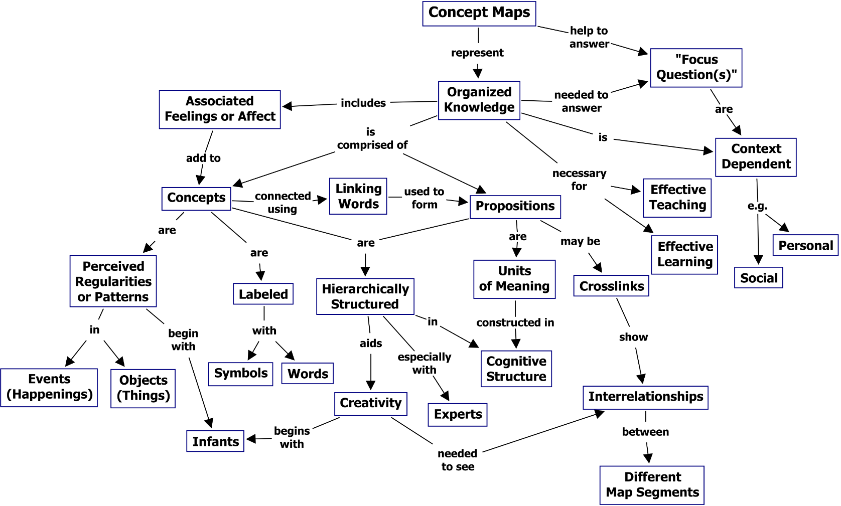
How would we do something like this (In theory)?
Focus Question
Propositional
Propositional
Propositional
Hierarchical
Propositional
Cross Linked

Slide 14
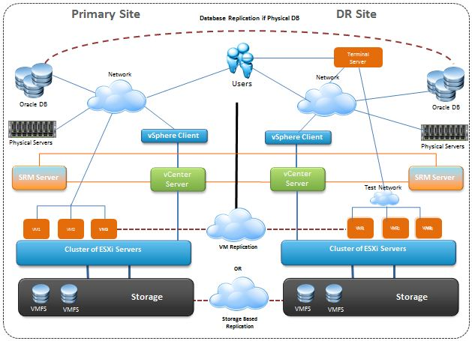
How would we do something like this (In practice)?

Slide 16
have

Slide 17
?
Let’s create a conceptual diagram …
Worksheet “System Analysis : Conceptual Architect Diagram”

Slide 18
Example Conceptual Architecture Diagram
Users
Interface
Processes
Resources
De
System Administrator
Desktop
Textbook Content
Import From Publishers
Professor
Web
Define Course
Course Content Database
Students
Phone App
Use Study Aids
Clipart from: https://openclipart.org

Slide 19
Conceptual Architectural Diagram
In-Class Activity…

Slide 20
Build Your Own Study Guide How does the internet work? - James May's Q&A
What are 3 key points from this reading?
What are 3 important details from this reading?
Students will be called upon at random

Slide 21
Build Your Own Study Guide There and Back Again: A Packet's Tale - How does the Internet work?
What are 3 key points from this reading?
What are 3 important details from this reading?
Students will be called upon at random

Slide 22
Build Your Own Study Guide How the Internet Works
What are 3 key points from this reading?
What are 3 important details from this reading?
Students will be called upon at random

Slide 23
Source: https://www.helloitsliam.com/2014/12/20/how-the-internet-works-infographic/

Slide 24
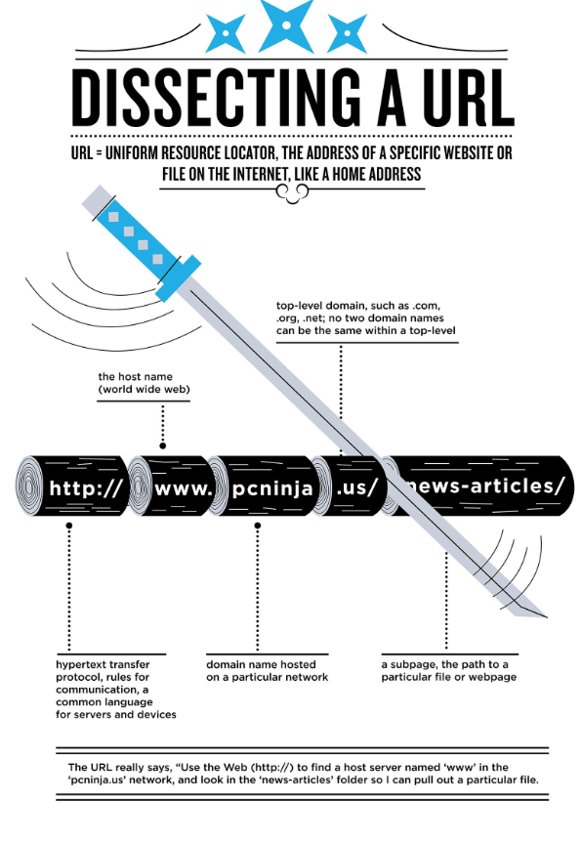
When you type in a URL, like community.mis.temple.edu/schedule – what you’re actually saying is “I want to use HTTP to access the world wide web and find a set of domains called community.mis.temple which are part of a top-level domain called .edu and once inside that domain I want to locate a particular file or page called schedule.

Slide 25
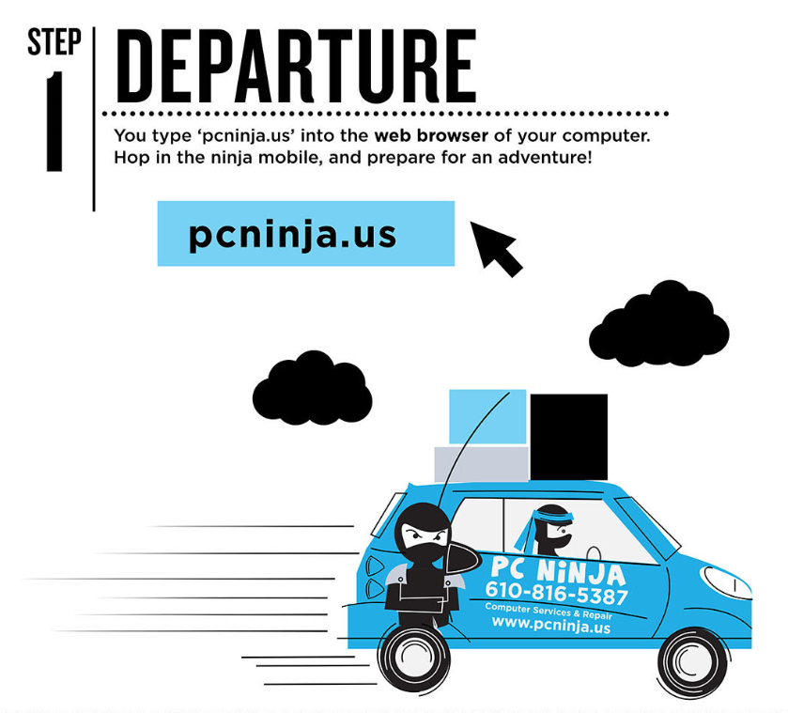

Slide 26
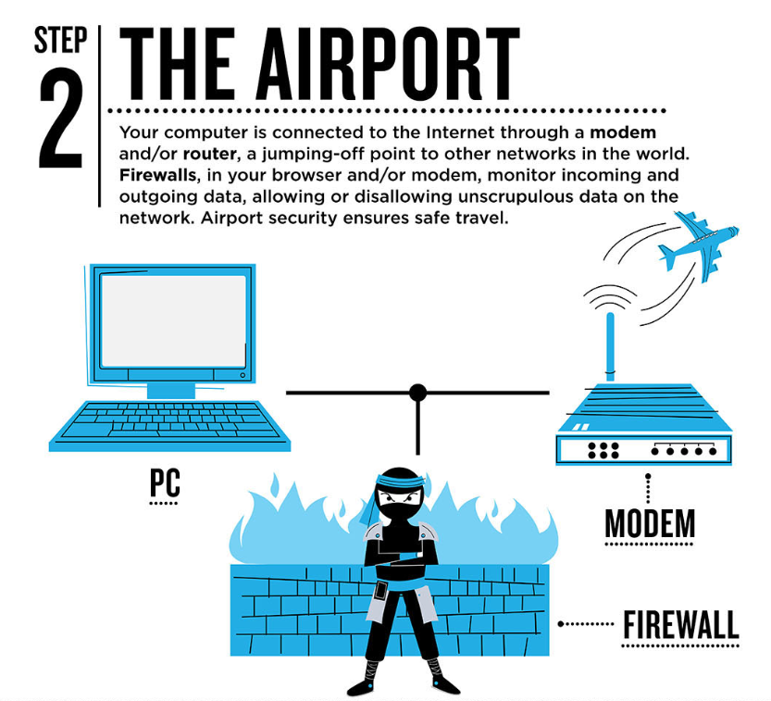

Slide 27
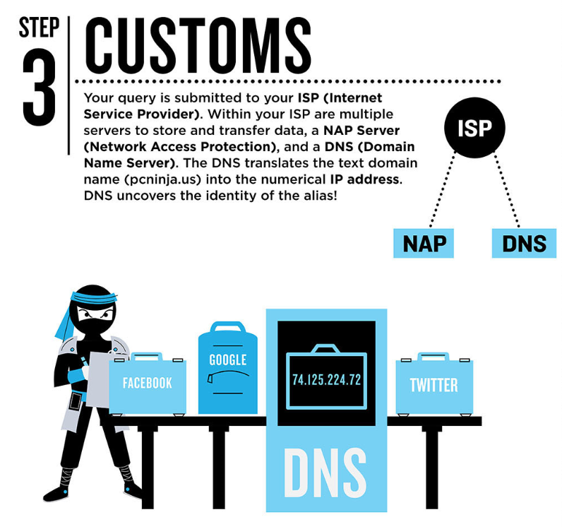

Slide 28
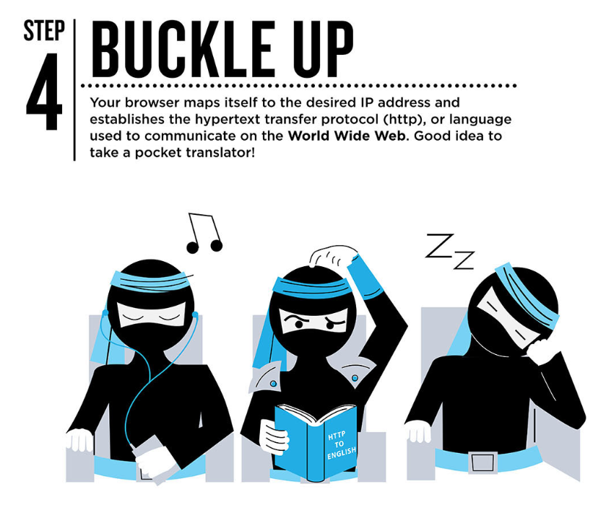

Slide 29
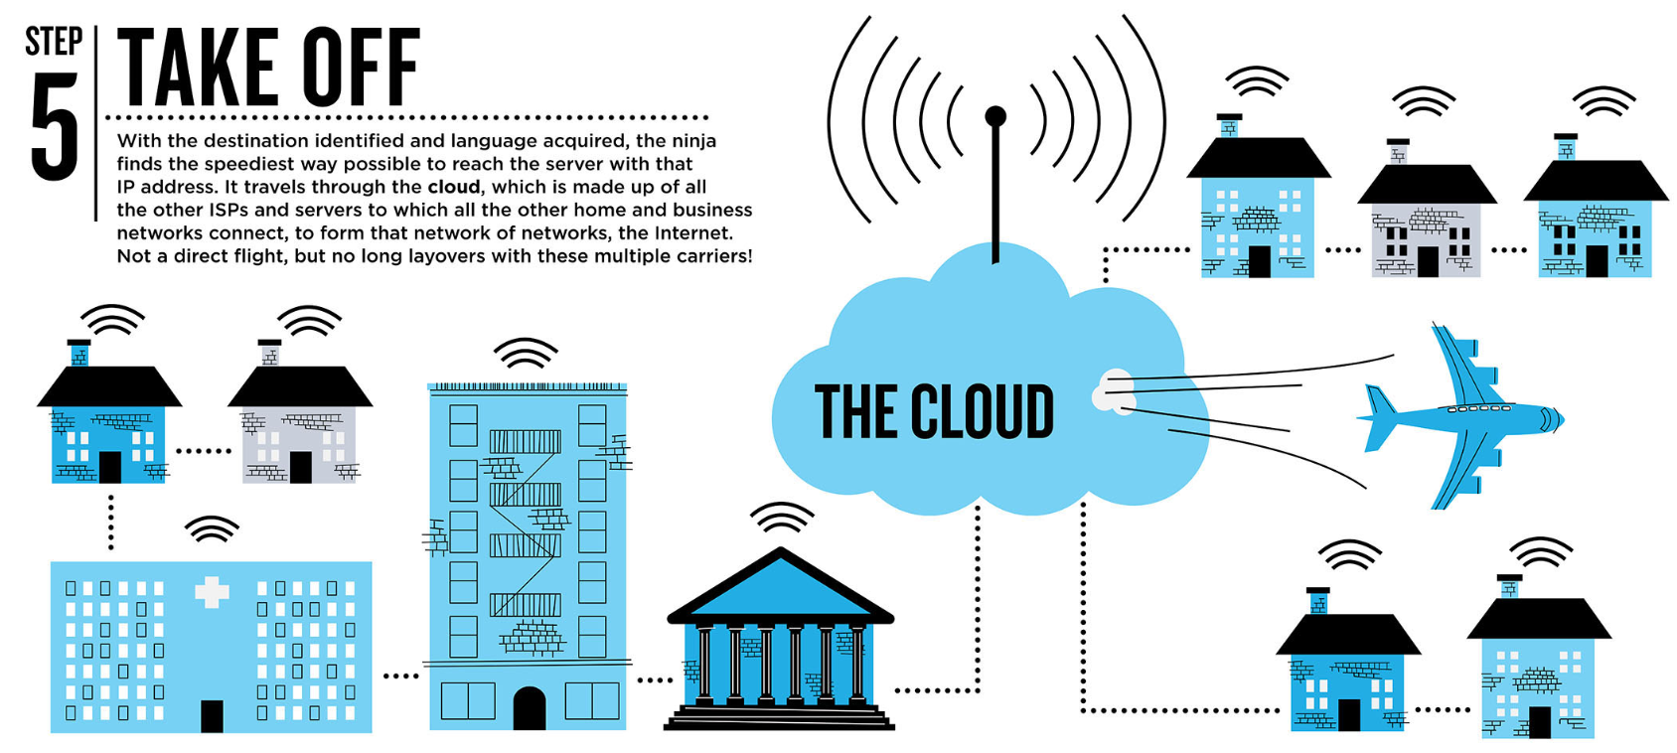

Slide 30
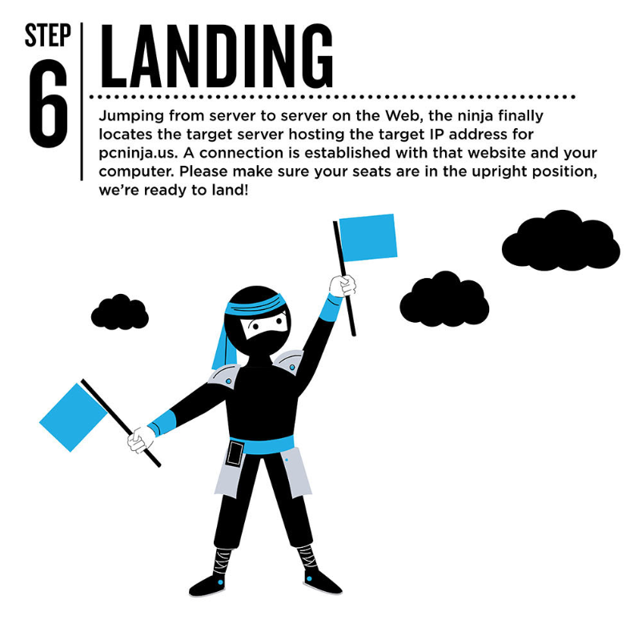

Slide 31
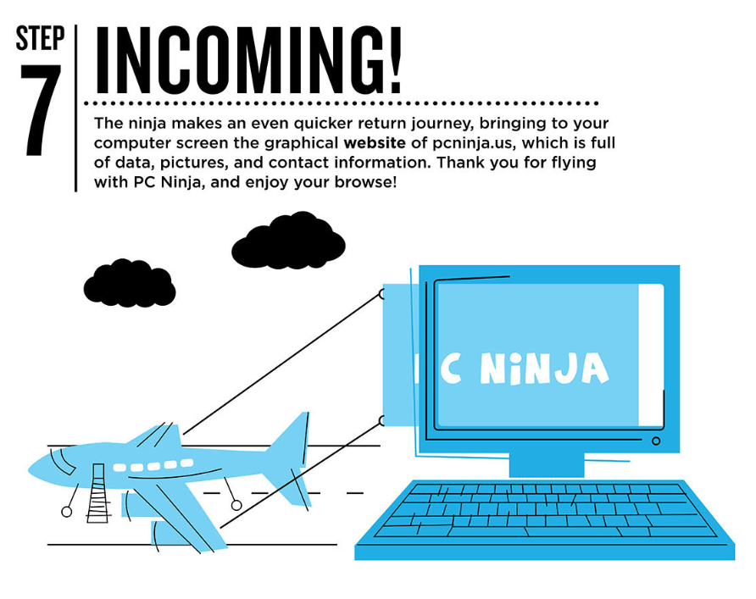

Slide 32
How the Internet works
When you go places on the Internet you are retrieving files that are on computers
You get these files by requesting them from your ISP (Internet Service Provider)
The ISP looks up the location of the file in the DNS (Domain Name Server)
It then asks for the data, e.g. file, you requested
If you have permission, the other computer chops the data into little pieces called packets and sends them
It knows where to send them because your IP address was on the request for the file
When all the data comes back, it is reconstructed and inspected

Slide 33
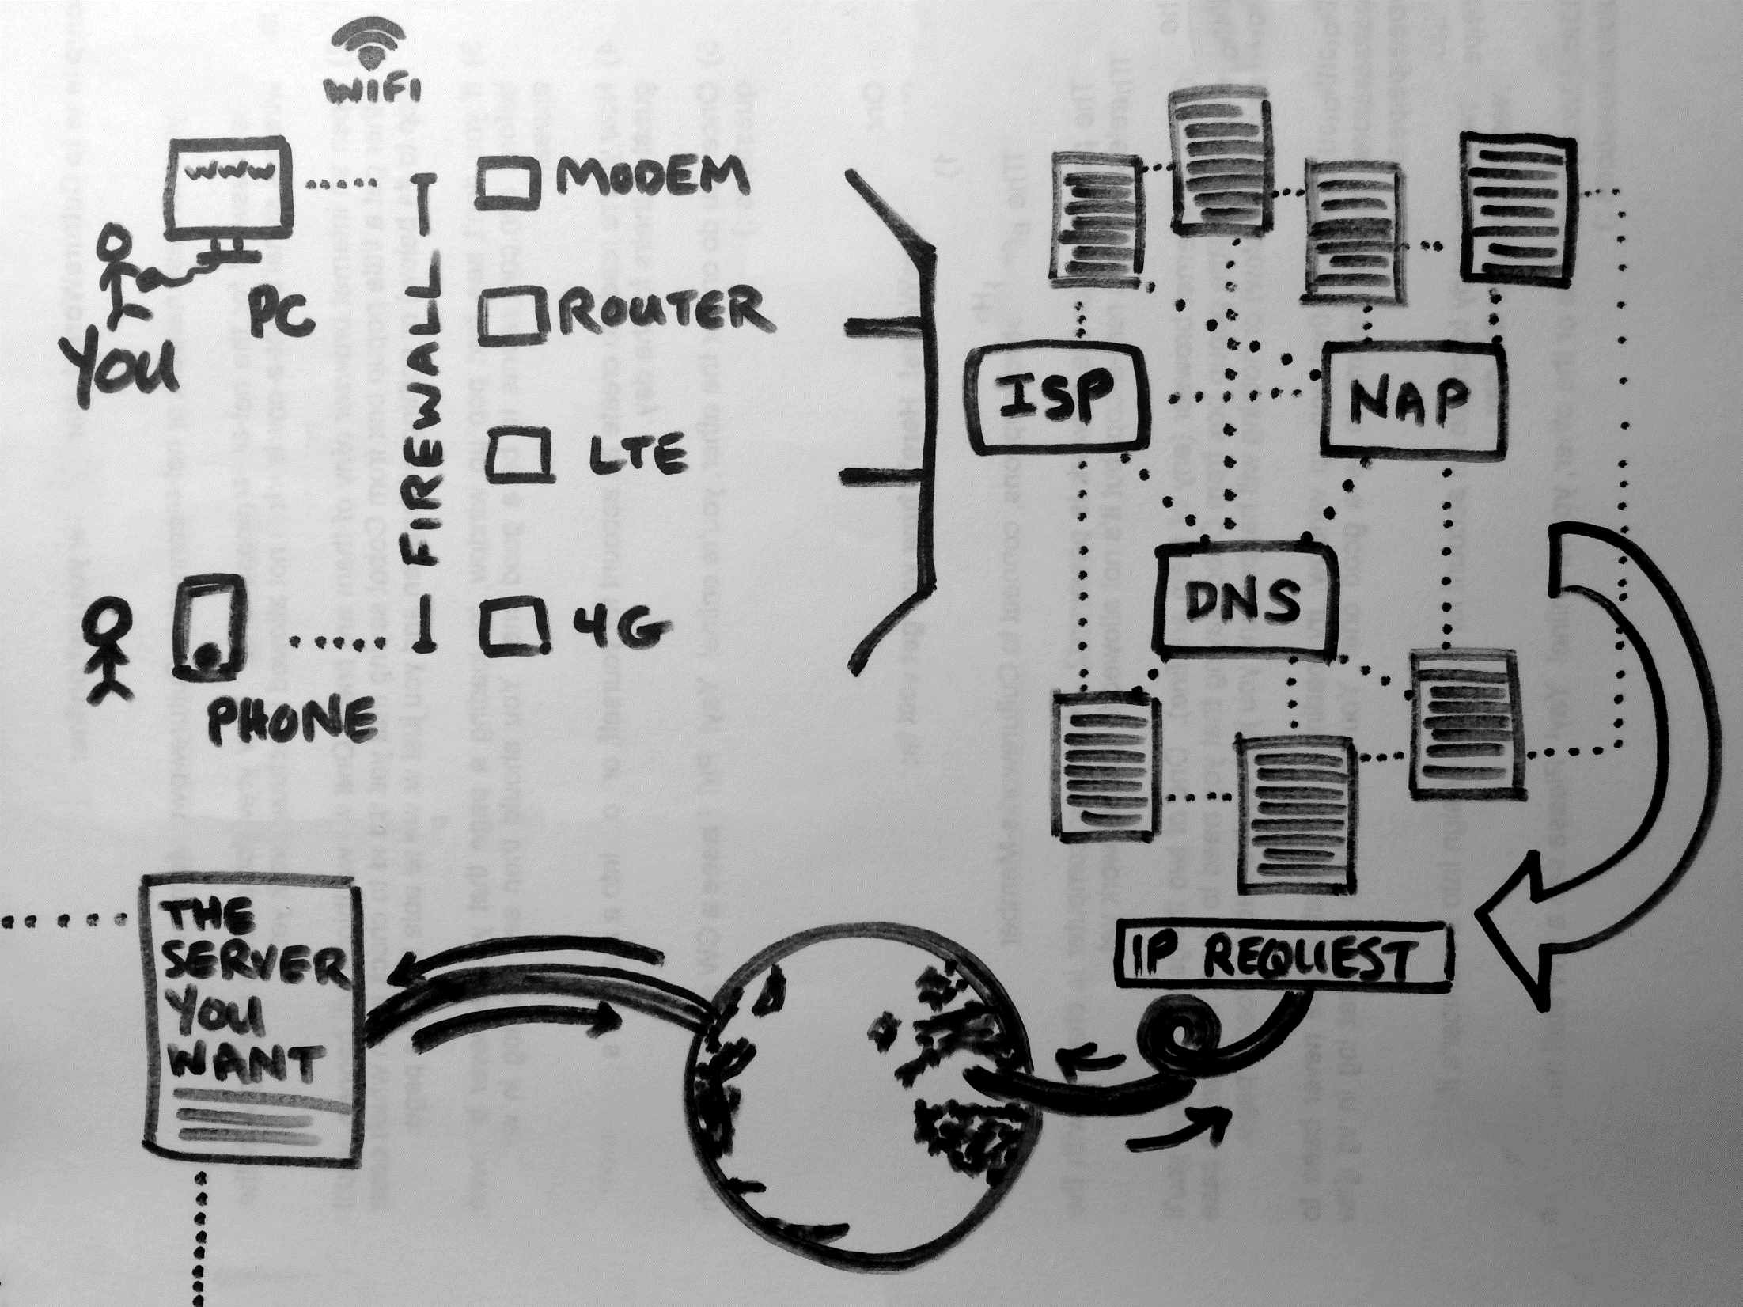
Your teacher’s third grade sketch:
This is a simplified view of what happens when you make a request for web site.
In reality, there is a lot more going on. There are multiple layers of firewall, for example. A request might go from a router to a modem to the ISP. A request might be routed through a proxy server. There are many permutations, but this is the general idea.

Slide 34
Digital Identity Management
In-Class Activity…

Slide 35
Next week
Learn IT # 2 is due 2/19. Email your document to the OWLbox email on the LearnIT2 page
Midterm # 1 & Review : covers Unit 1 and Unit 2 via Examity & Blackboard

