Slide 1
Information Systems in Organizations
1.1 The Modern Organization is a system and set of processes

Slide 2
Course Topics Overview
Unit 1: Introduction
Unit 2: Systems Analysis
Unit 3: Organizational Systems
Unit 4: Consumer Systems
Notes:
http://www.tcf.ua.edu/AZ/ITHistoryOutline.htm

Slide 3
Unit 1: Introduction
1. Introduction to information systems in organizations
  1.1 The modern organization is a system and set of processes
    1.1.1 What is IT, IS, and MIS?
    1.1.2 Evolution of organizational systems from start-up to global enterprise
  1.2 What’s in it for you?
    1.2.1 Systems and your career in business
    1.2.2 Your digital identity
  1.3 Ethics of analysis and use of systems, data, and information

Slide 4
?
What is the current demand for MIS workers?
What is an MIS System?
What do MIS people do?
What are the salary ranges for MIS professionals?
What is MIS?
How is MIS different from Computer Science?
What are the prospects for women in MIS?
Who works in MIS?
What type of programming do you do in MIS?

Slide 5
Some Defintions
IT: all computer based information systems used by organizations and their underlying technologies
IS: the interrelated components that collect, manipulate & disseminate data and info & provide feedback to meet an objective

Slide 6
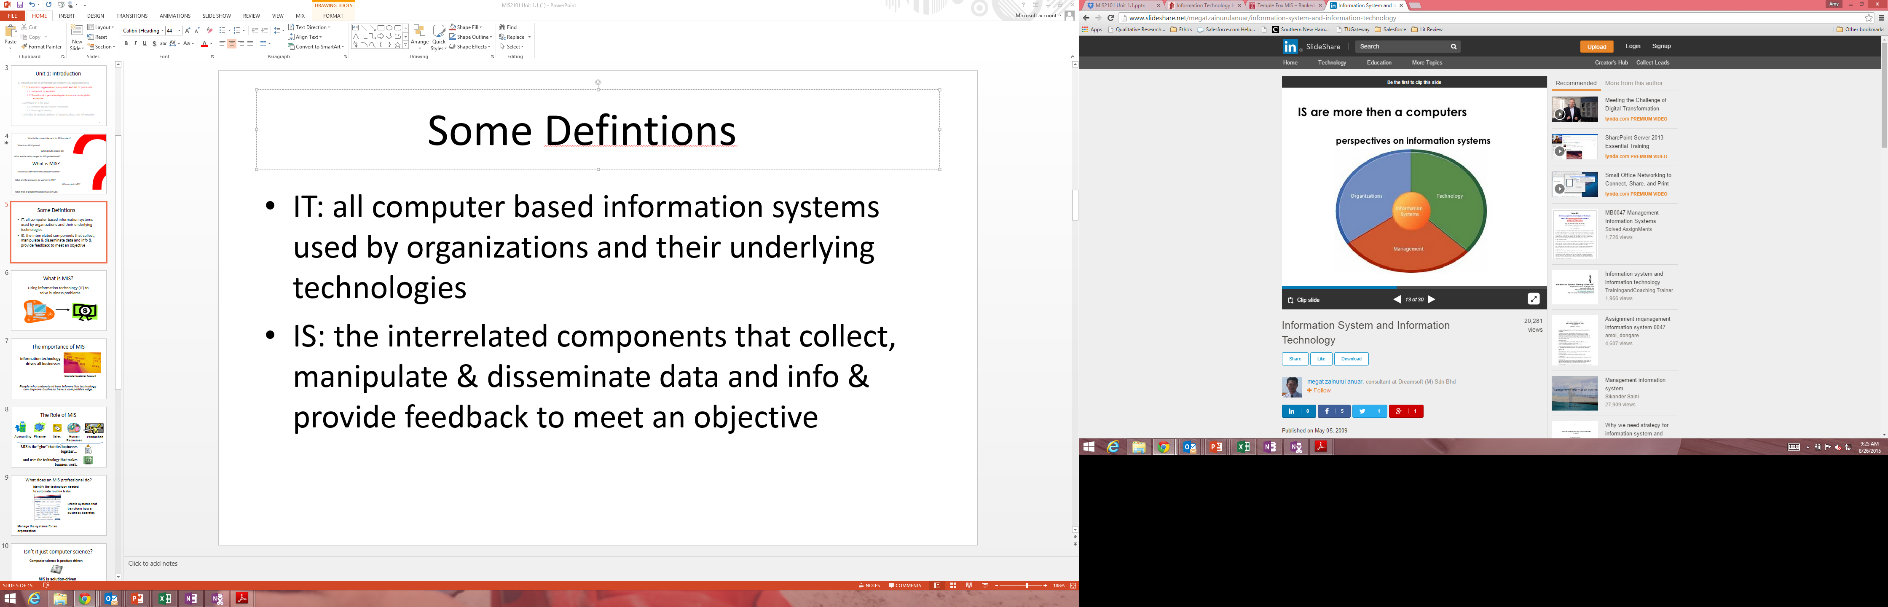

Slide 7
What is MIS?
Using information technology (IT) to
solve business problems

Slide 8

The importance of MIS
Information technology drives all businesses
Example: Customer Account
People who understand how information technology can improve business have a competitive edge

Slide 9
The Role of MIS
Accounting
Finance
Sales
Human Resources
Production
MIS is the “glue” that ties businesses together…
…and uses the technology that makes business work.

Slide 10
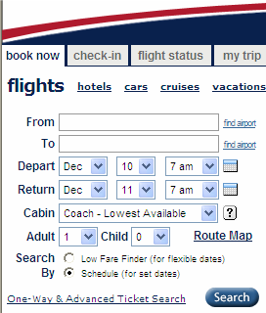
What does an MIS professional do?
Identify the technology needed
to automate routine tasks
Create systems that
transform how a
business operates
Manage the systems for an
organization
Notes:
Automate: Create a system to process airline reservation
Transform: Increase the speed of making an airline reservation by reducing the number of people involved
Manage: Analyze the cost and time it will take to integrate the systems of a newly acquired company (e.g., Usair and AmericaWest)

Slide 11
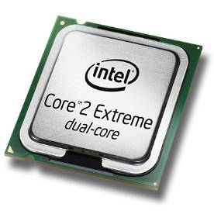
Isn’t it just computer science?
Computer science is product-driven
MIS is solution-driven
Example: Create systems to deliver products to customers

Slide 12
MIS Career Paths
Security Analyst
CIO
Technical support
Systems Architect
Programmer Analyst
Consultant
Application programmer
Data Administrator
Project Manager
Business Analyst
CTO
Software Designer
Data Analyst
Fox MIS Students 100% Placement
Notes:
Systems Analyst/Designer – Redesign Company Intranet
Database Administrator - Design, Implement, Upgrade, Company DB
Information Systems Manager – Over sees a new or existing project
MIS Consultant – Advise companies on newest technologies available
Network Specialist-Monitor and update companies Network
Software Designer-Develop programs for Playstation & pc applications
Web Developer- Design, manage and run web applications
Analyst/Programmer – Program in C#

Slide 13
IS Positions Rank Among the
Best Jobs in America
Rank | Career | Job Growth (10-year forecast) | Median Pay
1 | Software developer | 32% | $82,400
2 | Physical therapist | 30% | $75,900
3 | Financial adviser | 30% | $93,900
4 | Civil engineer | 24% | $74,700
5 | Marketing specialist | 28% | $52,200
6 | Management consultant | 24% | $111,000
7 | IT consultant | 20% | $96,500
8 | Database administrator | 20% | $86,600
9 | Financial analyst | 20% | $62,600
10 | Environmental engineer | 31% | $81,200
Notes:
Of the best 10 positions in America, information systems professions rank 7 and 8, Information Technology Consultants and Database Administrators. In fact, the related profession of Software Developer ranks as number one.

Slide 14
?
Corporate culture?
Founders?
Hiring process?
Risks/rewards of joining an early startup?
Compensation?
Who wants to work for a startup?
Potential for the product or service?
Long hours?
Any red flags?
Who’s footing the bills?
Why do you want to work for a startup?

Slide 15
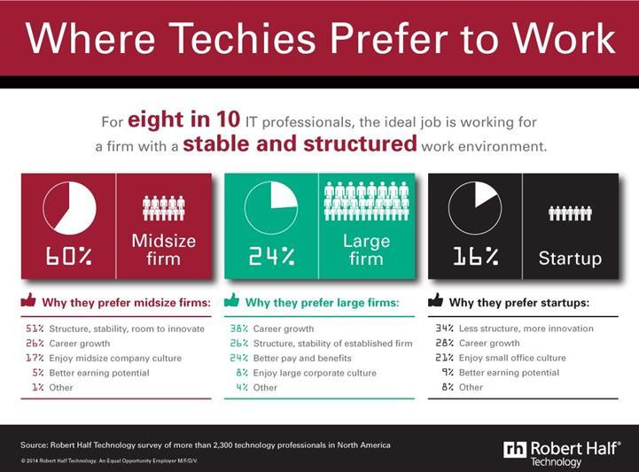

Slide 16
Unit 1: Introduction
1. Introduction to information systems in organizations
  1.1 The modern organization is a system and set of processes
    1.1.1 What is IT, IS, and MIS?
    1.1.2 Evolution of organizational systems from start-up to global enterprise
  1.2 What’s in it for you?
    1.2.1 Systems and your career in business
    1.2.2 Your digital identity
  1.3 Ethics of analysis and use of systems, data, and information

