Slide 1
Information Systems in Organizations
1.2 What’s in it for you?
1.3 Ethics of analysis and use of systems, data and information

Slide 2
Course Topics Overview
Unit 1: Introduction
Unit 2: Systems Analysis
Unit 3: Organizational Systems
Unit 4: Consumer Systems

Slide 3
Unit 1: Introduction
1. Introduction to information systems in organizations
  1.1 The modern organization is a system and set of processes
    1.1.1 What is IT, IS, and MIS?
    1.1.2 Evolution of organizational systems from start-up to global enterprise
  1.2 What’s in it for you?
    1.2.1 Systems and your career in business
    1.2.2 Your digital identity
  1.3 Ethics of analysis and use of systems, data, and information

Slide 4
?
What kind of money can you make?
Are there jobs in MIS?
Required education?
Future demand?

Slide 5
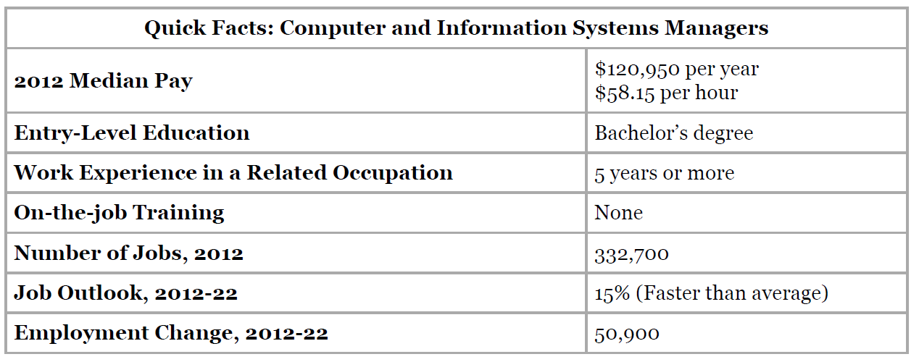
Bureau of Labor Statistics, U.S. Department of Labor, Occupational Outlook Handbook, 2014-15 Edition, Computer and Information Systems Managers. Updated 1/8/2014

Slide 6
Important Qualities
Analytical Skills
Communication Skills
Decision-Making Skills
Leadership Skills
Organization Skills

Slide 7
?
Real-world Identity
Partial Identity
What is your digital identity?
Persona
Online Identity

Slide 8
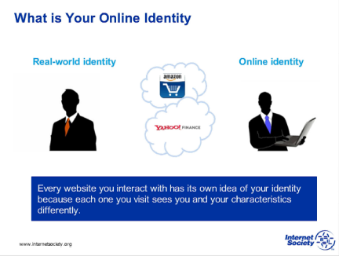

Slide 9
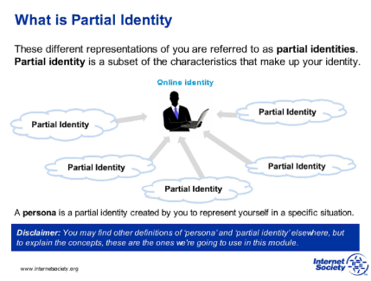

Slide 10
Learn IT #1
Digital Identity Assignment
Complete Part 1, Part 2, Part 3 and Part 4 of document

Slide 11
?
This isn’t Ethics class.
Why do we care about information ethics?

Slide 12
Information Ethics
Information Privacy
Information Accuracy
"the branch of ethics that focuses on the relationship between the creation, organization, dissemination, and use of information, and the ethical standards and moral codes governing human conduct in society” - Wikipedia
Information Property
Information Accessibility
Notes:
These are the four areas that we current discuss regarding Computer Ethics. Discuss the same four areas.

Slide 13
Unit 1: Introduction
1. Introduction to information systems in organizations
  1.1 The modern organization is a system and set of processes
    1.1.1 What is IT, IS, and MIS?
    1.1.2 Evolution of organizational systems from start-up to global enterprise
  1.2 What’s in it for you?
    1.2.1 Systems and your career in business
    1.2.2 Your digital identity
  1.3 Ethics of analysis and use of systems, data, and information

