Slide 1
Information Systems in Organizations
3.1.2. Managing the business: decision-making
3.1.3. Growing the business: knowledge management, R&D, and social business

Slide 2
Course Topics Overview
Unit 1: Introduction
Unit 2: Systems Analysis
Unit 3: Organizational Systems
Unit 4: Consumer Systems

Slide 3
Unit 3: Organizational Systems
How do large firms function today?
3.1. Types of systems in organizations
  3.1.1. Running the business: enterprise systems (ERP)
  3.1.2. Managing the business: decision-making (analytics, BI, dashboards)
  3.1.3. Growing the business: knowledge management, R&D, and social business

Slide 4
Unit 3: Organizational Systems
3.2. Systems management
  3.2.1. Business analysis, requirements, and systems acquisition
  3.2.2. Developing systems: programming, testing, and deployment
  3.2.3. Systems integration: standards, interoperability, and external collaboration
  3.2.4. Managing risk: security, hackers, and privacy

Slide 5
Unit 3: Organizational Systems
3.3. Digital business innovation
  3.3.1. Generating IT value
  3.3.2. Competitive advantage of digital business models

Slide 6
So what is this data analytics stuff all about?
One application of data analytics…
If a baseball team can do this and dramatically improve their standings, how much easier is it for a business to do these sorts of things and dramatically improve their balance sheet?
Notes:
This is a great movie that gets people thinking about data driven decision making. If a baseball team can do this and dramatically improve their standings, how much easier is it for a business to do these sorts of things and dramatically improve their balance sheet?

Slide 7
?
What is “Data Analytics”?
Notes:
Just get students talking about Data Analytics

Slide 8
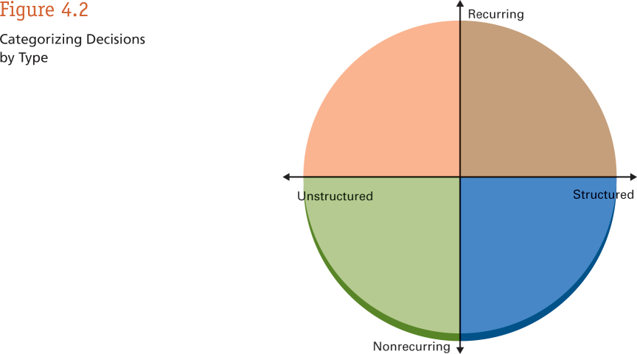
Types of Decisions You Face
Notes:
Business professionals need to make lots of different types of decisions. The more structured and more often the recur, the easier they are to make. The less structured they are and the less frequently they recur, the more difficulty they are to make. Decision Support Systems (DSS) can utilize Data Analytics to help improve your decision making when it comes to less structured, infrequently made decisions.
Ask students for examples of the types of decisions that they make at work (probably more structured and recurring) as well as the decisions the senior leadership in their organization (probably less structured and less frequently recurring) make and plot them on this graphic.

Slide 9
Define the problem.
Identify limiting factors.
Develop potential alternatives
Analyze the alternatives
Select the best alternative
Implement the decision
Establish a control and evaluation system
Notes:
Make sure you are defining the correct problem
Make sure you are analyzing the alternatives accurately and not in a bubble – take in to consideration all factors, don’t let people be
Critical right away – allow for people to make suggestions
The best alternative is the one that produces the most advantages and the fewest serious disadvantages. Sometimes, the selection process can be fairly straightforward, such as the alternative with the most pros and fewest cons. Other times, the optimal solution is a combination of several alternatives.
Sometimes, though, the best alternative may not be obvious. That's when a manager must decide which alternative is the most feasible and effective, coupled with which carries the lowest costs to the organization.

Slide 10
Scenario – Warehouse Manager
You know you have too much cash tied up in inventory. You want to reduce inventory levels.
You get a lot of heat when orders are placed and you can’t fill the order from inventory.
What information do you need, how would you like to see it and how do you make decisions about adjusting inventory levels?
Are these structured or unstructured decisions?
Notes:
Have students work in teams of 2-3 to answer these questions as the Warehouse Manager.
LogsPlus Implementation:
$200 million tied up in inventory
Spend $1 million on new system to safely reduce inventory levels 10%
New system would actually be a better job at reducing “stock outs”
Use that $20 million to put more salespeople out in the field.
What could your organization do with that $20 million?

Slide 11
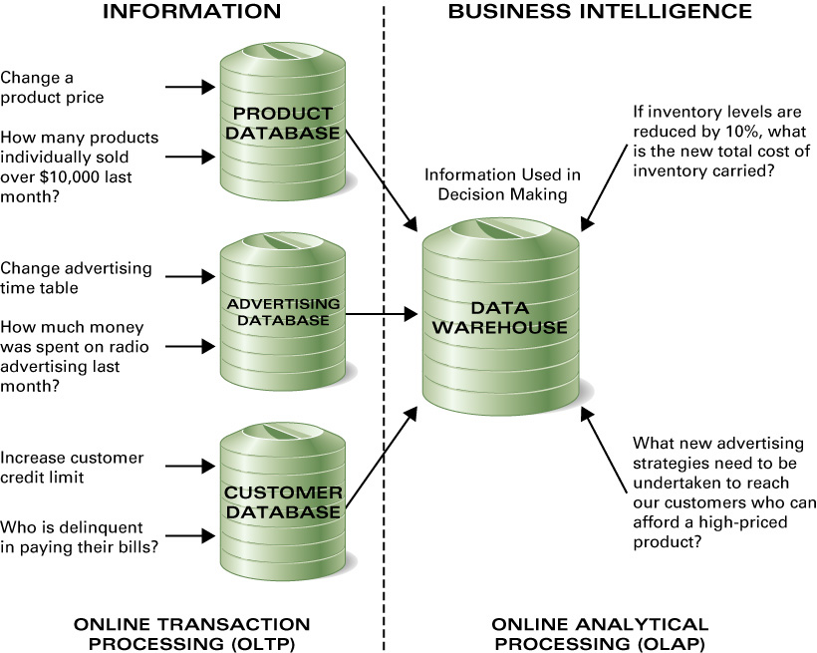
Databases & Data Warehouses
Operational Databases
Notes:
Talk about the world of OLTP and Operational Databases and how they feed our Data Warehouses, the realm of OLAP, DSS and Data Analytics

Slide 12
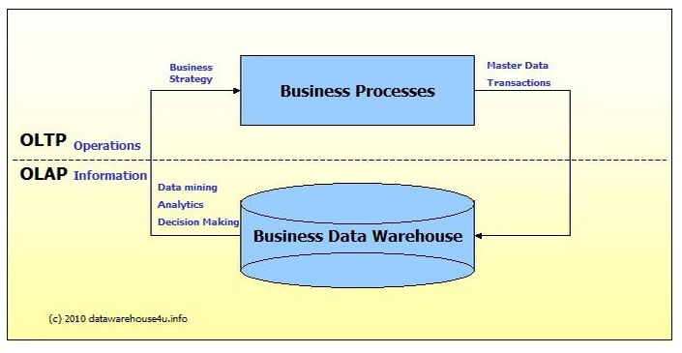
Notes:
http://datawarehouse4u.info/OLTP-vs-OLAP.html

Slide 13
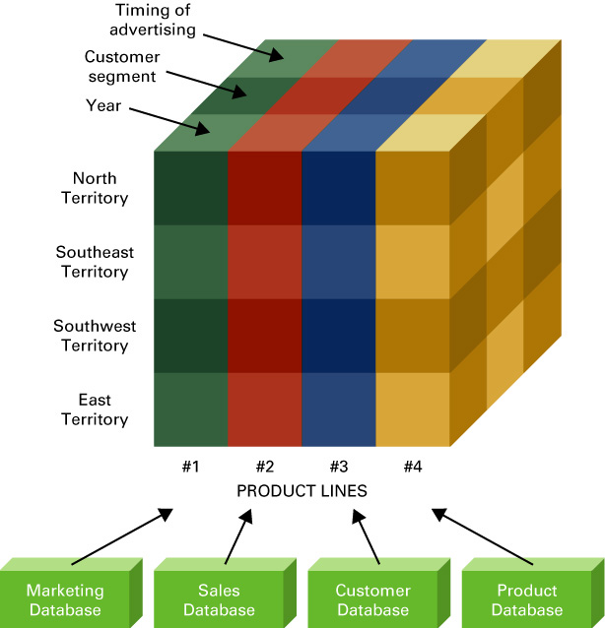
What Is a Hypercube?
Create multi-dimensional “cubes” of information that summarize transactional data across a variety of dimensions.
OLAP vs. OLTP
Envisioned by smart businesspeople, built by the IT pros

Slide 14
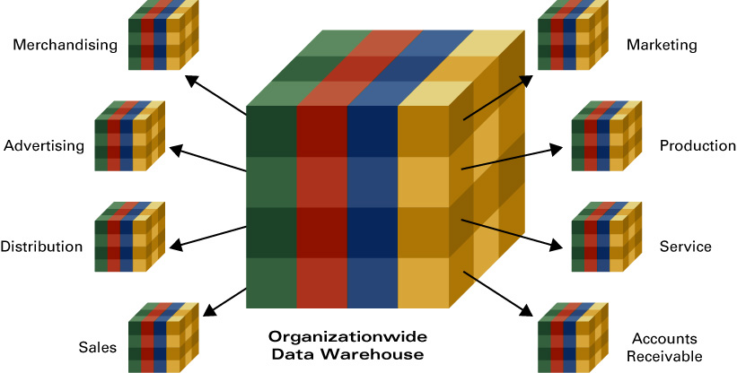
Data Marts

Slide 15
Big Data Opportunities
Will you be a player?
Notes:
Just a quick video to get students thinking that they need to leverage big data.

Slide 16
?
What is “Knowledge Management”?

Slide 17
Question
What is a “Baby Boomer” and how many of them are in the workforce today?
How many will be in the workforce 10 years from now?
What is “Tacit Knowledge”?
Why is this keeping CEOs awake at night?
Is there technology that we can use to help with this?

Slide 18
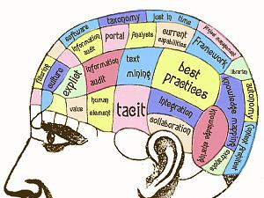
Notes:
Talk about all of the important information that is stored in the heads of people and ask how the organization can leverage these assets when they are stored in people’s heads.

Slide 19
Extra Credit
Worth up to 5 points on your midterm exam grade
Article related to a class topic – infoweek, wsj, business insider, etc…
Create a 3 minute presentation on the article
Present at the beginning of class
Articles must be submitted & approved

Slide 20
Domain
Community
Community of Practice
Practice
Notes:
knowledge is a critical asset that needs to be managed strategically. Initial efforts at managing knowledge had focused on information systems with disappointing results. Communities of practice provided a new approach, which focused on people and on the social structures that enable them to learn with and from each other.
Communities of practice enable practitioners to take collective responsibility for managing the knowledge they need, recognizing that, given the proper structure, they are in the best position to do this.
Communities among practitioners create a direct link between learning and performance, because the same people participate in communities of practice and in teams and business units.
Practitioners can address the tacit and dynamic aspects of knowledge creation and sharing, as well as the more explicit aspects.
Communities are not limited by formal structures: they create connections among people across organizational and geographic boundaries.

Slide 21
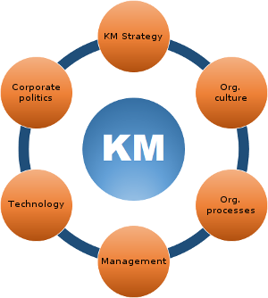
What are the benefits of Knowledge Management?
What are the challenges of Knowledge Management?
Notes:
Talk about knowledge management.
The goal is to capture, organize and leverage knowledge (our most important asset) with technology.
Ask the students to list some of the benefits of doing this?
Ask students to list some of the challenges?
Employee buy-in
Knowledge overload
Information obsolesce
Being enamored by the technology and forgetting the goal

Slide 22
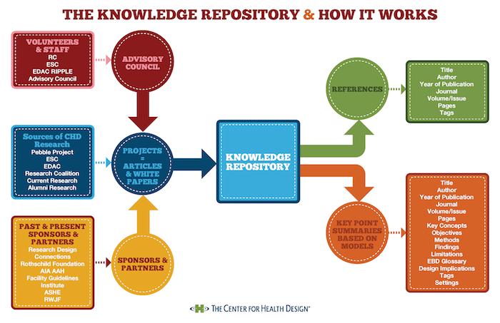

Slide 23


Slide 24
Unit 3: Organizational Systems
How do large firms function today?
3.1. Types of systems in organizations
  3.1.1. Running the business: enterprise systems (ERP)
  3.1.2. Managing the business: decision-making (analytics, BI, dashboards)
  3.1.3. Growing the business: knowledge management, R&D, and social business

Slide 25
Unit 3: Organizational Systems
3.2. Systems management
  3.2.1. Business analysis, requirements, and systems acquisition
  3.2.2. Developing systems: programming, testing, and deployment
  3.2.3. Systems integration: standards, interoperability, and external collaboration
  3.2.4. Managing risk: security, hackers, and privacy

Slide 26
Unit 3: Organizational Systems
3.3. Digital business innovation
  3.3.1. Generating IT value
  3.3.2. Competitive advantage of digital business models

