Slide 1
Procure to Pay
In-Class Activity…

Slide 2
Roadmap
Week 1: Intro to MIS
Week 2: Systems Analysis
Week 3: Systems Analysis
Week 4: Systems Analysis
Week 5
Swimlanes
ERDs
Decision Trees
Architecture Diagrams
Exam #1
Learn IT! #1
Max Labs 0
What is MIS?
Week 6: Organizational Systems
Week 7: Organizational Systems
Week 8: Organizational Systems
Week 9
Decision Support
SDLC
Exam #2
ERP
Knowledge Management
Digital Innovation
Max Labs 1a & 1b
Week 10: Organizational Systems
Week 11: Organizational Systems
Platforms
Week 13: Organizational Systems
Week 14
Customer Relationship Management Systems
Cloud Computing
Artificial Intelligence
Exam #3 Prep
Supply Chain Management Systems
Week 12: Organizational Systems
Max Labs 3a & 3b
Learn IT! #2
Max Labs 2a & 2b

Slide 3
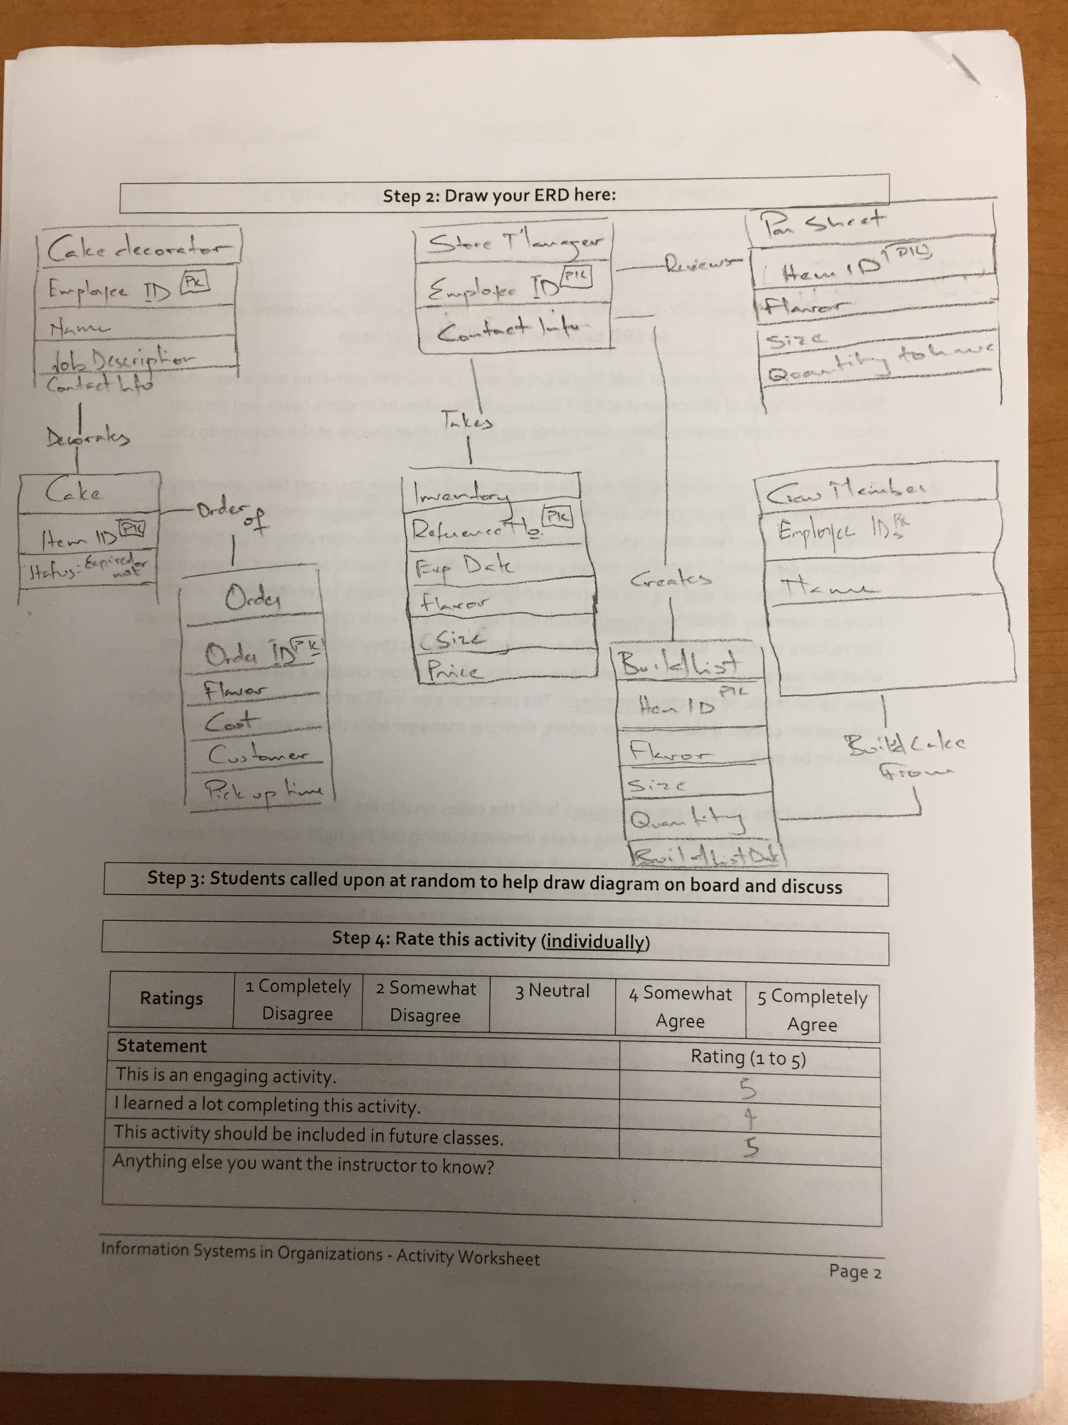
Worksheets will not be returned
In-class activities reinforce what was covered in
Assigned reading
Assigned videos
Lecture
Worksheets do NOT include new material that will be on exams
No need to study from worksheets to be successful on exams
Feel free to take pictures of your worksheets if you’d like

Slide 4
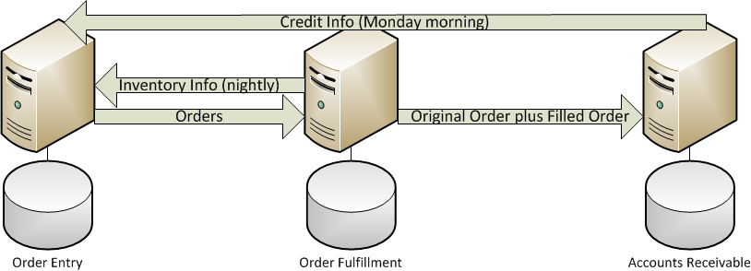
Legacy Systems
Sales
Warehouse
Accounting
Notes:
Show them the legacy systems that support the O2C process. Highlight that they are separate systems that really do make each of the individual functional areas more efficient/effective but point out some of the problems with legacy systems.
Problems with legacy systems:
Standalone systems – Not designed to work with each other.
Make each functional area more efficient/effective but not organization as a whole.
Multiple copies of data can make decision making a challenge.
You must build and support the system interfaces.
System interfaces must run like clockwork of chaos ensues.
Different computing platforms can be a challenge.
Every system interface can be designed differently.

Slide 5
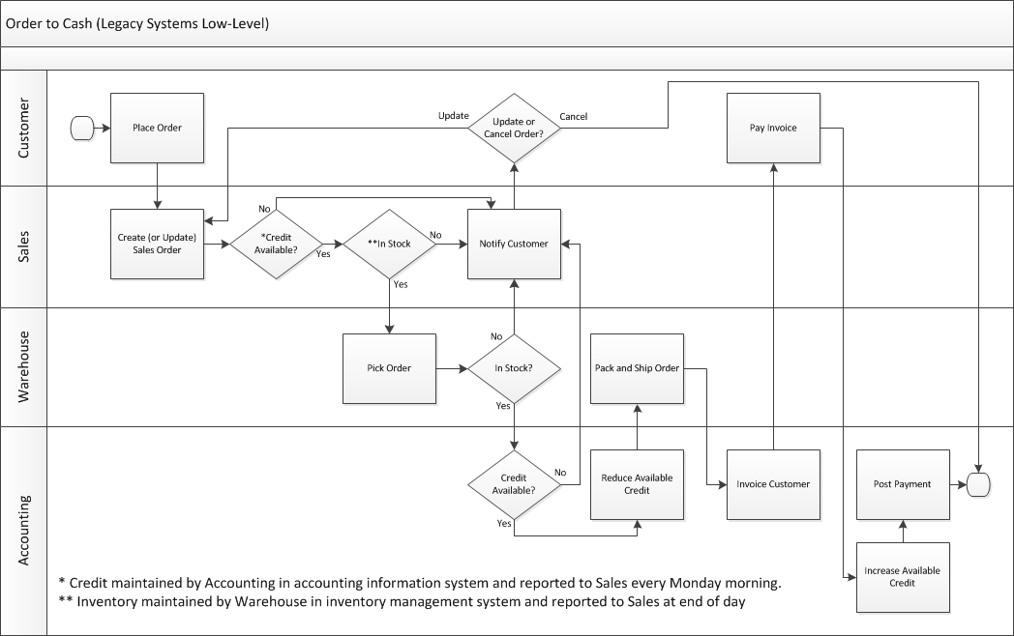
Does your customer view your organization as the “well oiled machine”?
What kind of non-value added work is created when inventory data or credit data is old?
Notes:
Talk about the chaos that occurs when we make decisions based on old data like mistakenly accepting an order when the customer has exceeded their credit limit or mistakenly rejecting an order when we think a customer is exceeding their credit limit but just paid their invoices. Talk about the chaos that occurs when you accept an order but you’re actually out of stock.
What kind of image does your customer get when you can’t even take an order without some sort of chaos?

Slide 6
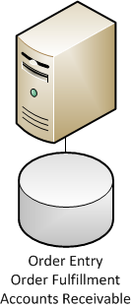
Enterprise System
Sales + Warehouse + Accounting
How many copies of data do I have?
How much non-value added work do I eliminate when inventory and credit data are current?
How much better is my decision making with a single copy of all data?
How much happier are your customers when they are dealing with the “well oiled machine”?

Slide 7
Procure to Pay (P2P)
What:
Review a narrative of the P2P process
Construct a swimlane diagram of how this process is currently performed
See how the implementation of an ERP can dramatically simplify this process
Why:
ERP systems can simplify business processes, making them much more efficient and much more effective
If your organization is not operating at this level of efficiency and effectiveness but your competitors are, you are at a major competitive disadvantage
It’s all about leveraging technology to gain competitive advantage!

Slide 8
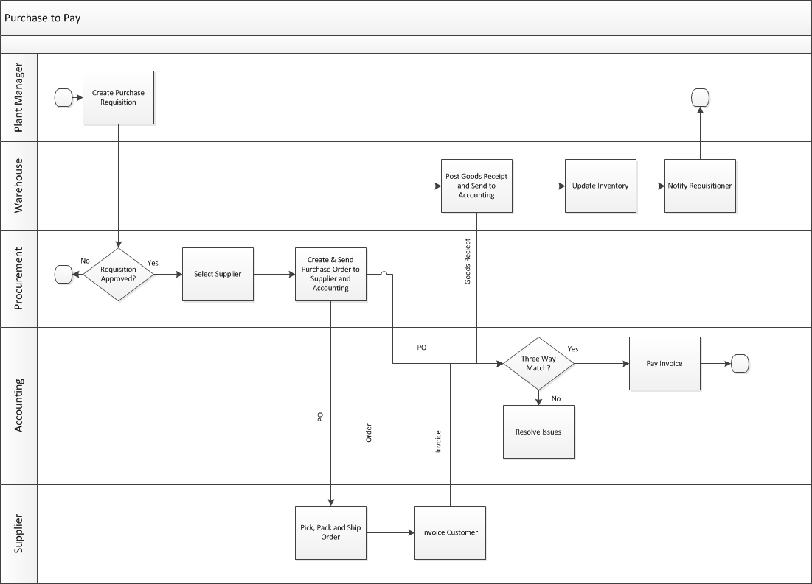

Slide 9
