Slide 1
Enterprise Systems
In-Class Activity…

Slide 2
Roadmap
Week 1: Intro to MIS
Week 2: Systems Analysis
Week 3: Systems Analysis
Week 4: Systems Analysis
Week 5
Swimlanes
ERDs
Decision Trees
Architecture Diagrams
Exam #1
Learn IT! #1
Max Labs 0
What is MIS?
Week 6: Organizational Systems
Week 7: Organizational Systems
Week 8: Organizational Systems
Week 9
Decision Support
SDLC
Exam #2
ERP
Knowledge Management
Digital Innovation
Max Labs 1a & 1b
Week 10: Organizational Systems
Week 11: Organizational Systems
Platforms
Week 13: Organizational Systems
Week 14
Customer Relationship Management Systems
Cloud Computing
Artificial Intelligence
Exam #3 Prep
Supply Chain Management Systems
Week 12: Organizational Systems
Max Labs 3a & 3b
Learn IT! #2
Max Labs 2a & 2b

Slide 3
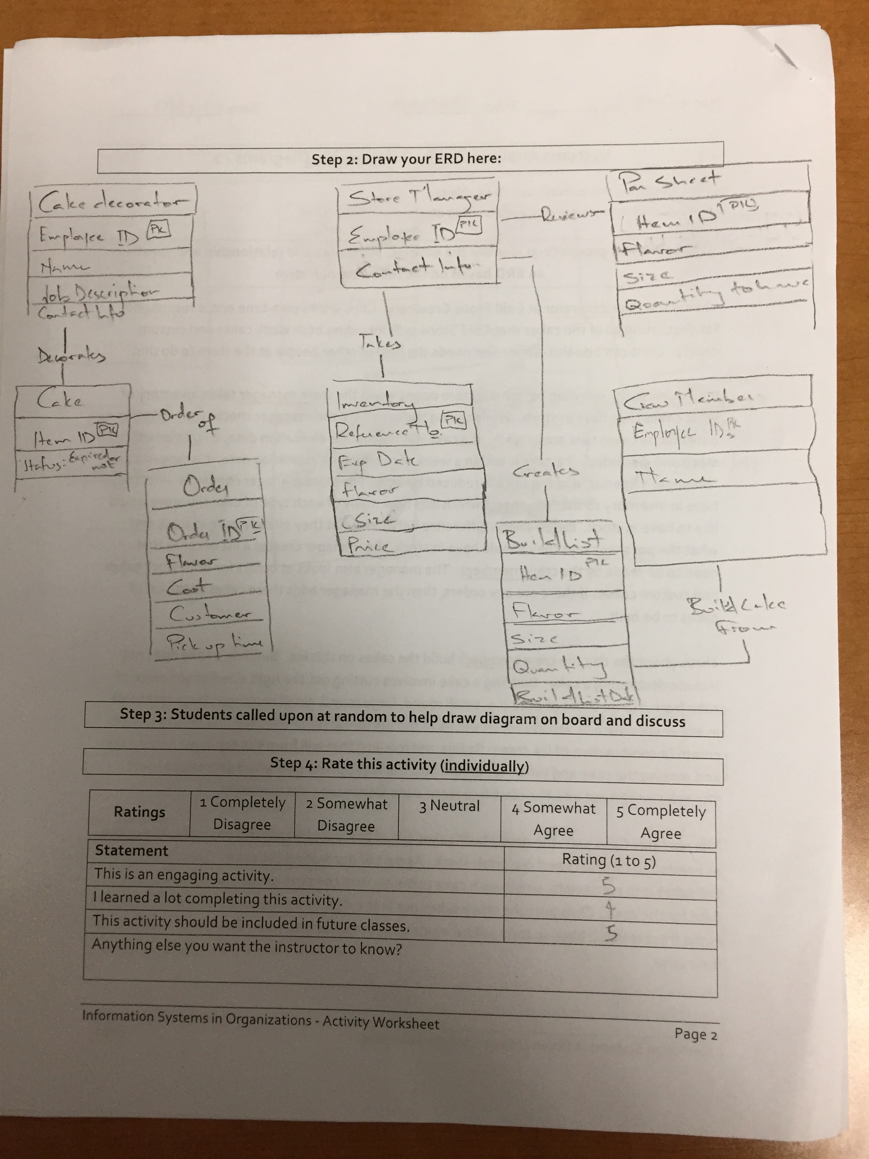
Worksheets will not be returned
In-class activities reinforce what was covered in
  Assigned reading
  Assigned videos
  Lecture
Worksheets do NOT include new material that will be on exams
No need to study from worksheets to be successful on exams
Feel free to take pictures of your worksheets if you’d like

Slide 4
Notes:
This is an example of a system interface map for a global Fortune 500 company (Rohm and Haas) before they implemented SAP. Each dot is a system. Each line is an interface.
Companies get like this over a few decades adding one system after another until they have this mess.
90+% of the IT organization’s budget was spent simply keeping these systems and these interfaces up and running. There wasn’t any money left over to do interesting and innovative things that could really help the business.

Slide 5
Notes:
This is the system interface map after Rohm and Haas implemented SAP. The collection of boxes in the middle is actually a single SAP system (each box is a separate module in this single system).
There are still quite a few systems but far fewer and all of the interfaces work the exact same way making support MUCH easier and MUCH less expensive.
In the end the organization spent far less money keeping systems and interfaces up and running and could invest much more money on projects that created value for the organization.

Slide 6
ERP Benefits
A single database providing superior, real-time, data-driven decision making
Standardizing business processes based on industry best practices
  Force business process reengineering
Reduced operating costs
  Rohm and Haas saved $200 million/year

Slide 7

Enterprise Systems
What:
Review a narrative describing the benefits of investing in an ERP for a fictitious company, Fittersnacker
Look at the P&L statement for Fittersnacker and see how this investment will impact the P&L statement
Determine if this will be a good investment or a bad investment for Fittersnacker
Why:
Investing in an ERP system is a business decision, not a technology decision
Like all investments, great investments have a great return
You need to look at investments in technology just like every other investment

