Slide 1
Filling in the Income Statement
In-Class Activity…

Slide 2
Roadmap
Week 1: Intro to MIS
Week 2: Systems Analysis
Week 3: Systems Analysis
Week 4: Systems Analysis
Week 5
Swimlanes
ERDs
Decision Trees
Architecture Diagrams
Exam #1
Learn IT! #1
Max Labs 0
What is MIS?
Week 6: Organizational Systems
Week 7: Organizational Systems
Week 8: Organizational Systems
Week 9
Decision Support
SDLC
Exam #2
ERP
Knowledge Management
Digital Innovation
Max Labs 1a & 1b
Week 10: Organizational Systems
Week 11: Organizational Systems
Platforms
Week 13: Organizational Systems
Week 14
Customer Relationship Management Systems
Cloud Computing
Artificial Intelligence
Exam #3 Prep
Supply Chain Management Systems
Week 12: Organizational Systems
Max Labs 3a & 3b
Learn IT! #2
Max Labs 2a & 2b

Slide 3
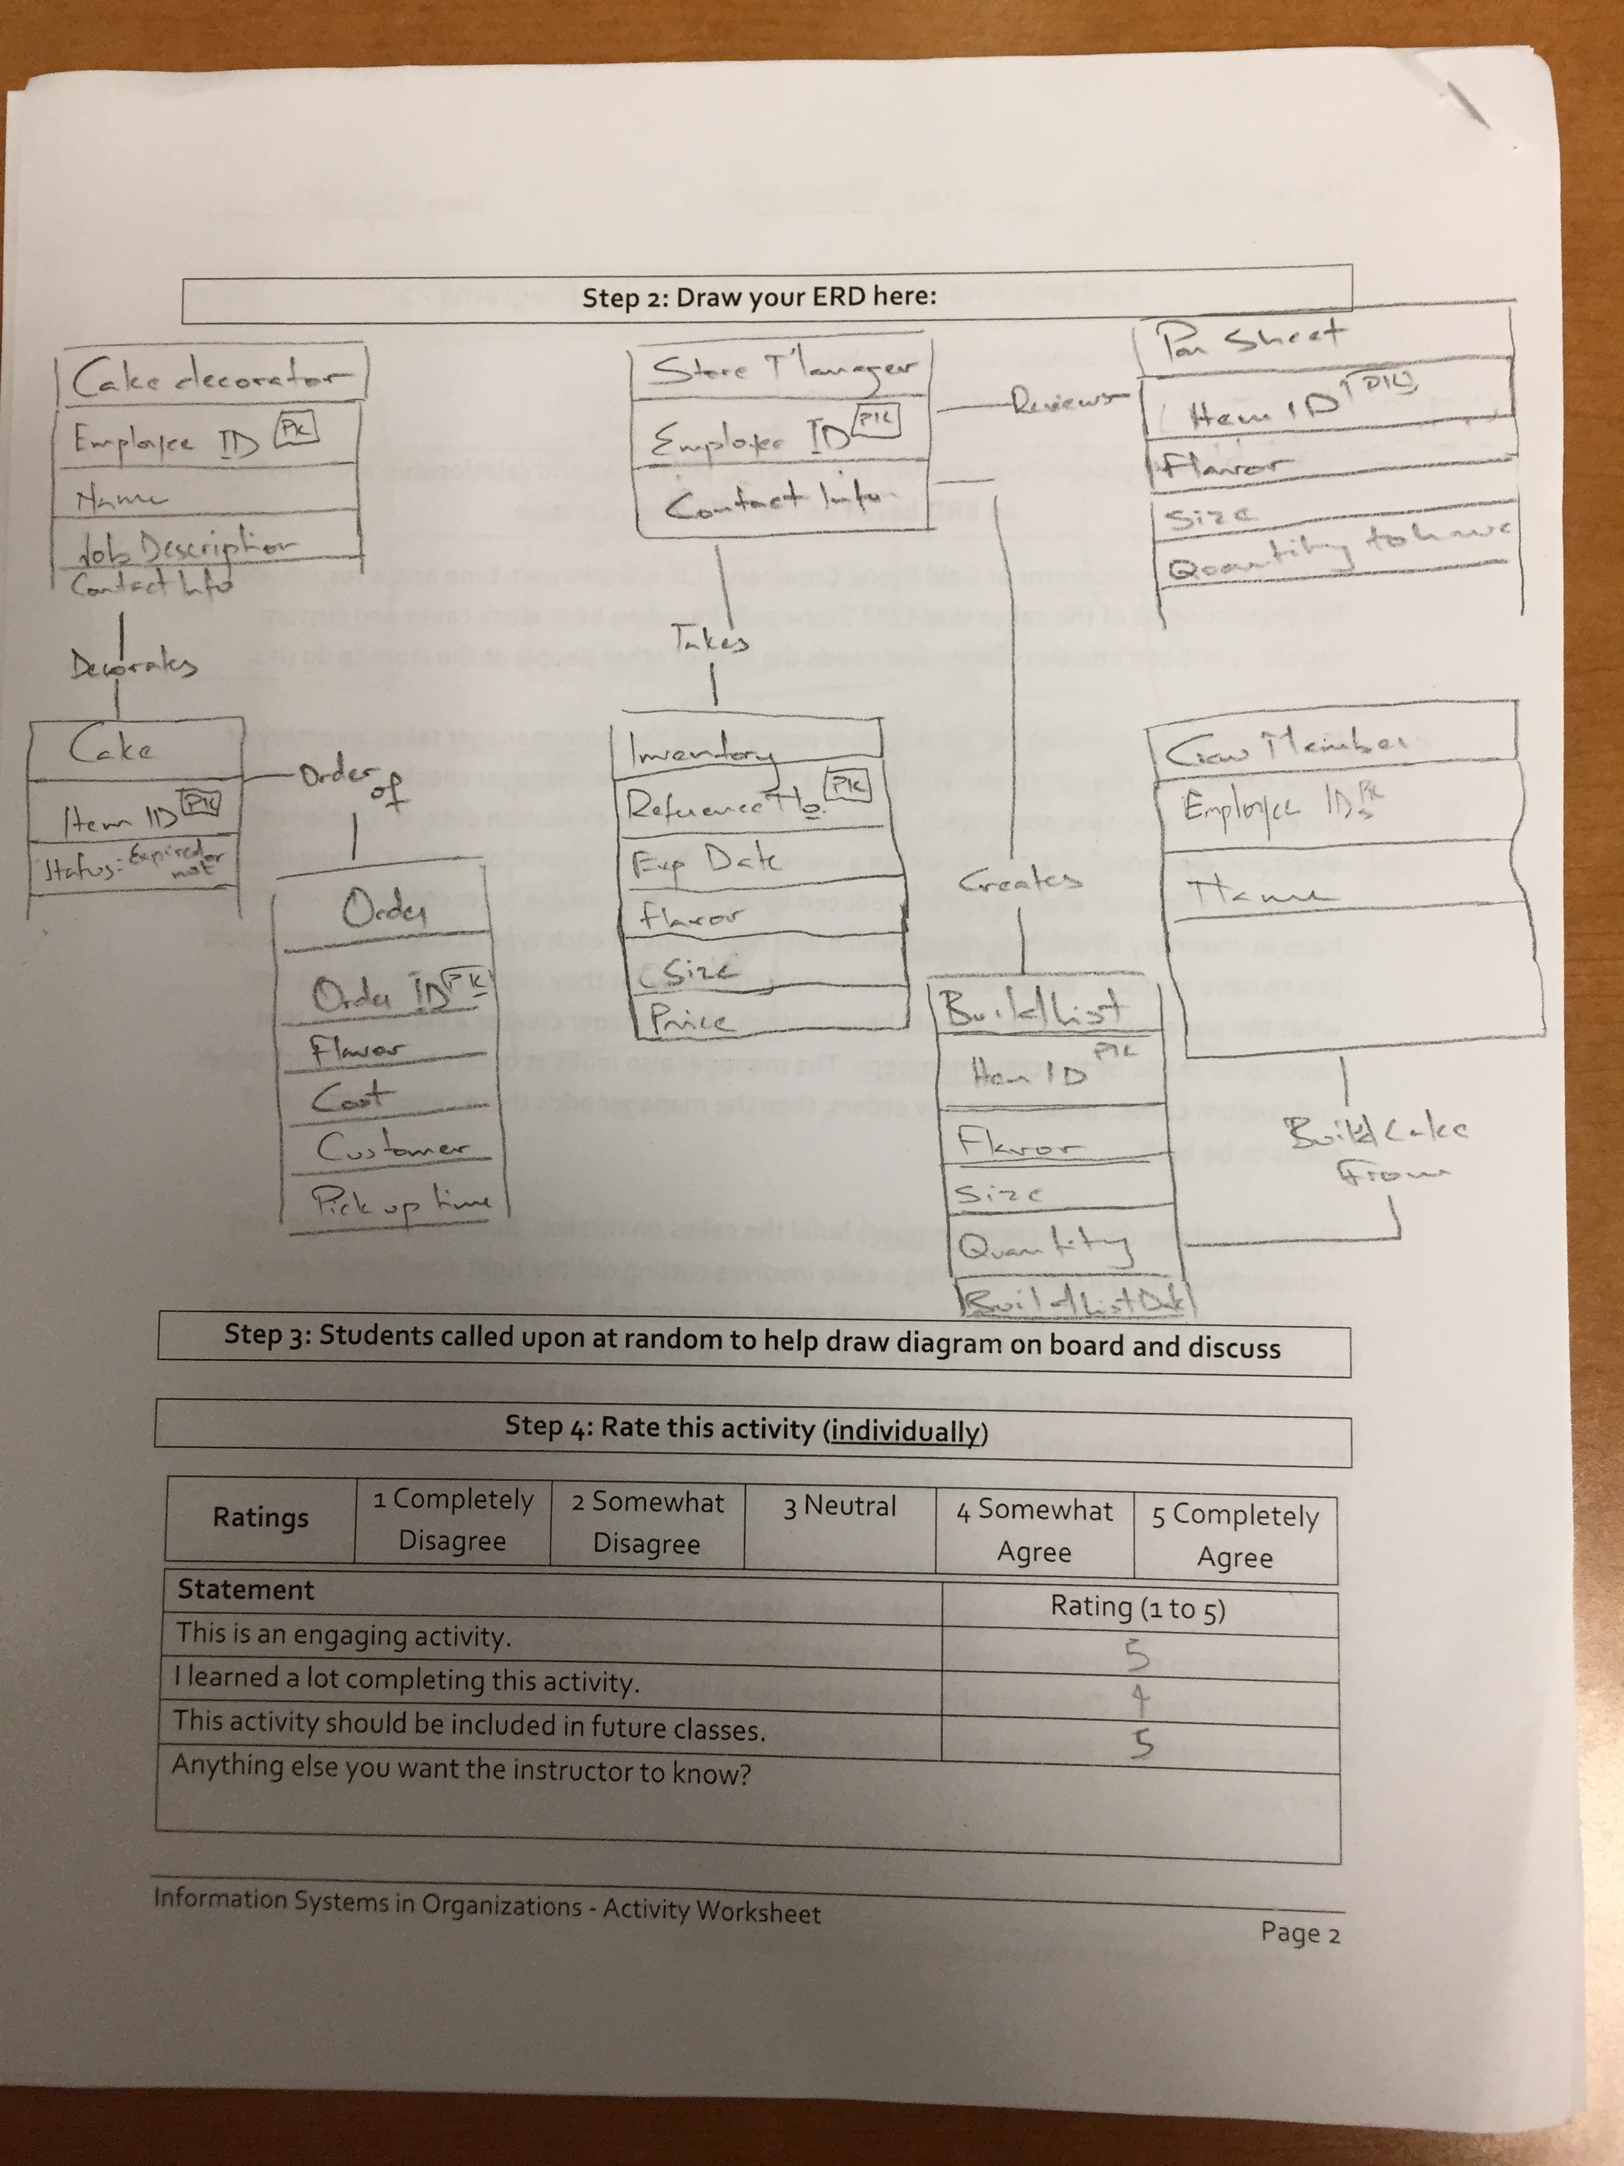
Worksheets will not be returned
In-class activities reinforce what was covered in
Assigned reading
Assigned videos
Lecture
Worksheets do NOT include new material that will be on exams
No need to study from worksheets to be successful on exams
Feel free to take pictures of your worksheets if you’d like

Slide 4
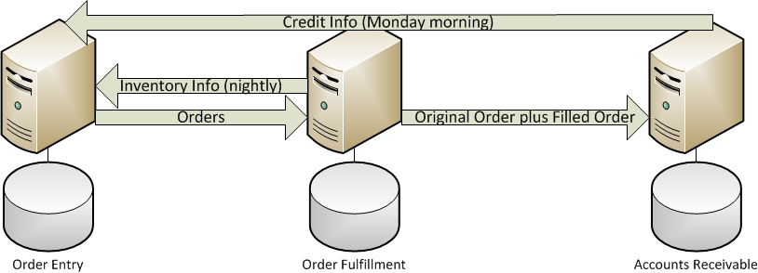
Legacy Systems
Sales
Warehouse
Accounting
Notes:
Show them the legacy systems that support the O2C process. Highlight that they are separate systems that really do make each of the individual functional areas more efficient/effective but point out some of the problems with legacy systems.
Problems with legacy systems:
Standalone systems – Not designed to work with each other.
Make each functional area more efficient/effective but not organization as a whole.
Multiple copies of data can make decision making a challenge.
You must build and support the system interfaces.
System interfaces must run like clockwork of chaos ensues.
Different computing platforms can be a challenge.
Every system interface can be designed differently.

Slide 5
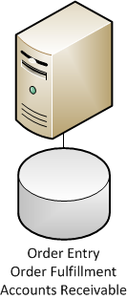
Enterprise System
Sales + Warehouse + Accounting
How many copies of data do I have?
How much non-value added work do I eliminate when inventory and credit data are current?
How much better is my decision making with a single copy of all data?
How much happier are your customers when they are dealing with the “well oiled machine”?

Slide 6
Filling in the Income Statement
What:
Look at how difficult it is to calculate a relatively simple but important number like “Cost of Goods Sold” when you don’t have an enterprise systems
Look at how difficult making a decision can be if you don’t have reliable, current information
Why:
The ability to make good business decisions makes the difference between success and failure
Without the right data and the right tools, you and your organization will not stand a chance
Invest in technologies that improve your decision making abilities!

