Slide 1
Gathering Systems Requirements
In-Class Activity…

Slide 2
Roadmap
Week 1: Intro to MIS
Week 2: Systems Analysis
Week 3: Systems Analysis
Week 4: Systems Analysis
Week 5
Swimlanes
ERDs
Decision Trees
Architecture Diagrams
Exam #1
Learn IT! #1
Max Labs 0
What is MIS?
Week 6: Organizational Systems
Week 7: Organizational Systems
Week 8: Organizational Systems
Week 9
Decision Support
SDLC
Exam #2
ERP
Knowledge Management
Digital Innovation
Max Labs 1a & 1b
Week 10: Organizational Systems
Week 11: Organizational Systems
Platforms
Week 13: Organizational Systems
Week 14
Customer Relationship Management Systems
Cloud Computing
Artificial Intelligence
Exam #3 Prep
Supply Chain Management Systems
Week 12: Organizational Systems
Max Labs 3a & 3b
Learn IT! #2
Max Labs 2a & 2b

Slide 3
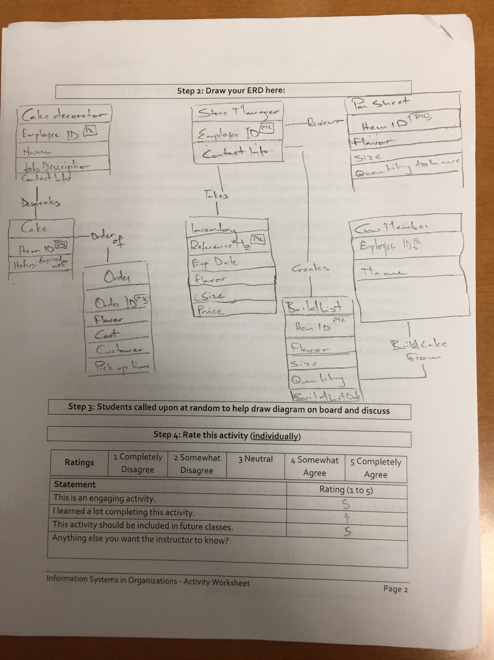
Worksheets will not be returned
In-class activities reinforce what was covered in
Assigned reading
Assigned videos
Lecture
Worksheets do NOT include new material that will be on exams
No need to study from worksheets to be successful on exams
Feel free to take pictures of your worksheets if you’d like

Slide 4
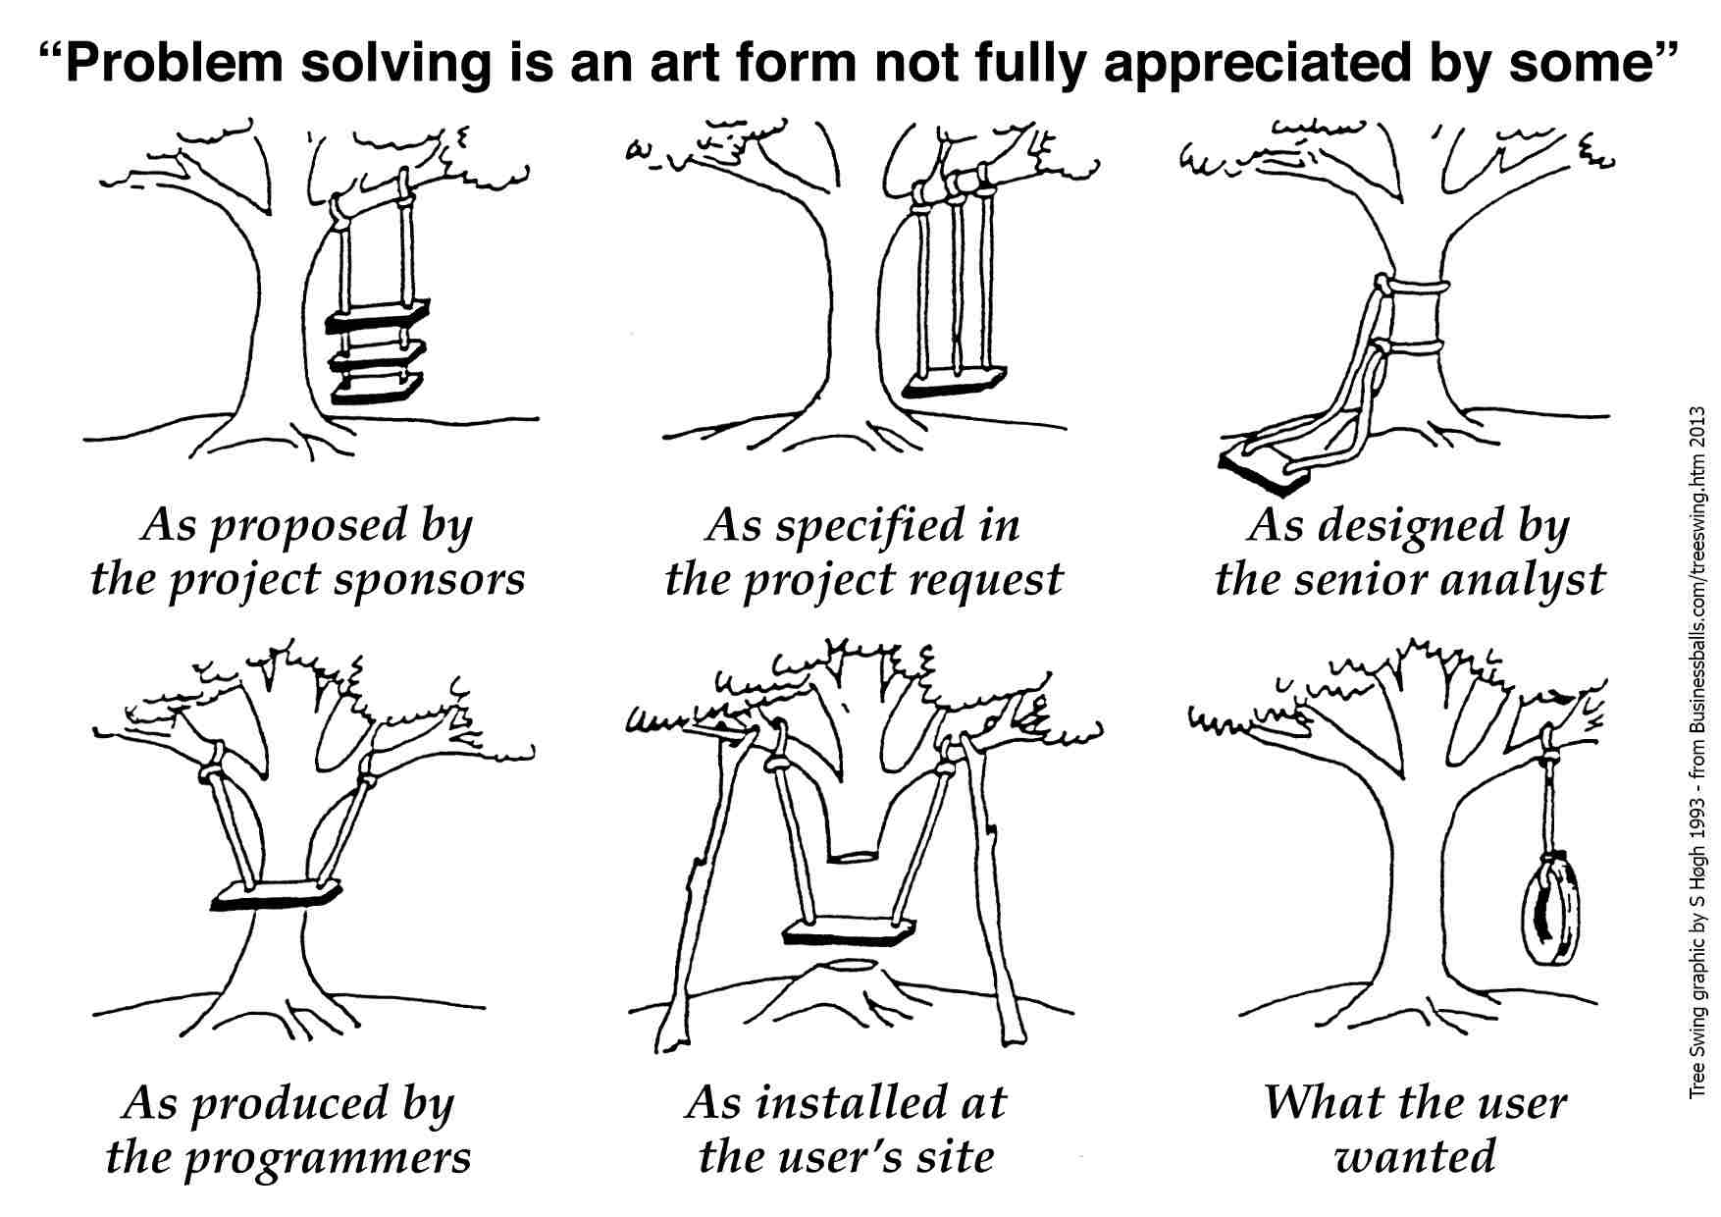

Slide 5
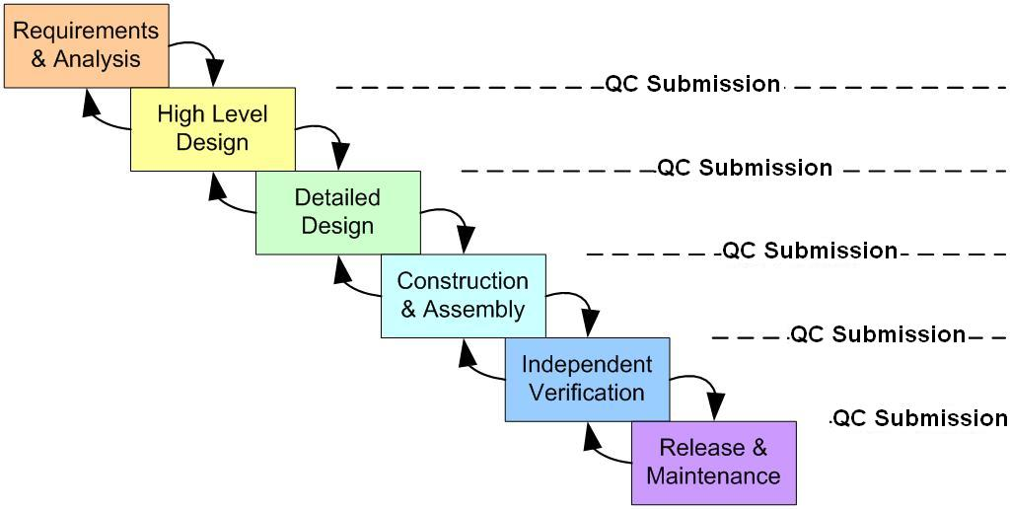
SDLC Phases: Waterfall Methodology
Requirements Gathering and the BRD
Conept Map & Architecture Diagram; Build vs. Buy Decision
Modeling: Swim Lanes & Entity Relationship Diagrams
Engineering & Implementation
Acceptance Testing, Training
Go Live
Maintenance, Upgrade & Support
Notes:
SDLC phases:
Preliminary analysis: The objective of phase 1 is to conduct a preliminary analysis, propose alternative solutions, describe costs and benefits and submit a preliminary plan with recommendations.
Systems design: Describes desired features and operations in detail, including screen layouts, business rules, process diagrams, pseudocode and other documentation.
Development: The real code is written here.
Integration and testing: Brings all the pieces together into a special testing environment, then checks for errors, bugs and interoperability.
Acceptance, installation, deployment: The final stage of initial development, where the software is put into production and runs actual business – includes Training!!
Maintenance: During the maintenance stage of the SDLC, the system is assessed to ensure it does not become obsolete. This is also where changes are made to initial software. It involves continuous evaluation of the system in terms of its performance.
Evaluation: Some companies do not view this as an official stage of the SDLC, while others consider it to be an extension of the maintenance stage, and may be referred to in some circles as post-implementation review.
Disposal: In this phase, plans are developed for discarding system information, hardware and software in making the transition to a new system. The purpose here is to properly move, archive, discard or destroy information, hardware and software that is being replaced, in a manner that prevents any possibility of unauthorized disclosure of sensitive data. The disposal activities ensure proper migration to a new system.

Slide 6
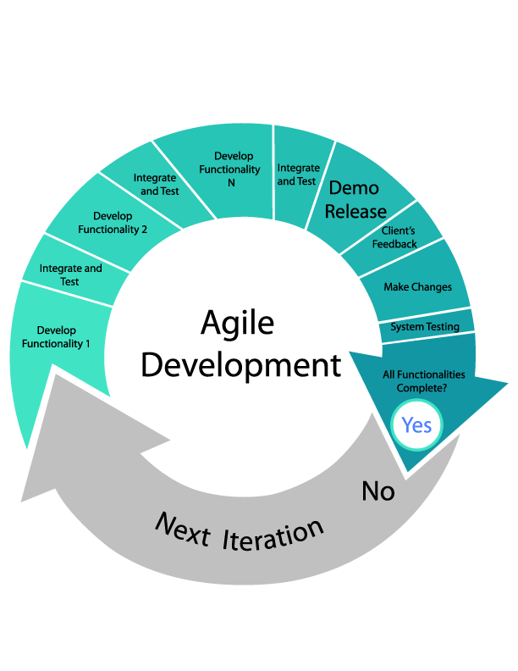
Notes:
While some organizations still use the traditional SDLC and while the traditional SDLC is a great way to look at projects from a high level, many organizations now use variations on the traditional SDLC that use an iterative approach to deliver solutions. Make sure that students understand that this approach enables the development team to demonstrate value early on even if you need to go through many iterations to achieve the final deliverable. Make sure they understand that the subject matter experts typically have a more intimate involvement with the development process using this type of approach.
Agile development:
Agile methodology is an alternative to traditional project management, typically used in software development. It helps teams respond to unpredictability through incremental, iterative work cadences, known as sprints. Agile methodologies are an alternative to waterfall, or traditional sequential development.
It promotes adaptive planning, evolutionary development, early delivery, continuous improvement, and encourages rapid and flexible response to change.
10 key principles of agile:
1. Active user involvement is imperative
2. The team must be empowered to make decisions
3. Requirements evolve but the timescale is fixed
4. Capture requirements at a high level; lightweight & visual
5. Develop small, incremental releases and iterate
6. Focus on frequent delivery of products
7. Complete each feature before moving on to the next
8. Apply the 80/20 rule
9. Testing is integrated throughout the project lifecycle – test early and often
10. A collaborative & cooperative approach between all stakeholders is essential
There are various methodologies that are collectively known as agile, as they promote the values of the agile manifesto and they are consistent with the above principles.

Slide 7
Gathering Systems Requirements
What:
Interview your professor to learn more about how they store your grades
Ask probing questions to figure out how, if at all possible, the integrity of the grading process could be compromised
Why:
As part of the analysis phase of the SDLC, business analysts spend a lot of time interviewing stakeholders to discover what is really needed
This ability to interview people and ask probing questions is essential to figuring out how things work and making improvements

