Slide 1
The Long Tail
In-Class Activity…

Slide 2
Roadmap
Week 1: Intro to MIS
Week 2: Systems Analysis
Week 3: Systems Analysis
Week 4: Systems Analysis
Week 5
Swimlanes
ERDs
Decision Trees
Architecture Diagrams
Exam #1
Learn IT! #1
Max Labs 0
What is MIS?
Week 6: Organizational Systems
Week 7: Organizational Systems
Week 8: Organizational Systems
Week 9
Decision Support
SDLC
Exam #2
ERP
Knowledge Management
Digital Innovation
Max Labs 1a & 1b
Week 10: Organizational Systems
Week 11: Organizational Systems
Platforms
Week 13: Organizational Systems
Week 14
Customer Relationship Management Systems
Cloud Computing
Artificial Intelligence
Exam #3 Prep
Supply Chain Management Systems
Week 12: Organizational Systems
Max Labs 3a & 3b
Learn IT! #2
Max Labs 2a & 2b

Slide 3
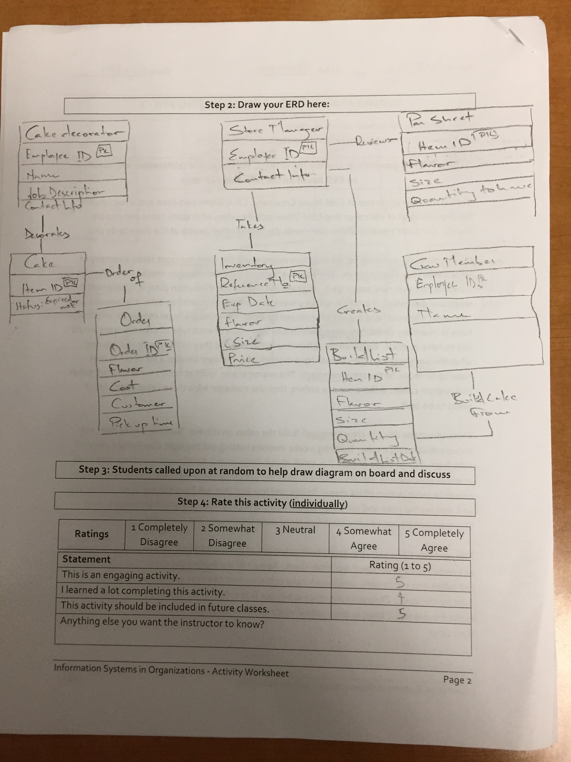
Worksheets will not be returned
In-class activities reinforce what was covered in
  Assigned reading
  Assigned videos
  Lecture
Worksheets do NOT include new material that will be on exams
No need to study from worksheets to be successful on exams
Feel free to take pictures of your worksheets if you’d like

Slide 4
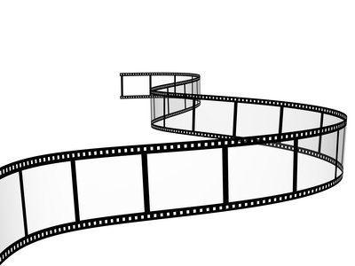

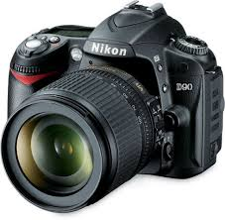
How has the photographic equipment industry been disrupted?
?

Slide 5
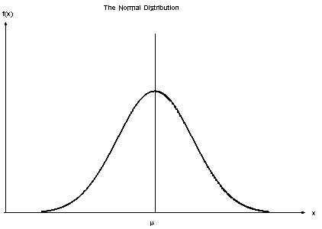
Normal Distribution
J. C. F. Gauss
Central Limit Theorem
Symmetry around μ
μ is the confluence of the mean, median, and mode of the data
μ splits the data in half

Slide 6
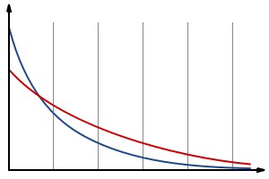
Long Tail Distribution
Variety > bestsellers
  Netflix
  Amazon
  iTunes
There’s money in the tail
  Advertising products
    Google
    Yahoo
    Bing
  Travel bookings
How does a company “fatten the tail?”

Slide 7
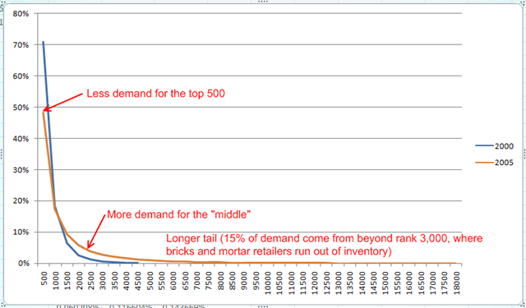
Netflix Long Tail
“…gets most of its profits from a large number of infrequently requested movies rather than from few large and profitable movies.”

Slide 8

The Long Tail
What:
Plot 2016 U.S. box office totals
Discuss the typical “Long Tail” distribution
Why:
For some products, especially digital products, there can be some serious money hidden in the long tail
How can technology enable you to tap into this elusive revenue stream?

Slide 9
Possible Solution

