Slide 1
SCM and the Income Statement
In-Class Activity…

Slide 2
Roadmap
Week 1: Intro to MIS
Week 2: Systems Analysis
Week 3: Systems Analysis
Week 4: Systems Analysis
Week 5
Swimlanes
ERDs
Decision Trees
Architecture Diagrams
Exam #1
Learn IT! #1
Max Labs 0
What is MIS?
Week 6: Organizational Systems
Week 7: Organizational Systems
Week 8: Organizational Systems
Week 9
Decision Support
SDLC
Exam #2
ERP
Knowledge Management
Digital Innovation
Max Labs 1a & 1b
Week 10: Organizational Systems
Week 11: Organizational Systems
Platforms
Week 13: Organizational Systems
Week 14
Customer Relationship Management Systems
Cloud Computing
Artificial Intelligence
Exam #3 Prep
Supply Chain Management Systems
Week 12: Organizational Systems
Max Labs 3a & 3b
Learn IT! #2
Max Labs 2a & 2b

Slide 3
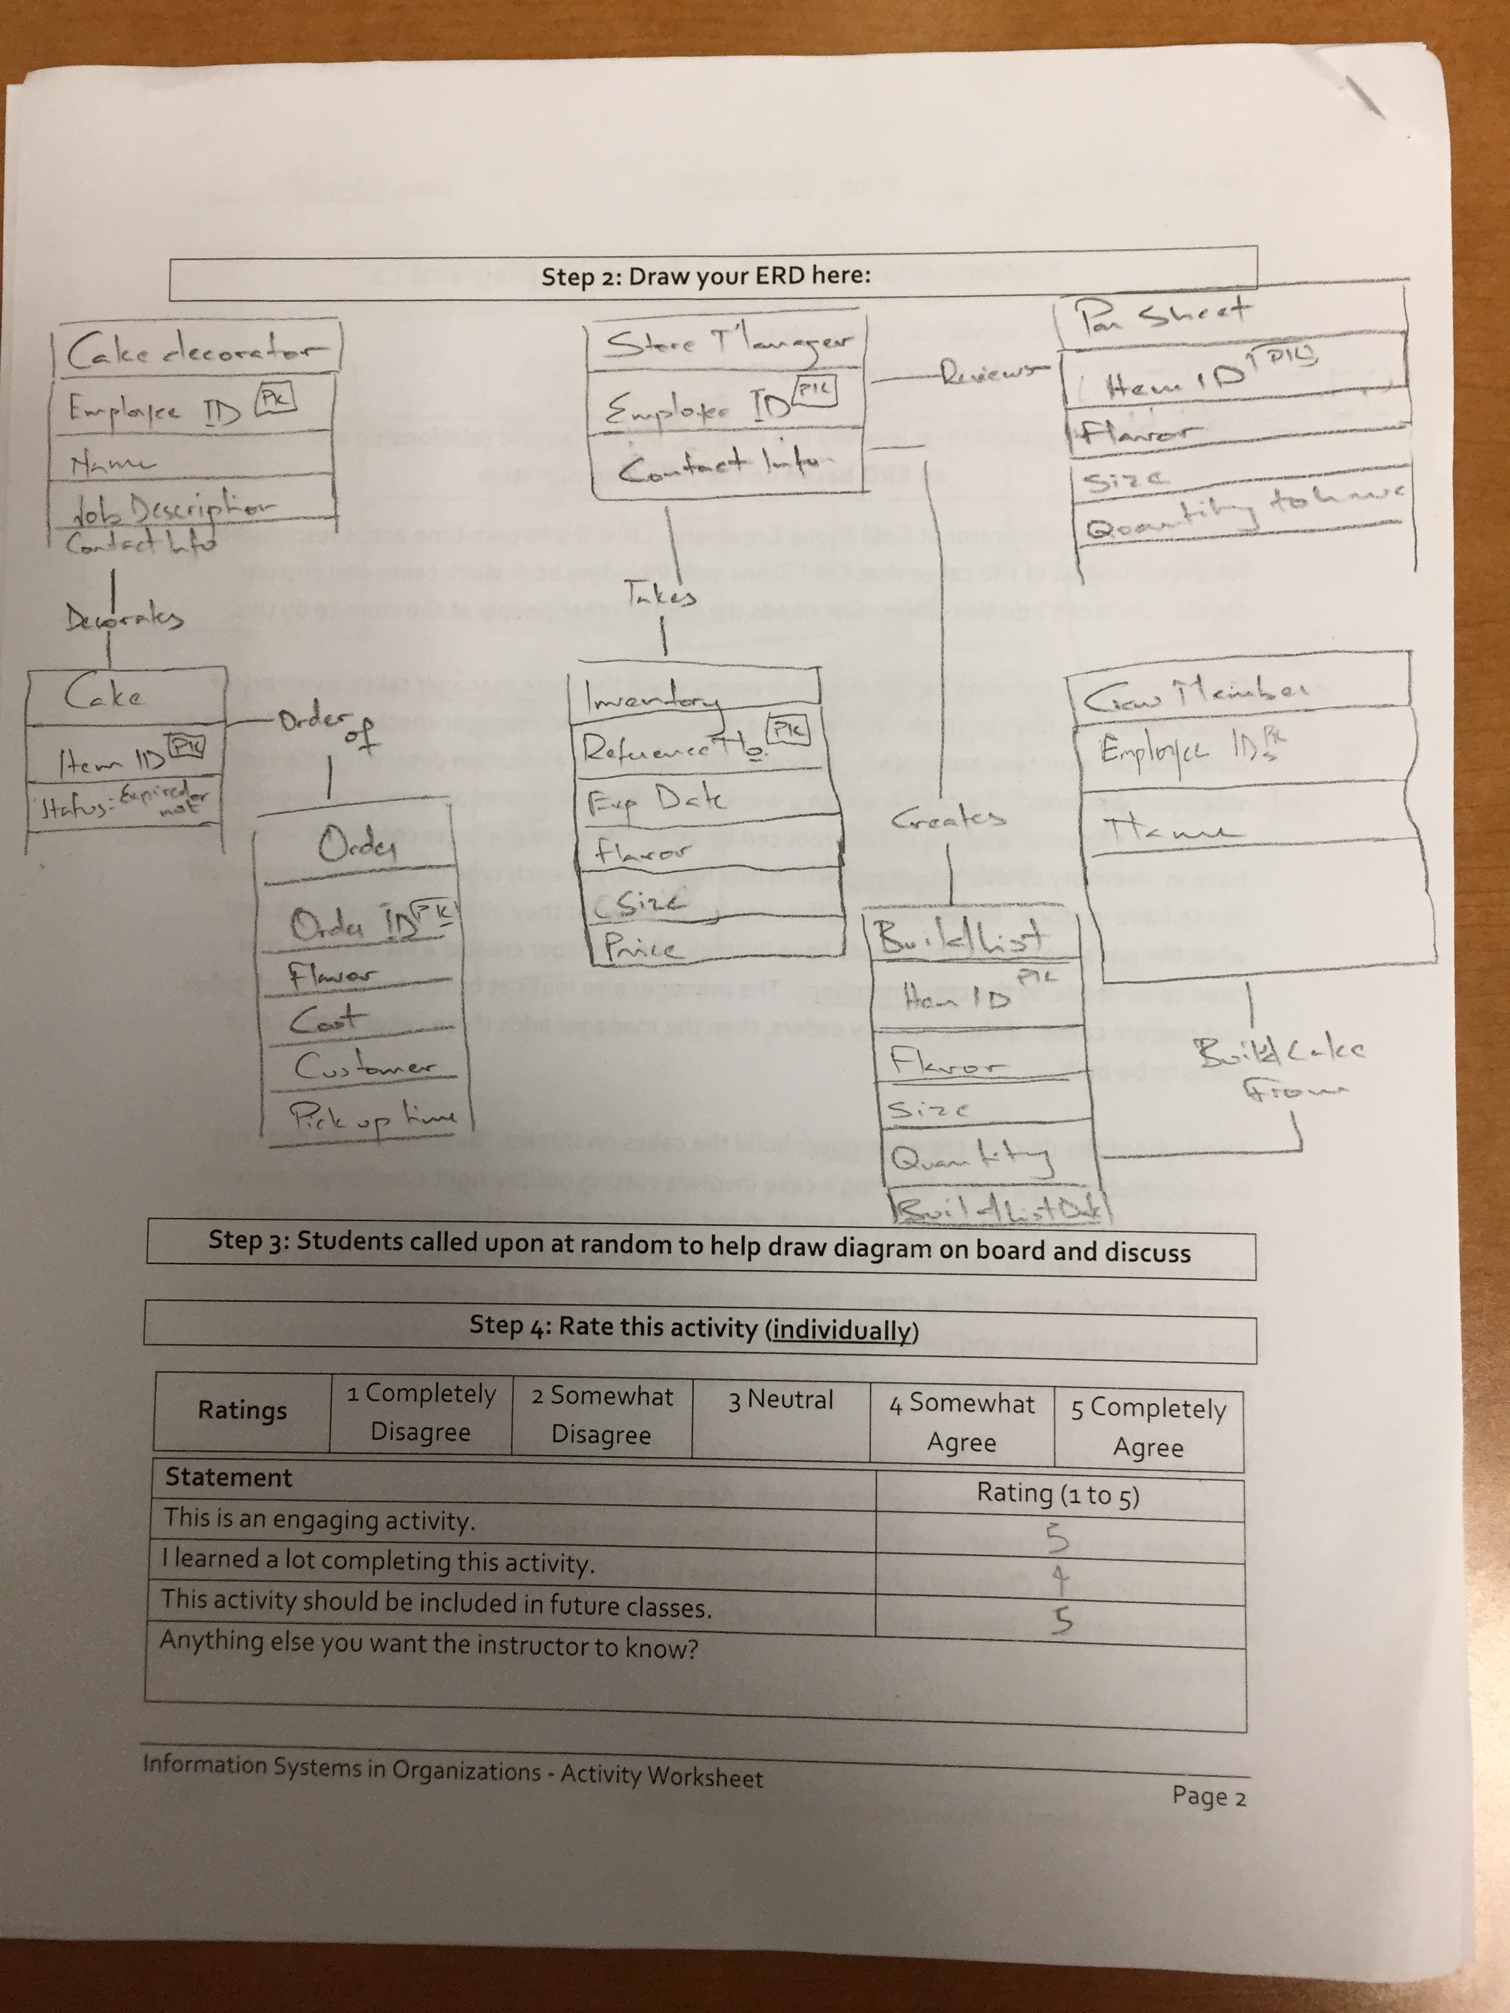
Worksheets will not be returned
In-class activities reinforce what was covered in
Assigned reading
Assigned videos
Lecture
Worksheets do NOT include new material that will be on exams
No need to study from worksheets to be successful on exams
Feel free to take pictures of your worksheets if you’d like

Slide 4
?
How difficult is it to get the right product on the right shelf at the right time and the lowest possible cost?
Notes:
This is far more difficult than most student believe. As the number of products an organization produces goes up and as the number of raw materials in each product goes up, the problem can become more complex geometrically, not linearly.
Keep in mind how challenging this can get if raw materials or finished goods have a shelf live and the shorter the shelf life, the bigger the challenge.

Slide 5
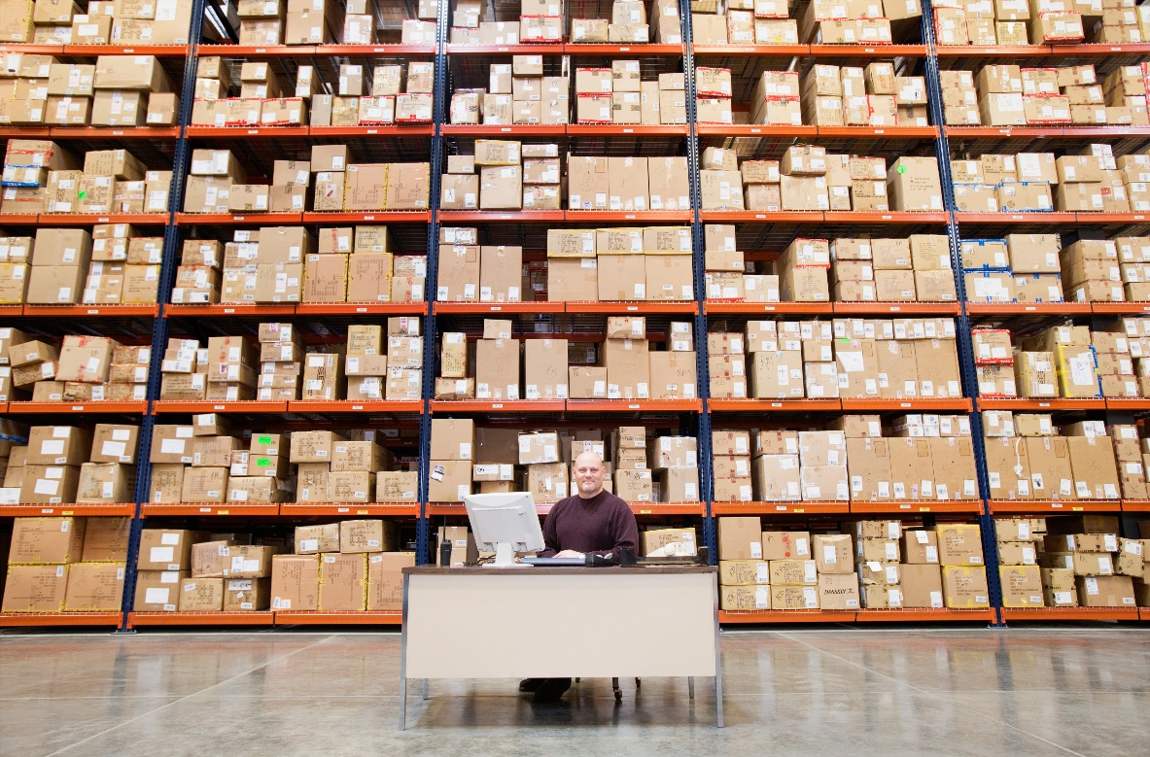
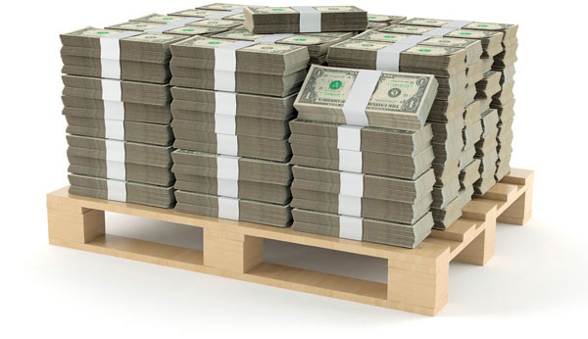
Safety Stock – That’s the Answer!
Here’s what the people in
order fulfilment see
Here’s what the people in
accounting see
Notes:
Stocking up on raw materials and/or finished goods might sound like a good idea so that you don’t stock out but safety stock costs money. Costs include:
Buying the raw materials.
Labor and other direct costs in making finished goods.
Distribution costs to get products out to distribution centers and retail locations.
Storage of finished goods.
Do all of these costs outweigh the benefits? What else could you be doing with all of that money you have tied up in safety stock?
What if a product has a shelf life? Keep in mind that some technology products have a “shelf life” related to how quickly “new technologies” become “old technologies” and if “old technologies” need to be sold at a discount for them to move, that will also impact your bottom line.

Slide 6
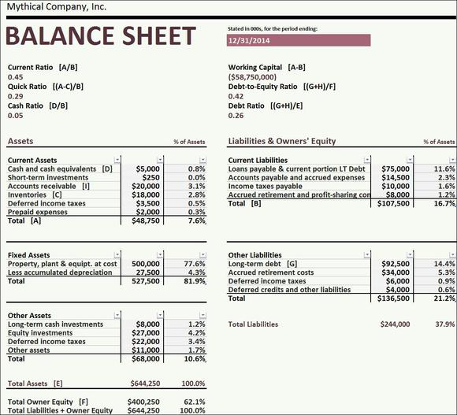
What else could I do with this cash?
If this goes up
then this goes down…
What else could I do
with this cash?
Notes:
To follow up on the previous slide…I had to spend cash to create the finished goods that are sitting in inventory. Sure, they’re both assets on the balance sheet but “cash is king” and what else can I do with cash???

Slide 7
SCM Architecture
SCM modules support two functions.
Supply chain planning—development of resource plans to support production.
Supply chain execution—efficient flow of products, information, and financing.
Copyright © 2014 Pearson Education, Inc.
Notes:
Supply chain planning is all about figuring out what you are going to need, when you are going to need it and where you are going to need it and working backwards from there (Demand Forecast). To get the right product on the right self at the right time, when do your products need to be out at your distribution centers and which products need to be at which distribution centers (Transportation Schedule). To get these products to the right distributions facilities at the appropriate time you need to figure out what products you are going to make and when you are going to make them (Production Plan). In order to execute the production plan you need to figure out when you are going to order raw materials and who you are going to order them from based on your production plan, lead times, costs and other factors (Sourcing Plan).
Supply chain execution then rolls forward in time (Product Flow). Purchase orders are generated at the appropriate time and sent to the best supplier who can get the raw materials you need to your manufacturing plants in time to meet the needs of the production plan. Finished goods are then produced and shipped out to the various distribution centers who then get the finished goods to their last stop before the customer acquires them.
Note that information flows both ways things like purchase orders going to suppliers from the manufacturer and invoices going from the suppliers to the manufacturers. In addition, payments flow in the opposite direction from the product flows (manufacturers pay the suppliers for raw materials)

Slide 8
SCM and the Income Statement
What:
Describe the financial impacts of investing in a SCM system
Why:
Every business has individual needs
Join the conversation of whether a company should invest

