Slide 1
SCM Sourcing Planning
In-Class Activity…

Slide 2
Roadmap
Week 1: Intro to MIS
Week 2: Systems Analysis
Week 3: Systems Analysis
Week 4: Systems Analysis
Week 5
Swimlanes
ERDs
Decision Trees
Architecture Diagrams
Exam #1
Learn IT! #1
Max Labs 0
What is MIS?
Week 6: Organizational Systems
Week 7: Organizational Systems
Week 8: Organizational Systems
Week 9
Decision Support
SDLC
Exam #2
ERP
Knowledge Management
Digital Innovation
Max Labs 1a & 1b
Week 10: Organizational Systems
Week 11: Organizational Systems
Platforms
Week 13: Organizational Systems
Week 14
Customer Relationship Management Systems
Cloud Computing
Artificial Intelligence
Exam #3 Prep
Supply Chain Management Systems
Week 12: Organizational Systems
Max Labs 3a & 3b
Learn IT! #2
Max Labs 2a & 2b

Slide 3
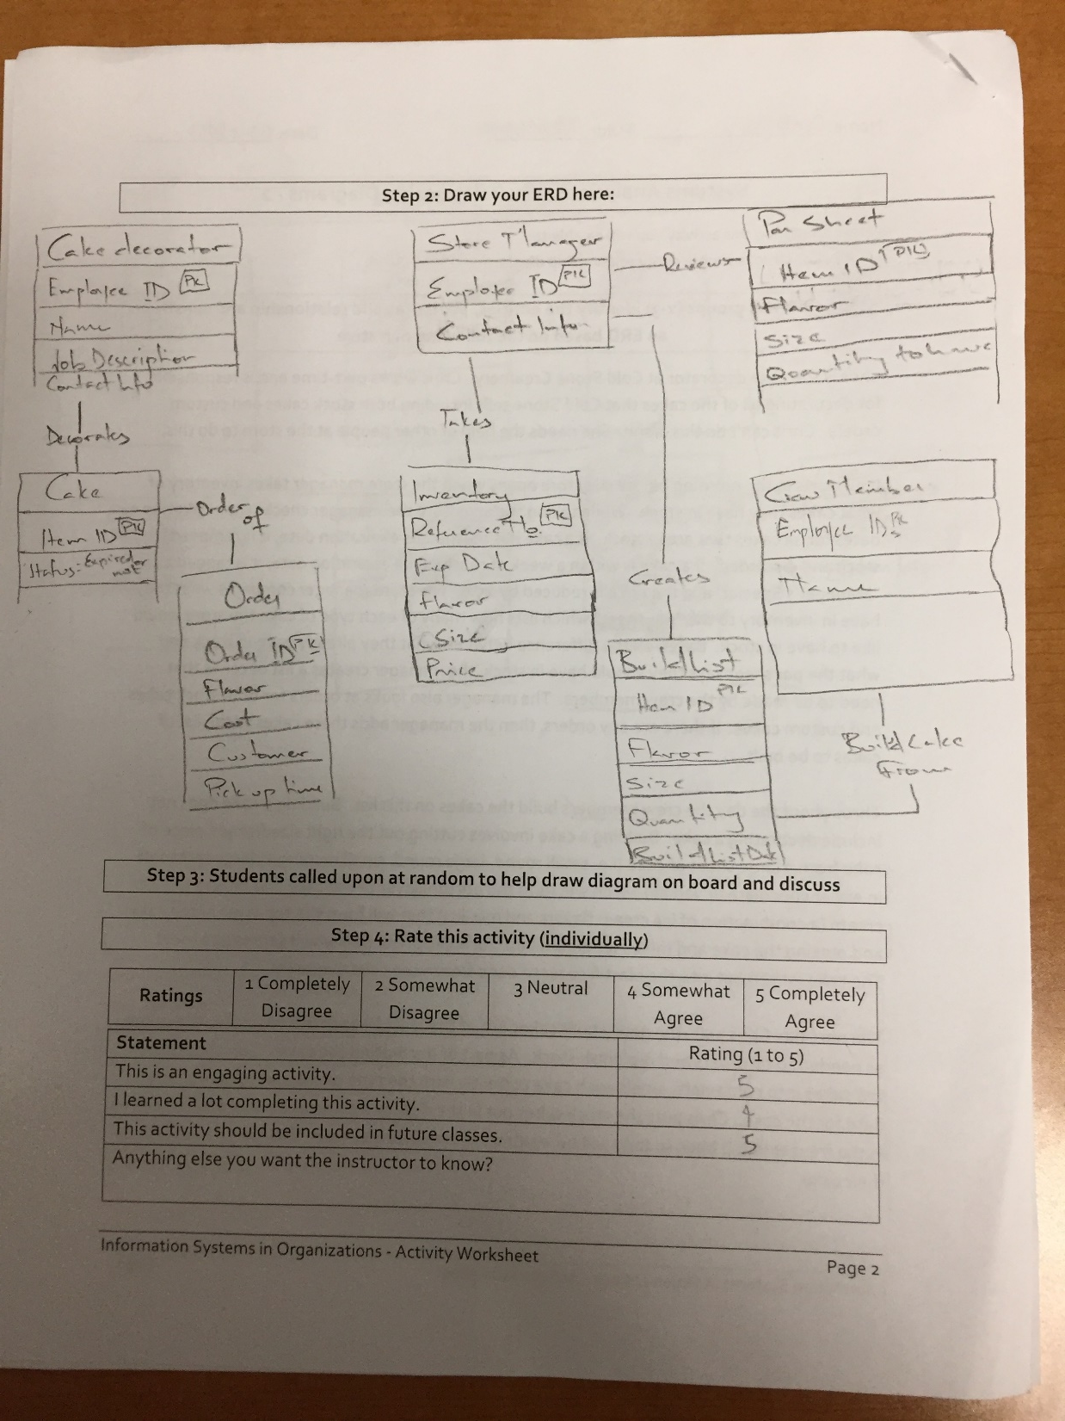
Worksheets will not be returned
In-class activities reinforce what was covered in
Assigned reading
Assigned videos
Lecture
Worksheets do NOT include new material that will be on exams
No need to study from worksheets to be successful on exams
Feel free to take pictures of your worksheets if you’d like

Slide 4
Just-in-Time Manufacturing
Discuss:
1. What was this article about?
2. Why should you care?
This article describes just-in-time manufacturing techniques, along with the pros and cons of using this technique.
Just-in-time manufacturing can provide tremendous value but only for organizations in certain industries and only for organizations with fine tuned supply chains. You simply can’t fine tune your supply chain well enough without having tightly integrated supply chain systems with your partners.

Slide 5
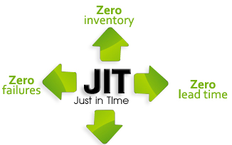
Notes:
Let’s talk a little bit about “Just in Time” manufacturing. This approach was first introduced by Toyota way back in 19??. This works best for businesses that have “Make to Order” businesses. It doesn’t work quite as well for businesses that “Make to Stock”. The goal is to dramatically reduce costs by not having much money tied up in raw materials and/or finished goods. It doesn’t work well if you have long lead times for raw materials; your suppliers need to be very responsive. It also doesn’t work well if your supply and manufacturing pipeline is not super reliable; any problems in supply chains or manufacturing can have a serious impact and cause real problems.

Slide 6
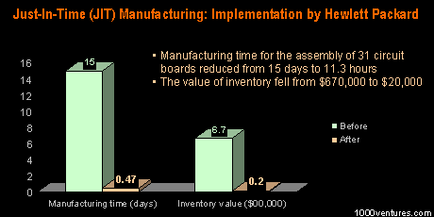
What else could I do with this cash?

Slide 7
SCM Sourcing Planning
What:
Decide which suppliers to purchase ingredients from
Why:
See the struggle of not having a SCM system
Business professionals need to think ahead & see the big picture

Slide 8
Week | 21 days from now | 28 days from now | 35 days from now | 42 days from now
NRG-A Bars | 40,000 | 50,000 | 40,000 | 40,000
NRG-B Bars | 20,000 | 40,000 | 50,000 | 40,000
Extra NRG-A Bars | 10,000
Extra NRG-B Bars | 10,000
Total NRG-A Bars | 50,000 | 40,000 | 40,000 | 40,000
Total NRG-B Bars | 30,000 | 40,000 | 40,000 | 40,000
Batches NRG-A | 25 | 20 | 20 | 20
Batches NRG-B | 15 | 20 | 20 | 20
Oat Quantity | 11,250 | 11,000 | 11,000 | 11,000
Oat Source | Yummy Oats | Oliver's Oats | Oliver's Oats | Oliver's Oats
Raisin Quantity | 1,250 | 1,000 | 1,000 | 1,000
Raisin Source | Yesterday's Grapes | Yesterday's Grapes | Yesterday's Grapes | Yesterday's Grapes
Date Quantity | 1,050 | 1,400 | 1,400 | 1,400
Date Source | 50 First Dates | Blind Dates | Blind Dates | Blind Dates
We only need a total of 60,000 bars three weeks from now and have the capacity to make 80,000 bars per week. However, since we need 90,000 bars 28 days from now and 35 days from now we better make an extra 20,000 bars this week so we have enough in stock to get us through those two weeks.
We’re going to have to by Oats from Yummy Oats and dates from 50 First Dates. They’re not the least expensive supplier but we need these in 21 days so we’ll pay a premium to get them quicker.

Slide 9
Week | 21 days from now | 28 days from now | 35 days from now | 42 days from now
NRG-A Bars | 40,000 | 50,000 | 40,000 | 40,000
NRG-B Bars | 20,000 | 40,000 | 50,000 | 40,000
Extra NRG-A Bars | 10,000
Extra NRG-B Bars | 10,000
Total NRG-A Bars | 50,000 | 40,000 | 40,000 | 40,000
Total NRG-B Bars | 30,000 | 40,000 | 40,000 | 40,000
Batches NRG-A | 25 | 20 | 20 | 20
Batches NRG-B | 15 | 20 | 20 | 20
Oat Quantity | 11,250 | 11,000 | 11,000 | 11,000
Oat Source | Yummy Oats | Oliver's Oats | Oliver's Oats | Oliver's Oats
Raisin Quantity | 1,250 | 1,000 | 1,000 | 1,000
Raisin Source | Yesterday's Grapes | Yesterday's Grapes | Yesterday's Grapes | Yesterday's Grapes
Date Quantity | 1,050 | 1,400 | 1,400 | 1,400
Date Source | 50 First Dates | Blind Dates | Blind Dates | Blind Dates
We need 90,000 bars but only have capacity to make 80,000 bars but we made an extra 20,000 bars the previous week so we’ll use 10,000 of these this week and will need the other 10,000 bars next week.

Slide 10
Week | 21 days from now | 28 days from now | 35 days from now | 42 days from now
NRG-A Bars | 40,000 | 50,000 | 40,000 | 40,000
NRG-B Bars | 20,000 | 40,000 | 50,000 | 40,000
Extra NRG-A Bars | 10,000
Extra NRG-B Bars | 10,000
Total NRG-A Bars | 50,000 | 40,000 | 40,000 | 40,000
Total NRG-B Bars | 30,000 | 40,000 | 40,000 | 40,000
Batches NRG-A | 25 | 20 | 20 | 20
Batches NRG-B | 15 | 20 | 20 | 20
Oat Quantity | 11,250 | 11,000 | 11,000 | 11,000
Oat Source | Yummy Oats | Oliver's Oats | Oliver's Oats | Oliver's Oats
Raisin Quantity | 1,250 | 1,000 | 1,000 | 1,000
Raisin Source | Yesterday's Grapes | Yesterday's Grapes | Yesterday's Grapes | Yesterday's Grapes
Date Quantity | 1,050 | 1,400 | 1,400 | 1,400
Date Source | 50 First Dates | Blind Dates | Blind Dates | Blind Dates
We need 90,000 bars but only have capacity to make 80,000 bars but we have the 10,000 extra bars we made two weeks ago so we’re in good shape.

Slide 11
Week | 21 days from now | 28 days from now | 35 days from now | 42 days from now
NRG-A Bars | 40,000 | 50,000 | 40,000 | 40,000
NRG-B Bars | 20,000 | 40,000 | 50,000 | 40,000
Extra NRG-A Bars | 10,000
Extra NRG-B Bars | 10,000
Total NRG-A Bars | 50,000 | 40,000 | 40,000 | 40,000
Total NRG-B Bars | 30,000 | 40,000 | 40,000 | 40,000
Batches NRG-A | 25 | 20 | 20 | 20
Batches NRG-B | 15 | 20 | 20 | 20
Oat Quantity | 11,250 | 11,000 | 11,000 | 11,000
Oat Source | Yummy Oats | Oliver's Oats | Oliver's Oats | Oliver's Oats
Raisin Quantity | 1,250 | 1,000 | 1,000 | 1,000
Raisin Source | Yesterday's Grapes | Yesterday's Grapes | Yesterday's Grapes | Yesterday's Grapes
Date Quantity | 1,050 | 1,400 | 1,400 | 1,400
Date Source | 50 First Dates | Blind Dates | Blind Dates | Blind Dates

