Slide 1
Tracking Customer and Service Information
In-Class Activity…

Slide 2
Roadmap
Week 1: Intro to MIS
Week 2: Systems Analysis
Week 3: Systems Analysis
Week 4: Systems Analysis
Week 5
Swimlanes
ERDs
Decision Trees
Architecture Diagrams
Exam #1
Learn IT! #1
Max Labs 0
What is MIS?
Week 6: Organizational Systems
Week 7: Organizational Systems
Week 8: Organizational Systems
Week 9
Decision Support
SDLC
Exam #2
ERP
Knowledge Management
Digital Innovation
Max Labs 1a & 1b
Week 10: Organizational Systems
Week 11: Organizational Systems
Platforms
Week 13: Organizational Systems
Week 14
Customer Relationship Management Systems
Cloud Computing
Artificial Intelligence
Exam #3 Prep
Supply Chain Management Systems
Week 12: Organizational Systems
Max Labs 3a & 3b
Learn IT! #2
Max Labs 2a & 2b

Slide 3
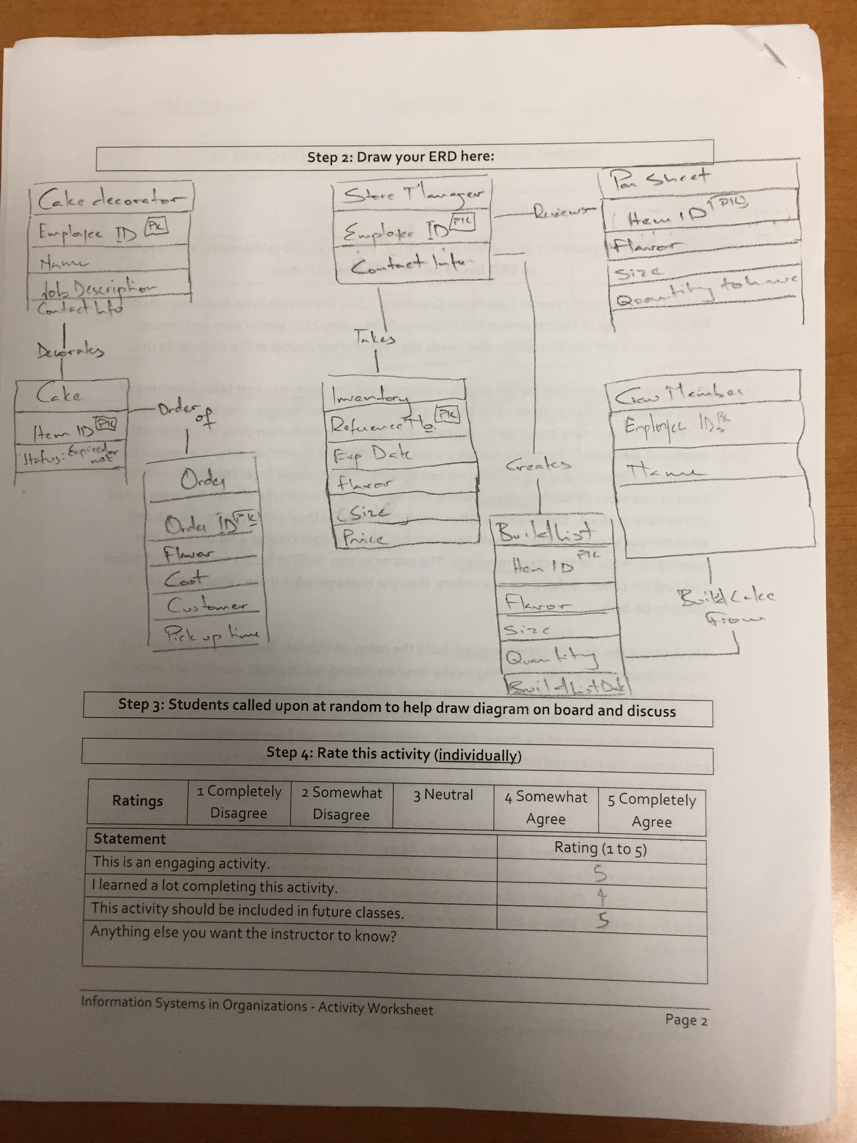
Worksheets will not be returned
In-class activities reinforce what was covered in
Assigned reading
Assigned videos
Lecture
Worksheets do NOT include new material that will be on exams
No need to study from worksheets to be successful on exams
Feel free to take pictures of your worksheets if you’d like

Slide 4
?
What kind of information is tracked in a CRM? How do companies use this data?
Notes:
Get students talking about what kinds of information is tracked in a CRM?
contact information,
purchase histories,
Browsing habits
ways and times they've interacted with your company (and reasons why),
demographics,
interests,
personal preferences
Customer Service issues
You can then use this information to segment customers for marketing purposes or to easily search for customers who fit specific criteria or work with customers on issues
Do students realize that CRMs can also track data about other parties you interact with and need for business? Vendors, contacts, partners,
As with customer lists, these contacts can include all types of information and can be labeled and categorized based on their specific attributes.
- See more at: http://www.businessnewsdaily.com/7838-choosing-crm-software.html#sthash.nZ6vSKQ4.dpuf

Slide 5
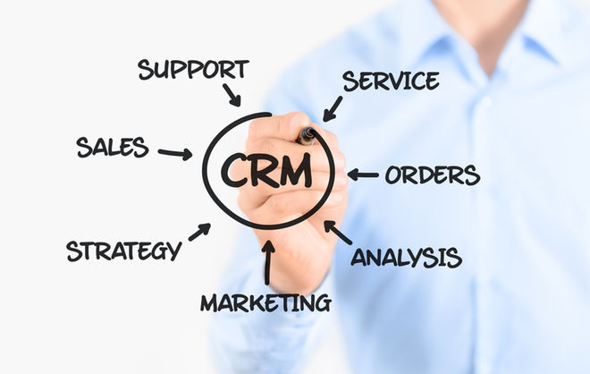
Evolution of CRM
Notes:
http://www.businessnewsdaily.com/7838-choosing-crm-software.html

Slide 6
Why Does My Business Need a CRM System?
Discuss:
1. What was this article about?
2. Why should you care?
While all organizations have the need to manage relationship with their customers, organizations that collect information about their customers, share this information across business teams, analyze the data when appropriate and act as needed benefit the most from CRM.
For many organizations having an intimate understanding of their customers and the ability to use this insight to drive revenue growth is the most strategic of all their assets.

Slide 7
Tracking Customer and Service Information
What:
Review a narrative about how Molly’s Coffee Company enters and tracks customer issues on their web site
Create swimlane and ERD diagrams to document this process
Why:
As business people, you REALLY need to understand your customer’s experience to ensure it is a positive experience and they will remain your customer
CRM can help you do this!

Slide 8
Solution

Slide 9
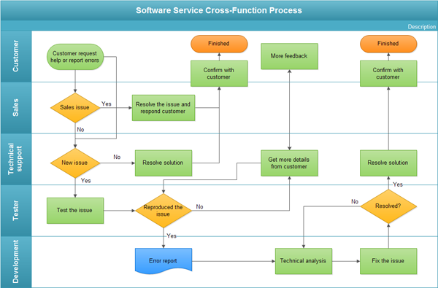
Swim Lane

Slide 10
ERD
Customer
Error Resolution
Customer ID
analyzed
Error ID
Customer First
Resolution status (Y/N)
Name
Sales Error
Customer Last
Name
submit
Technical Support Error
Customer Email
Error
Assigned Employee
Customer ID
Error Notes
Error ID
Resolution
Error Subject
Resolution Date
Error Description
Screenshot of error (jpeg)
Additional information from customer

