Slide 1
Platform Business Models
In-Class Activity…

Slide 2
Roadmap
Week 1: Intro to MIS
Week 2: Systems Analysis
Week 3: Systems Analysis
Week 4: Systems Analysis
Week 5
Swimlanes
ERDs
Decision Trees
Architecture Diagrams
Exam #1
Learn IT! #1
Max Labs 0
What is MIS?
Week 6: Organizational Systems
Week 7: Organizational Systems
Week 8: Organizational Systems
Week 9
Decision Support
SDLC
Exam #2
ERP
Knowledge Management
Digital Innovation
Max Labs 1a & 1b
Week 10: Organizational Systems
Week 11: Organizational Systems
Platforms
Week 13: Organizational Systems
Week 14
Customer Relationship Management Systems
Cloud Computing
Artificial Intelligence
Exam #3 Prep
Supply Chain Management Systems
Week 12: Organizational Systems
Max Labs 3a & 3b
Learn IT! #2
Max Labs 2a & 2b

Slide 3
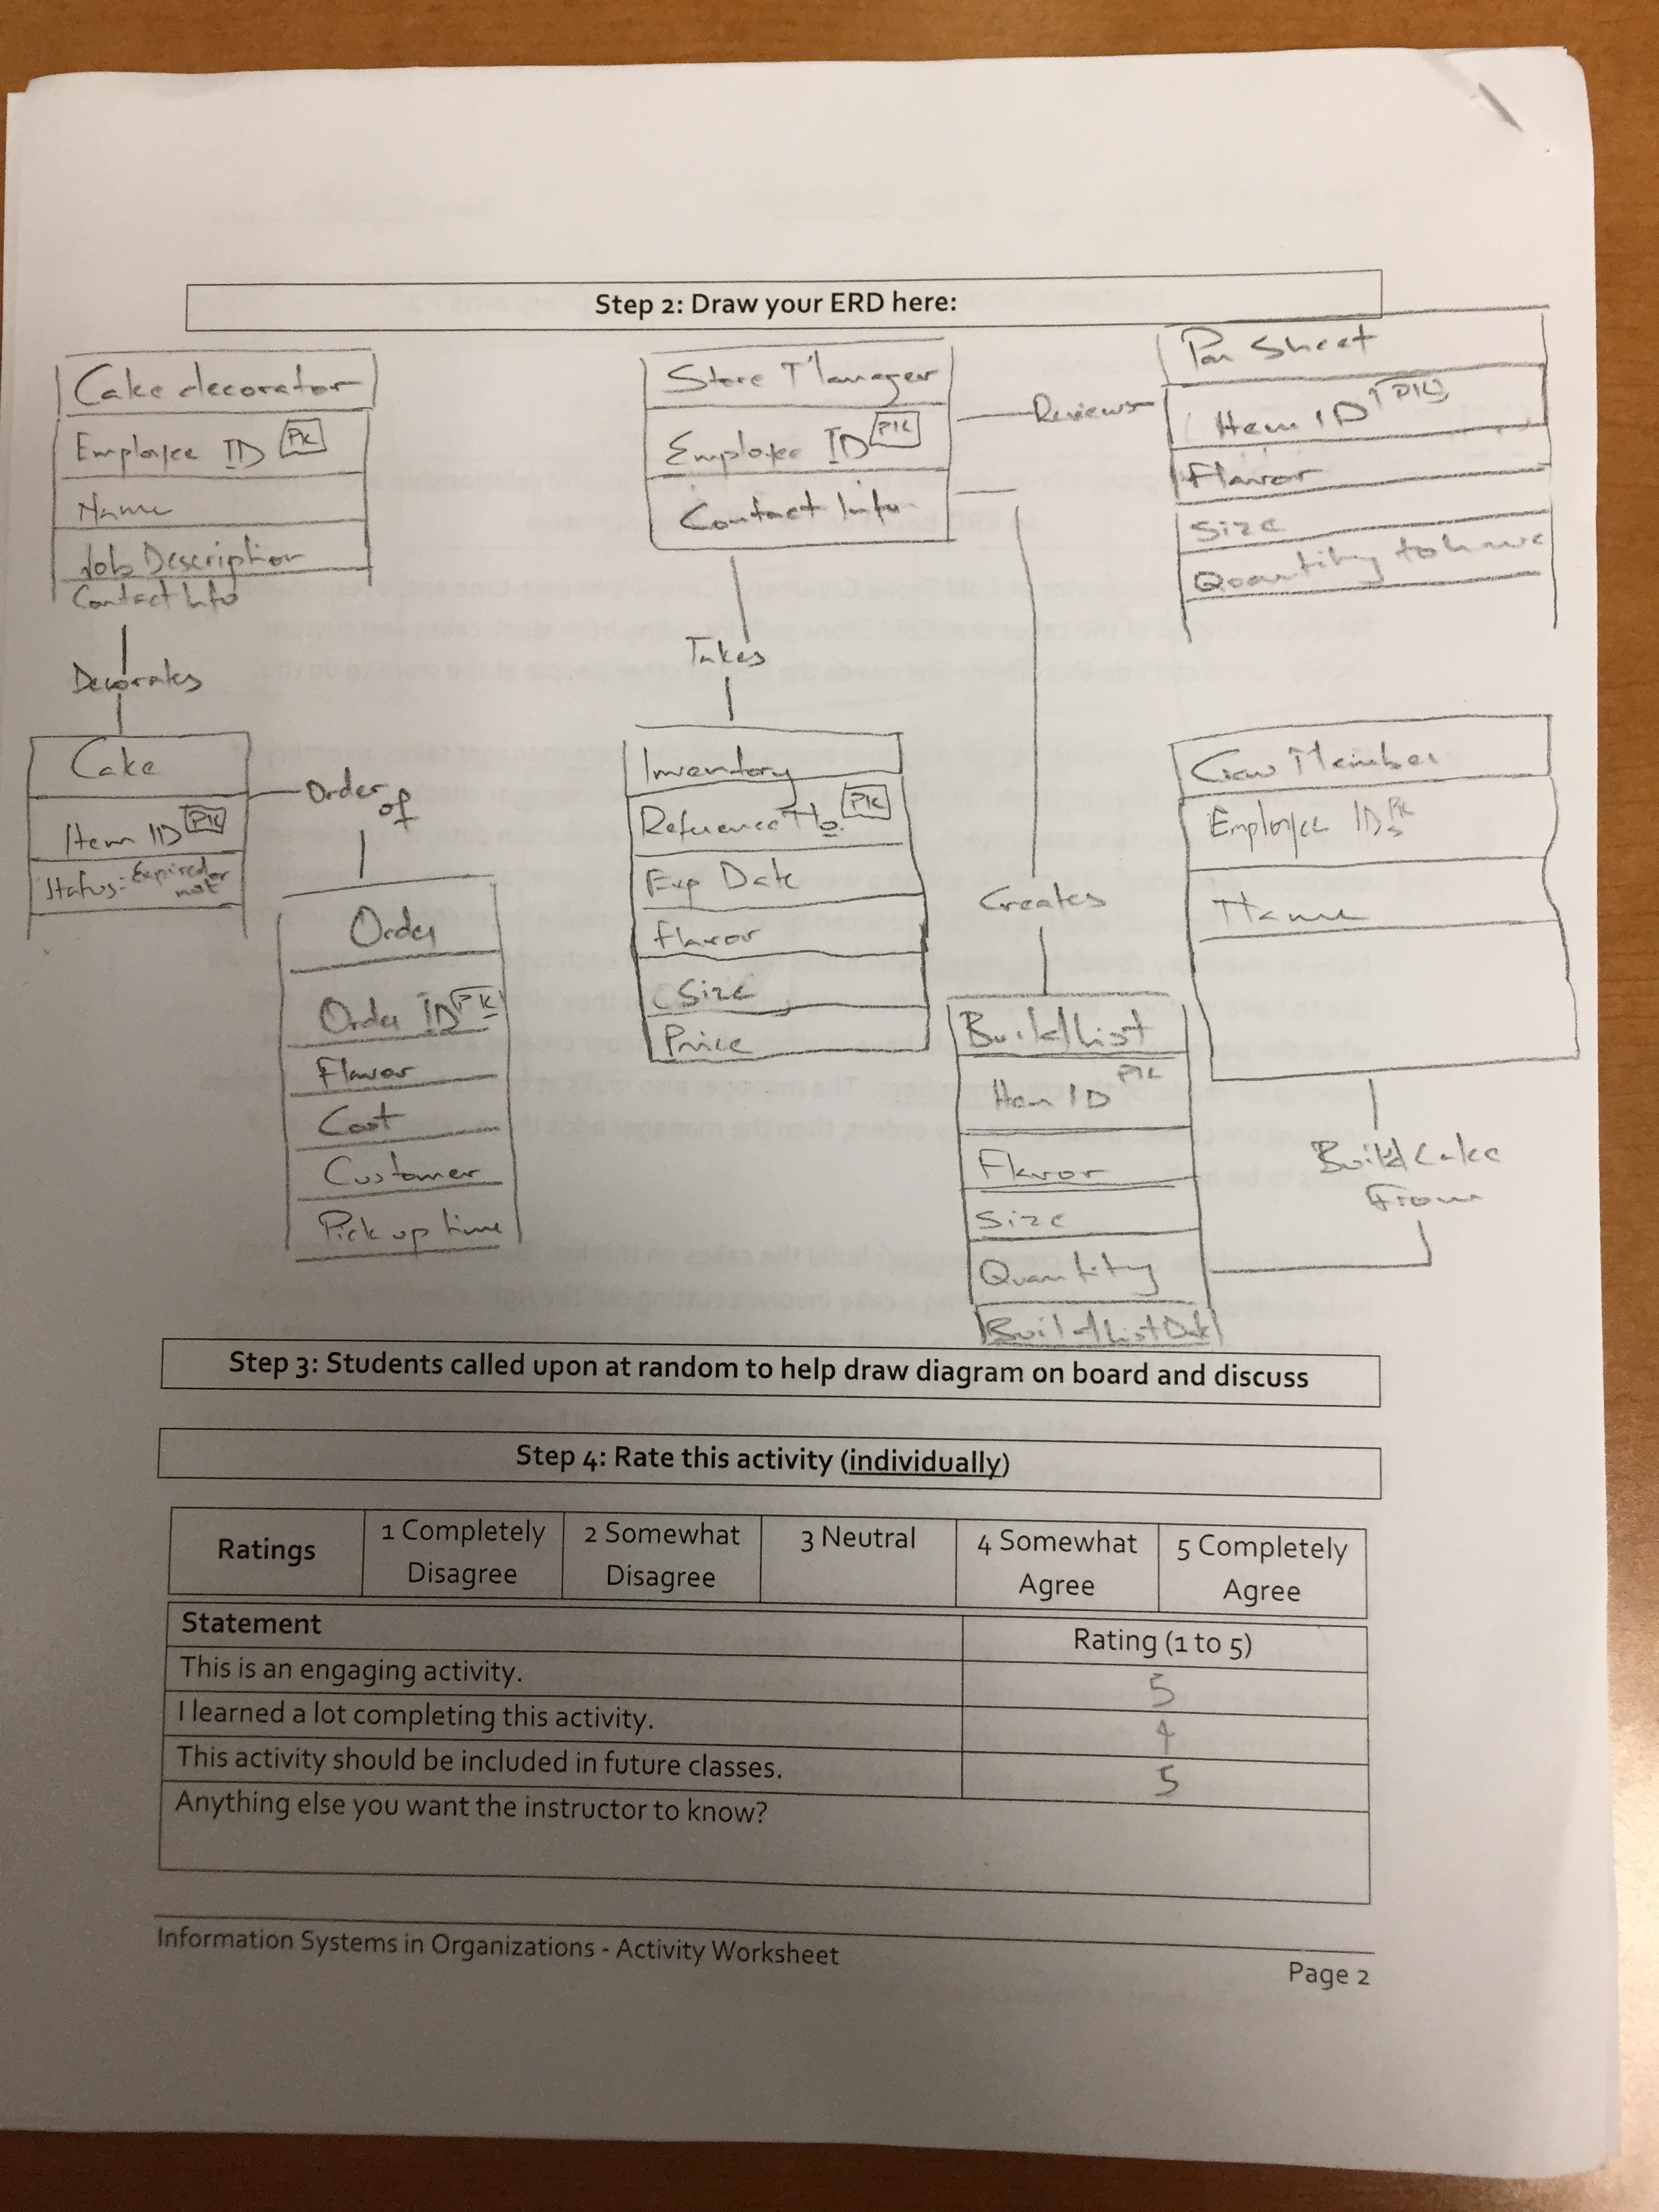
Worksheets will not be returned
In-class activities reinforce what was covered in
Assigned reading
Assigned videos
Lecture
Worksheets do NOT include new material that will be on exams
No need to study from worksheets to be successful on exams
Feel free to take pictures of your worksheets if you’d like

Slide 4
What is a Platform?
Discuss:
1. What was this article about?
2. Why should you care?
We learned that a platform is a business model that creates value by facilitating exchanges between two or more independent groups, usually consumers and producers.
Some of the most exciting new businesses out there today are built on platforms. With an understanding of technology, platforms and the different types of platforms, maybe you will be the creator of the next Uber!

Slide 5
Business Model Analysis, Part 2: Platforms and Network Effects
Discuss:
1. What was this article about?
2. Why should you care?
This article discusses different types of platforms and the impact of the network effect has on the value of a business built on a platform.
For many platform based businesses, the number of people involved makes the difference between making money and losing money.

Slide 6
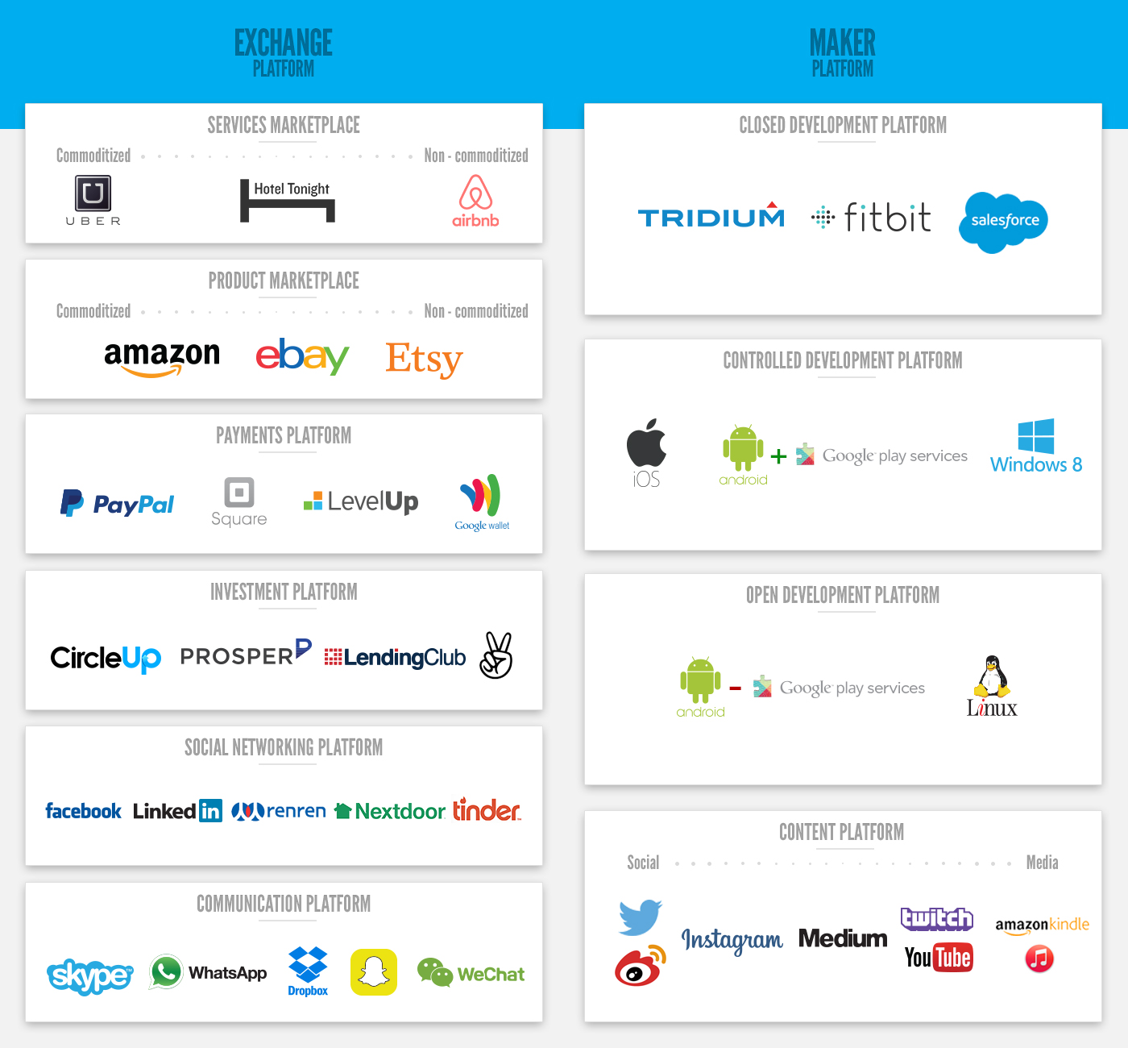
http://www.applicoinc.com/blog/what-is-a-platform-business-model/
Notes:
Review the differences between platform core value propositions, and how that relates to differences in strategies (technology, marketing, customer value prop, transaction handling, customer service, etc).

Slide 7
Platform Business Models
What:
Consider the options for a new media publishing company to either launch via exclusive partnerships with existing social platforms like Facebook or Snapchat or to launch as a standalone, distributed trough the mobile platform Newstands and your own website
Why:
Many new digital businesses are build on a platform. All business professional need to understand platforms
The Network Effect can make the different between success and
failure for many new digital businesses

