Slide 1
Cloud Computing
In-Class Activity…

Slide 2
Roadmap
Week 1: Intro to MIS
Week 2: Systems Analysis
Week 3: Systems Analysis
Week 4: Systems Analysis
Week 5
Swimlanes
ERDs
Decision Trees
Architecture Diagrams
Exam #1
Learn IT! #1
Max Labs 0
What is MIS?
Week 6: Organizational Systems
Week 7: Organizational Systems
Week 8: Organizational Systems
Week 9
Decision Support
SDLC
Exam #2
ERP
Knowledge Management
Digital Innovation
Max Labs 1a & 1b
Week 10: Organizational Systems
Week 11: Organizational Systems
Platforms
Week 13: Organizational Systems
Week 14
Customer Relationship Management Systems
Cloud Computing
Artificial Intelligence
Exam #3 Prep
Supply Chain Management Systems
Week 12: Organizational Systems
Max Labs 3a & 3b
Learn IT! #2
Max Labs 2a & 2b

Slide 3
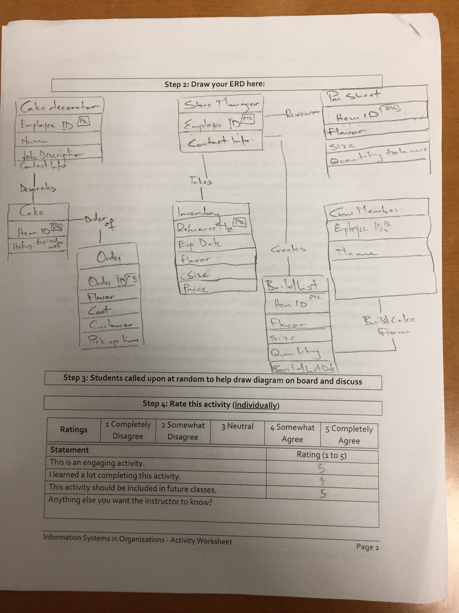
Worksheets will not be returned
In-class activities reinforce what was covered in
Assigned reading
Assigned videos
Lecture
Worksheets do NOT include new material that will be on exams
No need to study from worksheets to be successful on exams
Feel free to take pictures of your worksheets if you’d like

Slide 4
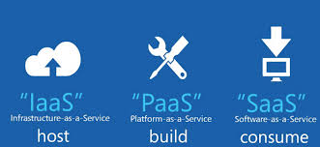
Cloud Computing Models
IaaS: Infrastructure as a Service
PaaS: Platform as a Service
SaaS: Software as a Service
Various other models exist (XaaS) / Hybrid

Slide 5
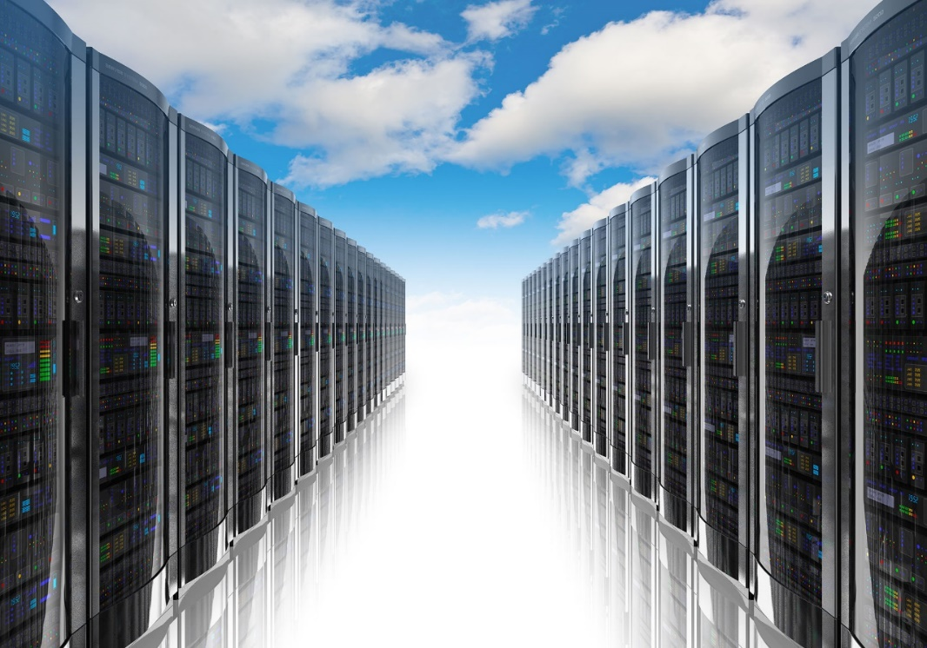
1) IaaS (Infrastructure as a Service)
“Online services that abstract user from the detail of infrastructure like physical computing resources, location, data partitioning, scaling, security, backup, etc.”
The user is responsible for installing and maintaining the operating system and the application software.
Resource Pooling
Pay for resources allocated and consumed, much like a utility service.

Slide 6
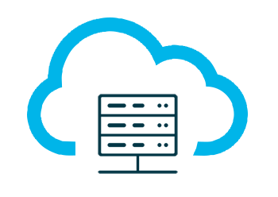
2) PaaS (Platform as a Service)
Build and deploy applications to the web quickly and without the significant capital expenditures and complexity of investments in infrastructure and support layers
Platform includes security layers, databases, operating systems, and developing/execution environments
Rapid deployment
Automatic Scaling
Integration with developing tools
Pay for what your application consumes

Slide 7
3) SaaS (Software as a Service)
Cloud based software
Central, multi-tenant or virtualization architecture supports scalability
Distributed via web browsers; available anywhere with an internet connection
Compatible with multiple operating systems and devices
Easy to use, collaborate, update, and sync
Reduced time to benefit / rapid prototyping
Revenue model is subscription based

Slide 8
Cloud Computing
What:
You have been assigned the role of creating the “short list” of best CRM solutions for the Owl Business School
Once you create your short list, figure out if you will need to figure out how most organizations run these system, in their own data centers or in the cloud
Why:
Cloud service provider provide business professionals with many options for delivering services to their businesses. The better you
understand these options, the better you can serve your
business

