Slide 1
The Turing Test and Mitsuku
In-Class Activity…

Slide 2
Roadmap
Week 1: Intro to MIS
Week 2: Systems Analysis
Week 3: Systems Analysis
Week 4: Systems Analysis
Week 5
Swimlanes
ERDs
Decision Trees
Architecture Diagrams
Exam #1
Learn IT! #1
Max Labs 0
What is MIS?
Week 6: Organizational Systems
Week 7: Organizational Systems
Week 8: Organizational Systems
Week 9
Decision Support
SDLC
Exam #2
ERP
Knowledge Management
Digital Innovation
Max Labs 1a & 1b
Week 10: Organizational Systems
Week 11: Organizational Systems
Platforms
Week 13: Organizational Systems
Week 14
Customer Relationship Management Systems
Cloud Computing
Artificial Intelligence
Exam #3 Prep
Supply Chain Management Systems
Week 12: Organizational Systems
Max Labs 3a & 3b
Learn IT! #2
Max Labs 2a & 2b

Slide 3
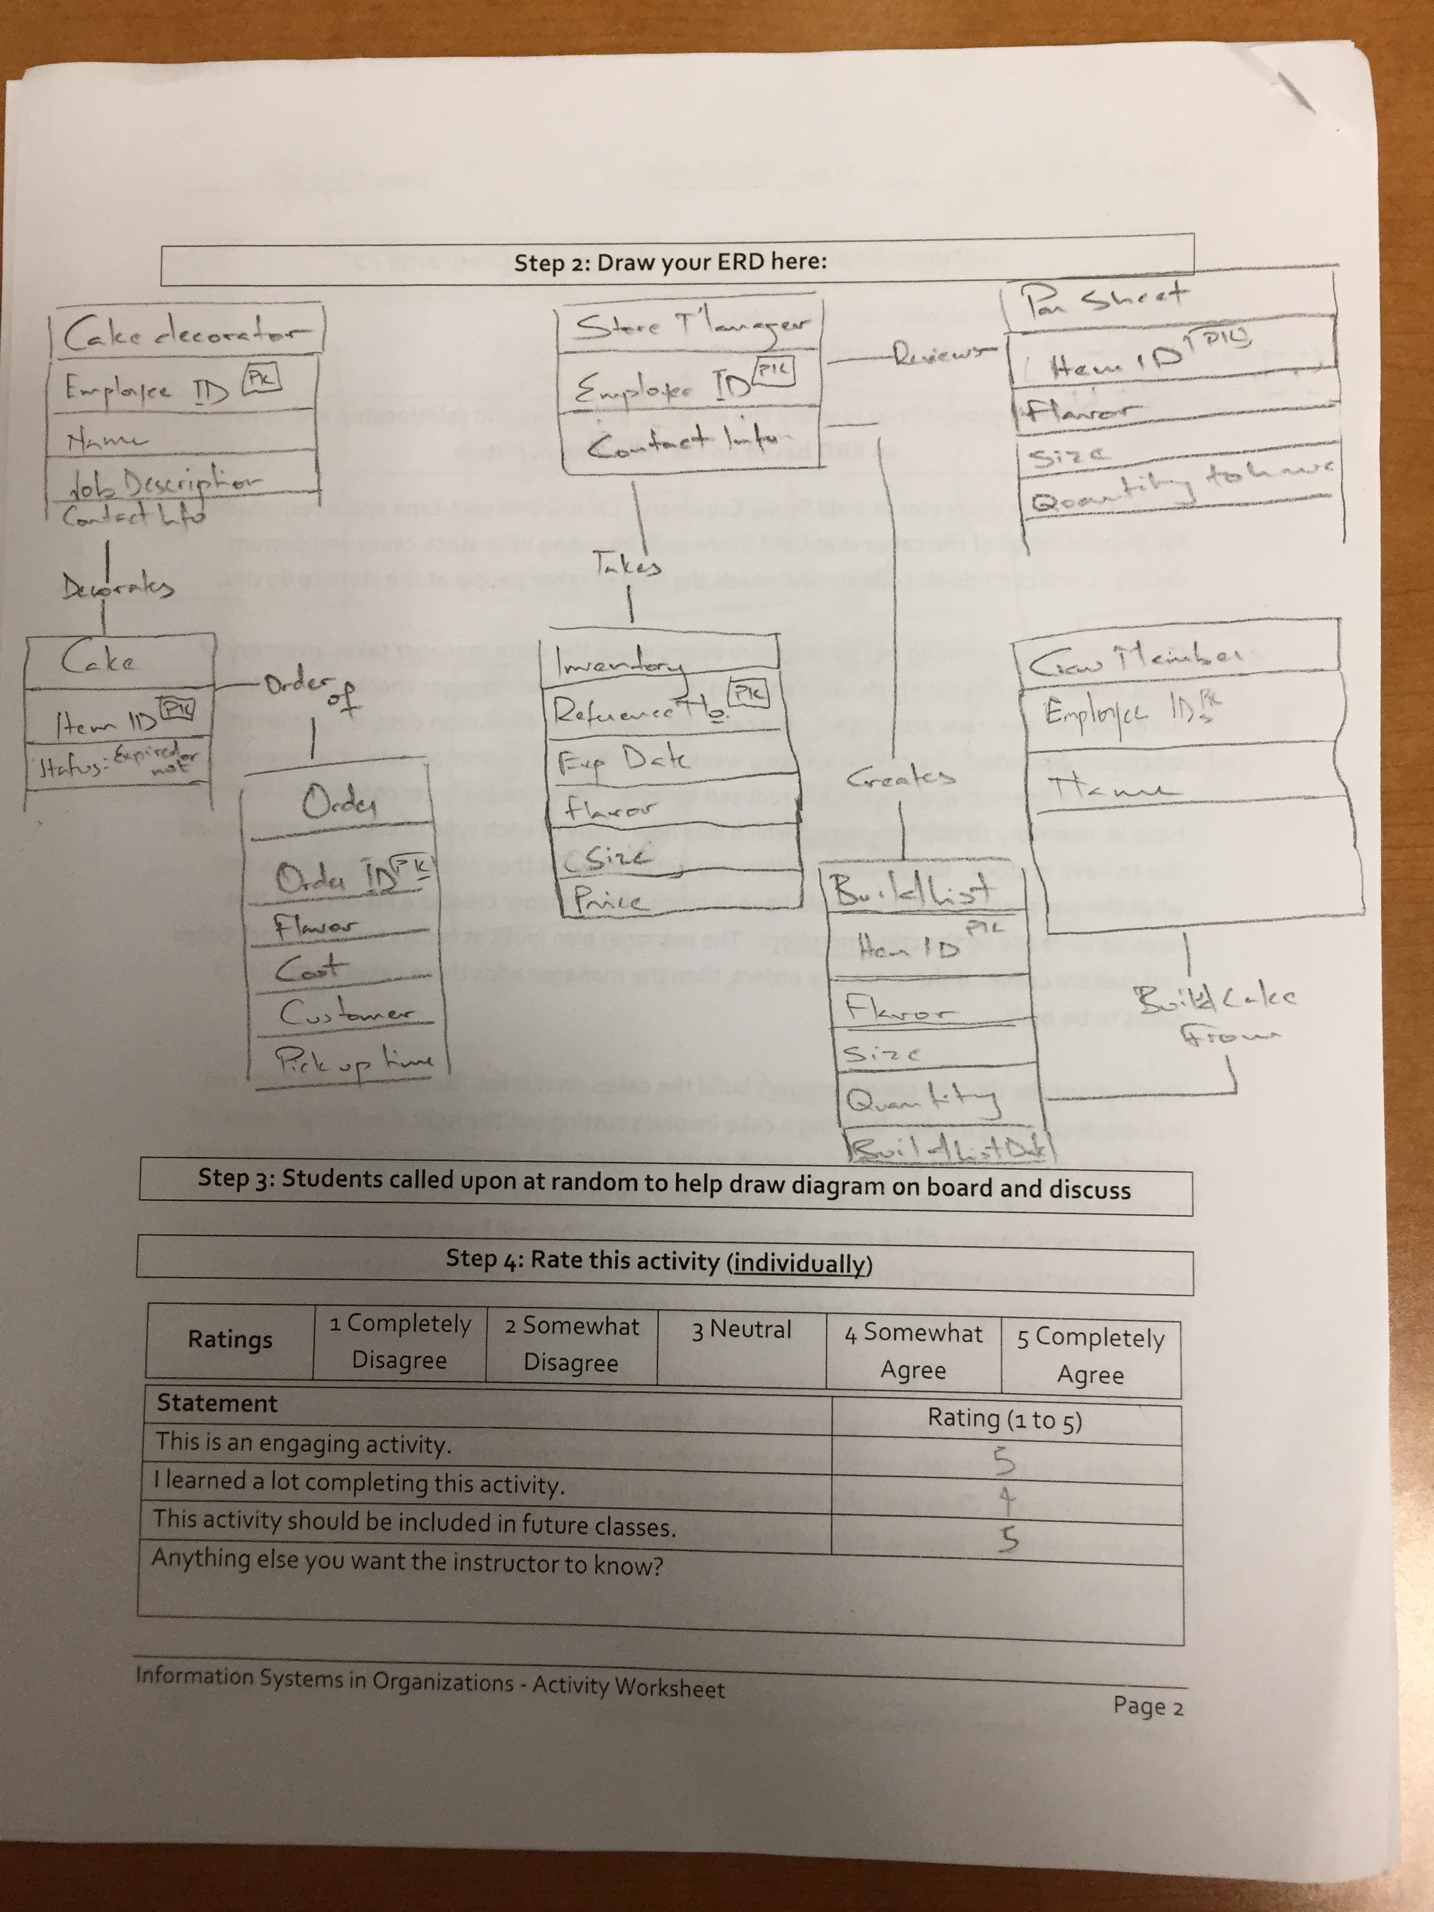
Worksheets will not be returned
In-class activities reinforce what was covered in
Assigned reading
Assigned videos
Lecture
Worksheets do NOT include new material that will be on exams
No need to study from worksheets to be successful on exams
Feel free to take pictures of your worksheets if you’d like

Slide 4
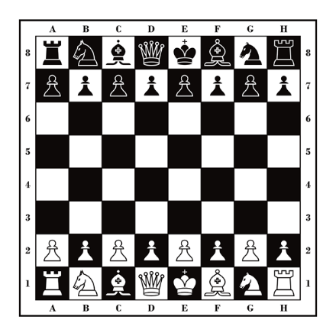
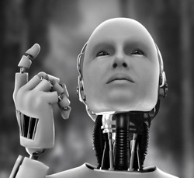
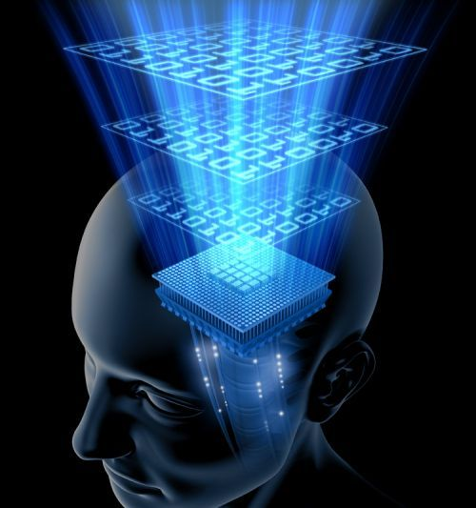
Wait But Why: The AI Revolution
Three types or calibers of AI:
Artificial Narrow Intelligence (ANI)
Artificial General Intelligence (AGI)
Artificial Superintelligence (ASI)
ANI: Chess Program
AGI: Human Level Intelligence
ASI: Superintelligence

Slide 5
AGI Tests
The Turing Test
The Coffee Test
The College Student Test
The Employment Test

Slide 6
Wikipedia, Turing Test
Discuss:
What was this article about?
2. Why should you care?
The Turing Test, developed by Alan Turning in 1950, tests a machine’s ability to exhibit intelligent behavior equivalent to, or indistinguishable from, that of a human. It is essentially having a person interact with either a machine or a person and not being able to tell the difference.
Most people believe that when we have finally created a machine that can pass the Turning Test, we will have achieved AGI.

Slide 7
Alan Turing (1912-1954)
Father of AI and computer science
Cryptanalyst during WWII
Cracked code that enabled Allies victory
Contributions to physical sciences (see Belousov–Zhabotinsky reaction)
Prosecuted by UK and punished with chemical castration for being gay
Died of cyanide poisoning
Receives public apology in 2009 and royal pardon in 2013

Slide 8
The Turing Test and Mitsuku
What:
Develop strategies to differentiate a person from a computer
Test these strategies with a chatbot to see how they work
Refine these strategies and try an actual Turing Test and determine if you are interacting with a person impersonating a computer or a computer impersonating a person
Why:
See for yourself how far AI has come
Get you thinking about the implications on business and your
career

