Slide 1
Expert Systems
In-Class Activity…

Slide 2
Roadmap
Week 1: Intro to MIS
Week 2: Systems Analysis
Week 3: Systems Analysis
Week 4: Systems Analysis
Week 5
Swimlanes
ERDs
Decision Trees
Architecture Diagrams
Exam #1
Learn IT! #1
Max Labs 0
What is MIS?
Week 6: Organizational Systems
Week 7: Organizational Systems
Week 8: Organizational Systems
Week 9
Decision Support
SDLC
Exam #2
ERP
Knowledge Management
Digital Innovation
Max Labs 1a & 1b
Week 10: Organizational Systems
Week 11: Organizational Systems
Platforms
Week 13: Organizational Systems
Week 14
Customer Relationship Management Systems
Cloud Computing
Artificial Intelligence
Exam #3 Prep
Supply Chain Management Systems
Week 12: Organizational Systems
Max Labs 3a & 3b
Learn IT! #2
Max Labs 2a & 2b

Slide 3
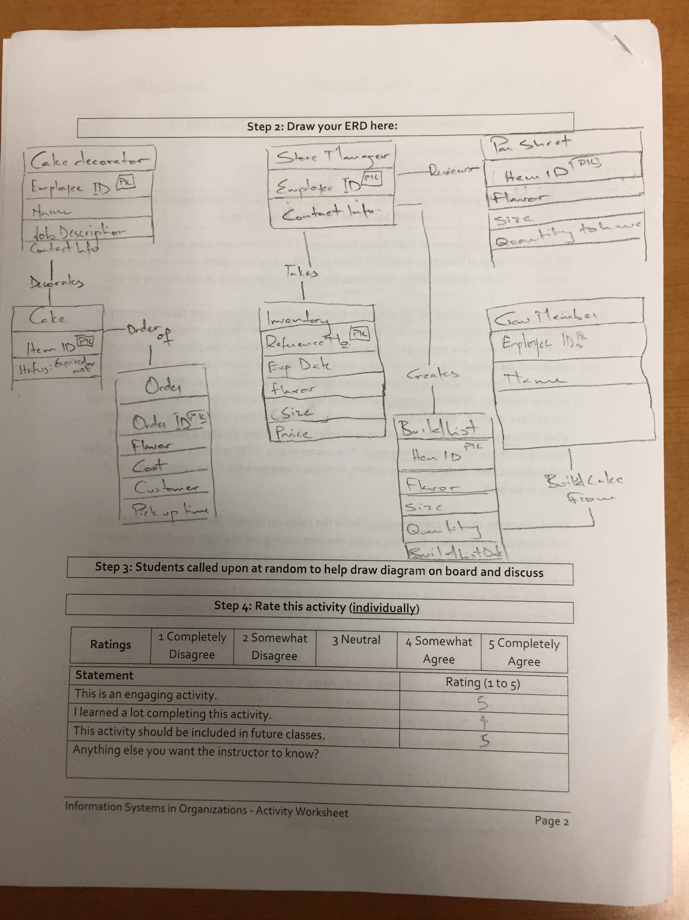
Worksheets will not be returned
In-class activities reinforce what was covered in
Assigned reading
Assigned videos
Lecture
Worksheets do NOT include new material that will be on exams
No need to study from worksheets to be successful on exams
Feel free to take pictures of your worksheets if you’d like

Slide 4
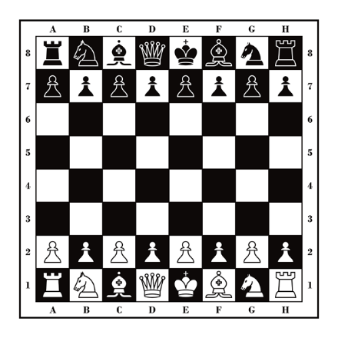
Wait But Why: The AI Revolution
Three types or calibers of AI:
Artificial Narrow Intelligence (ANI)
Artificial General Intelligence (AGI)
Artificial Superintelligence (ASI)
ANI: Chess Program
AGI: Human Level Intelligence
ASI: Superintelligence

Slide 5
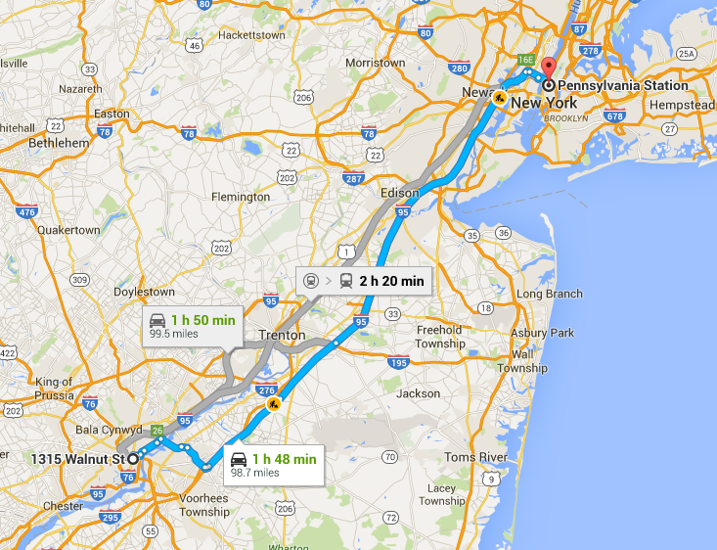
Wait But Why: The AI Revolution
ANI is everywhere:
Google maps
Autonomous cars
Spam filters
Google translate
Travel bookings
Manufacturing
Facebook suggestions

Slide 6
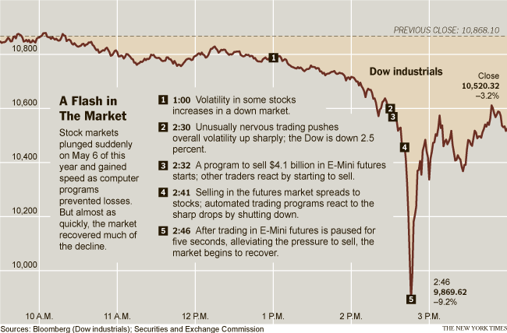
Wait But Why: The AI Revolution
2010 Flash Crash:
ANI caused stock market to plummet
$1 trillion decline in value
Quick recovery

Slide 7
Expert Systems
What:
Interact with an expert system, a form of artificial narrow intelligence (ANI)
Why:
Experts systems are everywhere in business and our personal lives
Learn more about these systems and how they create value

