Slide 1
Introduction to Information Systems in Organizations
In-Class Activity…

Slide 2
Roadmap
Week 1: Intro to MIS
Week 2: Systems Analysis
Week 3: Systems Analysis
Week 4: Systems Analysis
Week 5
Swimlanes
ERDs
Decision Trees
Architecture Diagrams
Exam #1
Learn IT! #1
Max Labs 0
What is MIS?
Week 6: Organizational Systems
Week 7: Organizational Systems
Week 8: Organizational Systems
Week 9
Decision Support
SDLC
Exam #2
ERP
Knowledge Management
Digital Innovation
Max Labs 1a & 1b
Week 10: Organizational Systems
Week 11: Organizational Systems
Platforms
Week 13: Organizational Systems
Week 14
Customer Relationship Management Systems
Cloud Computing
Artificial Intelligence
Exam #3 Prep
Supply Chain Management Systems
Week 12: Organizational Systems
Max Labs 3a & 3b
Learn IT! #2
Max Labs 2a & 2b

Slide 3
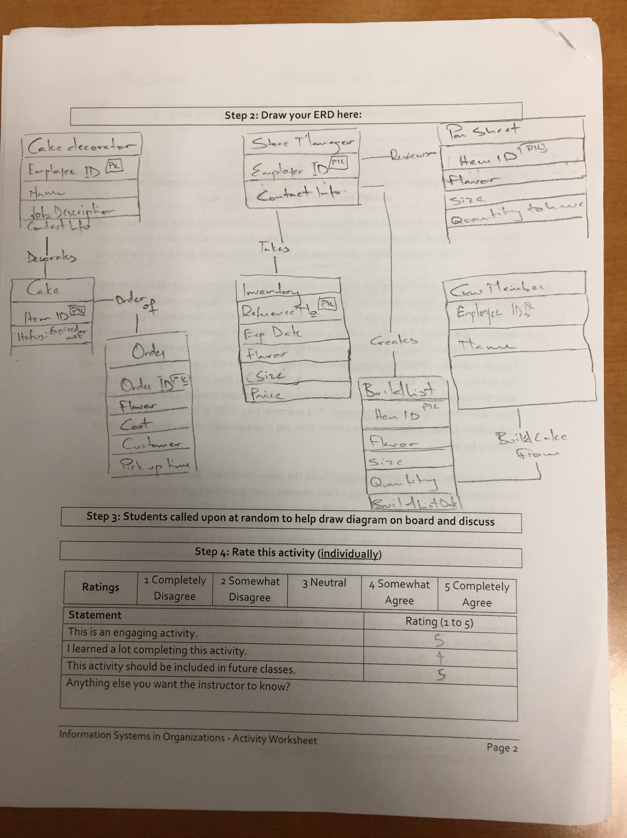
Worksheets will not be returned
In-class activities reinforce what was covered in
Assigned reading
Assigned videos
Lecture
Worksheets do NOT include new material that will be on exams
No need to study from worksheets to be successful on exams
Feel free to take pictures of your worksheets if you’d like

Slide 4
Intro to Information Systems in Organizations
What:
Ask your instructor questions about the course and about themselves
Learn what “In-Class Activities” are all about
Why:
Regardless of your major, the more you understand about information systems the more successful you will be
This course uses activity based learning to help students develop a deeper, more genuine understanding of topics. This is your first taste of “In-Class Activities”

