Slide 1
Did You Know?
In-Class Activity…

Slide 2
Roadmap
Week 1: Intro to MIS
Week 2: Systems Analysis
Week 3: Systems Analysis
Week 4: Systems Analysis
Week 5
Swimlanes
ERDs
Decision Trees
Architecture Diagrams
Exam #1
Learn IT! #1
Max Labs 0
What is MIS?
Week 6: Organizational Systems
Week 7: Organizational Systems
Week 8: Organizational Systems
Week 9
Decision Support
SDLC
Exam #2
ERP
Knowledge Management
Digital Innovation
Max Labs 1a & 1b
Week 10: Organizational Systems
Week 11: Organizational Systems
Platforms
Week 13: Organizational Systems
Week 14
Customer Relationship Management Systems
Cloud Computing
Artificial Intelligence
Exam #3 Prep
Supply Chain Management Systems
Week 12: Organizational Systems
Max Labs 3a & 3b
Learn IT! #2
Max Labs 2a & 2b

Slide 3
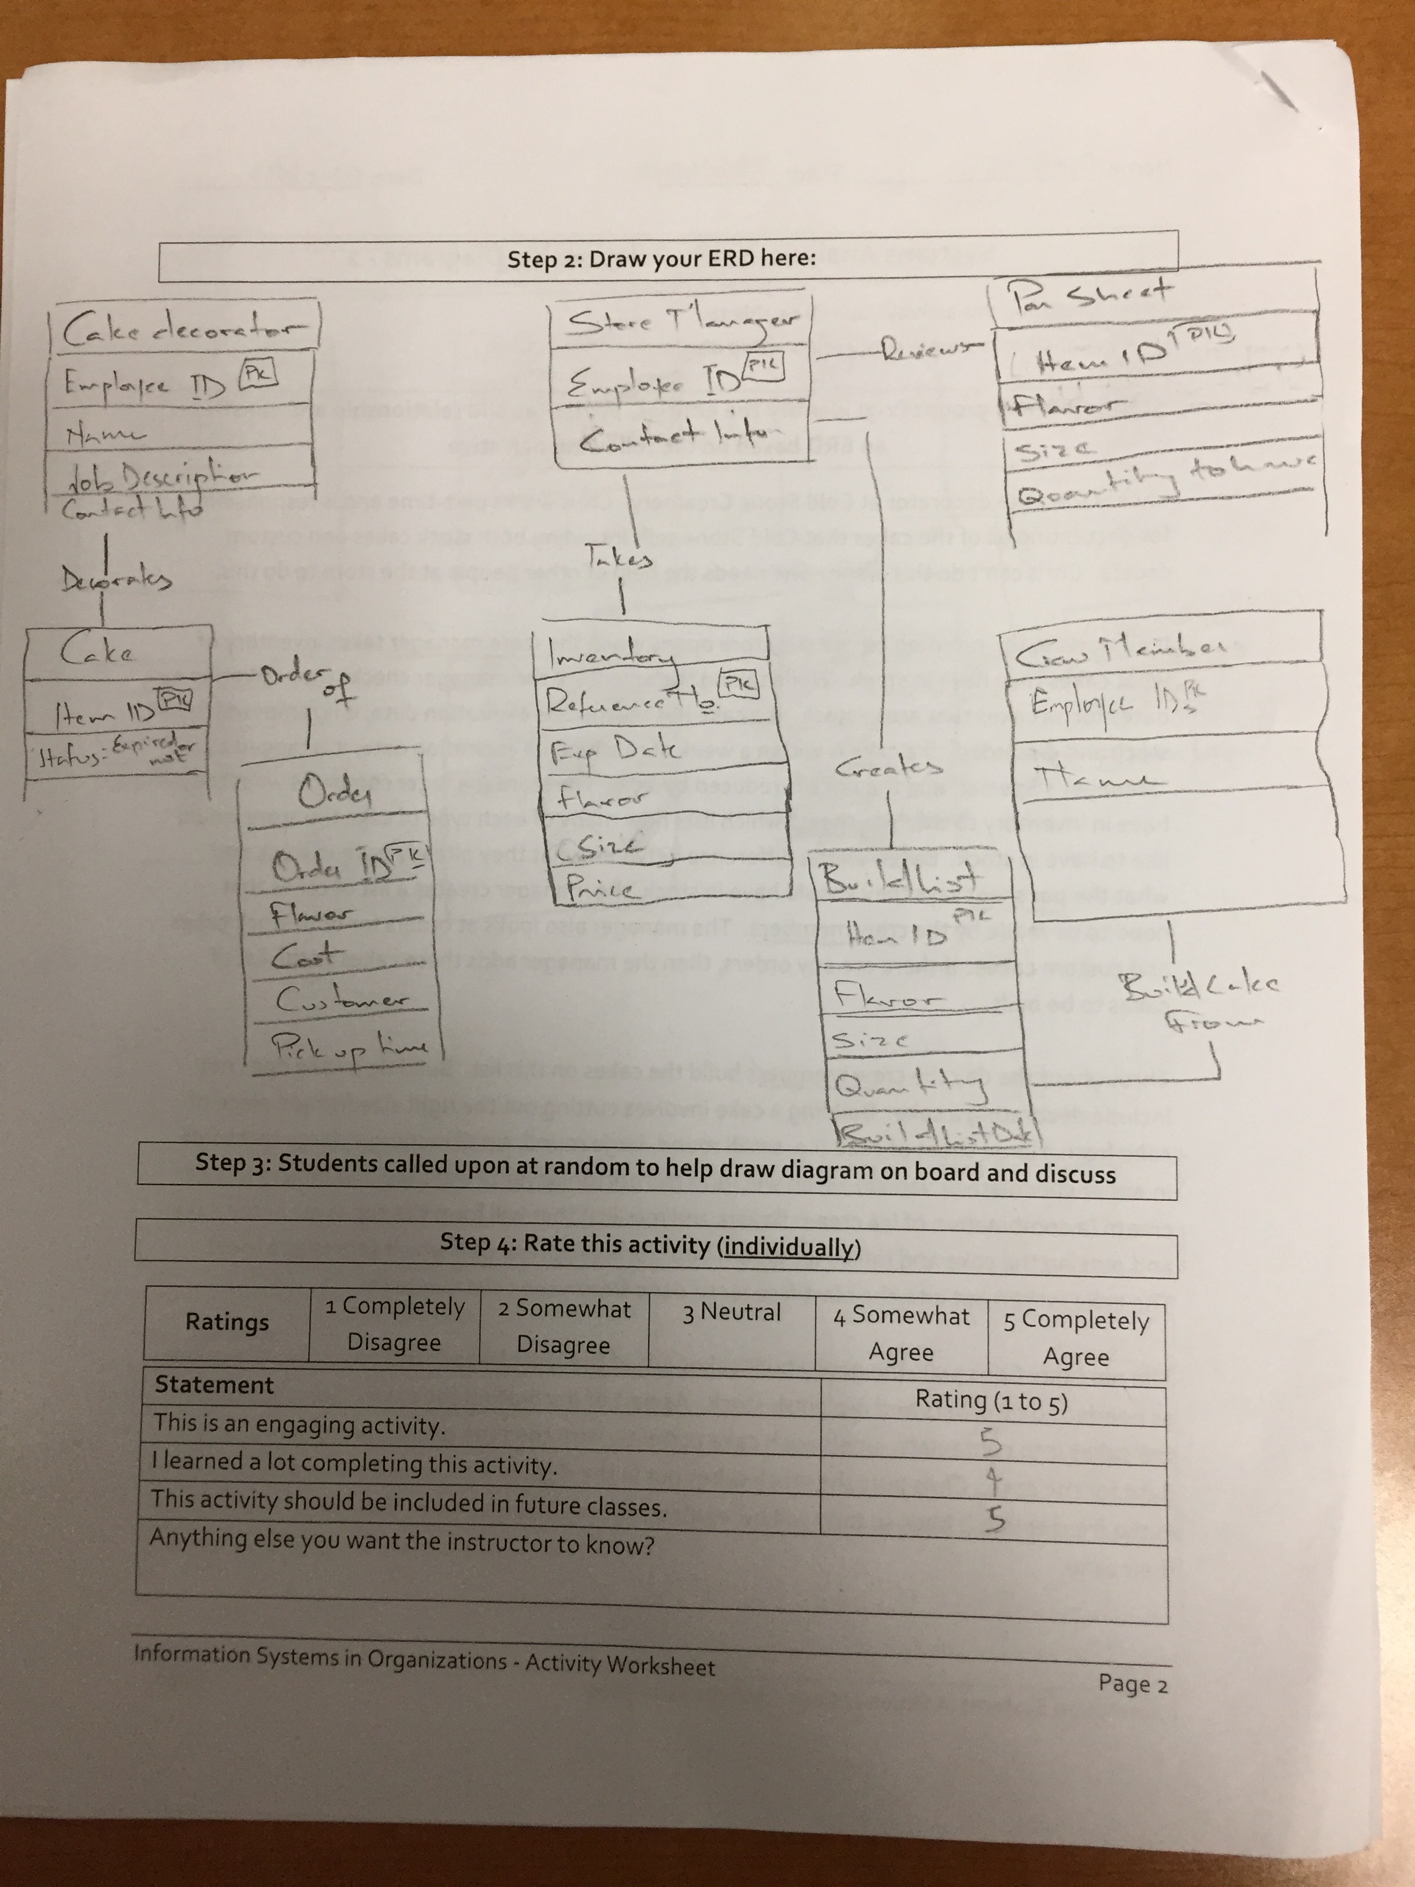
Worksheets will not be returned
In-class activities reinforce what was covered in
  Assigned reading
  Assigned videos
  Lecture
Worksheets do NOT include new material that will be on exams
No need to study from worksheets to be successful on exams
Feel free to take pictures of your worksheets if you’d like

Slide 4
What is MIS?
Using information technology (IT) to
solve business problems

Slide 5
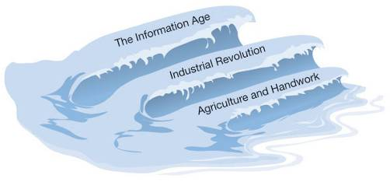
The Three Waves of Change
Where are we now?
Could the conventional wisdom of the day during the age of agriculture and handwork ever prepare a young person to be successful during the industrial age? How would your parents and teachers tell you to prepare?
When you were trying to figure out what to study in college, who did you talk to help you figure this out?
Copyright 2012 Pearson Education, Inc.
Notes:
Would the conventional wisdom of the day during the era of Agriculture and Handwork be able to prepare you for

Slide 6

Did You Know?
What:
Watch a short video that highlights how the world is changing
Identify how many of these changes have been enabled by technology
Identify changes that make people a little anxious
Why:
The world is changing at an ever accelerating rate. Most of this change is driven by technology
All the rules of doing business are being redefined every day
The people who understand business and how to leverage technology will be successful in this new world. The people who don’t are in for a very rude awakening

Slide 7
Did you know?
In-Class Activity…

