Slide 1
Swim Lane Diagrams - 2
In-Class Activity…

Slide 2
Roadmap
Week 1: Intro to MIS
Week 2: Systems Analysis
Week 3: Systems Analysis
Week 4: Systems Analysis
Week 5
Swimlanes
ERDs
Decision Trees
Architecture Diagrams
Exam #1
Learn IT! #1
Max Labs 0
What is MIS?
Week 6: Organizational Systems
Week 7: Organizational Systems
Week 8: Organizational Systems
Week 9
Decision Support
SDLC
Exam #2
ERP
Knowledge Management
Digital Innovation
Max Labs 1a & 1b
Week 10: Organizational Systems
Week 11: Organizational Systems
Platforms
Week 13: Organizational Systems
Week 14
Customer Relationship Management Systems
Cloud Computing
Artificial Intelligence
Exam #3 Prep
Supply Chain Management Systems
Week 12: Organizational Systems
Max Labs 3a & 3b
Learn IT! #2
Max Labs 2a & 2b

Slide 3
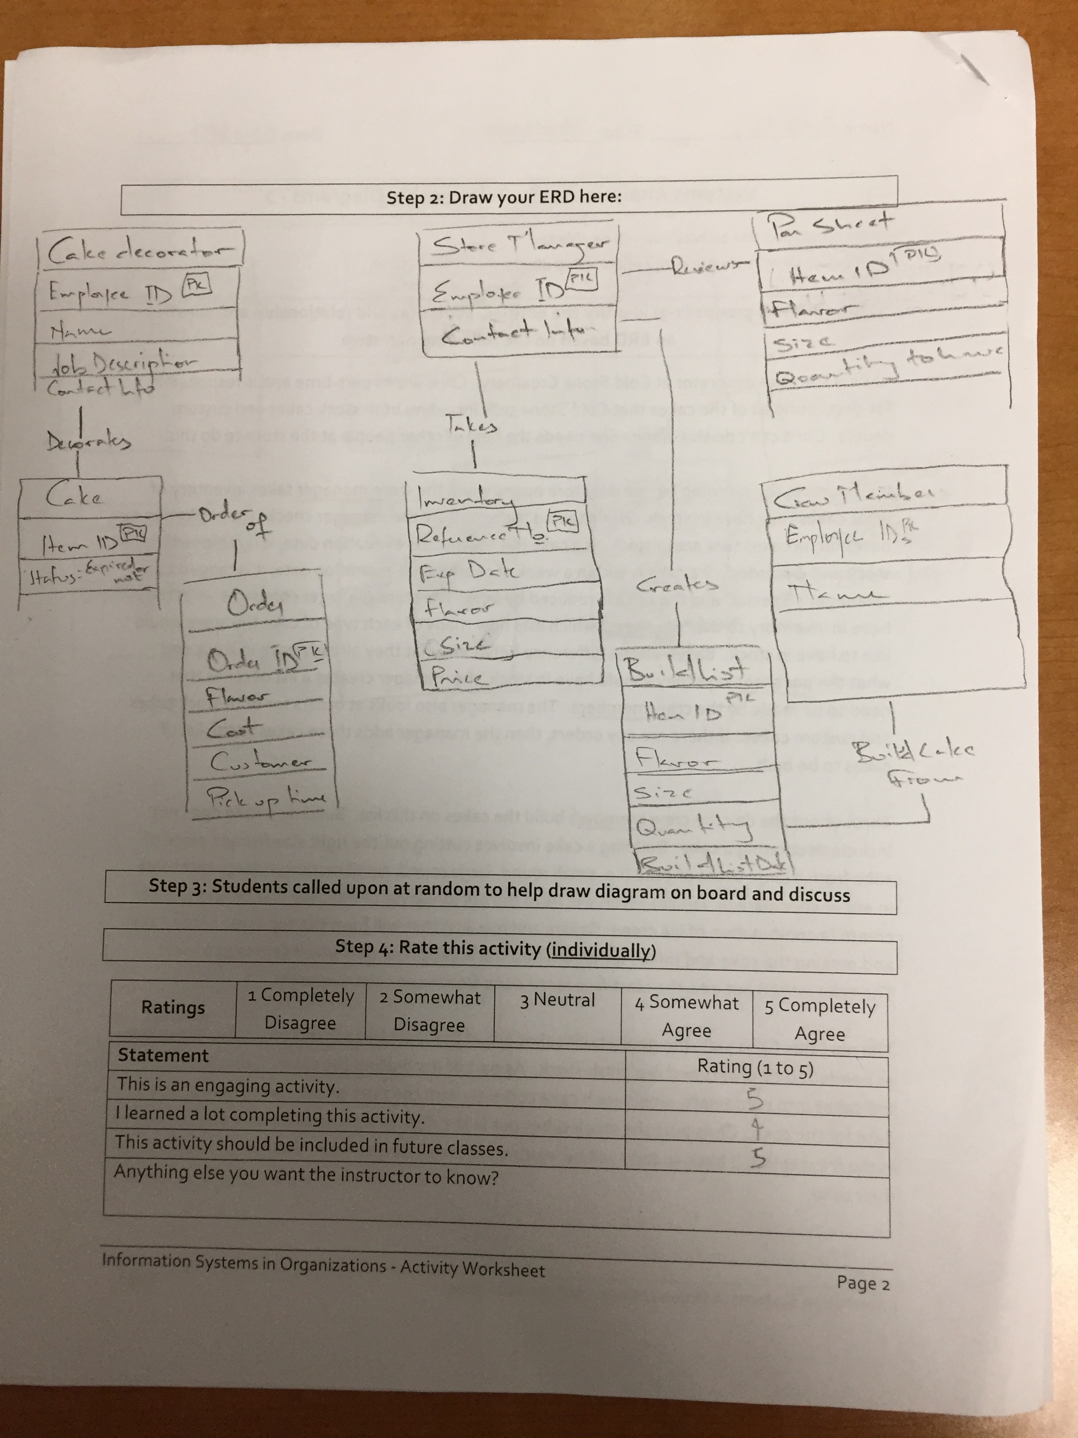
Worksheets will not be returned
In-class activities reinforce what was covered in
  Assigned reading
  Assigned videos
  Lecture
Worksheets do NOT include new material that will be on exams
No need to study from worksheets to be successful on exams
Feel free to take pictures of your worksheets if you’d like

Slide 4
What is a swim lane diagram?
A type of process flow diagram that features divisions or "lanes.“
Each lane is assigned an actor (which may be an individual, department, division, group, machine, entity, and so on), or even a phase or stage in a process, that is responsible for the activity or work described in the lane.

Slide 5
How to map a swim lane diagram
A circle signifies the starting and ending of an event in the process
A rectangle represents an activity in the process.
A diamond represents a decision that must be made.
Arrows indicate the flow of the process.
A cylinder represents stored data.

Slide 6

Swim Lane Diagrams - 2
What:
Construct a more complex Swim Lane Diagram from provided story
Why:
Swim Lane Diagrams are simple, effective tools for documenting a business process
Everything you do at work will be part of a business process – modelling these processes gives you the ability to study & improve them
Swim Lane Diagrams are on every exam

Slide 7
Possible Solution

