Slide 1
Entity Relationship Diagrams - 1
In-Class Activity…

Slide 2
Roadmap
Week 1: Intro to MIS
Week 2: Systems Analysis
Week 3: Systems Analysis
Week 4: Systems Analysis
Week 5
Swimlanes
ERDs
Decision Trees
Architecture Diagrams
Exam #1
Learn IT! #1
Max Labs 0
What is MIS?
Week 6: Organizational Systems
Week 7: Organizational Systems
Week 8: Organizational Systems
Week 9
Decision Support
SDLC
Exam #2
ERP
Knowledge Management
Digital Innovation
Max Labs 1a & 1b
Week 10: Organizational Systems
Week 11: Organizational Systems
Platforms
Week 13: Organizational Systems
Week 14
Customer Relationship Management Systems
Cloud Computing
Artificial Intelligence
Exam #3 Prep
Supply Chain Management Systems
Week 12: Organizational Systems
Max Labs 3a & 3b
Learn IT! #2
Max Labs 2a & 2b

Slide 3
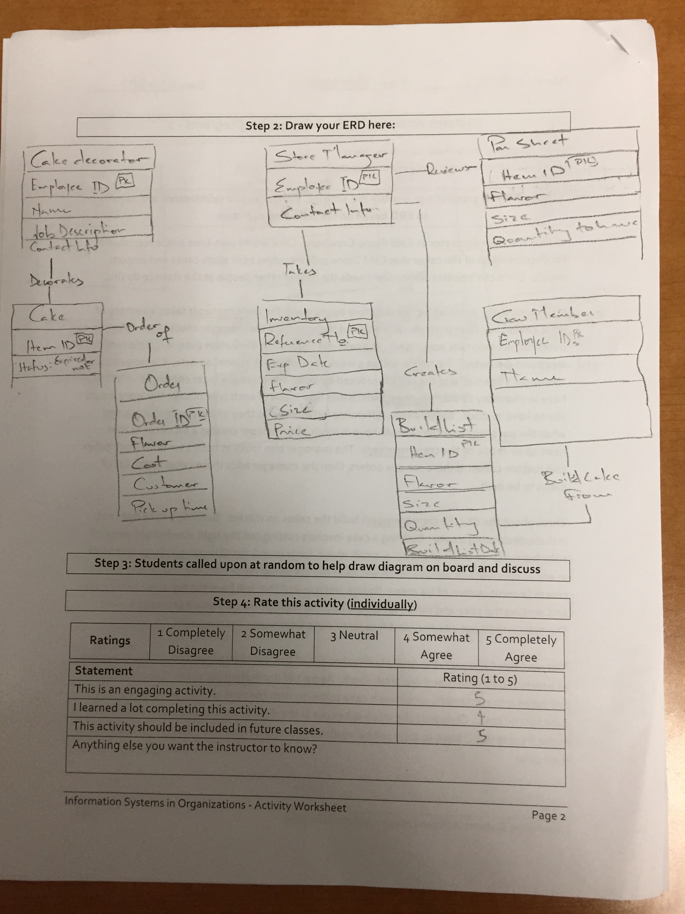
Worksheets will not be returned
In-class activities reinforce what was covered in
  Assigned reading
  Assigned videos
  Lecture
Worksheets do NOT include new material that will be on exams
No need to study from worksheets to be successful on exams
Feel free to take pictures of your worksheets if you’d like

Slide 4
What is a entity relationship diagram?
An Entity Relationship Diagram (ERD) is a visual representation of different data using conventions that describe how these data are related to each other.

Slide 5
Crow’s Foot Database Notation
A shopper walks into a store to buy an item. When the shopper makes a purchase, the system is updated with information about the person, including their name, loyalty card id and zip code. The store also records which items were purchased, including details like item name, price and item source.
Chen’s Database Notation

Slide 6

Entity Relationship Diagrams - 1
What:
Interpret an entity relationship diagram
Construct a simple entity relationship diagram from provided story
Why:
ERDs model the information required for a process
ERDs supplement swim lane diagrams and complete a bigger picture
ERDs are on every exam

Slide 7
Entity Relationship Diagram (ERD)
Legend :
PK : Primary Key
FK : Foreign Key (refer to PK)

Slide 8
Possible Solution

