Slide 1
Decision Trees
In-Class Activity…

Slide 2
Roadmap
Week 1: Intro to MIS
Week 2: Systems Analysis
Week 3: Systems Analysis
Week 4: Systems Analysis
Week 5
Swimlanes
ERDs
Decision Trees
Architecture Diagrams
Exam #1
Learn IT! #1
Max Labs 0
What is MIS?
Week 6: Organizational Systems
Week 7: Organizational Systems
Week 8: Organizational Systems
Week 9
Decision Support
SDLC
Exam #2
ERP
Knowledge Management
Digital Innovation
Max Labs 1a & 1b
Week 10: Organizational Systems
Week 11: Organizational Systems
Platforms
Week 13: Organizational Systems
Week 14
Customer Relationship Management Systems
Cloud Computing
Artificial Intelligence
Exam #3 Prep
Supply Chain Management Systems
Week 12: Organizational Systems
Max Labs 3a & 3b
Learn IT! #2
Max Labs 2a & 2b

Slide 3
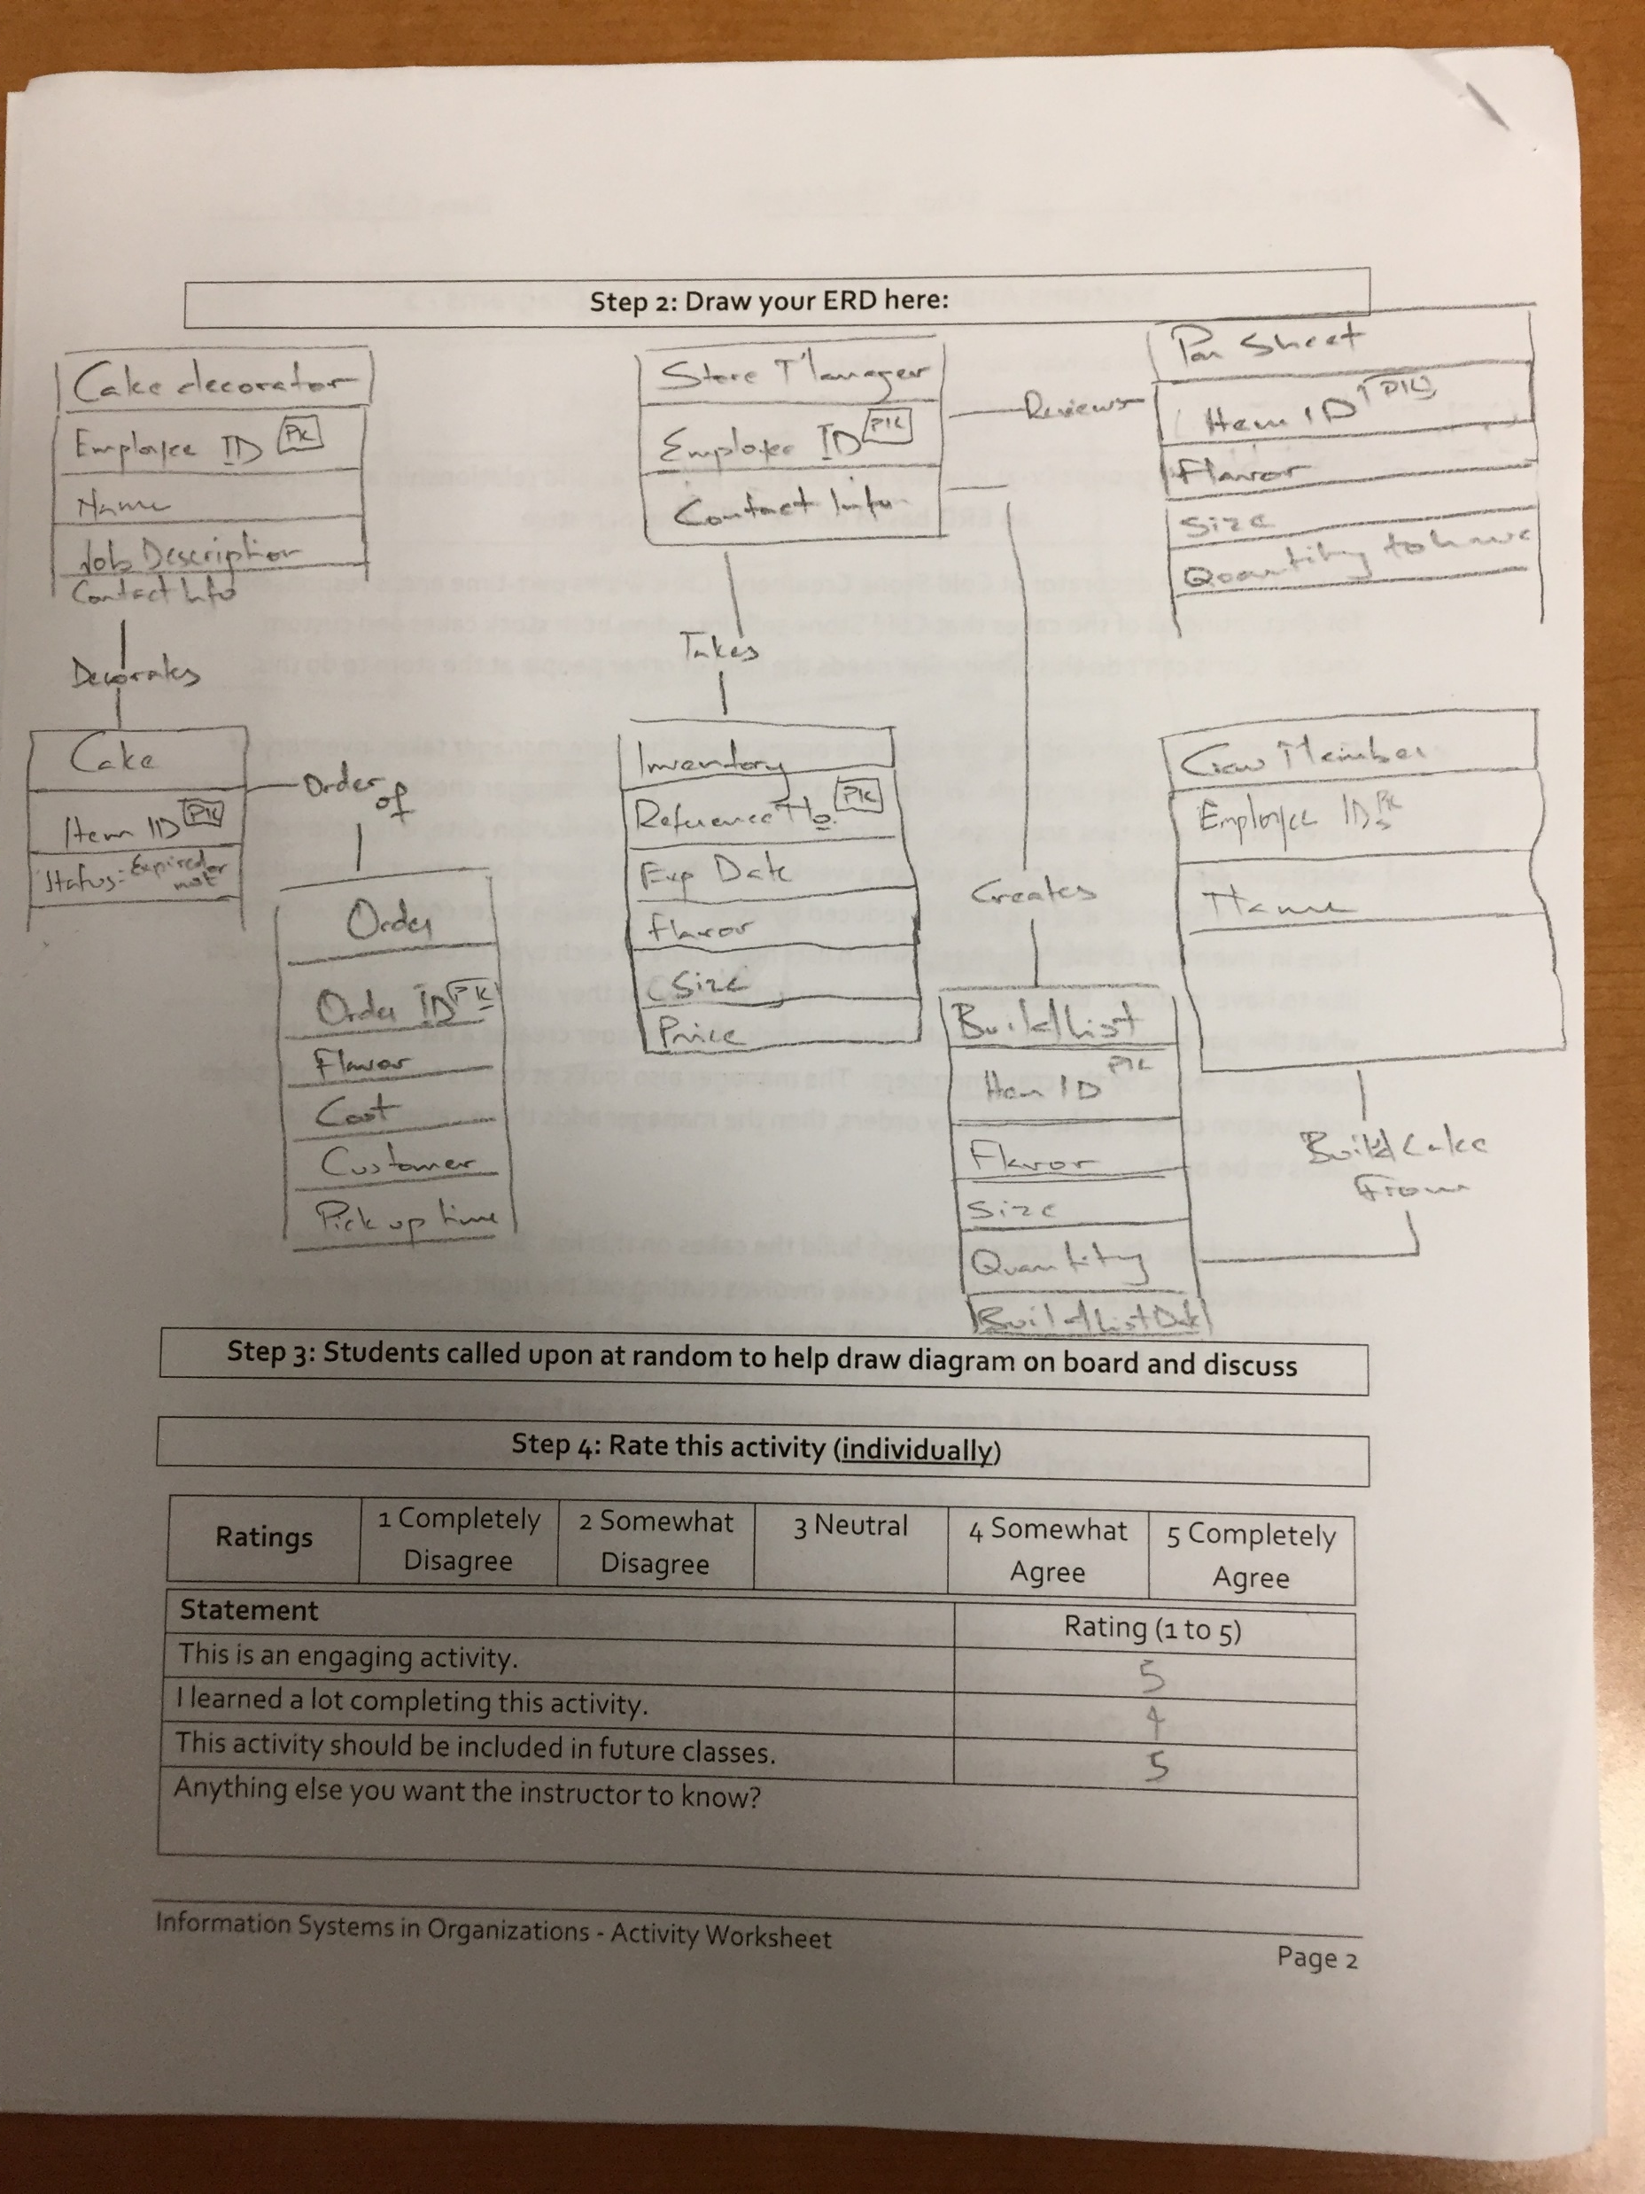
Worksheets will not be returned
In-class activities reinforce what was covered in
  Assigned reading
  Assigned videos
  Lecture
Worksheets do NOT include new material that will be on exams
No need to study from worksheets to be successful on exams
Feel free to take pictures of your worksheets if you’d like

Slide 4
What is a Decision Tree?
Discuss:
  1. What was this article about?
  2. Why should you care?
Decision trees are a great tool for modeling business rules. This article gives you the basic mechanics for creating decision trees to model business rules.
To operate and run your business, you must understand the business rules under which your business runs. Decision trees are a great way to model these business rules so that these business rules can be communicated to others and analyzed to find opportunities to improve the business.

Slide 5
How to map a decision tree
A condition (also refer to as a decision point) is declared in a diamond-shaped node
The possible values for the condition are represented by branches
The actions (also refer to as outcome) are declared at the end of each branches in a rectangle

Slide 6
Messy Business Rules
Answer
Shipping charges are a function of the weight of the shipment, how the shipment is being sent and where the shipment is being sent. For domestic shipment orders can be shipped via air or surface. For air shipments the cost is $2/lb ($20 minimum) with a maximum of 50 lbs. Over 50 lbs the cost is $100 plus $1/lb for every pound over 50. For surface the price varies based on if the shipment is to the same state or a different state. Within the same state the charge is $1/lb ($5 minimum) with a maximum of 60 lbs. Over 60 lbs costs $60 plus $0.25 for every pound over 60. Surface to another state is $1/lb ($7 minimum) with a maximum of 60 lbs. Over 60 lbs the cost is $60 plus $0.50/lb for every pound over 60. For international shipments the cost is $4/lb ($40 minimum) for shipments up to 60 lbs. Over 60 lbs the cost is $240 plus $2/lb for every pound over 60.
You have 15 seconds to answer the following question…
How much will it cost to ship a 12 pound package
from Philly to California via air?
The correct answer is?
12 pounds x $2/pound = $24

Slide 7
Answer
You have 15 seconds to answer the following question…
How much will it cost to ship a 12 pound package from Philly to California via surface?
The correct answer is?
12 pounds x $1/pound = $12

Slide 8

Decision Trees
What:
Construct a simple decision tree
Why:
Decision trees are an effective way to model business rules
Modeling makes it easier to
  Communicate business rules to others
  Improve upon current business rules
Models make everything better

Slide 9
Possible Solution

Slide 10
No
Yes

