Slide 1
Conceptual Architecture Diagram
In-Class Activity…

Slide 2
Roadmap
Week 1: Intro to MIS
Week 2: Systems Analysis
Week 3: Systems Analysis
Week 4: Systems Analysis
Week 5
Swimlanes
ERDs
Decision Trees
Architecture Diagrams
Exam #1
Learn IT! #1
Max Labs 0
What is MIS?
Week 6: Organizational Systems
Week 7: Organizational Systems
Week 8: Organizational Systems
Week 9
Decision Support
SDLC
Exam #2
ERP
Knowledge Management
Digital Innovation
Max Labs 1a & 1b
Week 10: Organizational Systems
Week 11: Organizational Systems
Platforms
Week 13: Organizational Systems
Week 14
Customer Relationship Management Systems
Cloud Computing
Artificial Intelligence
Exam #3 Prep
Supply Chain Management Systems
Week 12: Organizational Systems
Max Labs 3a & 3b
Learn IT! #2
Max Labs 2a & 2b

Slide 3
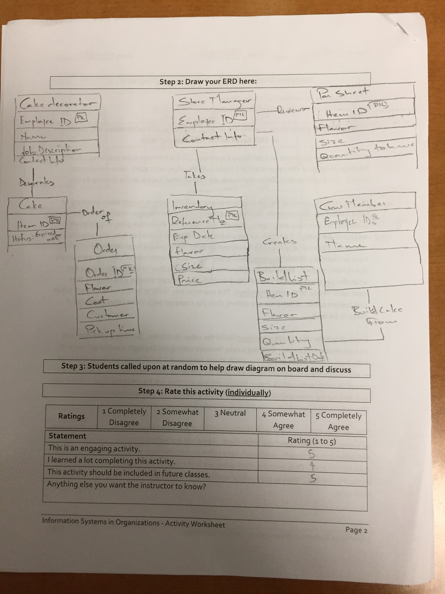
Worksheets will not be returned
In-class activities reinforce what was covered in
  Assigned reading
  Assigned videos
  Lecture
Worksheets do NOT include new material that will be on exams
No need to study from worksheets to be successful on exams
Feel free to take pictures of your worksheets if you’d like

Slide 4
Investigative Architecture: The Conceptual Diagram
Discuss:
  1. What was this article about?
  2. Why should you care?
A conceptual architecture diagram is a high-level diagram that describes a system including who interacts with the system, how they interact, the processes the system supports and the resources the system utilizes to make this all happen.
Regardless of your major you will be involved in the envisioning, planning, deployment and support of the systems that support your business. Conceptual architecture diagrams are useful for documenting and communicating ideas about how systems do or should work.

Slide 5
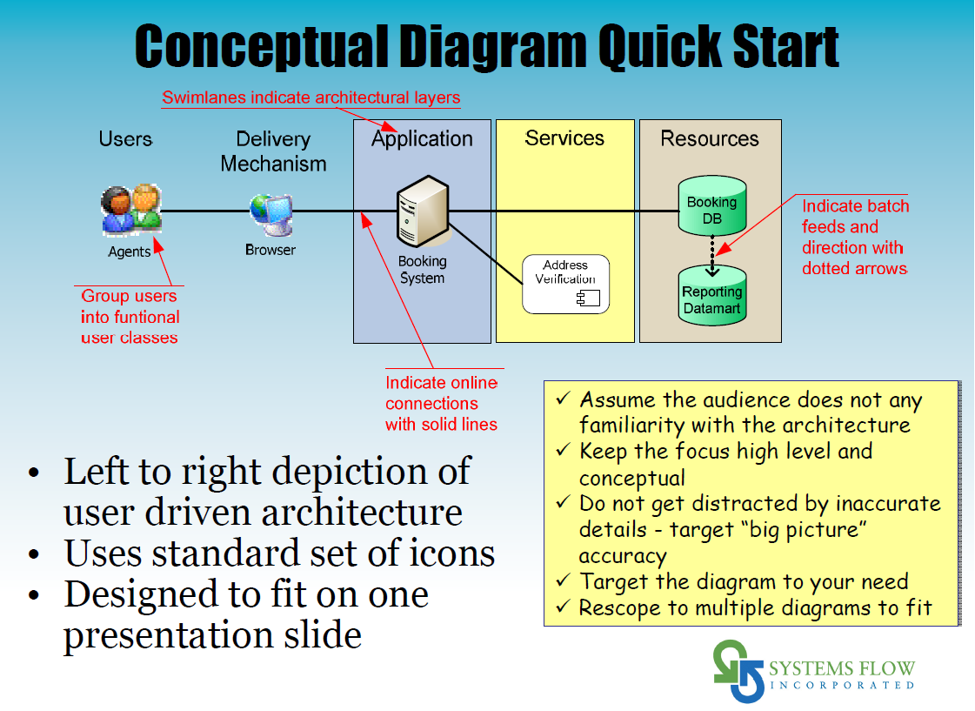
have

Slide 6











Example Conceptual Architecture Diagram
Users
Interface
Processes
Resources
De
System
Administrator
Desktop
Textbook
Content
Import From
Publishers
Professor
Web
Define Course
Course
Content
Database
Students
Phone App
Use Study Aids
Clipart from: https://openclipart.org

Slide 7

Conceptual Architecture Diagram
What:
Construct a simple conceptual architecture diagram and ERD
Why:
Conceptual Architecture Diagrams describe a system by considering:
  Who uses it
  How they access it
  What they use it for
  What data they are using

Slide 8





Analysis by Physician
Fine Tune Medications
Better Health Outcomes
Continuous Monitoring
Seizure Frequency, Duration & Intensity
Reduction in
Office Visits & Costs

Slide 9
Possible Solution

Slide 10


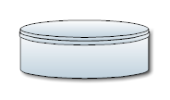






Users
Interface
Processes
Resources
Detect, Measure
and Report
Episode
Patient
Analyze Episodes
and Adjust
Treatment Plan
Physician
Track Covered
Procedures and
Episodes
Event Monitoring
And Reporting
Database
Insurer
Report Event
via Text
Loved
Ones

