Slide 1
Digital Identity Management
Notes:
Note: Slides with a red dot are required.

Slide 2
Learning goals
TOPICS
Individual branding and reputation management
TECHNOLOGIES
Digital identity and portfolio
Search neutrality
Communities of practice
Community platform
Cloud system architecture
E-portfolio
Web analytics
SEO
Privacy

Slide 3
What is a digital identity?
Personal relationships FACEBOOK
Purchase history TARGET
Credit history EQUIFAX
Ideas DROPBOX
Finances WELLS FARGO
Likes and dislikes NETFLIX
Daily commute IPHONE
GOOGLE Your identity is the product
Grades and Graduation TEMPLE
Source: The next revolution will be reclaiming your digital identity by Nik Milanovic, https://techcrunch.com/2017/10/17/the-next-revolution-will-be-reclaiming-your-digital-identity/
Notes:
Key point: There is a lot of digital data, that belongs to us, it is part of our digital identity, that we have no control over.

Slide 4
Digital identity management
AUTHENTICATION Prove who you are
PRIVACY Control what others can access
SECURITY Prevent and recover from theft
REPUTATION Personal and professional brand
NETWORKS Connect with relevant others
PROMOTION Help others find you
Notes:
Key point: Think of digital identity management as an interconnected ‘system’ – to go with the systems view of the course.

Slide 5
Active digital identity management
Shape professional reputation
Connect with relevant others
Notes:
Key point: This slide is just a simplification of the previous. It shows the two things we want students to focus on.
Background or additional
Curate = Create content online that projects what you want others to know
SEO = Use search engine optimization to make sure others find your curated identity

Slide 6
community platform
A social cloud based learning platform built on WordPress
social exchanges,
open co-creation, and
digital branding
Website
E-portfolios
Professional achievement program
Courses
Only platform that integrates web, professional development, and coursework.
Proprietary to the nationally ranked Fox School’s MIS department.
Notes:
Why aren’t we using Blackboard/Canvas/Moodle/etc? This is a common question as new students (and instructors!) have to deal with the pain of learning a new system:
Opportunity to experience a next generation learning management system developed at Temple that is now being piloted at other universities
Integrates professional development including digital identity management – others treat it as a standalone task
Experience a modern and interesting architecture (next slide)
This is our competitive advantage, it is one of the reasons we are the best department at Temple and worldwide

Slide 7
Digital Identity Management Assignment
Digital identity and profile
Digital portfolio - e-portfolio
Build a professional network
Assess with analytics
Professional achievement program (MIS majors only)
Notes:
These are all the components of the digital identity management assignment.

Slide 8
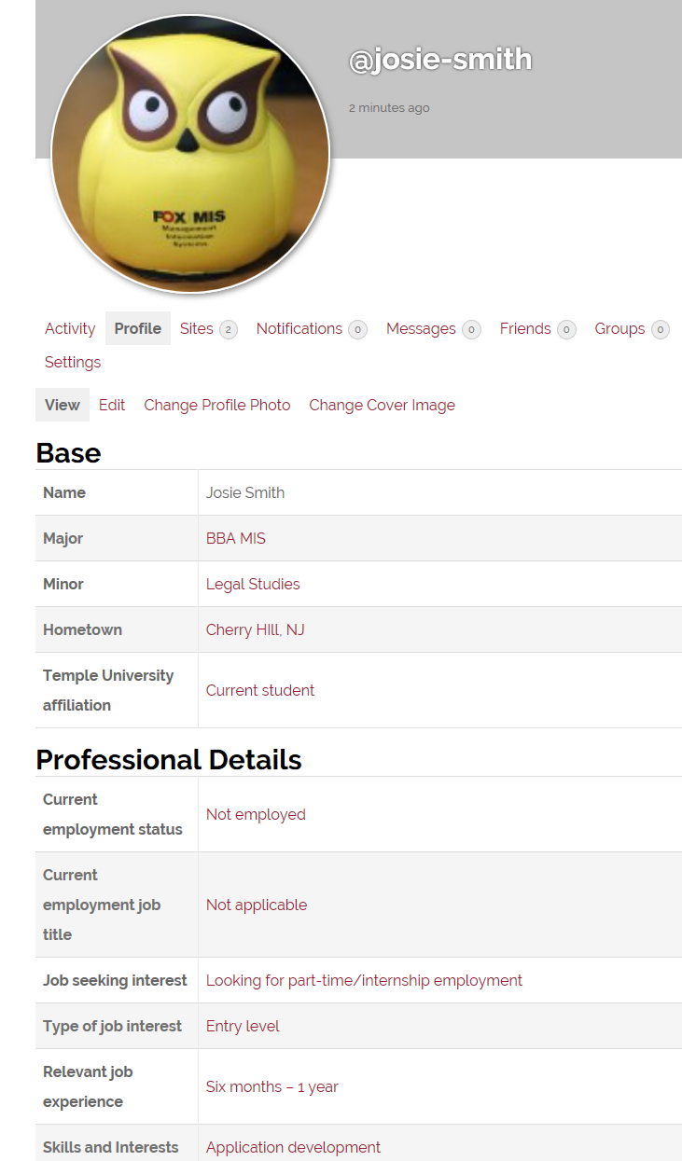
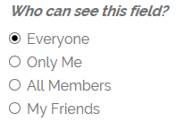
Digital identity
Profile
Major
Hometown
Skills and Interests
Avatar
Find others
Question: Is the concept of individual privacy at odds with the need to create a public brand and remain accessible to others?
Notes:
Ask the students which of major, hometown, skills and interests should be visible to everyone, all members of the community (people who have a userid on community), or just friends?
Major
Should always be public – otherwise how will people know which community you belong to? How will employers find you? How will you find other majors and how will they find you?
Hometown
You can make a case either way on this – which is why it is there.
Public: hometown is the easiest way to find common ground with somebody. It is usually the first question that people ask in a professional meeting – ‘where are you from?’
Friends only: You don’t want people coming to your house.
Note: that is why ‘hometown’ is listed the way it is – it is typically not the current home address – it is where they are from
Best answer: Public unless you are still living at home and come from a very small town.
Skills and Interests
Should always be public
Many students pick more than 5-7 options for Skills and Interests
Discuss the pitfalls of picking too many
Employers (and professors!) won’t believe the person
It dilutes their digital brand – how can you be interested in everything
It makes it harder for others to know you
Avatar
We require students to add a reasonably professional headshot as an avatar. It is not optional. The benefits include:
Creates a community – human beings relate to people they can see
Makes it easier to connect with others off-line
Certain features on the platform will not work (leaderboard, community activity, search, etc)
Find others
Demonstrate the power of finding others by clicking on one of the skills and interests

Slide 9
Digital portfolio
E-portfolio
Web site that highlight your skills and body of work
Updated frequently
Automatically pushed to search engines
Permanent location on the Internet
Uniform resource locator (URL)
Should be easy to remember
Sample content
Work experience (e.g., describe what you did in a job)
Sample of work (e.g., a PowerPoint of a project)
Interests or volunteer work (help others see you as a well-rounded person)
Pictures that highlight the above (e.g., a picture at work)
SEO
Student theme is Search Engine Optimized (SEO)
Software automatically pushes content to search engines

Slide 10
Digital content
☺
☺
☺
☺
☺
☹
☹
☺
☺
☹
The WordPress editor
☺
☺
Notes:
Notes
Since the editor looks like Microsoft Word, students mistakenly believe they can use it like Word.
This is not the case as the underlying theme (design framework) controls much of the presentation.
For example, many formatting commands will be over-ridden by the design framework. Other formatting commands will cause errors. Yet others will look okay on the desktop but mess up mobile.
The smiley faces are commands/actions you should encourage students to use:
Use clear descriptive titles for posts/pages. These get indexed by Google. If there is a spelling error the indexing will not work. If the title is generic (e.g., “My thoughts”), then it will be ignored by the search engine.
Use the provided styles (e.g.,. Heading 1, heading 2). This will allow the theme framework to automatically adjust the display to work on mobile devices. It is also helps disabled people use special software.
Bullet lists work well as a general rule of writing. As we know, very few people want to read a long rambling paragraph.
The T icon is very useful if you are pasting from Word. You can try an example:
Copy and paste in some text from Word (don’t press the T yet).
Now click on the “Text” tab on the right of the editor box (cut-off not visible in the screen print above). This will show junky HTML.
Switch back to “Visual”
Next click the T.
Now copy and paste the same text from Word
Click on the “Text” tab again.
The eraser icon is also useful in removing extraneous formatting.
The link icon is used to set up a hyperlink
Tags are important for SEO.
ImageInject locates copyright friendly images. Images liven up a web page.
The frowny faces are commands/actions that students should avoid using
Specific font choices will either not work or break certain browsers
Directly picking the font size will break mobile devices especially if you pick a very large or very small font size
Picking font colors usually looks ugly and will either not work or break certain browsers
All the other commands / buttons can be ignored for now.

Slide 11
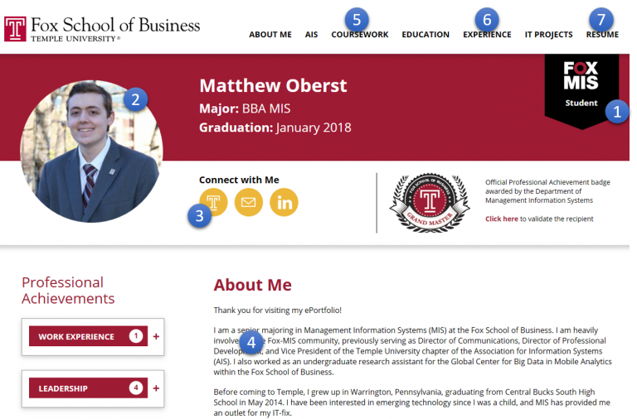
MIS major e-portfolio design requirements
Student e-portfolio
Professional picture
Profile fields
About me (home) page
Coursework
Experience and/or Interests
Resume as a PDF
Notes:
Must use the “Student e-portfolio” theme on a publicly available site.
Appropriate site title based on your name, business professional picture on the top left of the home page, all sample pages and posts removed, and e-portfolio linked to your profile.
Update the following Community platform profile fields: major, affiliation, employment status, employment job title, job seeking interest, type of job interest, relevant job experience, skills and interests, job interest, and graduation date.
About me (home) page: Briefly describe your personal and professional background.
Coursework page: List selected courses taken followed by what you learned from each course in one or two sentences. Optional: Include a picture or downloadable file of an interesting project.
Experience page: List each professional position including internships and part-time jobs. Describe your role in each position. Optional: Include a company picture. AND/OR Interests page: Describe professional and personal interests. Include a picture or other visual element that highlights the interest.
Resume: Downloadable in PDF format. (Note: Consider removing the home address from the public resume).

Slide 12
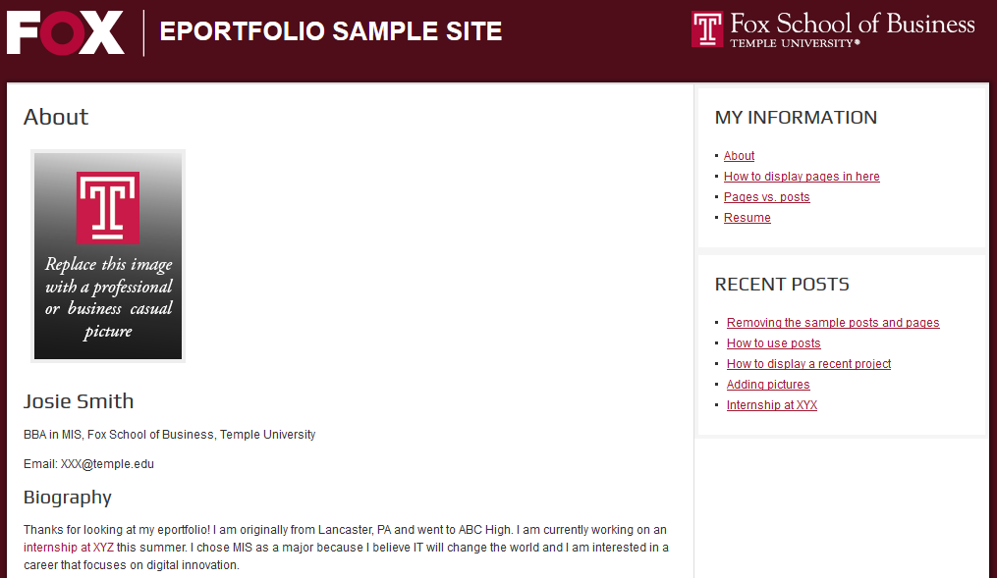
Fox major e-portfolio design requirements
2
3
1
Professional picture
About me (home) page
Three pages including “My Interests”
Remove all extra posts and pages

Slide 13
E-portfolio Tips
DO’S
Help Google: Include full name in the site title.
Sample work. This is your digital portfolio!
Describe work experience.
Involvement in non-profits.
Pictures of professional experiences.
Proofread
Google and Mobile friendly formatting.
DON’TS
Inappropriate photos
Inappropriate content
Private information
Broken hyperlinks
Word documents
Don’t password protect or close the site.
Don’t use custom formatting or CSS.
Notes:
DO’s
Include your full name in the e-portfolio site title. This is the most important way you can influence Google’s page ranking algorithm so that it displays the e-portfolio. On your homepage, include descriptive and contact information (e.g., email address).
Include sample work. If you are proud of work you did for a class (e.g., class project) or outside school, then show case it! After all, this is your digital portfolio.
Include a description of your work experience:
Highlight your involvement in both professional and non-profit organizations. Describe your role in those organizations. What did you accomplish? Include a hyperlink for each activity with a picture.
Add pictures. Pictures that highlight your professional experience and/or achievements will make your site more attractive.
Proofread your e-portfolio. This is your public digital identity. Typos, spelling mistakes, or poor formatting will negatively affect your professional image.
Use Google and Mobile friendly formatting: The use of pre-defined styles such as Heading 1, Heading 2, etc., makes it easier for Google to index your site. These styles are available in the editor in the Paragraph menu. Moreover, pre-defined styles will automatically adjust to look good on mobile devices.
DON’TS
Avoid inappropriate photos. A typical headshot displays your face and shoulders with a neutral background such as a wall or building.
Don’t post personal information such as home phone, home address, and anything else that does not belong on a public forum. Remember, e-portfolios are your public digital identity.
Fix broken links. Make sure all hyperlinks work.
Don’t post word documents. Word documents might contain viruses and often don’t work across platforms. Use PDF instead.
Don’t post inappropriate content. This is not Facebook. YouTube videos of the greatest song ever… and things of that nature do not belong on the e-portfolio.
Don’t password protect or close the site. This defeats the purpose of having a public digital identity.
Don’t use custom formatting or CSS: The underlying theme and software is designed to professionally display content on both desktop and mobile devices. The use of different fonts, font colors, custom font sizes, or CSS code may break your site on desktop or mobile or both.

Slide 14
Web Analytics
Web analytics is the measurement, collection, analysis and reporting of web site use data such as number of visitors and page views¹.
Web traffic
Are people looking at my site?
Advertising
Are people clicking on my ad?
Market research
Who is visiting the site?
Site improvement
Which are the most popular pages?
Sources
https://en.wikipedia.org/wiki/Web_analytics
Notes:
Notes
Google Analytics is the most popular web analytics service

Slide 15
Google Analytics
Create a Google Analytics account to generate a site tracking code
Connect the code to your e-portfolio
Insert the code into the Google Analytics plugin available within the community platform
Each time a user visits your e-portfolio
A small software program is invisibly and automatically loaded into each user’s browser
The program stores and transmits information about the use (AKA ‘cookie’) to a Google server
View Google Analytics
Aggregated activity is displayed in Google Analytics

Slide 16
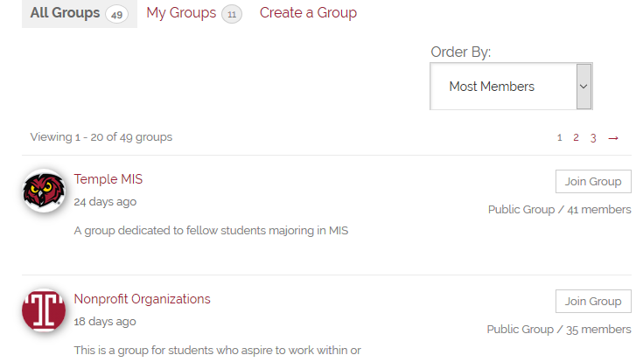
Communities of practice
A group of people who share a profession or interest.
Slickdeals.net is a community of practice for people interested in deals.
Professional communities of practice and networks are a critical resource for entry level workers
Get started with joining or creating a group!
Source: http://en.wikipedia.org/wiki/Communities_of_practice
Notes:
Organizations expect employees to share knowledge and learn from each other.

Slide 17
Learn more The tutorials below are available for free to Temple students and faculty
Digital content generation
https://www.lynda.com/WordPress-tutorials/WordPress-Essential-Training/372542-2.html?org=temple.edu
Analytics
https://www.lynda.com/WordPress-tutorials/WordPress-Plugins-Analytics/558000-2.html?org=temple.edu
https://www.lynda.com/Google-Analytics-tutorials/Google-Analytics-Essential-Training/574707-2.html?org=temple.edu
Responsive web design
https://www.lynda.com/WordPress-tutorials/Responsive-Web-Design-Browser/422839-2.html?org=temple.edu
Design framework (Genesis)
https://www.lynda.com/Genesis-tutorials/Up-Running-Genesis-WordPress/170289-2.html?org=temple.edu

Slide 18
Next
All Fox Majors (excluding MIS majors)
Fox Majors assignment
http://eportfolios.fox.temple.edu
Sites automatically removed at the end of the term
Fox MIS Majors (only)
Complete Fox MIS major assignment
http://community.mis.temple.edu
Start professional achievement program
Sites are permanent

