Slide 1
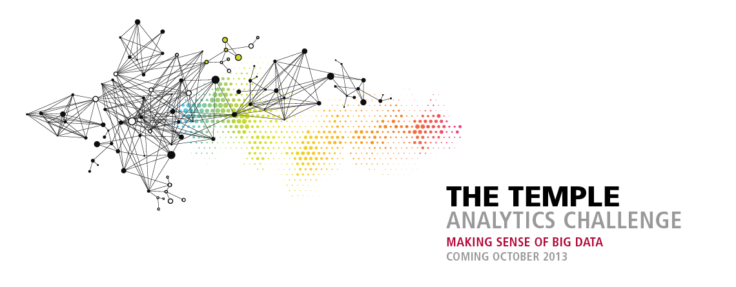
The 4th Annual TEMPLE UNIVERSITY
ANALYTICS CHALLENGE
Apply the power of analytics to improve world health
ibit.temple.edu/analyticschallenge

Slide 2
University-wide/National student competition
Real-world problems for AmerisourceBergen / Alexion / Merck
Opens September 30th, entries due October 28th
$12,000 in prizes for winning entries
Use any tool. Workshops throughout October
Work in teams (max of 4 students) or individually

Slide 3
The Challenges
Can small independent pharmacies compete with the big chains?
Where will doctors find subjects for rare disease clinical trials?
What solutions can analytics provide to the worldwide diabetes epidemic?

Slide 4
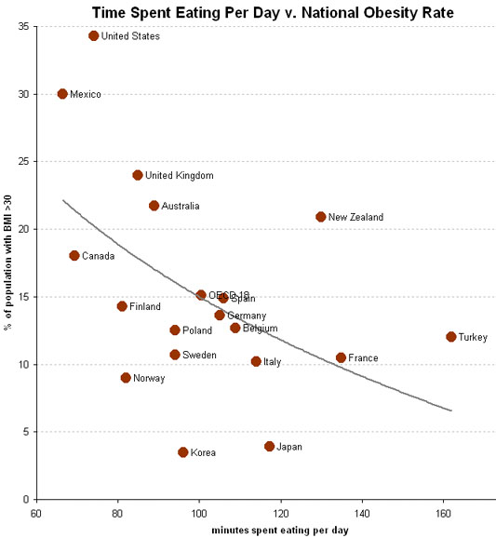
A good graphic tells a story

Slide 5
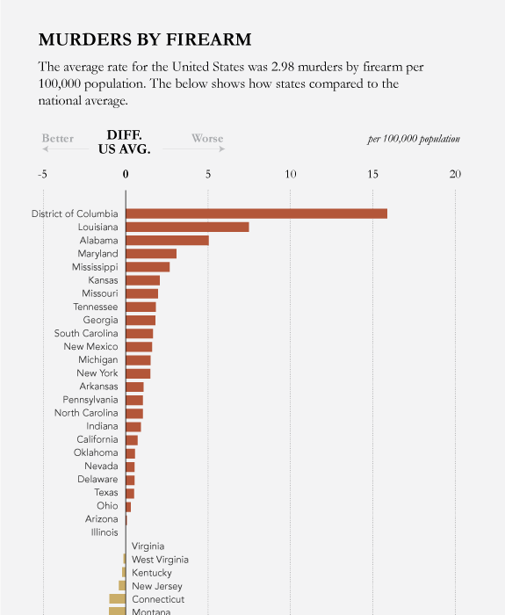
Good graphics help compare large amounts of data easily

Slide 6
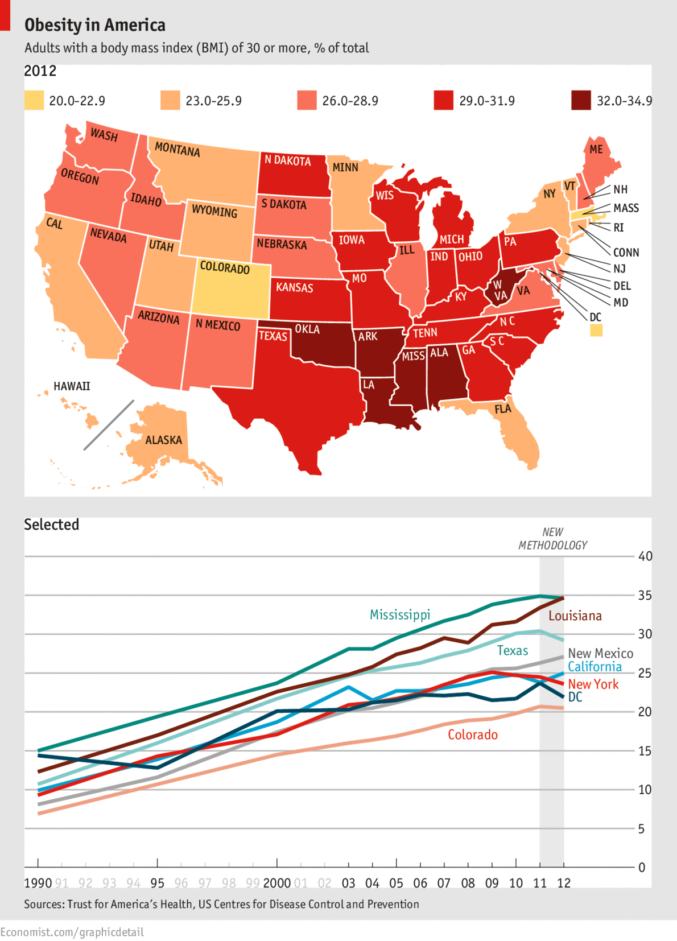
They look at data from multiple angles…

Slide 7
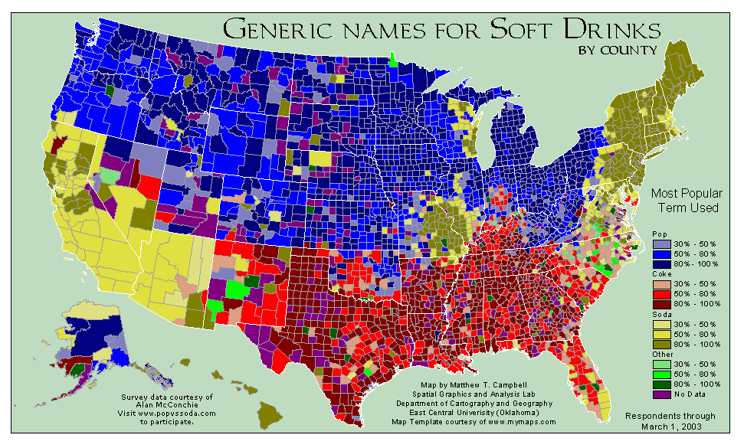
It’s also about choosing the right data…

Slide 8
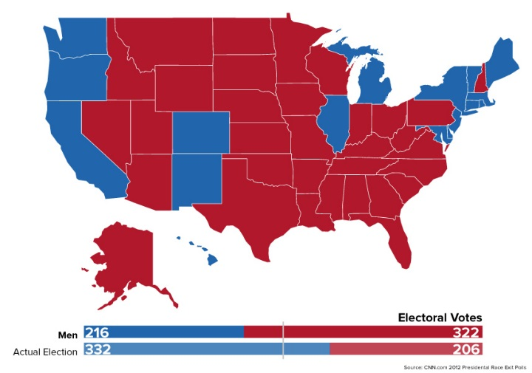
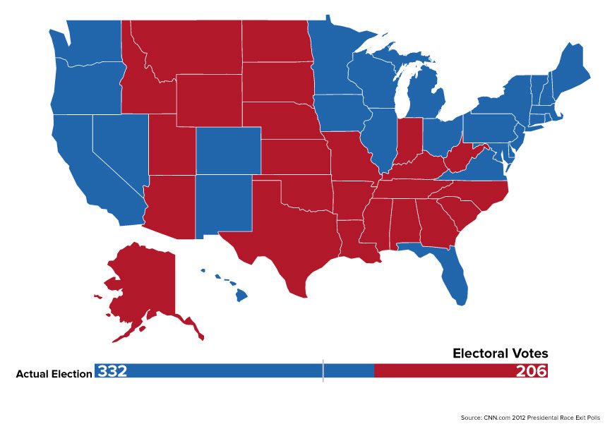
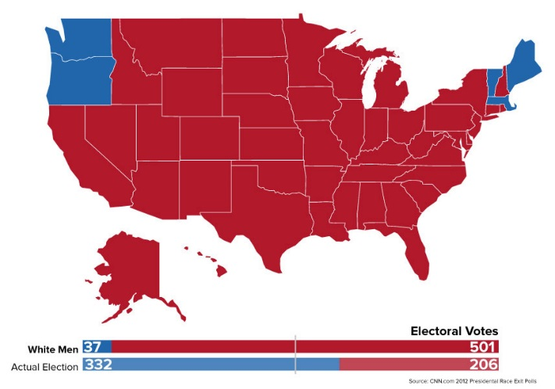
Good graphics provide meaningful insight
Under pre-1920 rules: men only
The electoral result of the 2012 election
Under 1850 rules: white men only

Slide 9
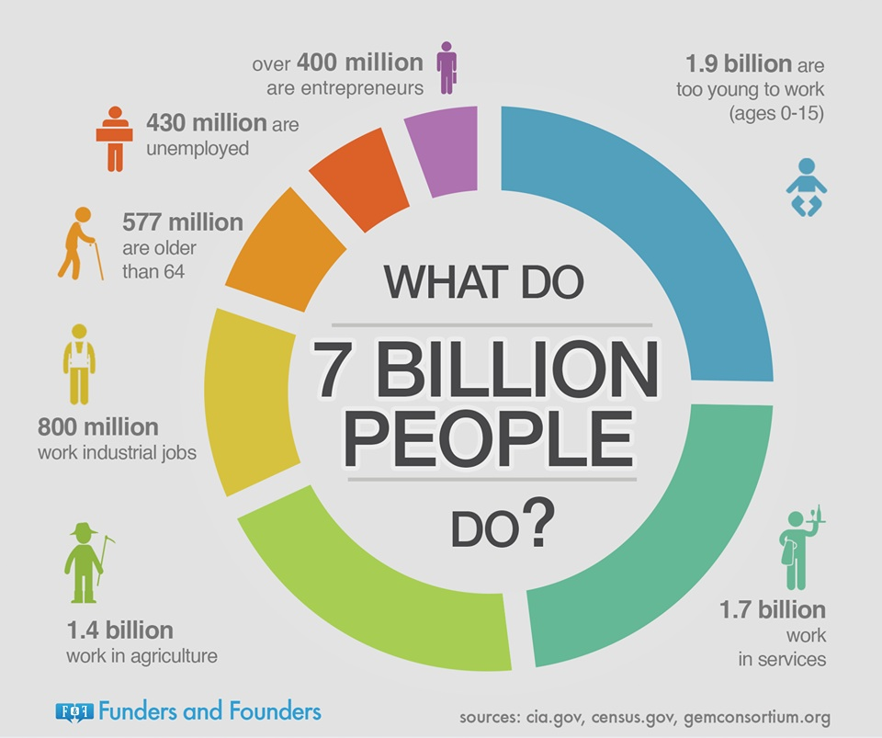
Infographics:
They can be simple

Slide 10
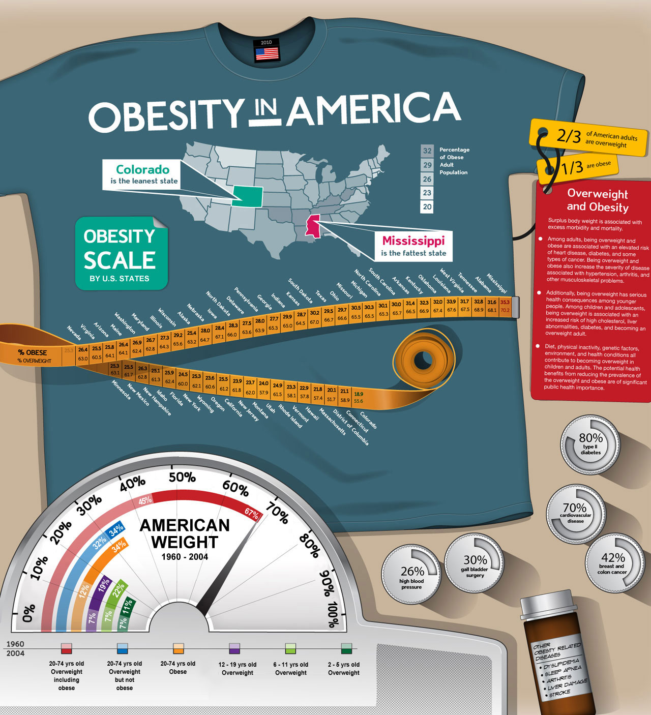
Or they can be more complex, combining several types of data

Slide 11
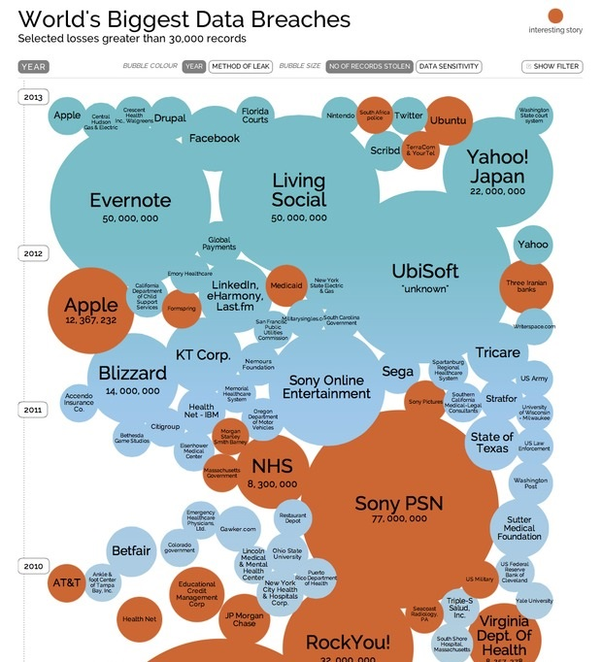
Infographics tell a story using data and images

Slide 12
For more information, visit
ibit.temple.edu/analyticschallenge

