Slide 1
Information Systems in Organizations
1.1 Introduction to MIS

Slide 2
What is MIS? (read page contents and watch embedded videos)
MIS professionals are business-oriented, proficient individuals who are found in every type of industry
MIS systems gather, process, and manage .
MIS is short for Management Information Systems and is the name of an academic discipline and major which focuses on solving _________ problems and creating new opportunities with .
  The MIS professional will often computer programmers on what to build.

Slide 3
?
What is the current demand for MIS workers?
What is an MIS System?
What do MIS people do?
What are the salary ranges for MIS professionals?
What is MIS?
How is MIS different from Computer Science?
What are the prospects for women in MIS?
Who works in MIS?
What type of programming do you do in MIS?

Slide 4
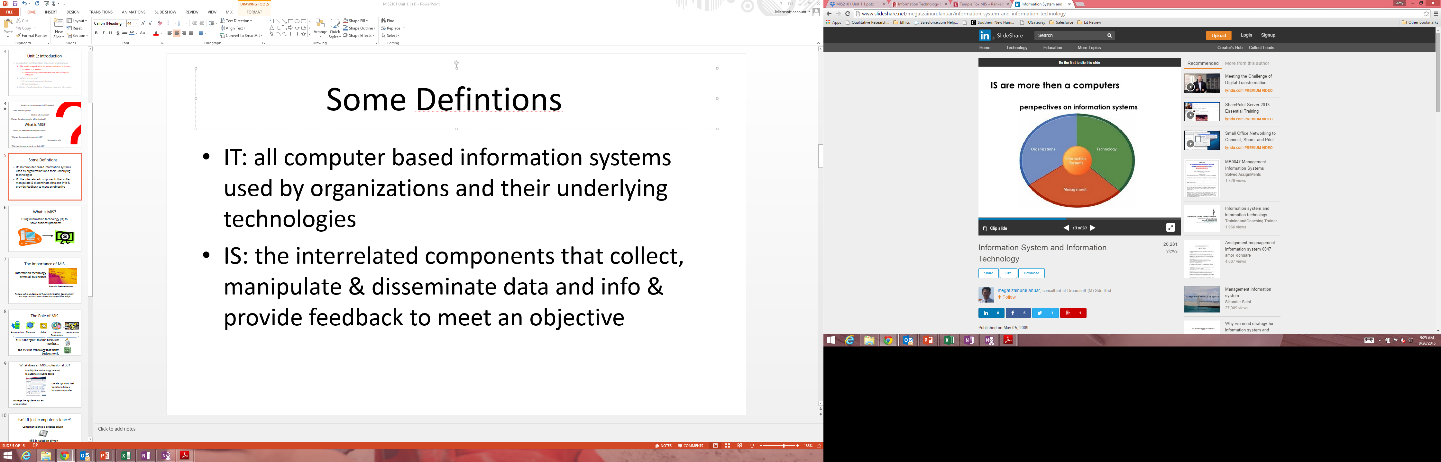

Slide 5
What is MIS?
Using information technology (IT) to
solve business problems

Slide 6

The importance of MIS
Information technology drives all businesses
Example: Customer Account
People who understand how information technology can improve business have a competitive edge

Slide 7
The Role of MIS
Accounting
Finance
Sales
Human Resources
Production
MIS is the “glue” that ties businesses together…
…and uses the technology that makes business work.

Slide 8

What does an MIS professional do?
Identify the technology needed
to automate routine tasks
Create systems that
transform how a
business operates
Manage the systems for an
organization

Slide 9
Difference between IS, CS, and IT
  Information Systems are concerned with the processes that an enterprise can implement and improve using .
  In common usage, the term “information technology” is often used to refer to all
  of .
  IS professionals bridge between the and communities within an organization.
  The work of falls into three categories:
  a) designing and building software
  b) developing effective ways to solve computing problems
  c) devising new and better ways of using computers

Slide 10
Information Systems vs. Information Technology
  Information technology is a subset of .
  Information technology focuses on managing technology and improving its utilization to advance the overall goals.
Although information systems are heavily reliant on computers and other technology-based tools, the term predates computers and can include ___________________ systems.
A career in information technology often requires a degree in or information science
  Information System is the term for the systems, people and processes designed to create, store, manipulate, distribute and disseminate .

Slide 11
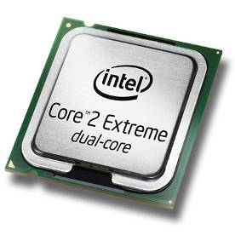
Isn’t it just computer science?
Computer science is product-driven
MIS is solution-driven
Example: Create systems to deliver products to customers

Slide 12
AIS Information Systems Job Index
  professionals apply and develop information systems (IT) in organizations and comprise a significant portion of the IT labor market.
  There are an estimated IS jobs in the U.S.
  IS professionals work with other business professionals and rely on computer scientists and engineers to create platforms and focus on understanding requirements and integrating technologies to design solutions that _________________________ and increasingly, ________________________________.
  About _______ educational programs produce IS professionals in the U.S. in Business Schools, as well as in a few standalone Information Schools or integrated with Computer Science.
  IS programs are classified as and typically called Management Information Systems (MIS), Information Systems (IS) or Computer Information Systems (CIS).

Slide 13
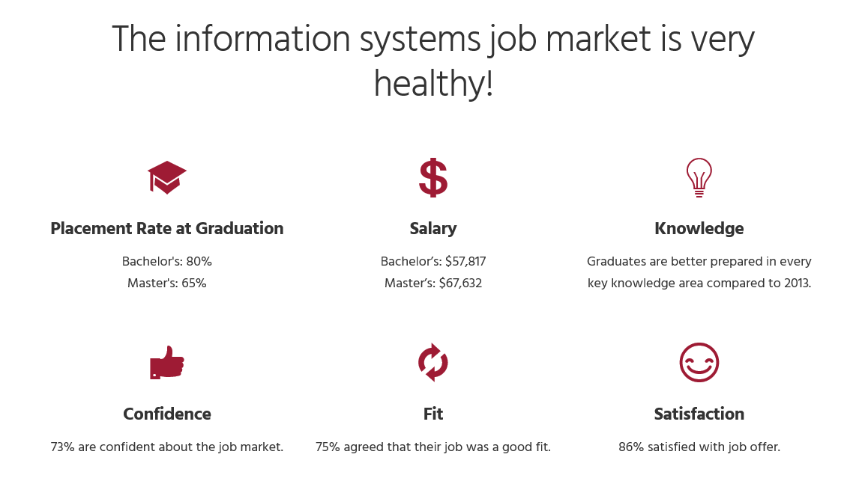
Based on 1600+ recent graduates from 57 universities across the U.S.

Slide 14
Information systems is open!
Double the percentage of females as compared to Computer Science

Slide 15
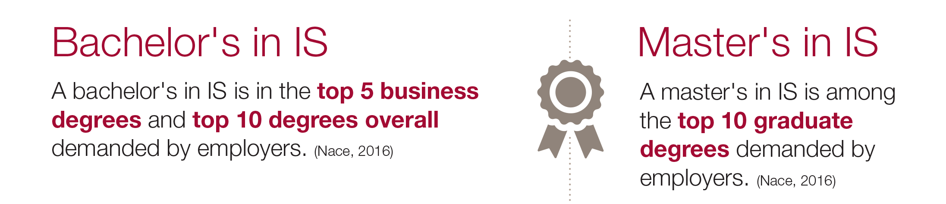

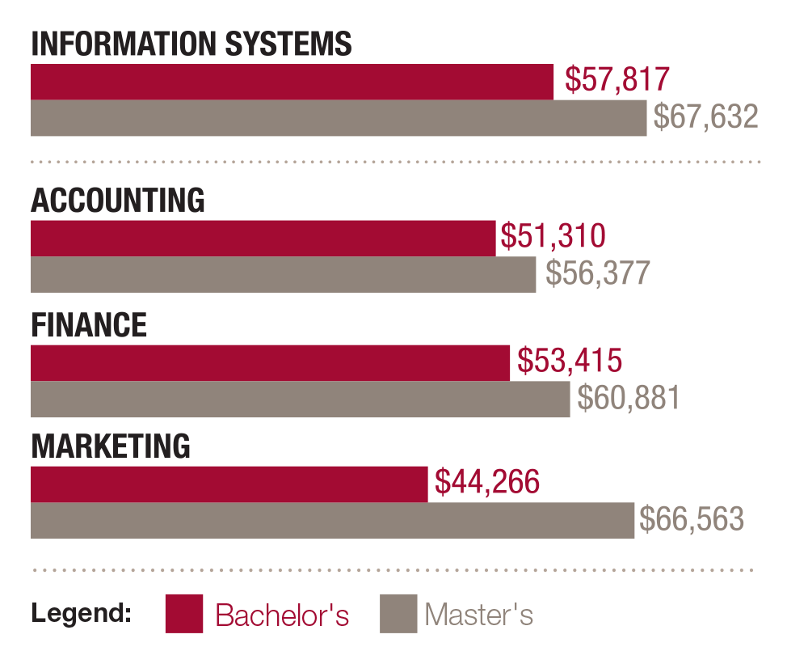
Information systems is hot!

Slide 16
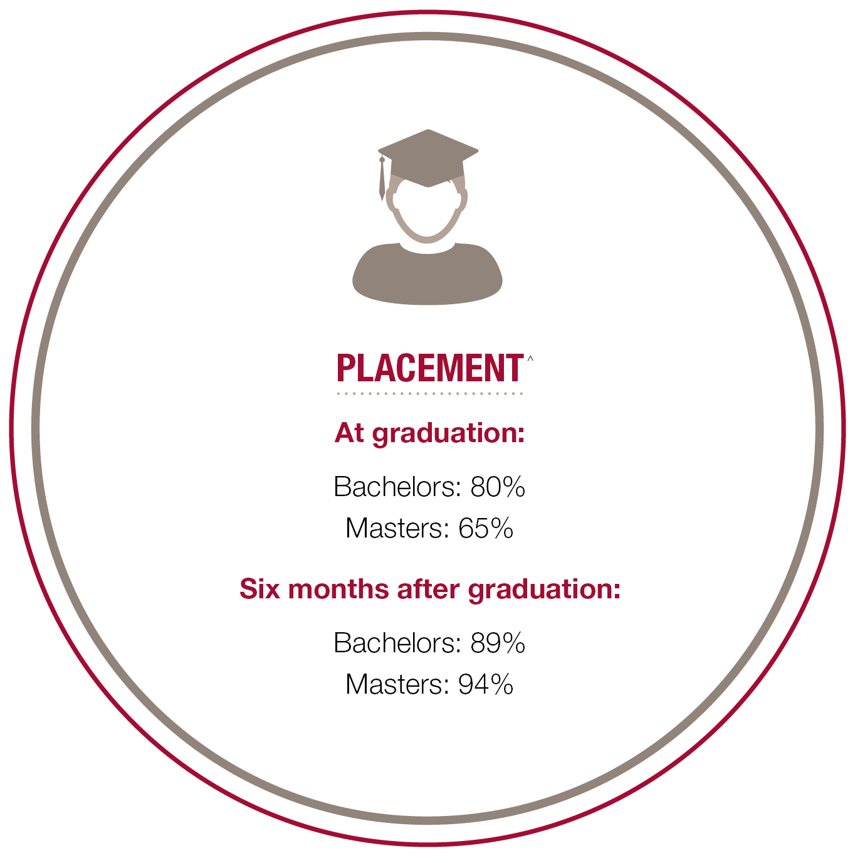
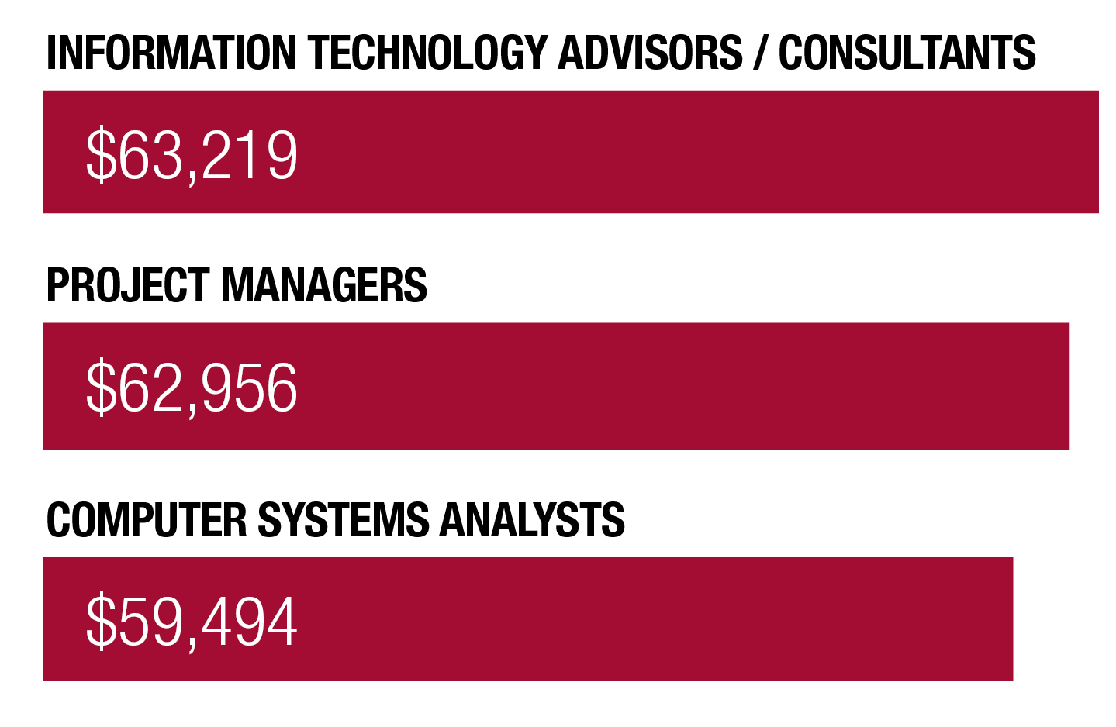
THE THREE BEST PAYING JOBS IN IS

Slide 17
MIS Career Paths
Security Analyst
CIO
Technical support
Systems Architect
Programmer Analyst
Consultant
Application programmer
Data Administrator
Project Manager
Business Analyst
CTO
Software Designer
Data Analyst
Fox MIS Students 100% Placement

Slide 18
Wikipedia, Business Analyst
  A Business Analyst works with to improve the quality of the services being delivered, sometimes assisting in Integration and Testing of new solutions.
  Due to working on projects at a fairly level of abstraction, BAs can switch between industries.
  The BA may also support the development of training material, participates in the implementation, and provides post-implementation support. This may involve the development of project plans and often requires skills.
  A BA is a liaison among in order to understand the structure, policies, and operations of an organization, and to recommend solutions that enable the organization to achieve its goals.

Slide 19
Wikipedia, Systems Analyst
  System analysts assess the of information systems in terms of their intended outcomes.
  The main purpose of the stage is to gather information about the existing system in order to determine the requirements for an enhanced system or a new system.
  A systems analyst is typically confined to an assigned or given system and will often work in conjunction with a .
  A will often evaluate code, review scripting and, possibly, even modify such to some extent

Slide 20
Important Qualities
Analytical Skills
Communication Skills
Decision-Making Skills
Leadership Skills
Organization Skills

Slide 21
Learn IT! #1
Digital Identity Management
Due week 3
Create your e-Portfolio and connect it to Google Analytics

Slide 22
Did you know?
In-Class Activity…

