Slide 1
Information Systems in Organizations 4.2 Customer Relationship Management Systems

Slide 2
Learn IT Assignment #5 : Digital Identity Management (part 2)
Analyze the data collected by Google Analytics
Report on key metrics
Explain what you would do to influence traffic to your site
Due in week 13 – Nov 30th

Slide 3
Why does my business need a CRM system?
The process of CRM is conducted naturally by business.
A formal CRM tool provides a central for the evolution of internal processes that ensure the business operates at optimum efficiency.
CRM software is a tool that should provide the structure necessary to connect the majority of customer “ .”
Every organization can take advantage of a CRM software solution in order to enhance their position.
Reasons to invest in CRM software will vary depending on the specific needs, size and type of .

Slide 4
Just a System?
Strategy
Processes
Procedures
CRM

Slide 5
?
What kind of information is tracked in a CRM? How do companies use this data?

Slide 6
CRM Processes
Lead Generation
Prospecting
Lead Nurturing
Conversion
After Sales Support
Reengagement

Slide 7
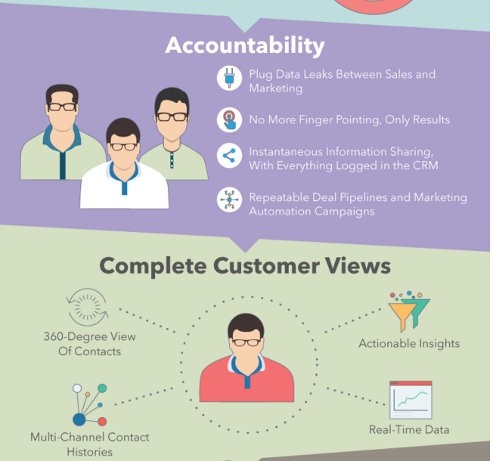

Slide 8
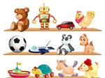
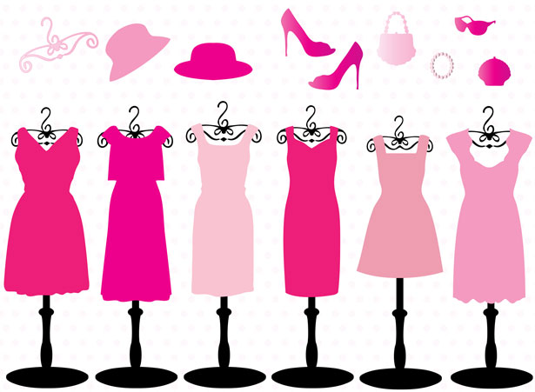
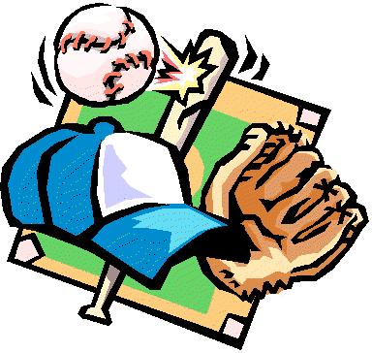
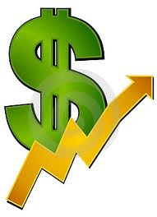
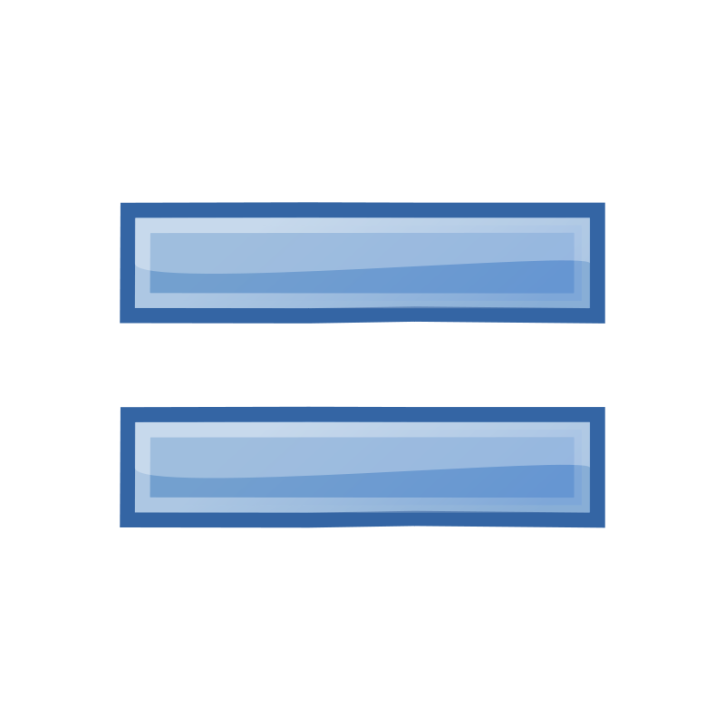
Benefits of a CRM

Slide 9
Choosing a CRM Software: 2015 Buyer’s Guide
CRM software has evolved from a simple contact management system into a robust tool that lets your data all in one easily accessible solution.
Benefits of using CRM software: Save time, Save money, Better marketing, Extra functionalities, and Help sales team reach their goals.
As a whole, CRM software gives you and your sales teams all the tools necessary to grow your business in a hub with the least amount of work possible.
CRM acts as an entire for all types of insights on customers.
Pricing for CRM software for the most part, you can expect to pay on a , per-month basis

Slide 10
Evolution of CRM
Customer Relationship Management
Early Goal: help businesses build and maintain relationships with new and existing customers
New Goal: manage sales, marketing, point-of-sale (POS), accounting, vendor and other types of operational data, all in one easily accessible solution

Slide 11
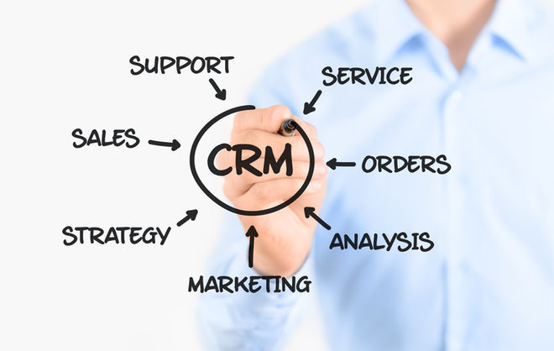
Evolution of CRM

Slide 12
?
So why can’t I just use my ERP to do this?

Slide 13
CRM & ERP – What’s the difference?
ERP and CRM are similar in many ways, as they are both used to increase the overall _____________ of a business.
Where CRM is focused on the customer, ERP focuses on the .
focuses on reducing overhead and cutting costs.
CRM is often the best bet for a business’s first .
ERP and CRM working together make it much easier for a business to increase profits while _______________.

Slide 14
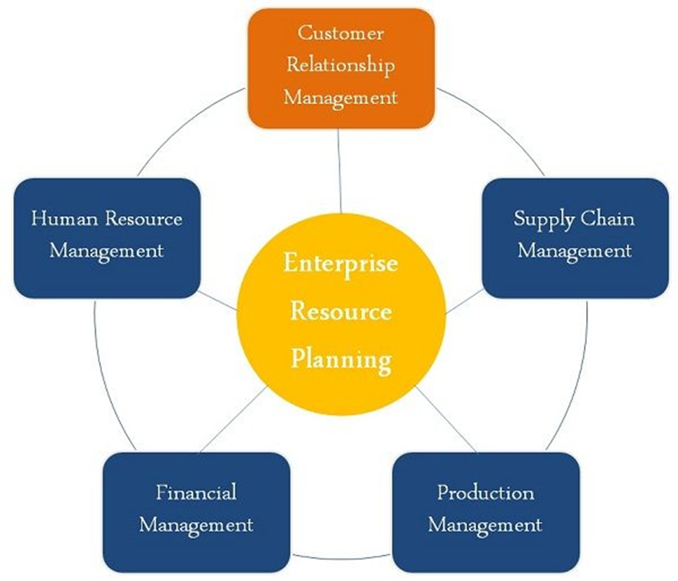

Slide 15
CRM and ERP
“Deciding which system is more important is like deciding between having an engine or having a steering wheel in a car. CRM is the engine that drives a business. It improves sales and increases profits. ERP is the steering wheel—it allows a business to be guided with precision, and to steer around obstacles well in advance. ERP and CRM working together make it much easier for a business to increase profits while reducing costs.”
TOP LINE
BOTTOM LINE

Slide 16
Key differences between CRM & ERP:
The CRM is mainly utilized in back office activities.
ERP is used in back office activities.
CRM focuses on increasing , but ERP gives emphasis on reducing costs.
ERP is mainly concerned with planning the of the organization to ensure its best possible use.
CRM is defined as a software that lets the organization to trace every with the clients and customers.

Slide 17
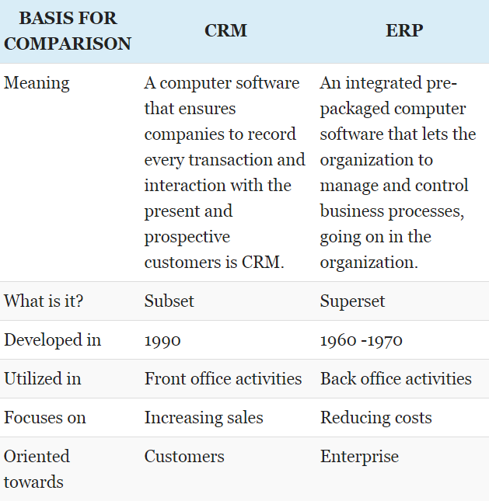

Slide 18
18 Surprising CRM Statistics
15% of organizations have replaced all or most of their on premise customer service applications with solutions.
Between 25 and 60% of CRM projects fail to meet .
Sales reps saw increased by 15% when they had mobile access to CRM applications.
CRM offers an average return of $5.60 for every $ spent.
91% of companies with more than 11 use a CRM system.

Slide 19
By the numbers…
Forecasts from Gartner anticipate that the customer relationship management market will be worth $36.4 billion worldwide by 2017.
CRM offers an average return of $5.60 for every $1 spent
Productivity increased by 15% when they had mobile access to CRM applications.
30% of marketers say having disparate data sources is a main reason why they can’t glean useful insights from customer data

Slide 20
CRM dashboard
All major enterprise CRM vendors offer of some type.
CRM dashboards serve the same general purpose: to quickly provide a user, manager, or administrator with a quick related to a particular job function or department.
Dashboards serve a valuable purpose in giving system users visibility into both overall system health and performance measurement.
CRM dashboard functions: Sales, Marketing, and Support.

Slide 21
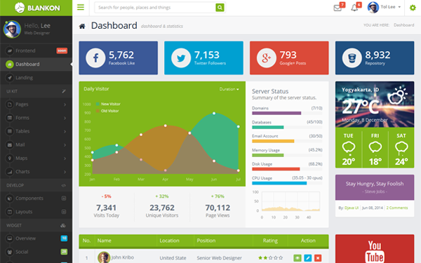
Dashboards

Slide 22
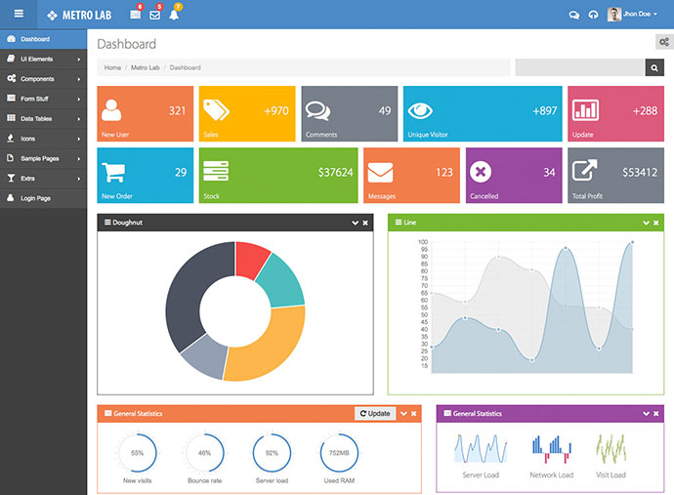
Why is this better than….

Slide 23
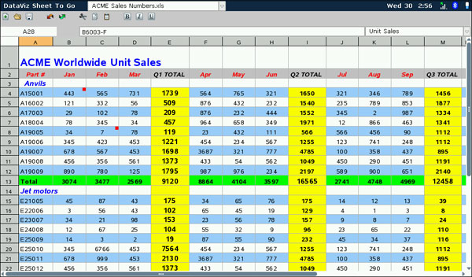
This?

