Slide 1
Information Systems in Organizations 4.1 Supply Chain Management Systems

Slide 2
Roadmap
Week 1: Intro to MIS
Week 2: Systems Analysis
Week 3: Systems Analysis
Week 4: Systems Analysis
Week 5
Swimlanes
ERDs
Decision Trees
Architecture Diagrams
Exam #1
Max Labs 0
What is MIS?
Week 6: Organizational Systems
Week 7: Organizational Systems
Week 8: Organizational Systems
Week 9
Decision Support
SDLC
Exam #2
ERP
Knowledge Mgmt
Digital Innovation
Max Labs 1a & 1b
Learn IT! #1
Week 10: Organizational Systems
Week 11: Organizational Systems
Platforms
Week 13: Organizational Systems
Week 14
Customer Relationship Management Systems
Cloud Computing
Artificial Intelligence
Exam #3 Prep
Supply Chain Management Systems
Week 12: Organizational Systems
Max Labs 3a & 3b
Learn IT! #2
Max Labs 2a & 2b

Slide 3
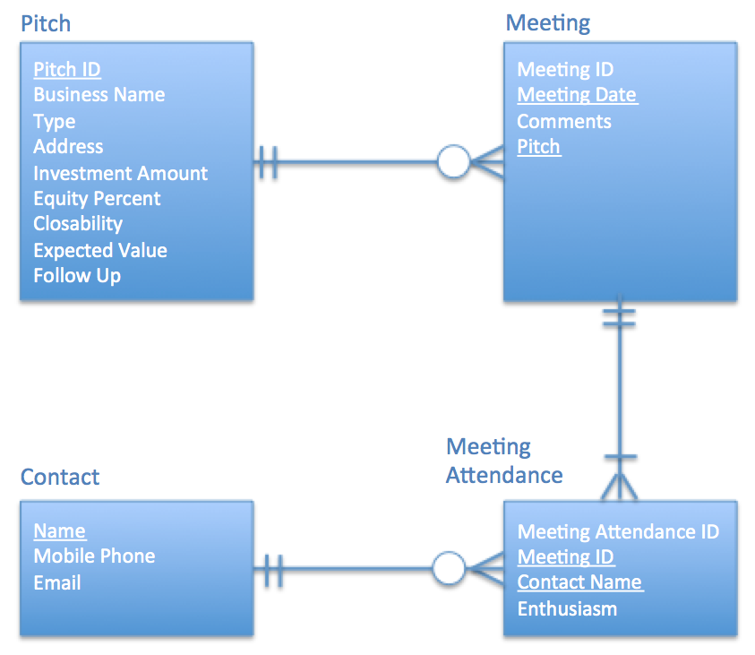
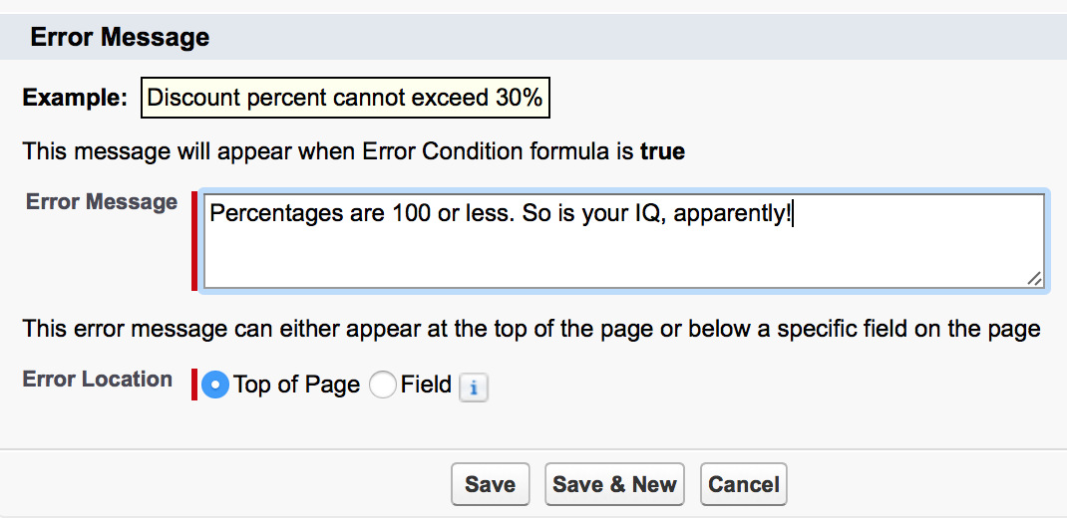
Max Labs 2a & 2b
Due week 10 – Each part will take about an hour
Max Labs 2a
3 Screenshots
Learn about how to fix & prevent errors in data
Build to the user’s need
Max Labs 2b
2 Screenshots
Protect the integrity of your data
Create a big, beautiful data “map”

Slide 4
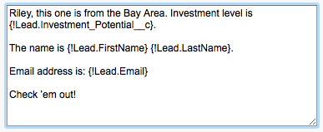
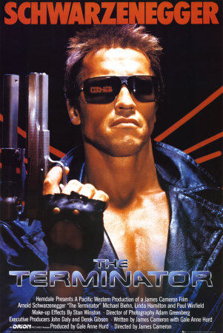
Max Labs 3a & 3b
Due week 12 – Each part will take about an hour
Max Labs 3a
4 Screenshots
Make the app scalable
See how CRM systems make life easier
Max Labs 3b
3 Screenshots
Go full cyborg
Make connections between Salesforce and social media

Slide 5
Common Organizational Systems
4.1 Supply Chain Management Systems
4.2 Customer Relationship Management Systems

Slide 6
Required Reading
Wikipedia, Supply Chain Management
Supply Chain Futurists Predict the Impact of Digital Transformation
Integrated Planning – Optimization for the Entire Internal Supply Chain
Just-in-Time Manufacturing
Vendor-Managed Inventory (VMI): What is it and When Does it Make Sense to Use It
What is RFID?

Slide 7
Thinking About Supply Chain…
Just to get you thinking….

Slide 8
Wikipedia, Supply Chain Management
“Design, planning, execution, control and monitoring of supply chain activities”
Management and storage of raw materials
Work-in-process inventory
Finished goods
Integrated approach
Minimize total costs

Slide 9
Integrated Planning – Optimization for the Entire Internal Supply Chain
What is integrated planning?
Requires coordinated flow of information
Inventory cost control
Information systems
Forecast demand
Optimize inventory levels

Slide 10
Required Viewing 1/4
Objectives:
Identify what supply chain management systems are
Technologies that organizations invest in to optimize their supply chain operations
Recognize how SCMs create value for organizations
Information needs to flow both ways as product goes through chain

Slide 11
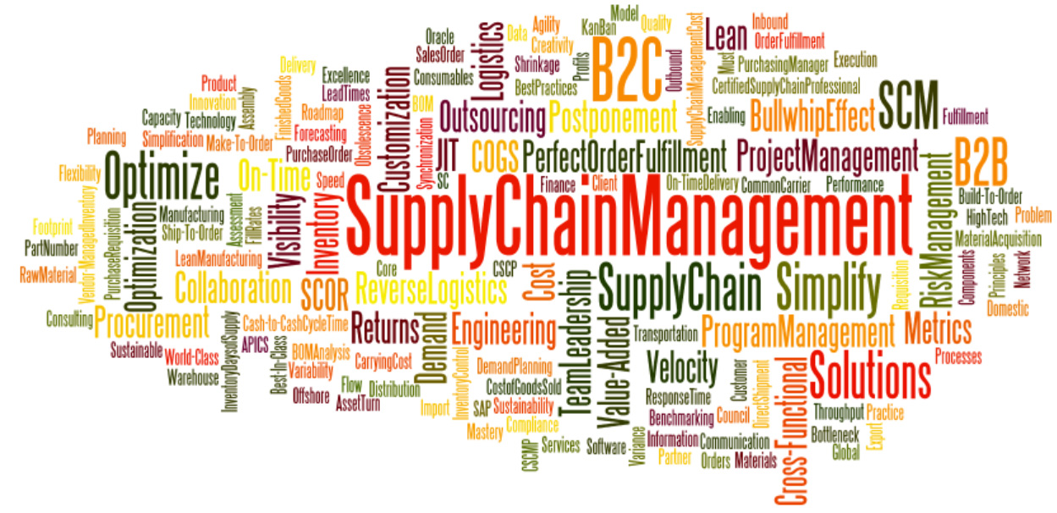

Slide 12
Supply Chain Futurists Predict the Impact of Digital Transformation
“A digital supply chain is no longer an option. It’s a necessity.”
Better enable customer-centricity
Information in real time
Business relationships based on IT compatibility
Manage risk

Slide 14
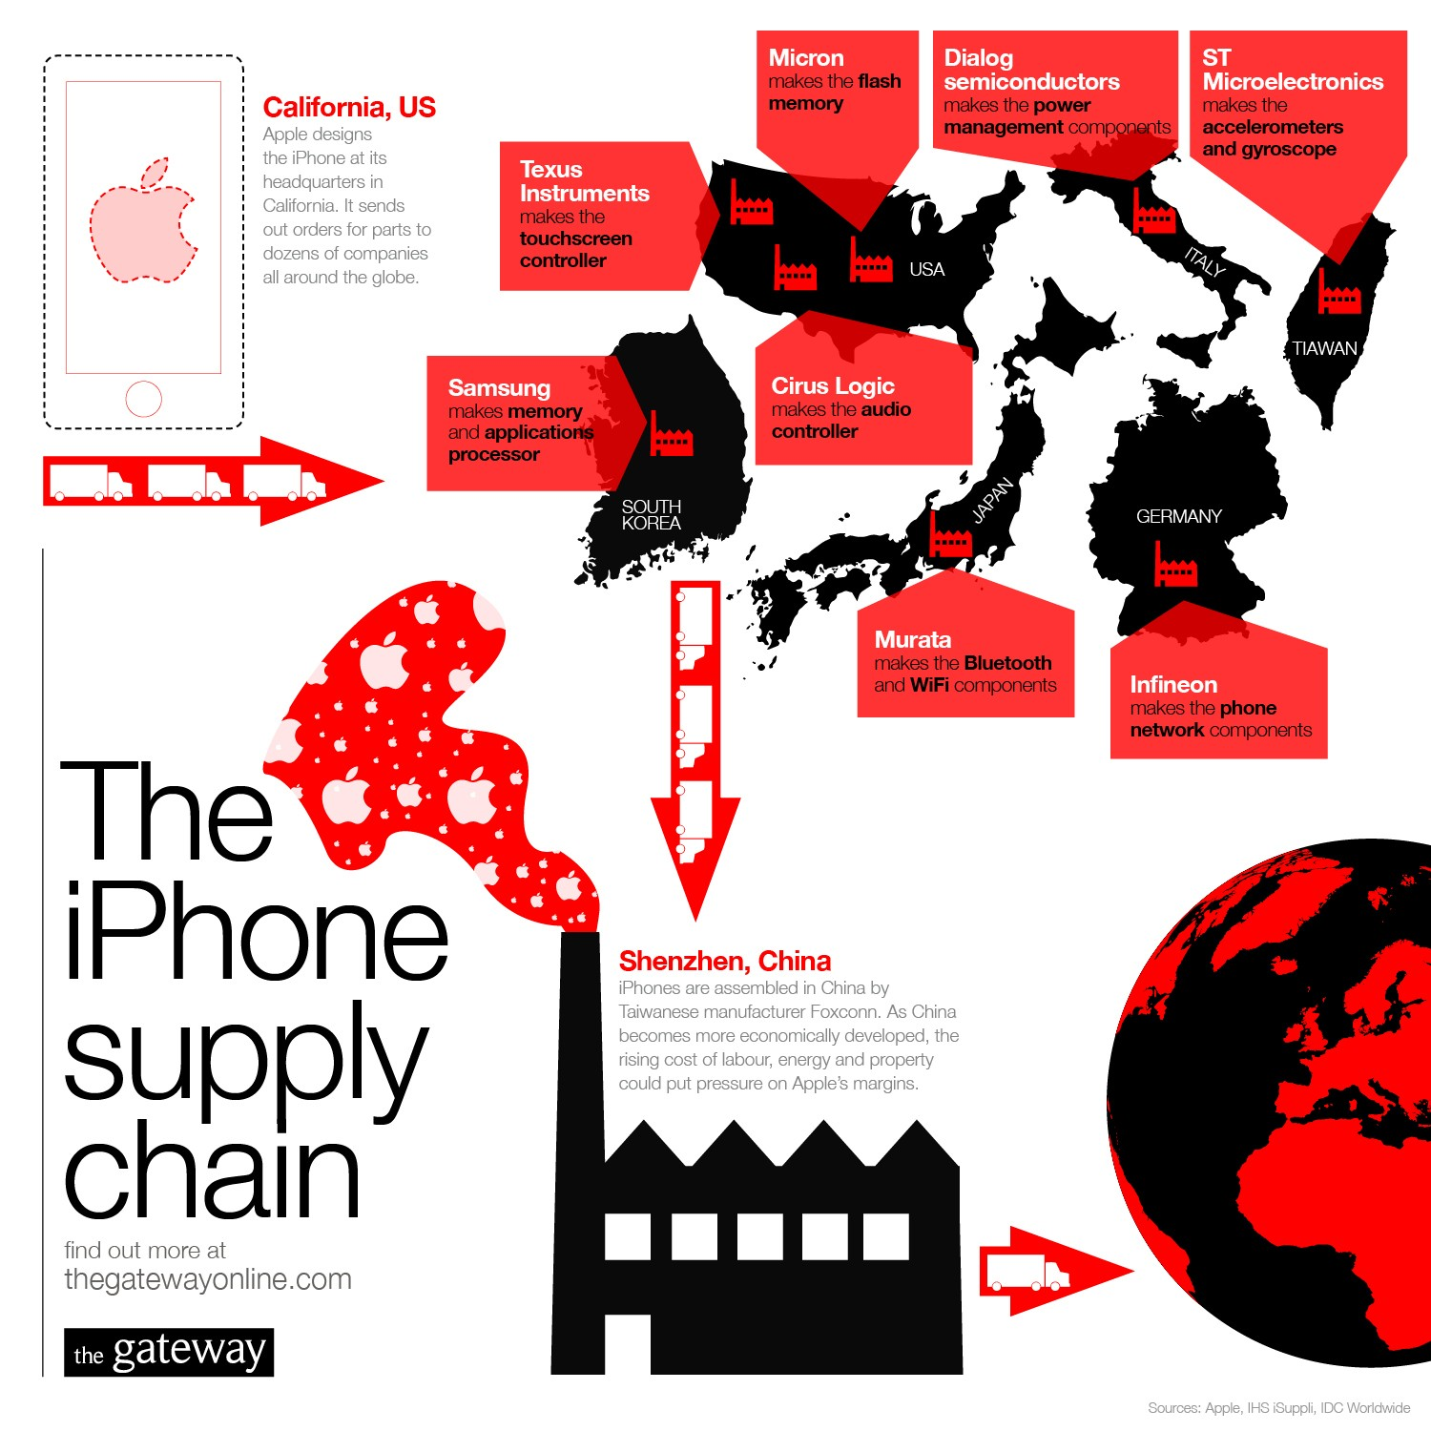
Where is your
iPhone “made”?
What happens in
Shenzhen, China
if there are any
delays?
“What is SCM?” Video

Slide 15
Question
Who works for a company which manufactures a product?
What kind of product is it?
What stuff do you need to make your product?
Where do you get this stuff?
What happens if they run out of this stuff?

Slide 16
?
How difficult is it to get the right product on the right shelf at the right time and the lowest possible cost?
“What is SCM?” Video

Slide 17
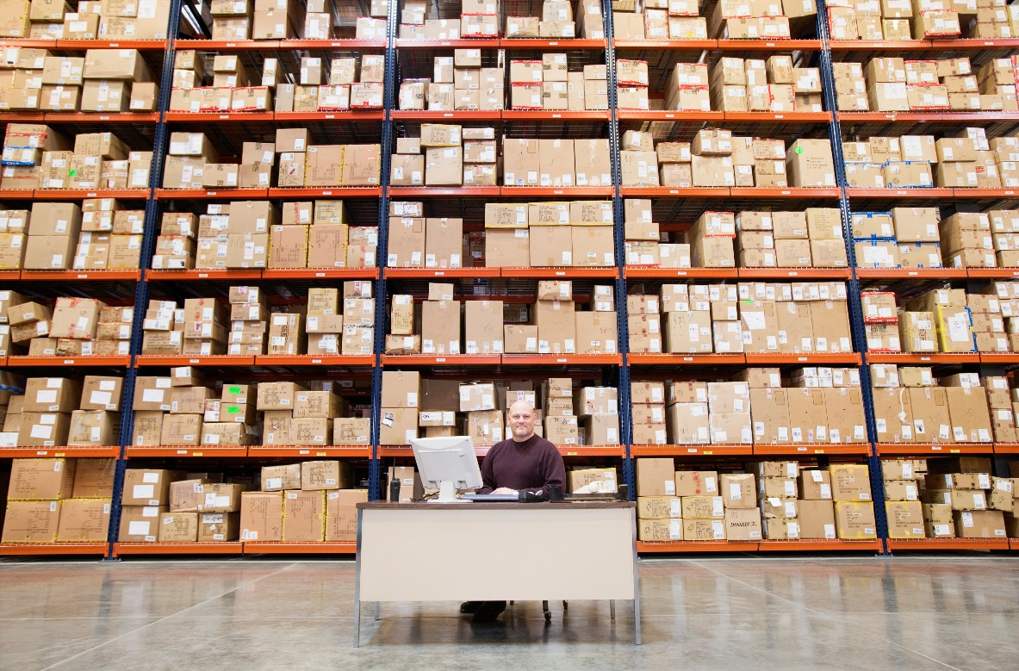
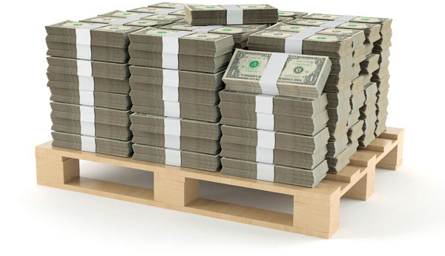
Safety Stock – That’s the Answer!
“What is SCM?” Video
Here’s what the people in
order fulfilment see
Here’s what the people in
accounting see

Slide 18
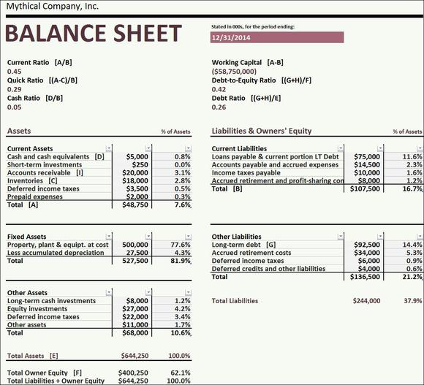
What else could I do with this cash?
If this goes up
then this goes down…
What else could I do
with this cash?
“What is SCM?” Video

Slide 19
SCM Architecture
SCM modules support two functions.
Supply chain planning—development of resource plans to support production.
Supply chain execution—efficient flow of products, information, and financing.
“What is SCM?” Video
Copyright © 2014 Pearson Education, Inc.

Slide 20
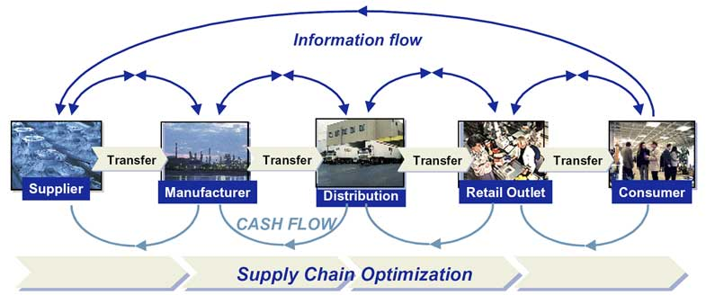
“What is SCM?” Video

Slide 21
Just-in-Time Manufacturing
What is Just-in-Time Manufacturing?
Purchasing and receive components just before needed on assembly line
Build to Order
High-tech industry: product is customized and manufactured according to specific customer requests
Pros and Cons
Requires disciplined assembly-line process
Web can enable more efficient communication with suppliers

Slide 22
Required Viewing 2/4
Objectives:
Recognize Just in Time (JIT)
Minimize inventory levels
Minimize lead time for raw materials
Identify how JIT creates value for organizations
Free up capital to create value

Slide 23
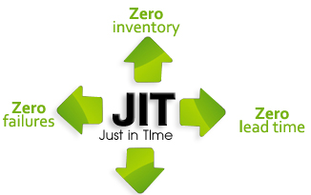

Slide 24
Dell’s Supply Chain
Dell Internal
Supplier
Customer Order
Manufacturing
Storing
Merging
Customer
Supply on demand every two hours
Taken by Internet or phone
“Just in Time” Video

Slide 25
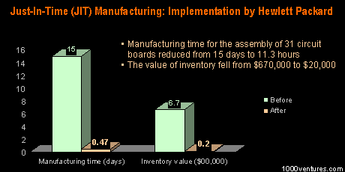
What else could I do with this cash?
“Just in Time” Video

Slide 26
Required Viewing 3/4
Objectives:
Identify Vendor Managed Inventory (VMI)
“Business model where supplier takes full responsibility for maintaining an agreed inventory of materials at buyer’s consumption location”
Determine how recent case studies are relevant to VMI
Behr, Rohm and Haas
Intel, Shipley

Slide 27
Vendor-Managed Inventory (VMI): What is it and When Does it Make Sense to Use It
What is vendor-managed inventory?
Inventory managed by vendor; vendor determines when and how much to replenish
Customer Perspective
Relieves of burden and responsibility of managing inventory
Vendor Perspective
Increases likelihood customer will use 1 vendor

Slide 28
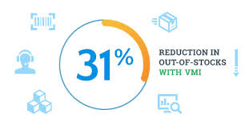

Slide 30
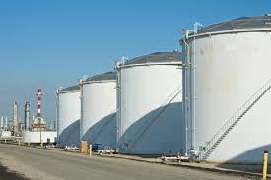
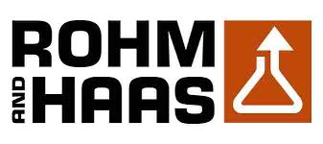
Case Study Vendor Managed Inventory
Owned by Behr
Owned by Rohm and Haas
Vendor Managed Inventory Video

Slide 31
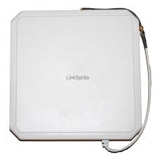
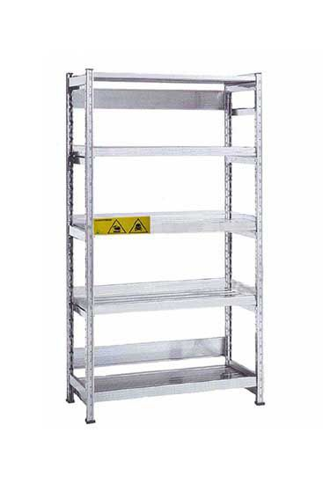
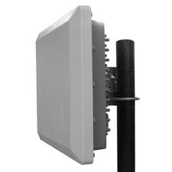
Case Study Vendor Managed Inventory & RFID
Owned by Intel
Owned by Shipley
Vendor Managed Inventory Video

Slide 32
What is RFID?
What is RFID?
Radio Frequency Identification
Wireless technology that lets you identify objects that have been fitted with special RF identification tags
What is RFID good for?
Inventory control, access control…
How it works
Antenna reads electromagnetic energy
Can penetrate non-metallic solid objects

Slide 33
Required Viewing 4/4
Objectives:
Identify RFID
Technology used to track items as they move through the supply chain
Can store a lot of information on each tag – shelf life, safety information, when it was manufactured…
Recognize how RFID creates value for organizations
Track when products enter or exit facility

Slide 34
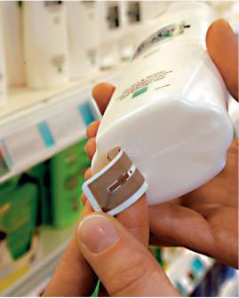
Radio Frequency Identification (RFID)
RFID tags will soon replace standard bar codes.
RFID is the use of electromagnetic energy to transit energy between a reader (transceiver) and the tag (antenna).
Line-of-sight reading is not necessary.
RFID tags can contain more information than bar codes.
Tags are programmable, so there is a vast array of potential uses.
Scanning can be done from greater distance.
Passive tags—inexpensive, range of few feet.
Active tags—more expensive, range of hundreds of feet.
Source: METRO AG.
RFID Video

Slide 35
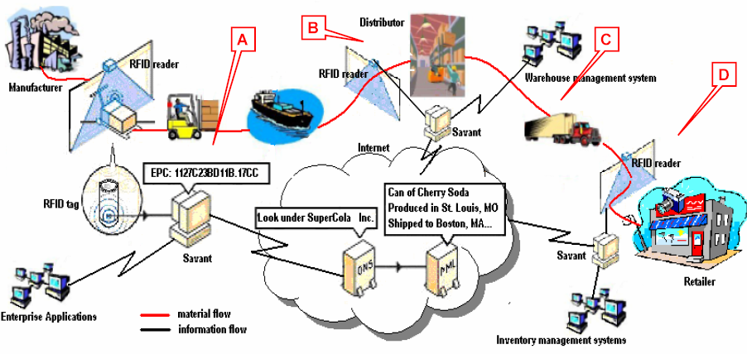
The Big Picture
RFID Video

Slide 36
Roadmap
Week 1: Intro to MIS
Week 2: Systems Analysis
Week 3: Systems Analysis
Week 4: Systems Analysis
Week 5
Swimlanes
ERDs
Decision Trees
Architecture Diagrams
Exam #1
Max Labs 0
What is MIS?
Week 6: Organizational Systems
Week 7: Organizational Systems
Week 8: Organizational Systems
Week 9
Decision Support
SDLC
Exam #2
ERP
Knowledge Mgmt
Digital Innovation
Max Labs 1a & 1b
Learn IT! #1
Week 10: Organizational Systems
Week 11: Organizational Systems
Platforms
Week 13: Organizational Systems
Week 14
Customer Relationship Management Systems
Cloud Computing
Artificial Intelligence
Exam #3 Prep
Supply Chain Management Systems
Week 12: Organizational Systems
Max Labs 3a & 3b
Learn IT! #2
Max Labs 2a & 2b

