Slide 1
Information Systems in Organizations 4.2 Customer Relationship Management Systems

Slide 2
Roadmap
Week 1: Intro to MIS
Week 2: Systems Analysis
Week 3: Systems Analysis
Week 4: Systems Analysis
Week 5
Swimlanes
ERDs
Decision Trees
Architecture Diagrams
Exam #1
Max Labs 0
What is MIS?
Week 6: Organizational Systems
Week 7: Organizational Systems
Week 8: Organizational Systems
Week 9
Decision Support
SDLC
Exam #2
ERP
Knowledge Mgmt
Digital Innovation
Max Labs 1a & 1b
Learn IT! #1
Week 10: Organizational Systems
Week 11: Organizational Systems
Platforms
Week 13: Organizational Systems
Week 14
Customer Relationship Management Systems
Cloud Computing
Artificial Intelligence
Exam #3 Prep
Supply Chain Management Systems
Week 12: Organizational Systems
Max Labs 3a & 3b
Learn IT! #2
Max Labs 2a & 2b

Slide 3
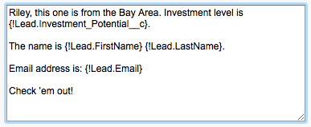
Max Labs 3a & 3b
Due week 12 – Each part will take about an hour
Max Labs 3a
4 Screenshots
Make the app scalable
See how CRM systems make life easier
Max Labs 3b
3 Screenshots
Go full cyborg
Make connections between Salesforce and social media

Slide 4
Common Organizational Systems
4.1 Supply Chain Management Systems
4.2 Customer Relationship Management Systems

Slide 5
Required Reading
Why Does my Business Need a CRM System?
Choosing a CRM Software: A Buyer’s Guide
6 Examples Of How To Use CRM Dashboards
CRM & ERP: What’s the Difference?
Key Differences Between CRM & ERP

Slide 6
What is CRM?
Marketing
Campaigns &
Tactics
Sales
Leads,
Sales Pipeline
Sales Forecasting &
Sales quota/attainment
Results/Performance
Customer
Support and Help desk,
Profile & Contact management
CRM Video

Slide 7
Why Does My Business Need a CRM System?
Discuss:
1. What was this article about?
2. Why should you care?
While all organizations have the need to manage relationship with their customers, organizations that collect information about their customers, share this information across business teams, analyze the data when appropriate and act as needed benefit the most from CRM.
For many organizations having an intimate understanding of their customers and the ability to use this insight to drive revenue growth is the most strategic of all their assets.

Slide 8
Required Viewing 1/3

Slide 9
Just a System?
Strategy
Processes
Procedures
CRM

Slide 10
?
What kind of information is tracked in a CRM? How do companies use this data?

Slide 11
CRM Processes
Lead Generation
Prospecting
Lead Nurturing
Conversion
After Sales Support
Reengagement

Slide 12
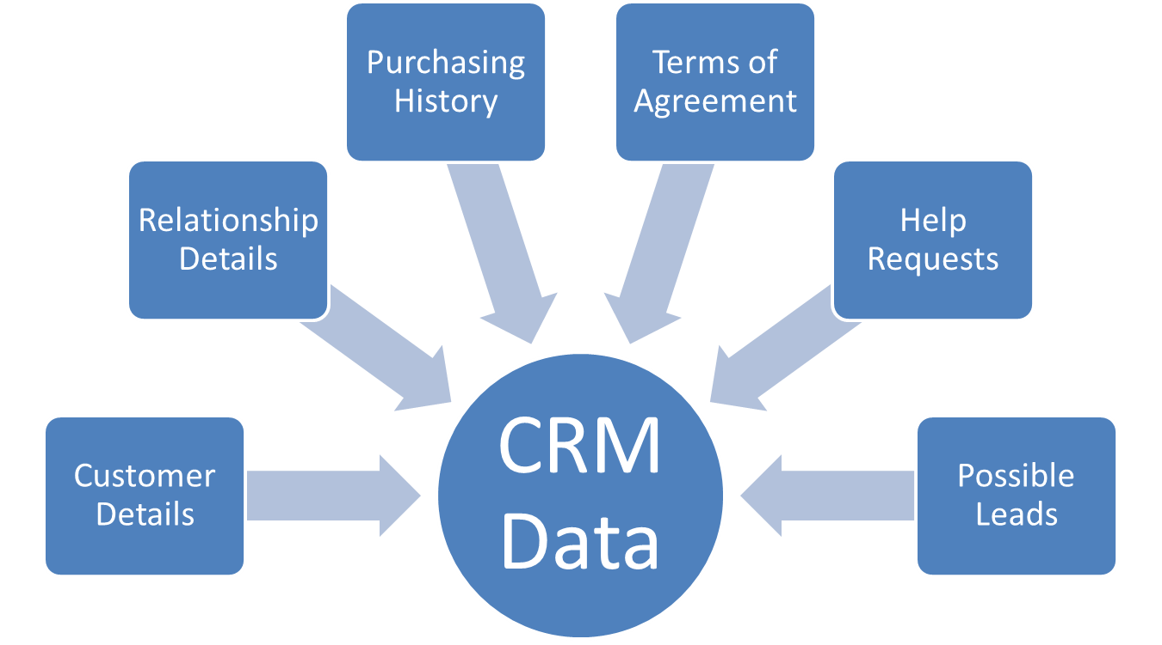

Slide 13
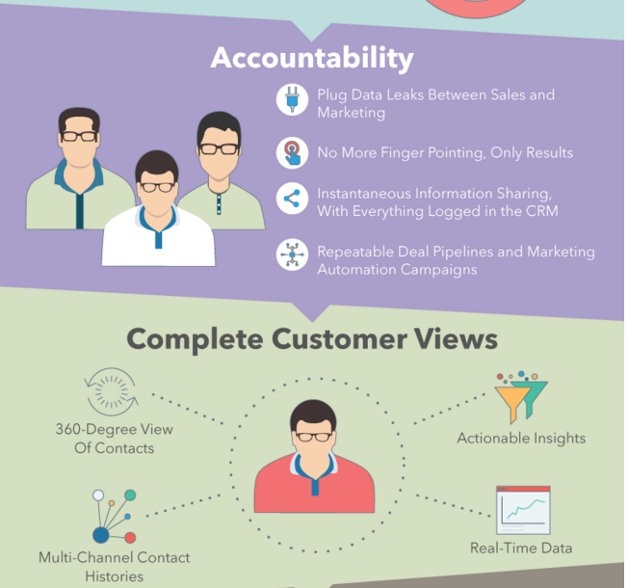

Slide 14
Required Viewing 2/3

Slide 15
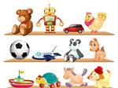
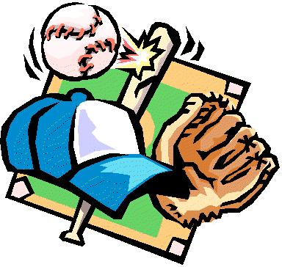
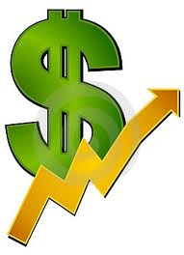
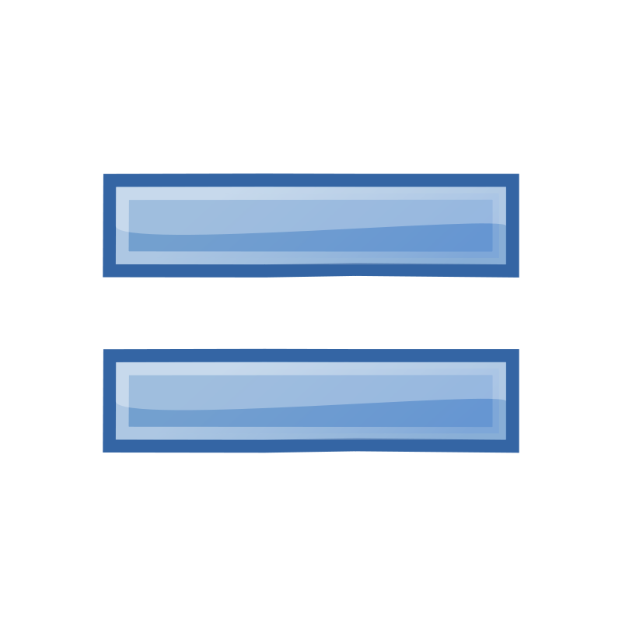
Benefits of a CRM

Slide 16
Benefits of a CRM
Collaboration
Efficiency
Data, Data, Data
Accountability
Improved Customer Experience

Slide 17
Choosing a CRM Software: A Buyer’s Guide
Discuss:
1. What was this article about?
2. Why should you care?
From simple contact databases to world class enterprise systems, there are lots of different types of CRM software out there to meet the needs of lots of organizations. This article provides an overview of features that organizations might need.
CRM software can represent a big investment for an organization. With so many options you want to make sure you purchase the right solution for your organization, no more and no less.

Slide 18
Evolution of CRM
Customer Relationship Management
Early Goal: help businesses build and maintain relationships with new and existing customers
New Goal: manage sales, marketing, point-of-sale (POS), accounting, vendor and other types of operational data, all in one easily accessible solution

Slide 19
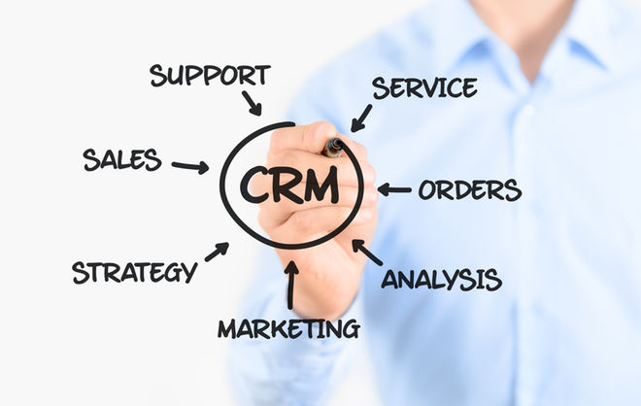
Evolution of CRM

Slide 20
?
So why can’t I just use my ERP to do this?

Slide 21
CRM & ERP: What’s the Difference?
Discuss:
1. What was this article about?
2. Why should you care?
While CRM and ERP are both enterprise systems that increase the profits of companies, the goal of ERP is to reduce costs by making business processes more efficient while the goal of CRM is to increase revenue.
These are two very different technologies that do two very different things. One reduces costs while the other increases revenue. Make sure you are using the right technology to solve the problem.

Slide 22
Required Viewing 3/3

Slide 23
What’s the Difference?
CRM – Focus on the Customer
Record & store customer interactions
ERP – Focus on the Business
Streamlining the sharing of information across departments

Slide 24
CRM – Focus on the Customer
Increase profits by producing greater sales volume
ERP – Focus on the Business
Reduce capital spent on inefficient processes
Both lead to increased profitability!

Slide 25
CRM and ERP
“Deciding which system is more important is like deciding between having an engine or having a steering wheel in a car. CRM is the engine that drives a business. It improves sales and increases profits. ERP is the steering wheel—it allows a business to be guided with precision, and to steer around obstacles well in advance. ERP and CRM working together make it much easier for a business to increase profits while reducing costs.”
TOP LINE
BOTTOM LINE

Slide 26
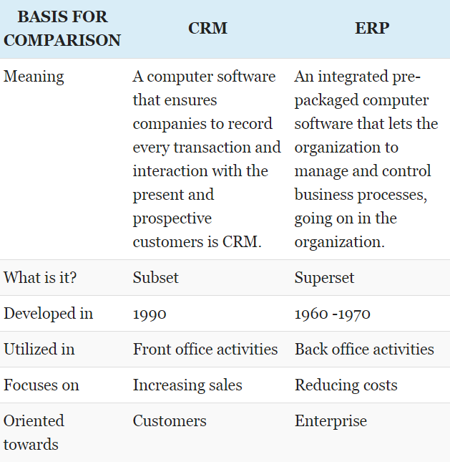

Slide 27
CRM by the numbers…
Size matters. 91% of companies with more than 11 employees use a CRM system, compared with 50% of companies employing fewer than 10 people..
CRM offers an average return of $5.60 for every $1 spent
Productivity increased by 15% when they had mobile access to CRM applications.
30% of marketers say having disparate data sources is a main reason why they can’t glean useful insights from customer data

Slide 28
6 Examples Of How To Use CRM Dashboards
Discuss:
1. What was this article about?
2. Why should you care?
All CRMs make use of dashboards to provide insight in to an organization’s sales and marketing activities. This article describes some of the important things you will find in these dashboards.
As a business professional it is important to understand how people interact with systems like these as part of these systems creating value for the organization.

Slide 29
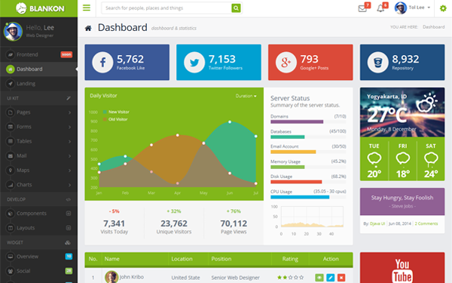
Dashboards

Slide 30
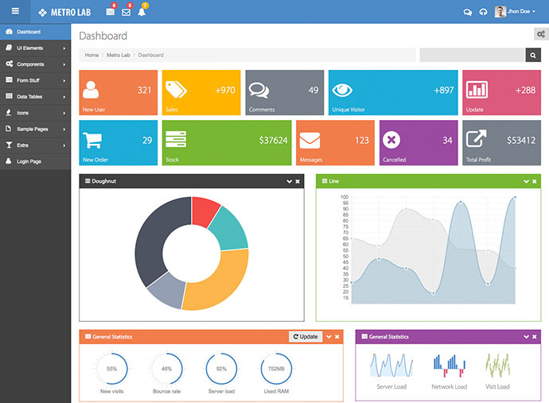
Why is this better than….

Slide 31
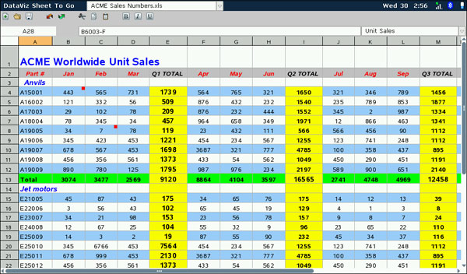
This?

Slide 32
Roadmap
Week 1: Intro to MIS
Week 2: Systems Analysis
Week 3: Systems Analysis
Week 4: Systems Analysis
Week 5
Swimlanes
ERDs
Decision Trees
Architecture Diagrams
Exam #1
Max Labs 0
What is MIS?
Week 6: Organizational Systems
Week 7: Organizational Systems
Week 8: Organizational Systems
Week 9
Decision Support
SDLC
Exam #2
ERP
Knowledge Mgmt
Digital Innovation
Max Labs 1a & 1b
Learn IT! #1
Week 10: Organizational Systems
Week 11: Organizational Systems
Platforms
Week 13: Organizational Systems
Week 14
Customer Relationship Management Systems
Cloud Computing
Artificial Intelligence
Exam #3 Prep
Supply Chain Management Systems
Week 12: Organizational Systems
Max Labs 3a & 3b
Learn IT! #2
Max Labs 2a & 2b

