Slide 1
Information Systems in Organizations
1.1 Introduction to MIS
FOX
MIS

Slide 2
Welcome!
Fall 2019
FOX
MIS

Slide 3

Introduction to Instructor
Jaclyn Hansberry
Jaclyn.hansberry@temple.edu
Wachman 755
O. 215-204-1132
Office Hours:
by appointment
FOX
MIS

Slide 4
Introduction to Instructor (cont.)
Adjunct Professor of Management Information Systems
Teaches undergraduate & graduate courses
  Information Systems in Organizations
  Data Analytics
  Information Technology Management
Sr. Systems Administrator, Information Technology Services
Temple Alum
FOX
MIS

Slide 5
“Tell me and I forget. Teach me and I remember. Involve me and I learn.”
- Benjamin Franklin

Slide 6
Managing Expectations
This class is unique!
We will work through challenges together…plan on it!
You will find the class engaging and fun!
You will acquire knowledge and skills that you will use in future classes and your career!!!
FOX
MIS

Slide 7
Course Highlights
Systems Analysis
Process Mapping (Modeling with swim lanes)
Digital Product Management
Information Systems CRM & ERP, Data Analytics & SCM
Platforms & Digital Business models, including API’s
Cyber security and the Enterprise plus AI
JavaScript
FOX
MIS

Slide 8
Course Objectives
Explore the systems which organizations use to create their digital products
Explore the platforms which these digital systems are built upon
Explore the API ecosystems by which systems extend their reach and capability.
Discuss cyber security including risks & responses surrounding digital products
Introduction to the creation of software
Learning the basics of programming in JavaScript
FOX
MIS

Slide 9
Graded Components
Component | Percentage
In-Class Activities & Worksheets (approximately 7) * must be present in class to earn credit – no exceptions! | 10%
Learn IT! and Max Lab Assignments ** no late assignments accepted – no exceptions! | 30%
Exam #1 (50 minutes) | 20%
Exam #2 (50 minutes) | 20%
Exam #3 (50 minutes – held during finals week) | 20%
*In-Class activities must be submitted while in class.
**Completed assignments will not be returned in class. Grades will be posted to the gradebook. Please note that two weeks after a grade is posted, the grade will be considered “final.”
FOX
MIS

Slide 10


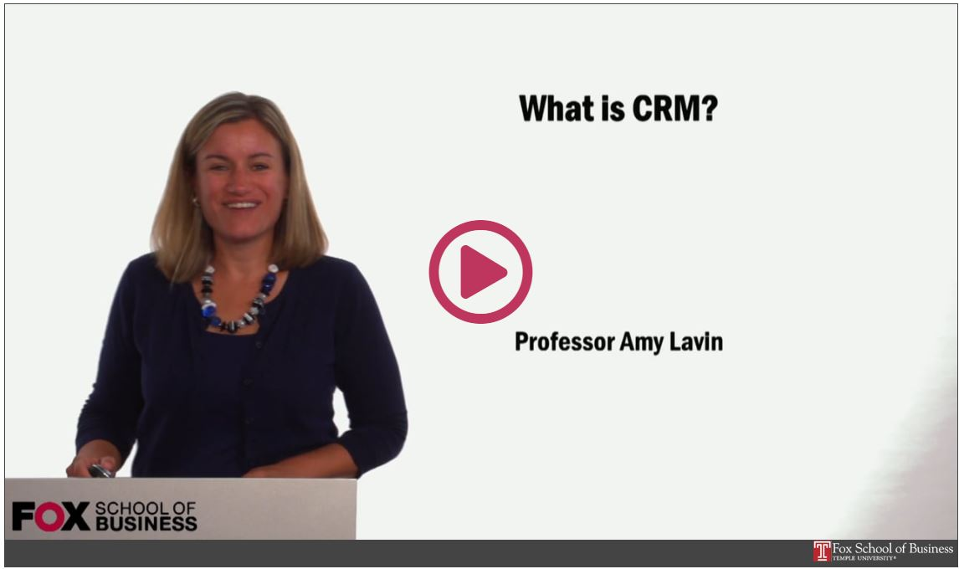
Readings & Videos – Part 1
No required texts the first 2/3’s of the semester!
Engaging collection
Current content
Available for Free!!!
FOX
MIS

Slide 11

Readings & Videos – Part 2
JavaScript
  Create simple JavaScript programs
  Prompt users for input
  Utilize loops
  Process Information
FOX
MIS

Slide 12

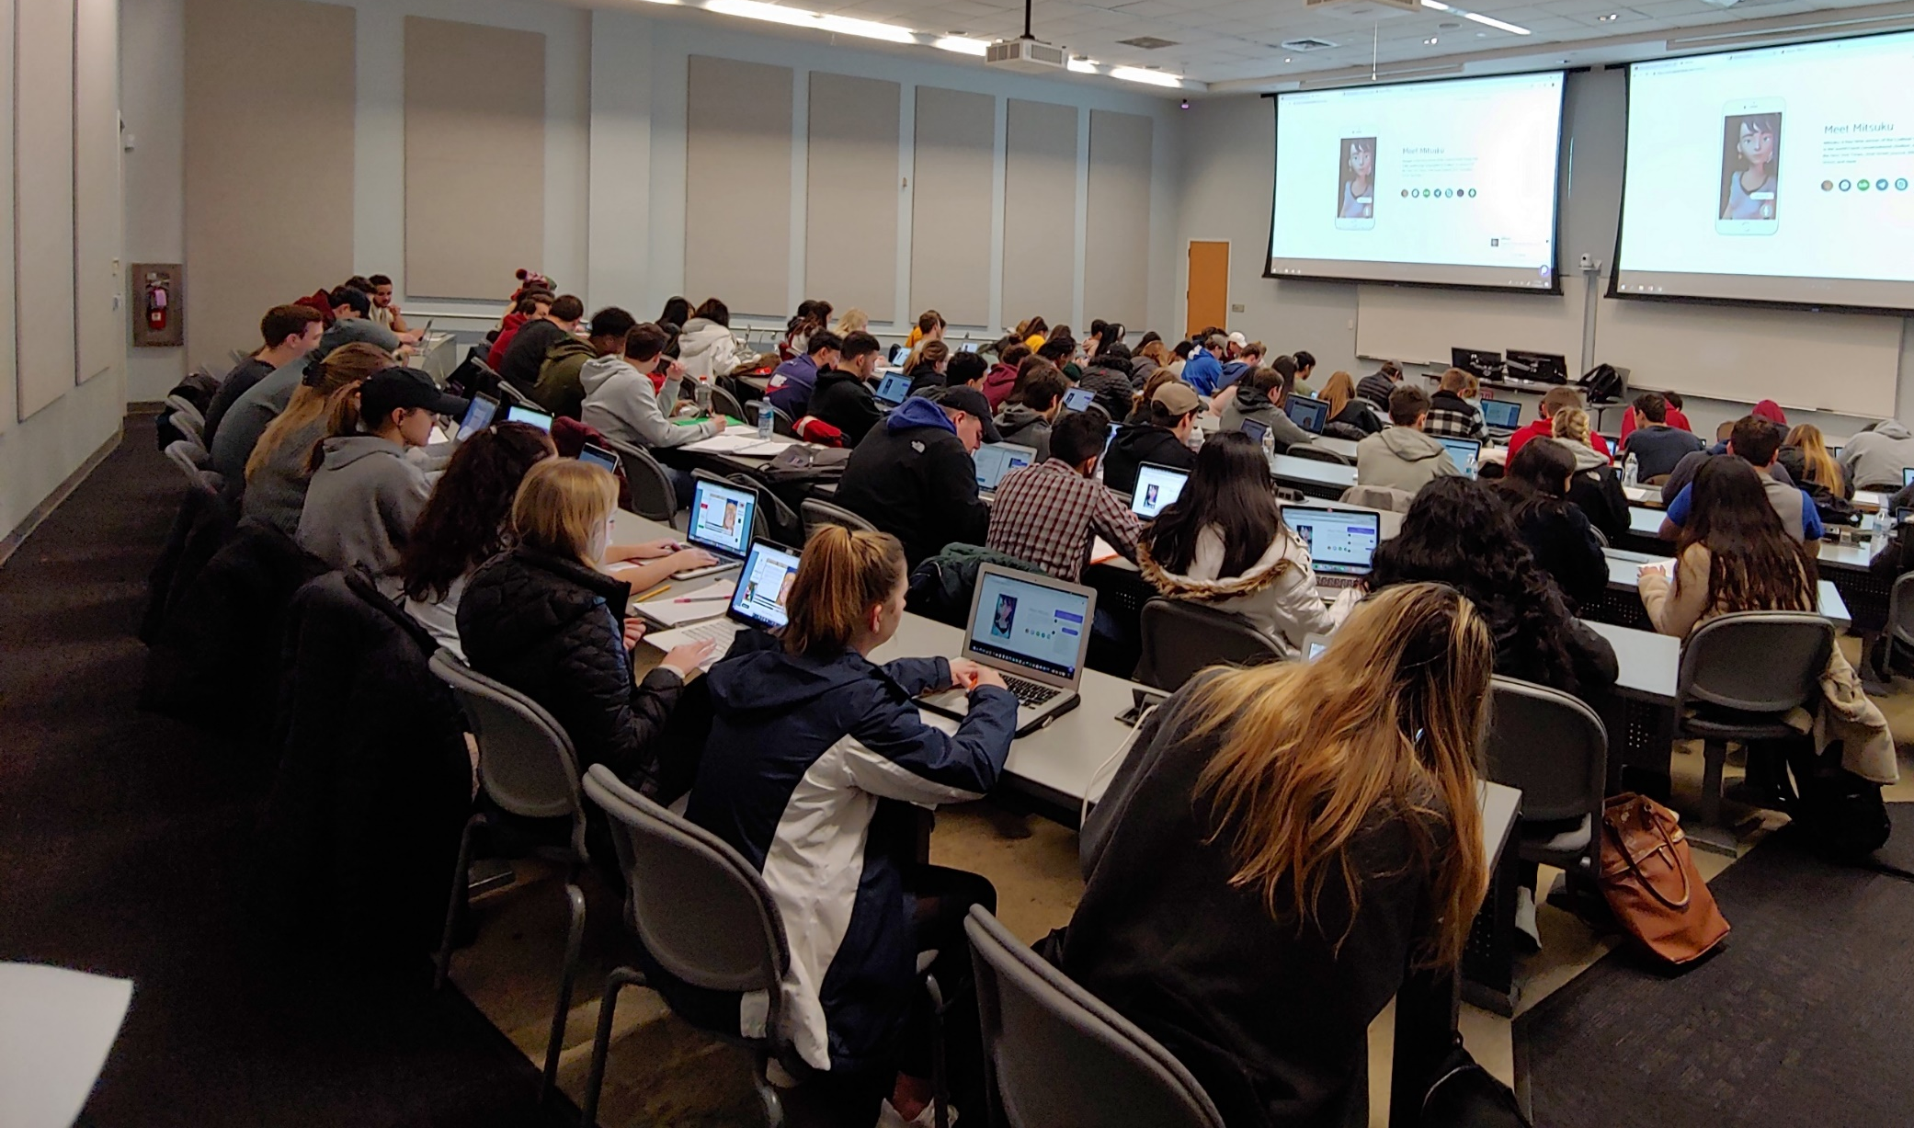
Lecture vs. Activities
Source: https://www.theodysseyonline.com/11-things-college-lecture-hall
3 Hours of zzzzzzzzz’s
1 Hour Discussion
2 Hours of Activity
FOX
MIS

Slide 13
Active Learning Components
TECHNOLOGY
CONTENT
ACTIVITY
FOX
MIS

Slide 14
The Active Learning Funnel
CONTENT
TECHNOLOGY
ACTIVITY
ENHANCED LEARNING ENVIRONMENT
FOX
MIS

Slide 15
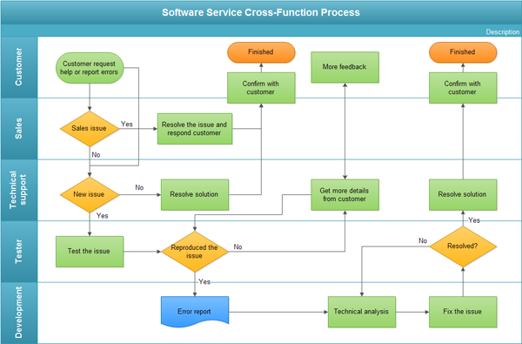
The In-class Activity
Process Diagrams
  Swim lane diagram
Real life scenarios
Knowledge Application
Problem Solve
Synthesize Solutions
Engagement
Analysis
Synthesis
FOX
MIS

Slide 16
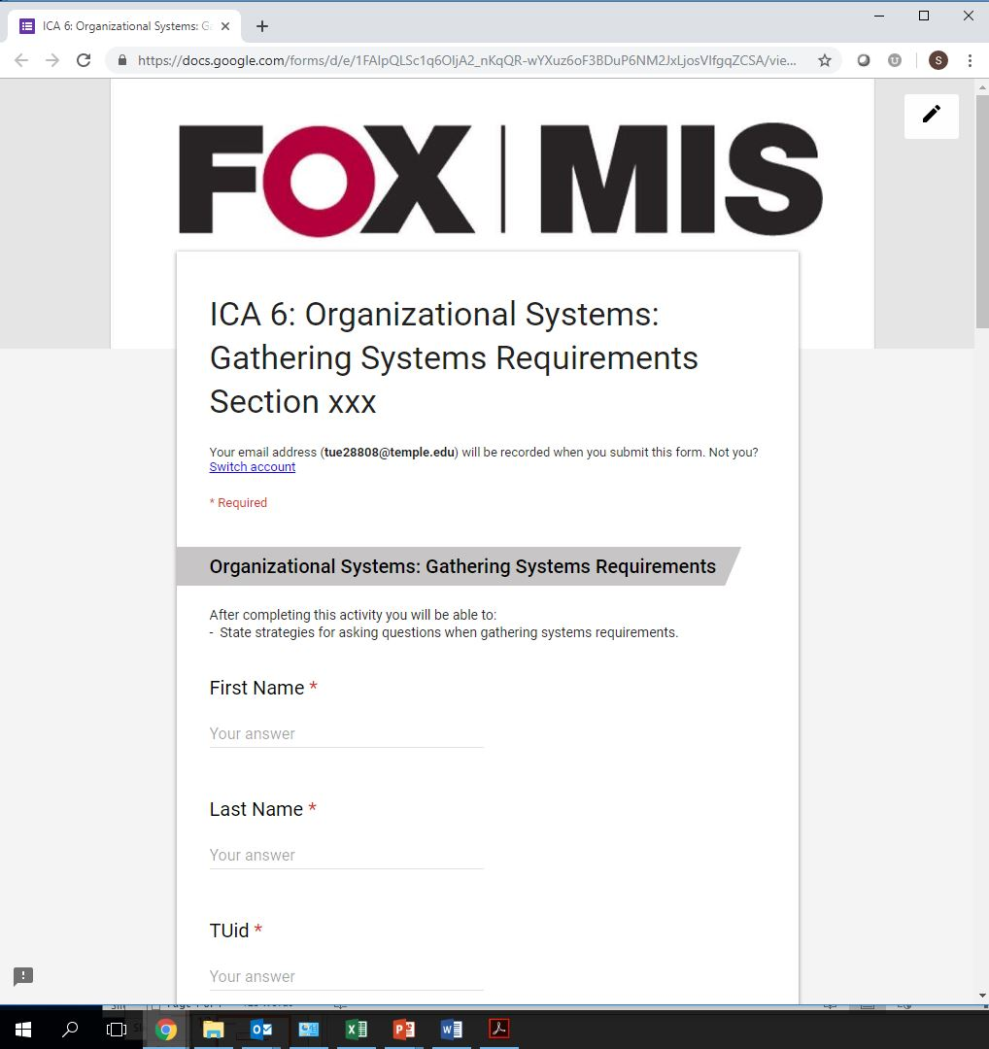
The In-class Activity – Google Forms
Reinforce assigned materials
  Readings
  Videos
  Lecture
Exam Preparation
Work in teams
Must be present
You keep your work
Synthesis
FOX
MIS

Slide 17
Not Just Another Intro Class!
Accounting
Business Management
Entrepreneurship & Innovation Management
Financial Planning
International Business Administration
Marketing
Risk, Insurance & Healthcare Management
Supply Chain Management
Actuarial Science
Economics
Finance
Human Resources Management
Legal Studies in Business
Management Information Systems
Real Estate
Statistical Science and Data Analytics
FOX
MIS

Slide 18

FOX
MIS

Slide 19
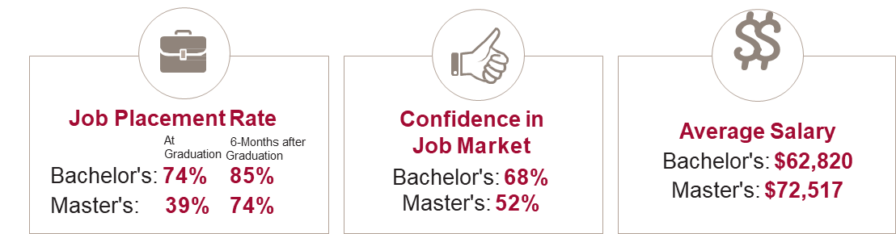
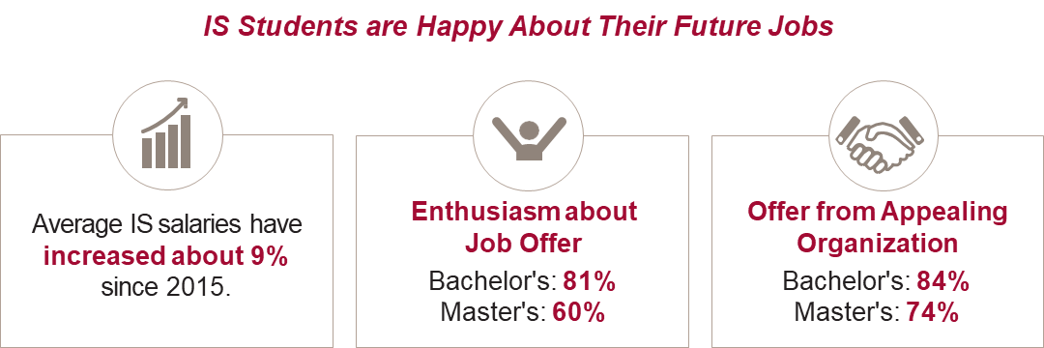
Based on 2140 graduates in 2017 from 58 universities across the U.S.
FOX
MIS

Slide 20
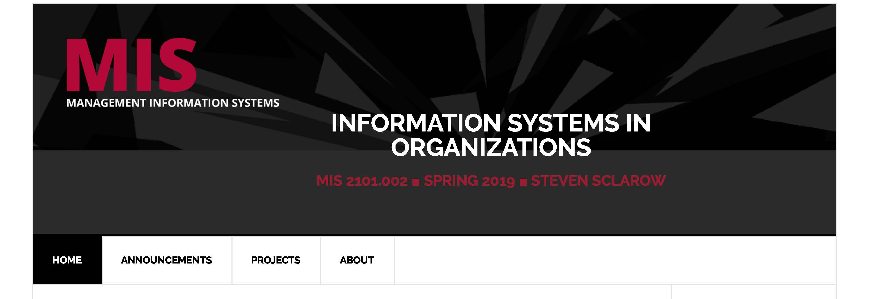
Class Site Review
No Blackboard or Canvas
  https://community.mis.temple.edu/
FOX
MIS

Slide 21
ROADMAP
START
Week 1:
Introduction & Systems Analysis
Course Description
Systems Thinking
Week 2:
Introduction to Process Mapping
Systems & Processes
Swim Lane Diagrams
Assignment #01
Week 3:
Digital Product Management
Max Labs 1a & 1b
Assignment #02
Week 4:
Information Systems – Part I
CRM & ERP
Max Labs 2a & 2b
Assignment #03
Week 5:
Exam #1
Midterm review
Exam Prep
*check course calendar
Week 9:
Exam #2
Midterm review
Exam Prep
*check course calendar
Week 8:
Cybersecurity & the Enterprise
Protection Protocols
Artificial Intelligence
Assignment #06
Week 7:
Platforms & Digital Business Models
API’s
Max Labs 3a & 3b
Assignment #05
Week 6:
Information Systems – Part II
Data Analytics & CRM
Learn IT #1 & 2
Assignment #04
Week 10:
JavaScript Unit #1
Hello World, Variables
Input and Output
Assignment #07
Week 11:
JavaScript Unit #2
Operator types
Strings
Assignment #08
Week 12:
JavaScript Unit #3
Logical Operators
Conditional Types
Assignment #09
Week 13:
JavaScript Unit #4
Intro to Loops
While and Do
Assignment #10
Week 14:
JavaScript Unit #5
HTML basics
CSS basics
Assignments #’s 11 & 12
FINISH

