Slide 1
MIS 2101 Exam 2 Review

Slide 2
Advice
Review the slide decks
Review assigned readings
Review assigned videos
How to prepare…

Slide 3
Exam Will Cover Discussions: 6.1 | 7.1 | 8.1
Readings, Videos and Lectures (80%)
Data Analytics
Supply Chain Management
Platforms
Digital Business Models
API’s
Cybersecurity
Artificial Intelligence
Mini-Case – Demonstrate your ability to apply (20%)
Swim Lane Diagrams

Slide 5
Information Systems – Part III
Topics and Required Reading What Is The Difference Between Data Analysis And Data Visualization? What is BI? Companies Are Failing in Their Efforts to Become Data-Driven Disney’s $1 Billion Bet on a Magical Wristband McDonald’s Bites on Big Data With $300 Million Acquisition
Required Viewing Data Analytics Big Data What is SCM?

Slide 6
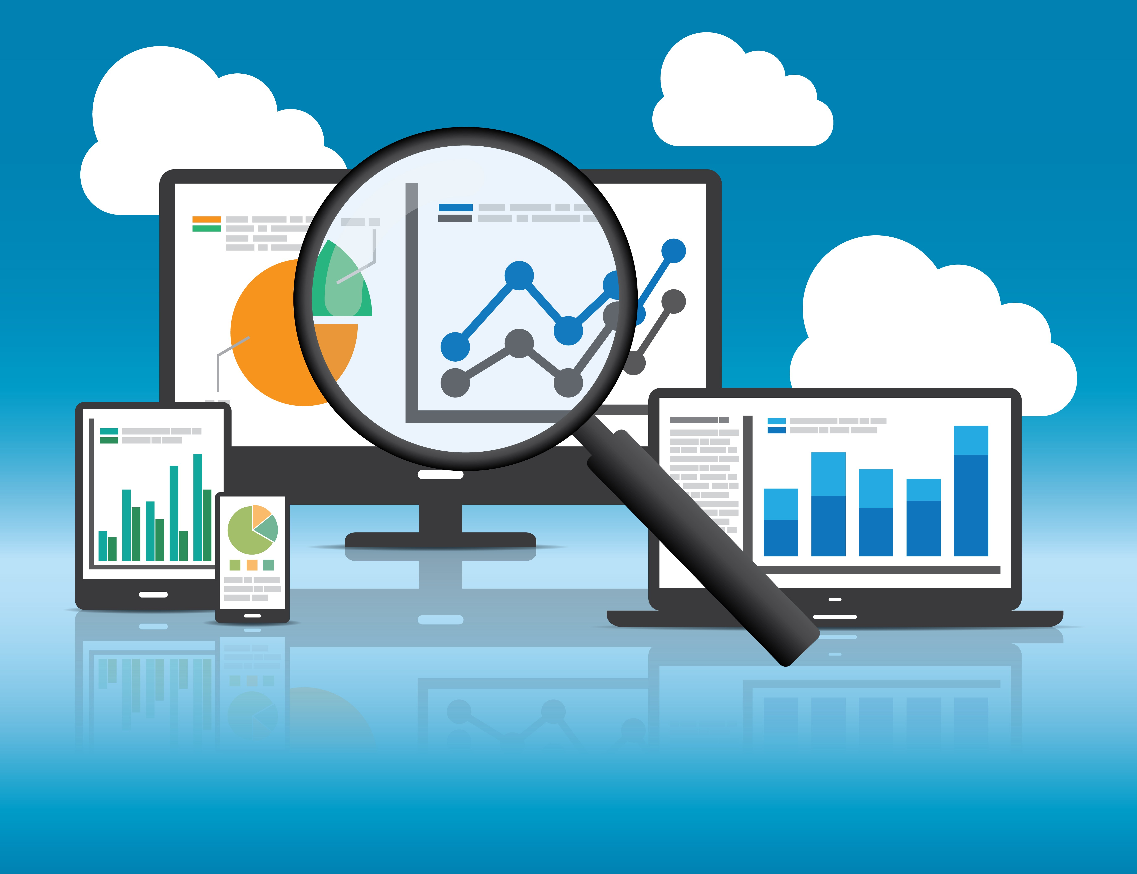
What is Data Analytics?
“The use of tools & people to uncover hidden patterns in the data that might not be readily available to the naked eye”
– Professor Lavin

Slide 7
3 types of analytics
Descriptive – Dashboards
Predictive – use past data to model future
Prescriptive – Optimization – advise on how best to do your job.

Slide 8
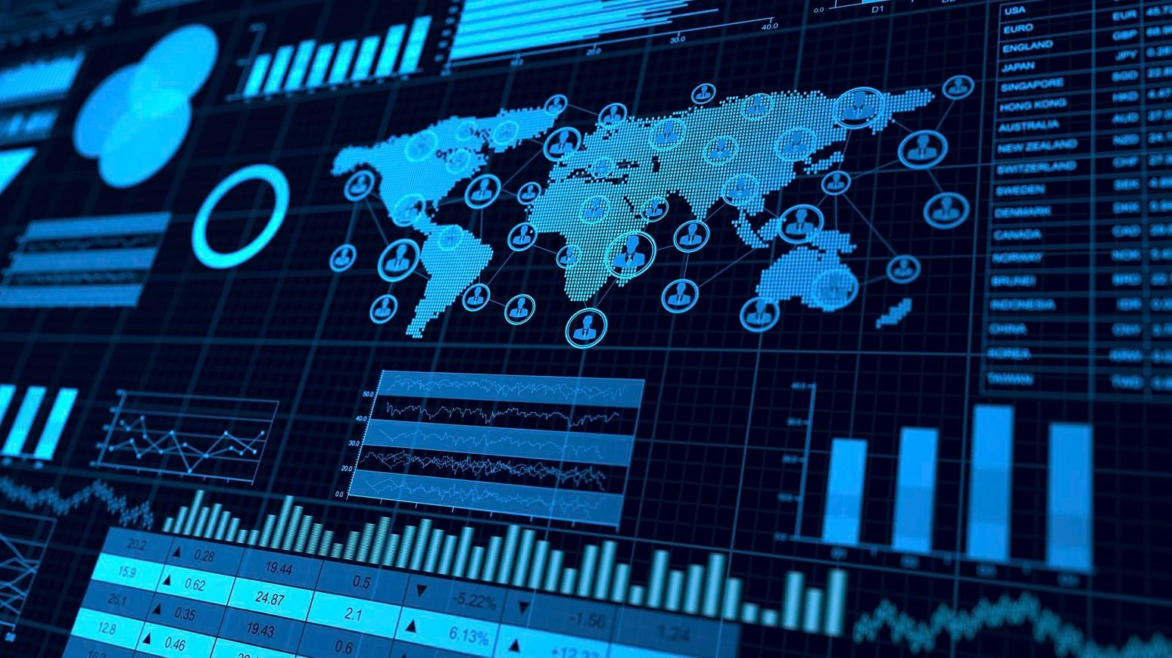
Data Investments… Why Care?
Top Reasons Why:
Decrease Expenses
Find New Innovations
Launch New Products/Services
Increase Efficiency
Transform Business
Establish Data-Driven Culture

Slide 9
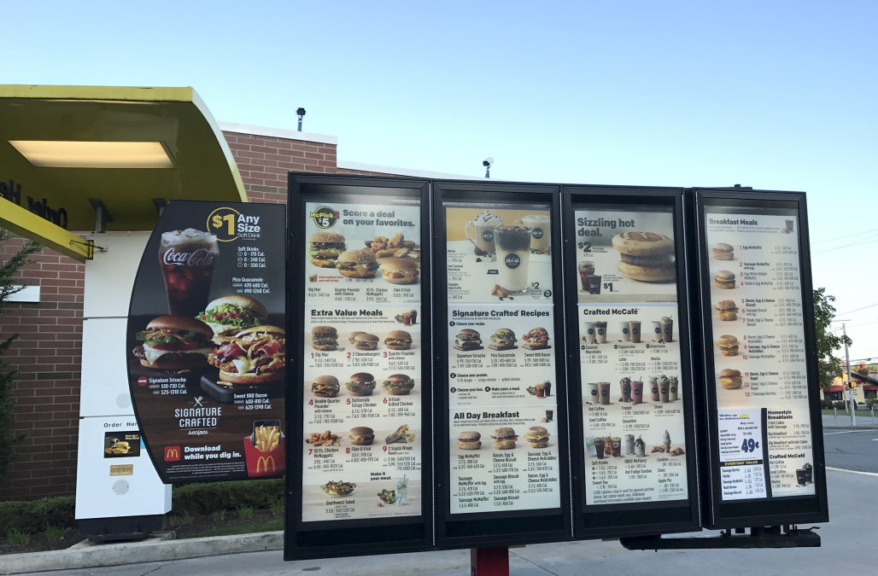
McDonald’s & Big Data
300 Million Acquisition
Customer experience
Mass personalization
Infrastructure
Technology Transformation
Algorithms crunch data
Machine Learning
Replacing stagnant signs
Digital displays

Slide 10
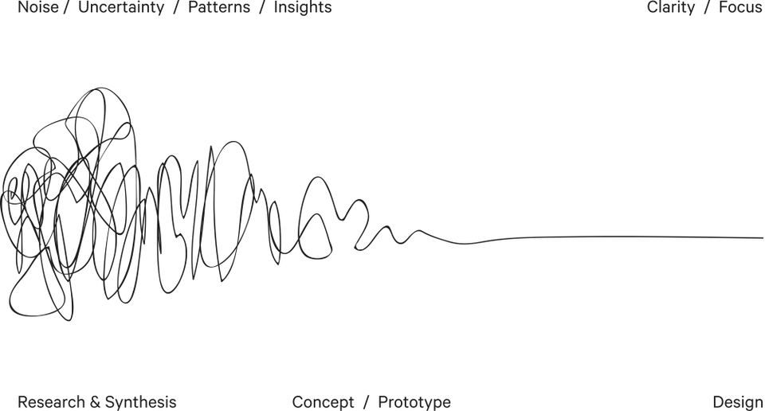
Data Analysis & Data Visualization
Data analysis is an exploratory process that often starts with specific questions.
Data visualization involves the visual representation of data, ranging from single charts to comprehensive dashboards.

Slide 11
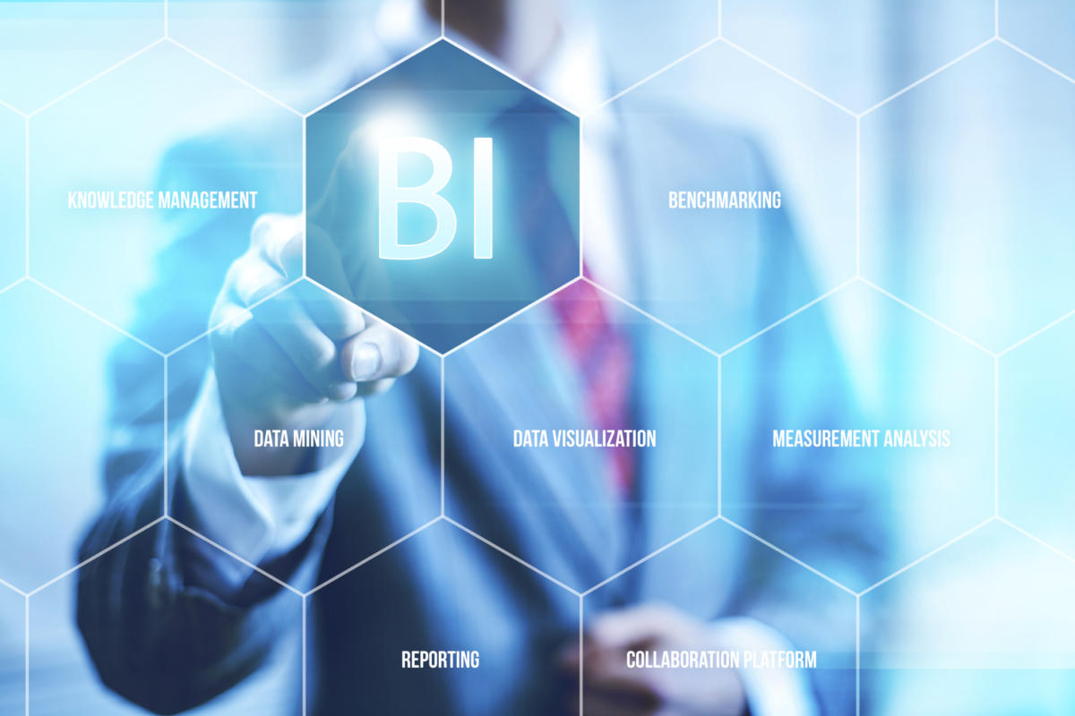
Business Intelligence (BI)
BI Leverages Software & Services to Transform Data into actional intelligence that informs the organization’s business decisions
Analytical findings can be presented in:
Reports
Summaries
Dashboards
Graphs
Charts
Maps

Slide 12
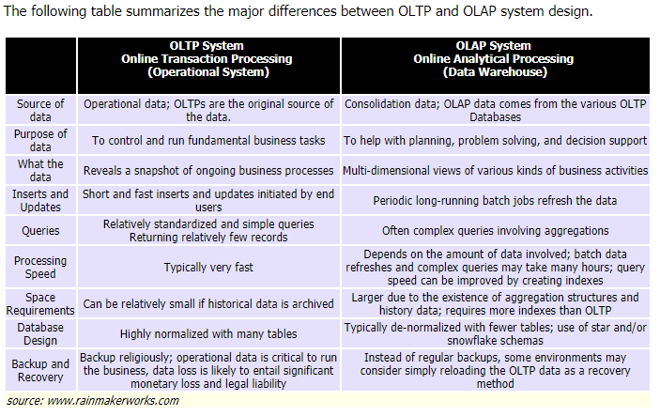

Slide 13
OLTP vs. OLAP
OLTP: Transactional
Provides source data to the data warehouse
ex: Financial Transaction Systems
OLAP: Analytical
Systems help analyze the data
Ex: Amazon predictive buying

Slide 14
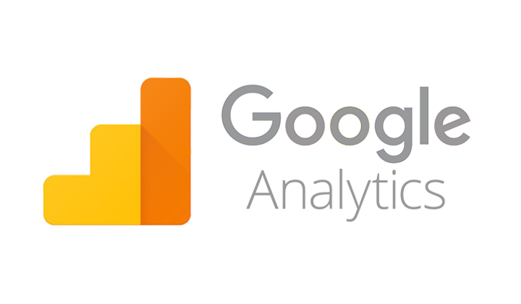
Google Analytics
Track
Website engagement
Number of sessions
Number of pages visited
Bounce Rate
Conversion Rate

Slide 15
Supply Chain Management
“Supply Chain includes many components…from Procurement to Manufacturing to Distribution. It’s about getting the right product on the right shelf at the right time!” – Professor Doyle
Cross Functional Approach:
Improves trust & collaboration
Improves inventory visibility & velocity

Slide 16
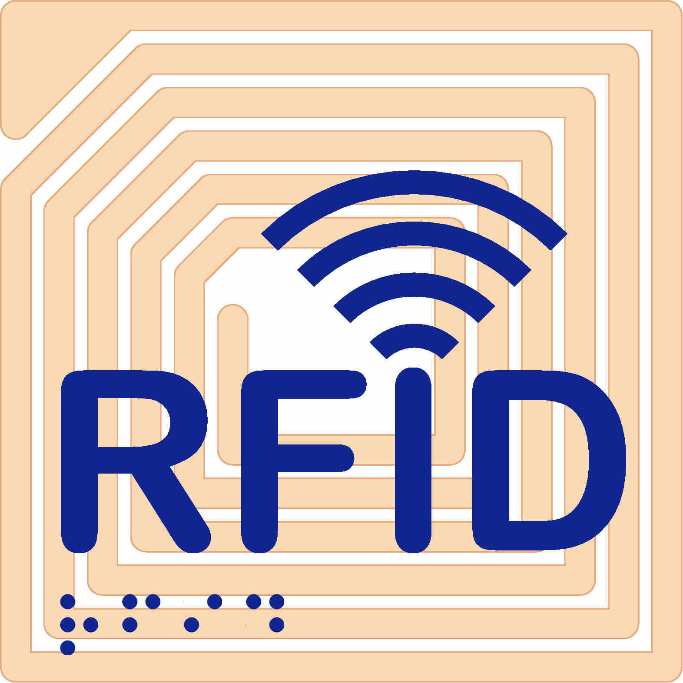
RFID
What is RFID?
Radio Frequency Identification
Wireless technology that lets you identify objects that have been fitted with special RF identification tags
What is RFID good for?
Inventory control, access control…
How it works
Antenna reads electromagnetic energy
Can penetrate non-metallic solid objects

Slide 17
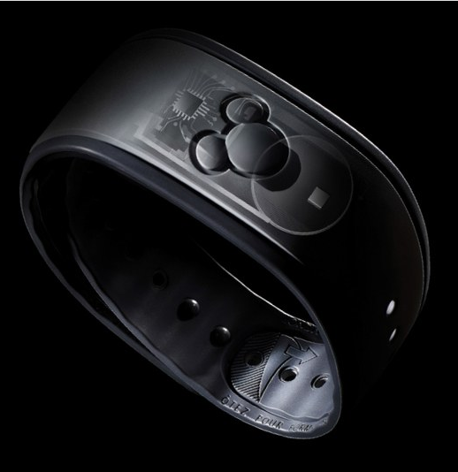
Disney Magic Band
$1 Billion Investment
Design the Customer’s experience
Customer Tracking
Parks & Hotels
Everything is linked together
Removes the customer’s need for:
Credit Cards
Tickets
Trip Itinerary

Slide 18
Platforms & Digital Business Models
Topics and Required Reading API Imperative How the API economy is igniting a cultural shift in businesses What are digital platforms? Product Managers for the Digital World 4 reasons you should consider a platform strategy What’s the difference between IaaS, Saas & PaaS? What is the Network Effect? Platform Businesses 9 types of software platforms
Required Viewing The API Economy What is a Platform Cloud Computing Models

Slide 19
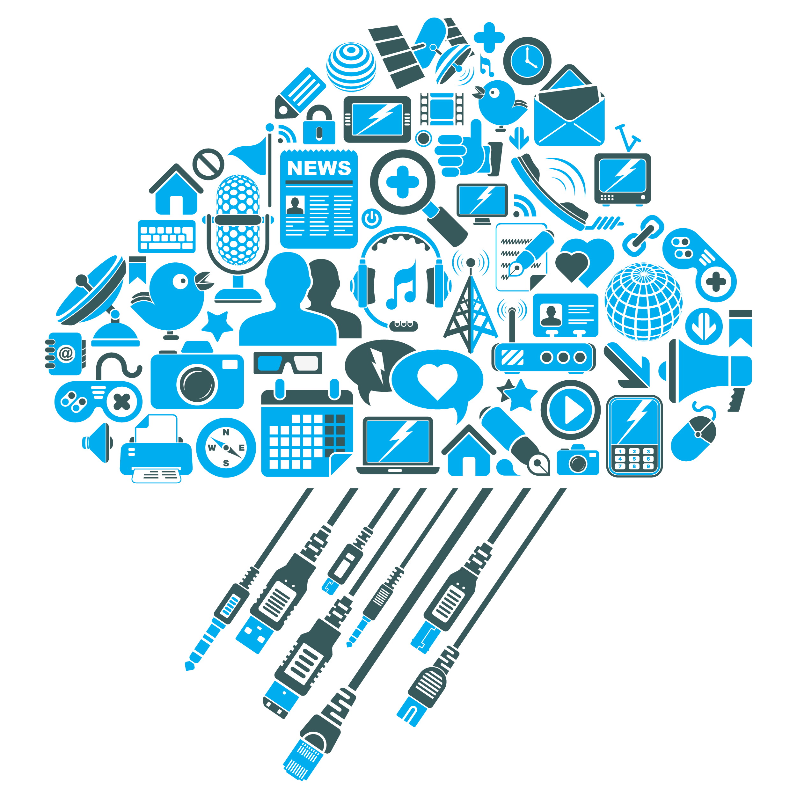
Digital Platforms?
“…facilitates commercial interactions between at least two different groups…”
What are some core functions of a platform?
Audience Building
Matchmaking
Providing Core Tools & Services

Slide 20
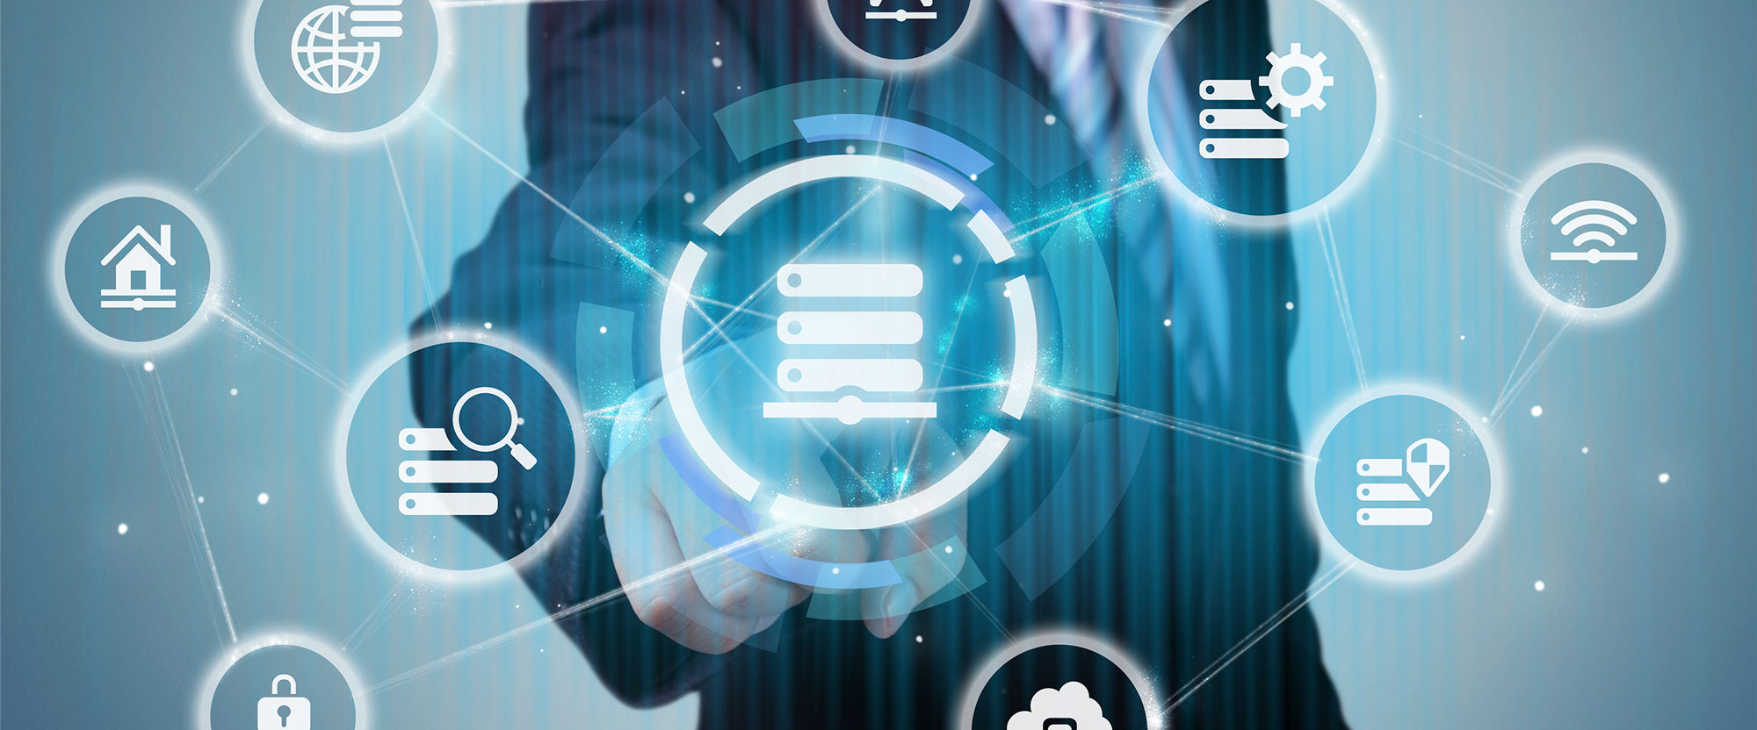
Digital Platform Benefits
Easier to find customers
Monetize underutilized assets
Reduce transaction costs
Reduce barriers to entry
Reduce Search costs

Slide 21
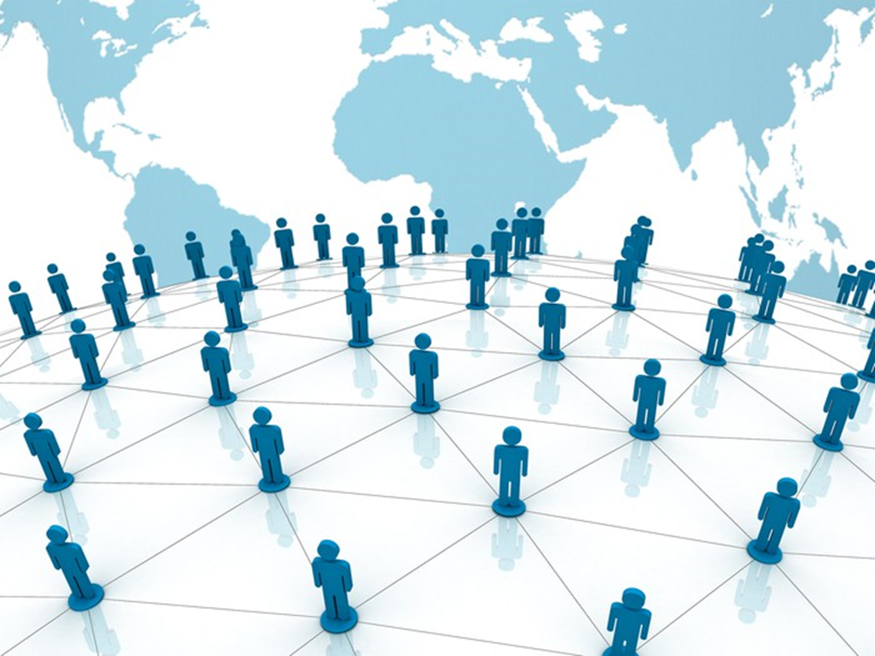
Network Effects
The indirect value goods and services gain as more people use them.
Benefits of the network effect
ex. Facebook
Beyond the internet
ex. Deere & Co.

Slide 22
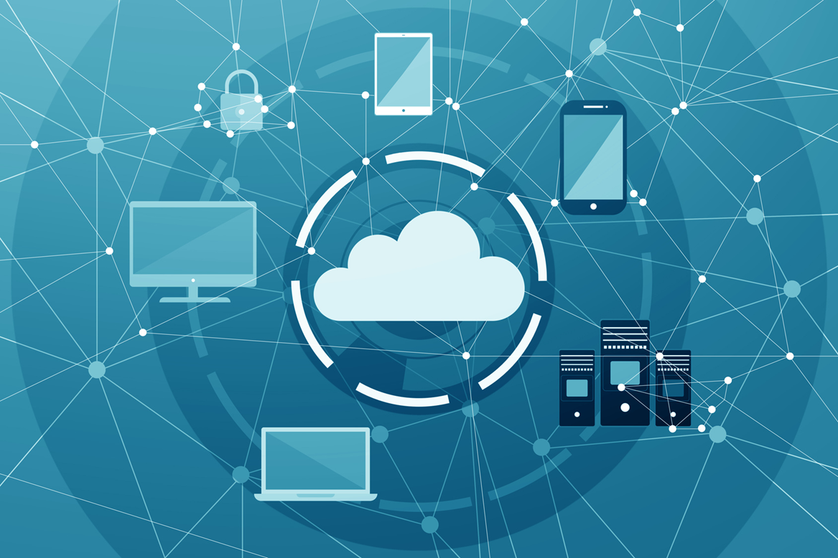
Cloud Computing
Pros
Collaboration
Environment
Cost
Ease of use
Cons
Security
Data Integrity
Availability
Privacy

Slide 23
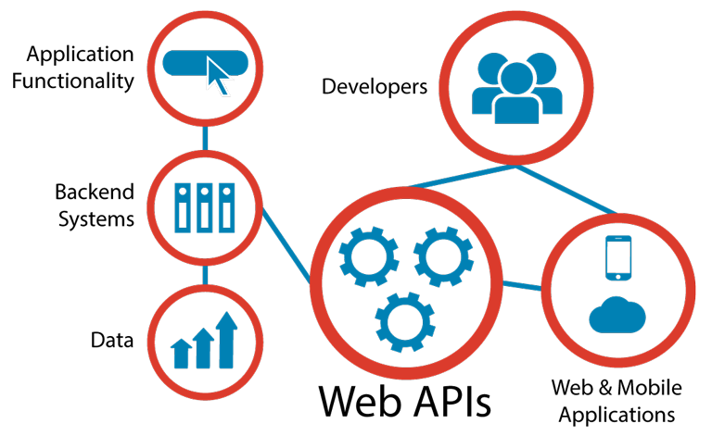
API’s: Application Programming Interface
What is an API?
Connect computer software components
Contract for Data Interaction
Facilitates interactions between front & backend IT systems (Web API’s)
Facilitate development of applications
Web
Mobile
Cloud

Slide 24
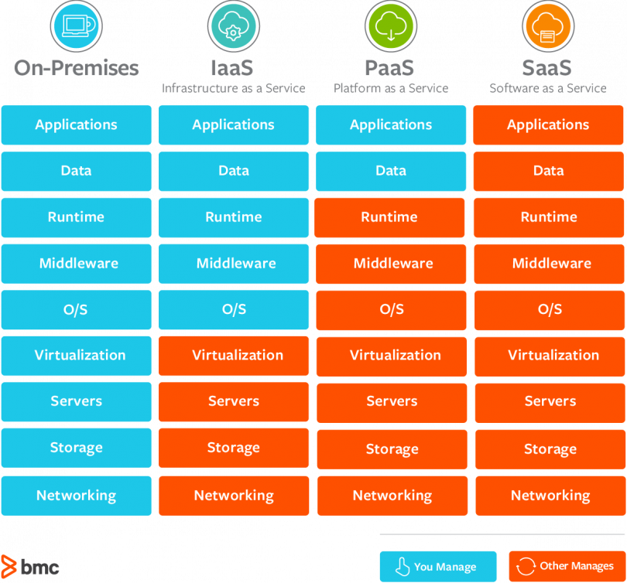
Cloud Computing
3 Basic Service types to Consider
Infrastructure as a Service (IaaS)
Amazon Web Service
Platform as a Service (PaaS)
Google App Engine
Microsoft Azure
Software as a Service (SaaS)
DropBox
G-Suite

Slide 25
Proprietary vs. Shared
Advantages
Proprietary:
Larger market share,
Simplified user experience
Product stability
Shared:
Flexibility and Agility
Speed and cost-effective
Disadvantages
Proprietary:
Can’t be tweaked by users
Dependency of the user
Shared:
Reduced competitive advantage
Tech Support

Slide 26
Cybersecurity & the Enterprise
Topics and Required Reading What is threat modeling? Data Breaches John Deere’s Promotional USB Drive Hijacks Your Keyboard These are the worst corporate hackers of all time 5 Worst Data Hacks What is AI The Wired Guide to Artificial Intelligence Why Hospitals Are The Perfect Target For Ransomware
Required Viewing 3 Types of AI Cybersecurity Concepts Cybersecurity: Vulnerability & Protection Case Study: Ransomware Cybersecurity Future & AI

Slide 27
Cybersecurity – Core Fundamentals
Five Questions for treat modeling:
What do you want to protect?
Who do you want to protect it from?
How likely is it that you will need to protect it?
How bad are the consequences if you fail?
How much trouble are you willing to go through in order to try to prevent those consequences?

Slide 28
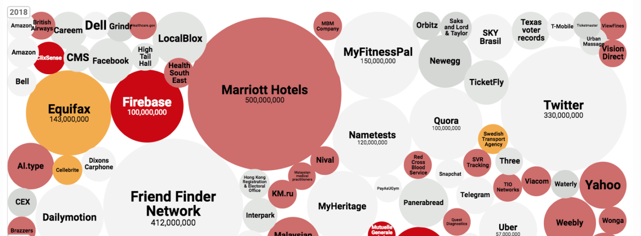
World’s Biggest Data Breaches & Hacks
Text

Slide 29
Myths of Protection
Right fit for the Organization
Five key elements:
Build 1:do/not do
Build 2: risk/cost ratios
Build 3: industry risk profile
Build 4: growth perspective
Build 5: sustainability

Slide 30
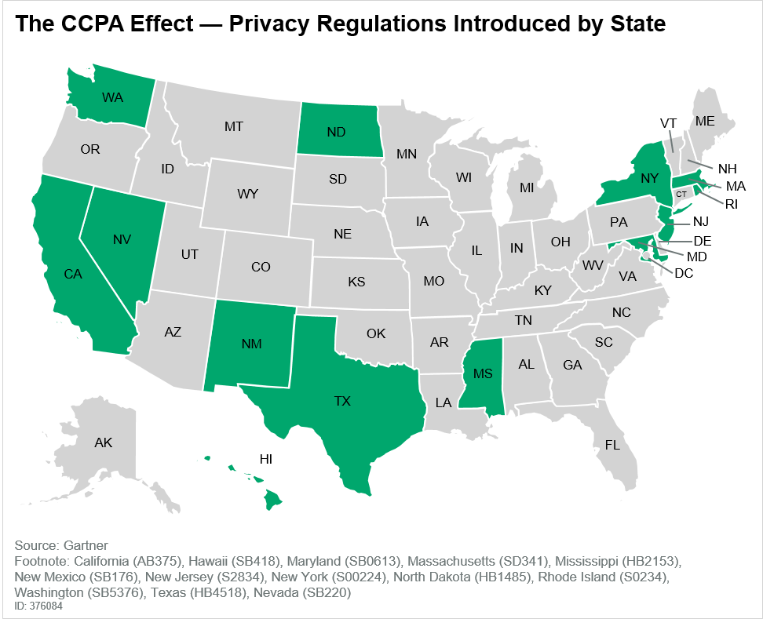
Regulations
Privacy and Personal Data Protection
California Consumer Privacy Act (CCPA)
Few Federal cybersecurity regulations
1996-Health Insurance Portability and Accountability Act (HIPAA)
1999-Gramm-Leach-Bliley Act
2002 Homeland Security Act, includes
Federal Information Security Management Act (FISMA)

Slide 31
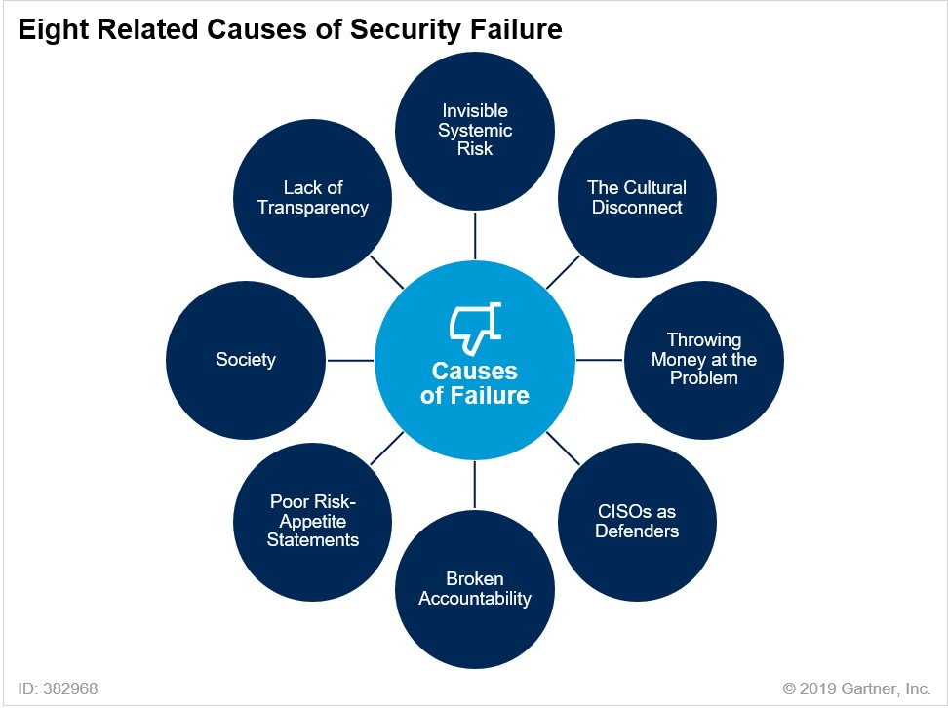
Strategic Planning

Slide 32
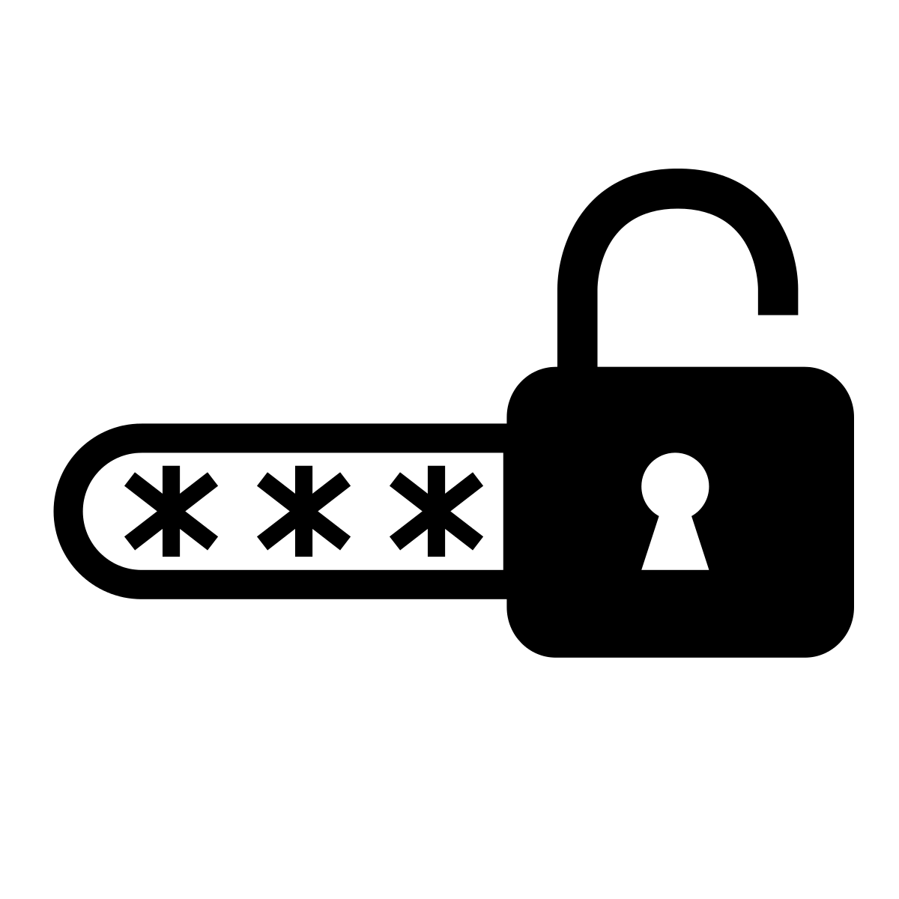
Password Management
Password Basics
Keep them in you head?
Don’t change them?
Reuse them?
Password Management
Consider a passphrase
Access a vault of your passwords
Two-Factor Authentication

Slide 33
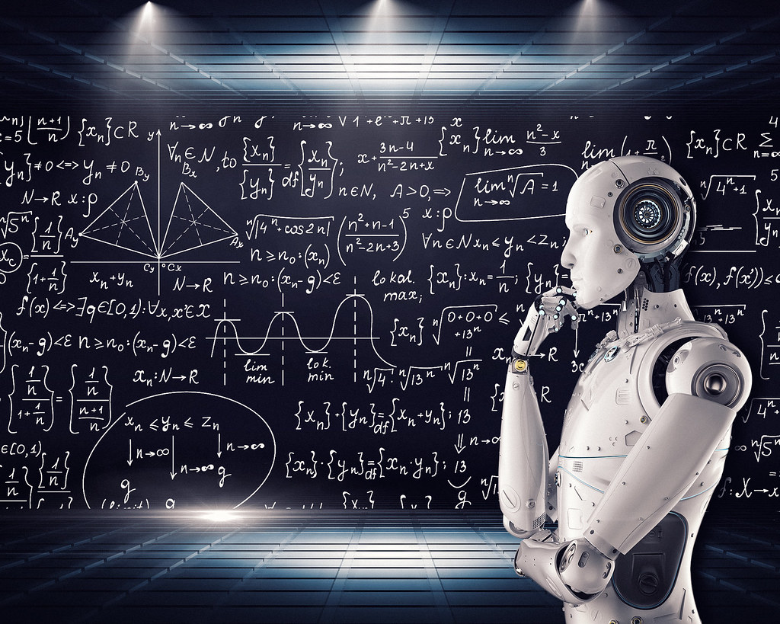
Artificial Intelligence
Three Types
Narrow (ANI)
General (AGI)
Superintelligence (ASI)

Slide 34
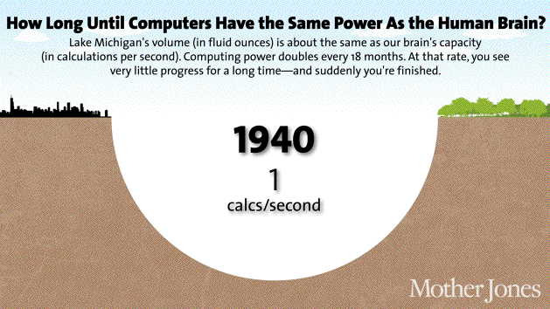
From AGI to ASI
This could happen soon
Advancements in technology
Experimentation
Innovation

Slide 35
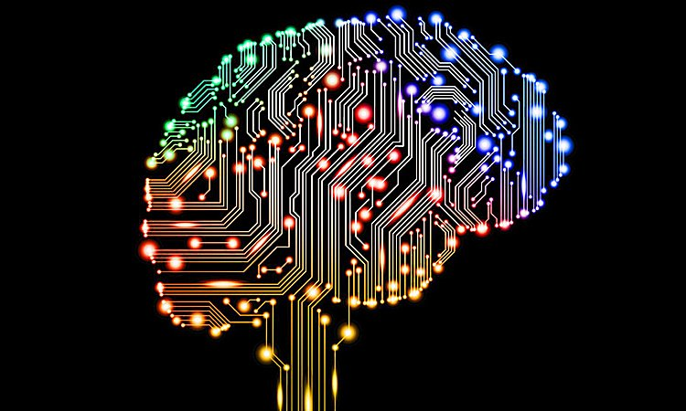
AGI Tests
The Turing Test
The Coffee Test
The College Student Test
The Employment Test

Slide 36
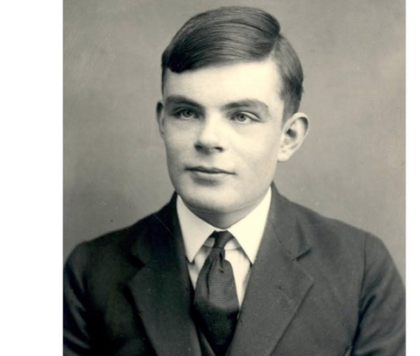
Alan Turing (1912-1954)
Father of AI and computer science
Cryptanalyst during WWII
Cracked code that enabled Allies victory
Contributions to physical sciences
Prosecuted by UK and castrated for being gay
Died of cyanide poisoning
Receives public apology in 2009 & royal pardon in 2013

Slide 37
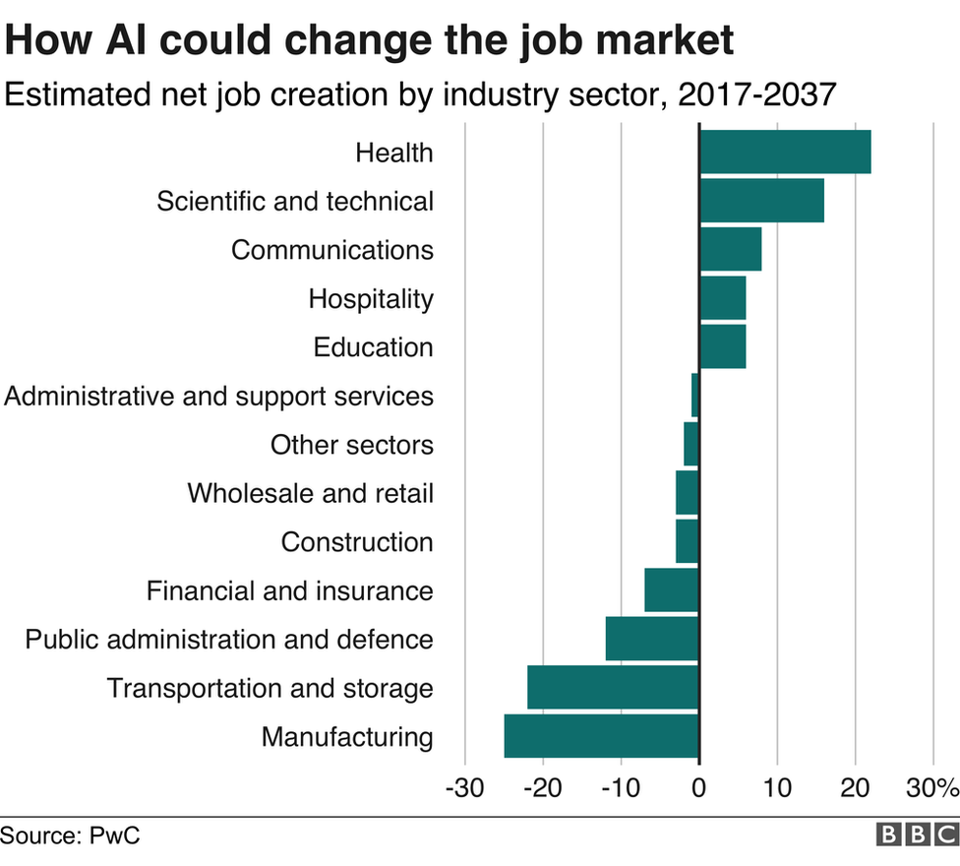
Future of AI

Slide 38
Questions?

