Slide 1
Information Systems in Organizations
9.1 An Introduction to Programming
FOX
MIS

Slide 2
ROADMAP
START
Week 1:
Introduction & Systems Analysis
Course Description
Systems Thinking
Week 2:
Introduction to Process Mapping
Systems & Processes
Swim Lane Diagrams
Assignment #01
Week 3:
Digital Product Management
Max Labs 1a & 1b
Entity Relationship Diagrams (ERD)
Assignment #02
Week 4:
Introduction to Data Modeling
ERD Diagrams
Learn IT Kickoff
Assignment #03
Week 5:
Exam #1 & Information Systems – Part I & II
CRM & ERP
*check course calendar
WE ARE HERE
Week 9:
Exam #2 & JavaScript Unit #1
- Part I & II
Hello World, Variables
Input and Output
*check course calendar
Week 8:
Cybersecurity & AI – Part I & II
Protection Protocols
Artificial Intelligence
Assignment #06
Week 7:
Platforms & Digital Business Models – Part I & II
Platforms & Digital Models
APIs
Assignment #05
Week 6:
Information Systems – Part III & IV
Data Analytics
SCM
Max Labs 2a2b
Assignment #04
Week 10:
JavaScript Unit #2 Functions
Operator types
Strings
Assignment #07
Week 11:
JavaScript Unit #3 Logical Operators & Conditional Logic
Logical Operators
Conditional Types
Assignment #08
Week 12:
JavaScript Unit #4 Loops
Intro to Loops
While and Do
Assignment #09
Week 13:
JavaScript Unit #4 Working with Loops
Writing the code
Assignments #’s 10 & 11
Week 14:
HTML & CSS Unit
HTML basics
CSS basics
Course Reflection
Assignment #12
FINISH

Slide 3
An Introduction to Programming
Week 9
FOX
MIS

Slide 4
Goals For Today
Learn what Programming is
Get VS Code downloaded
How to access Starter Files
Open Starter File and program/run Hello World

Slide 5
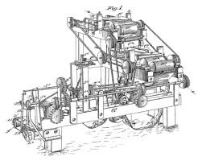
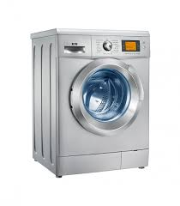
Machines
How many different things does a machine do?
Source: https://lh3.googleusercontent.com/_MsstYyQ4UORpFRdwNu6BN2_cL3vu_raiYq-RErSsdf_Y6v_lKZss8N-8qCO-Tnf3aalDw=s170
Source: https://lh3.googleusercontent.com/GB8PJSrB61OSat3rBAJO-wEjTGstYfB2N4ECL2LSYOahESElAVf7LWJMNrJ0undIP10o=s119
Source: https://lh3.googleusercontent.com/VVZxPvd2BpOPvECeBytaSZqFUfAg5UqPmeroft5ONc3bQVKYqr2s5IxoI4NvEP4unuJiFDI=s94
Source: https://lh3.googleusercontent.com/eZGdlrLtdzW9nEKR758LiagZ3_-wjxflYbpU-IfZeVdny34bXSgn4s0DQTsfS3t_O2eZ_g=s85
Source: https://lh3.googleusercontent.com/OCVAphS1iC9nYvF2FeP_llNXwWQ69mCX8HjK2DJ7UU_xGnoHOgXd4YX8O4Zes09WIcIFxP8=s85
Source: https://lh3.googleusercontent.com/mCtpPS6Qz3guK0-cyCruwUwgbKYAJhWH1iTqGbCNjMOvSnGMvL1FeBGeDIBYboOC7P-gfQ=s102
FOX
MIS

Slide 6
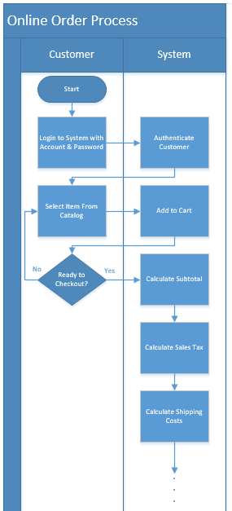
Machines (cont.)
How many different things does a computer do?
How can this machine do so many different things?
Source: https://lh3.googleusercontent.com/59wm5Z8eXC40_WKib3Ghe3ORRuSITa17Xl5BN8QIikEh_cDnScrGnOouZnO4X-cBY6ad5w=s128
Source: https://lh3.googleusercontent.com/luQcPRIrni_WsHytr016U1SPu7FvyVlK2AfyBH3fXEjhoBPrmpzuTfgjvQV40UR63ZTq1jk=s134
Source: https://lh3.googleusercontent.com/Mkj8bl6o0XbrVqnFs40Y3AFVMibSJX1xra-Ll5rwbMCxGs67gpljSny2TUI4KASK1u8sD-M=s85
Source: https://lh3.googleusercontent.com/dMhdY1wyo91ER5uMkI1recx4-0w7fOjNUNmSB9ZCgVnIMqqqXNDkxiw9ckuWij_vtzFSEw=s128
Source: https://lh3.googleusercontent.com/qu1kdMmaM8SbvpyiDQEULPMPGfCrHneGT7WZ494FhgM8N4SHp-TOQvmuKBK2leESFBSPUjg=s151
FOX
MIS

Slide 7
Software Programs = Software = Apps
But aren’t all programmers nerds?
FOX
MIS

Slide 8
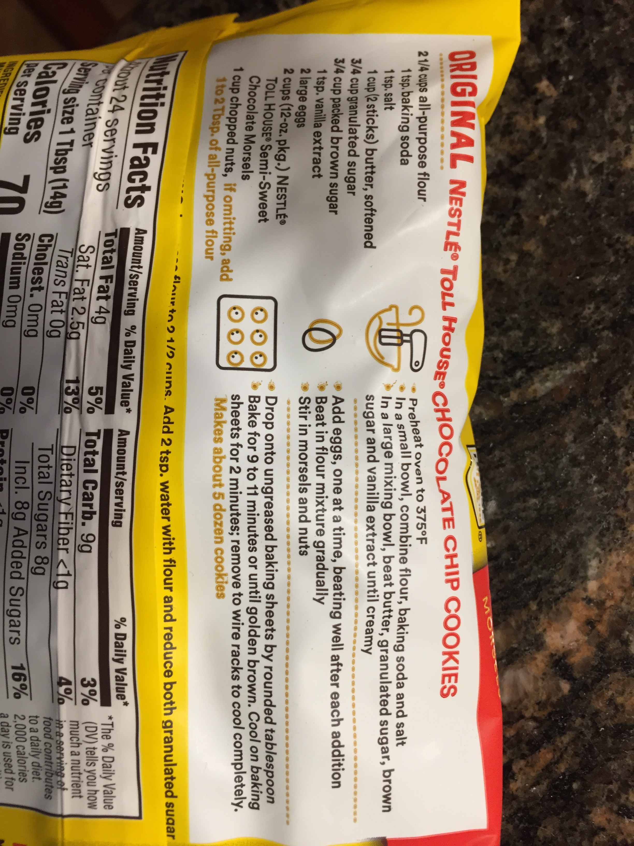
What exactly is a program?
Source: https://lh3.googleusercontent.com/ZcDhYsffPS_f2HRcyXUenTLZm9EeoVwHGlxcMrlw7G4HsGcCE_7o3HcToGjynKLosbP2EQ=s114
FOX
MIS

Slide 9
How to learn how to program
Program
Program some more
Program more after that
Delete everything and program it all over again
Source: https://i.pinimg.com/originals/75/0f/6f/750f6fae522eb0e3b03d49a7e46b6c58.jpg
FOX
MIS

Slide 10
“To err is human, but to really foul things up you need a computer.”
- Paul R. Ehrlich
FOX
MIS

Slide 11
Managing Expectations
Who here just LOVES music?
Source: https://lh3.googleusercontent.com/nLWIDzFEKGeMf5fbx1TqPCByiu0FAqARpXYexvoOsJeyccXS1U0fgllH946Zjdrr0L6MSw=s157
FOX
MIS

Slide 12
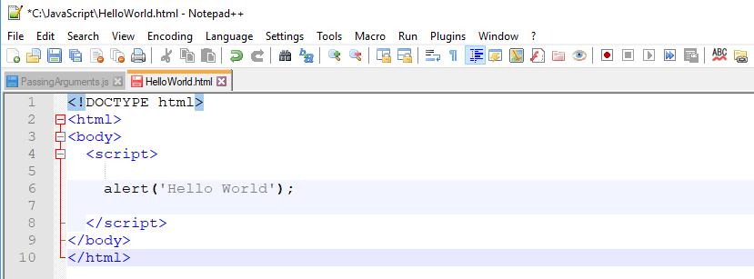
Hello World
Keep track of where you store your code!
}
This is the HTML and never changes
This is the JavaScript code
}
This is the HTML and never changes
FOX
MIS

Slide 13
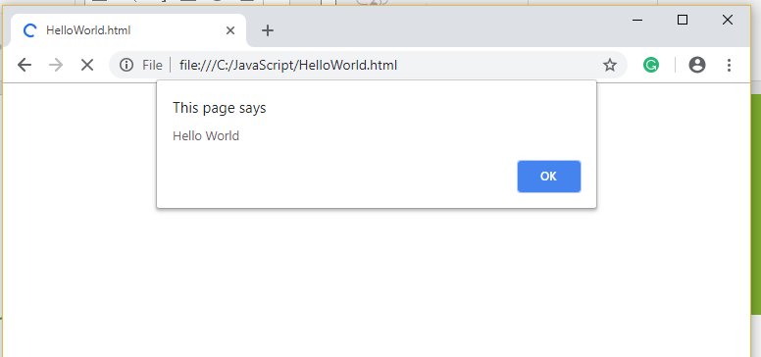
Hello World
Keep track of where you store your code!
Output from Alert
FOX
MIS

Slide 14
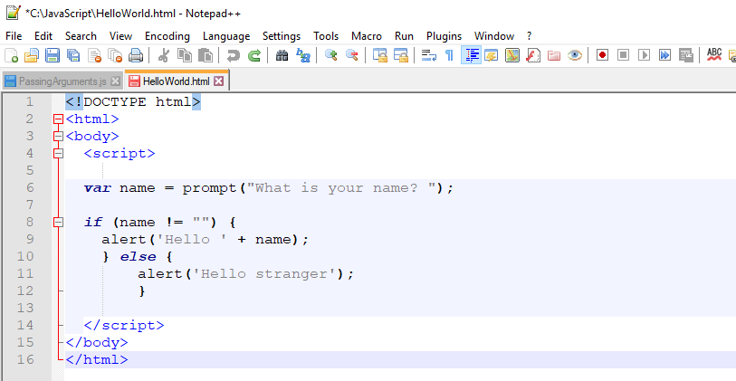
Fancy Hello World!
}
This is the HTML and never changes
}
This will make more sense in the coming weeks
}
This is the HTML and never changes
FOX
MIS

Slide 15
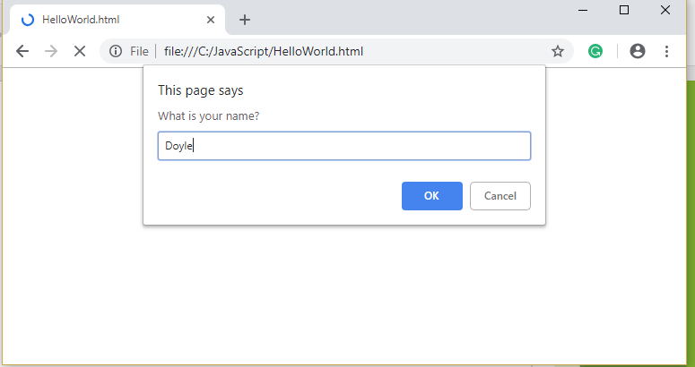
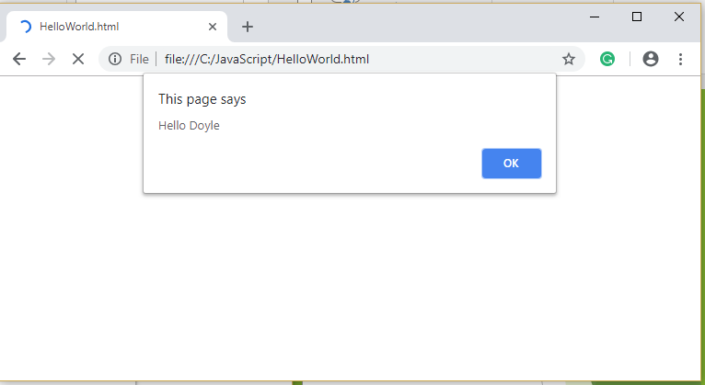
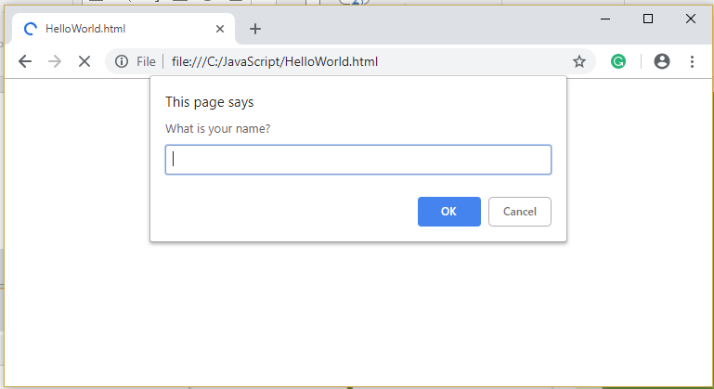
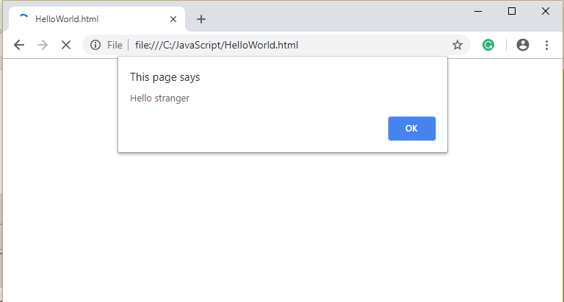
Fancy Hello World!
FOX
MIS

Slide 16
To code, we will need a text editor: Installing-VS-Code-Windows Installing-VS-Code-Mac-OS
FOX
MIS
Notes:
This is just a reminder/review. Students were required to complete the download before class.
ITAs should work with the students still having problems while the instructors continue with the discussion.

Slide 17
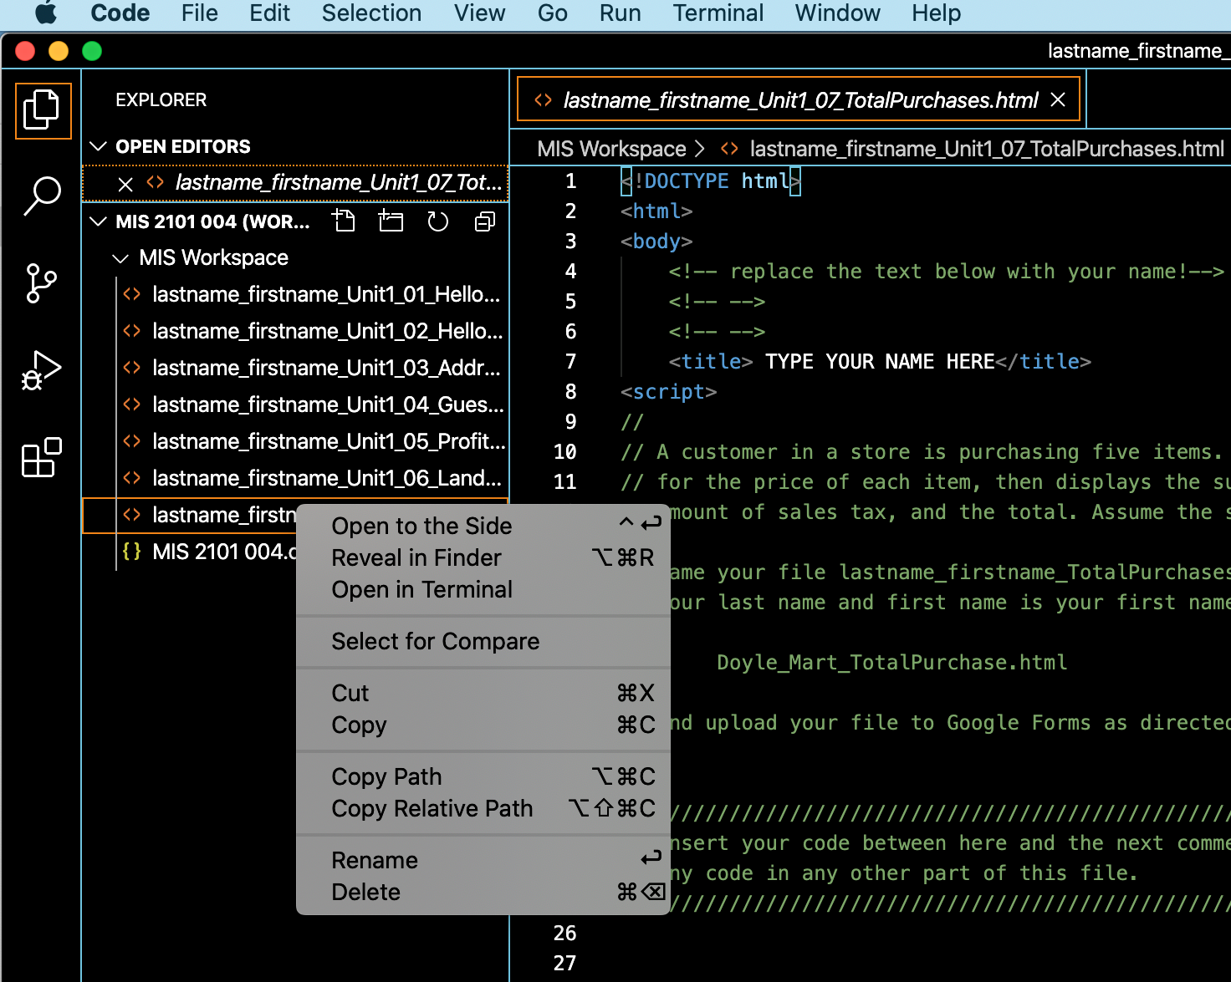
Special Message for Mac Users
The windows version of VS Code has an option to view a file that you have edited in your browser
This option is no longer available in the Mac Version. Instead, you have to right click on a file, and then select “View in Finder”

Slide 18
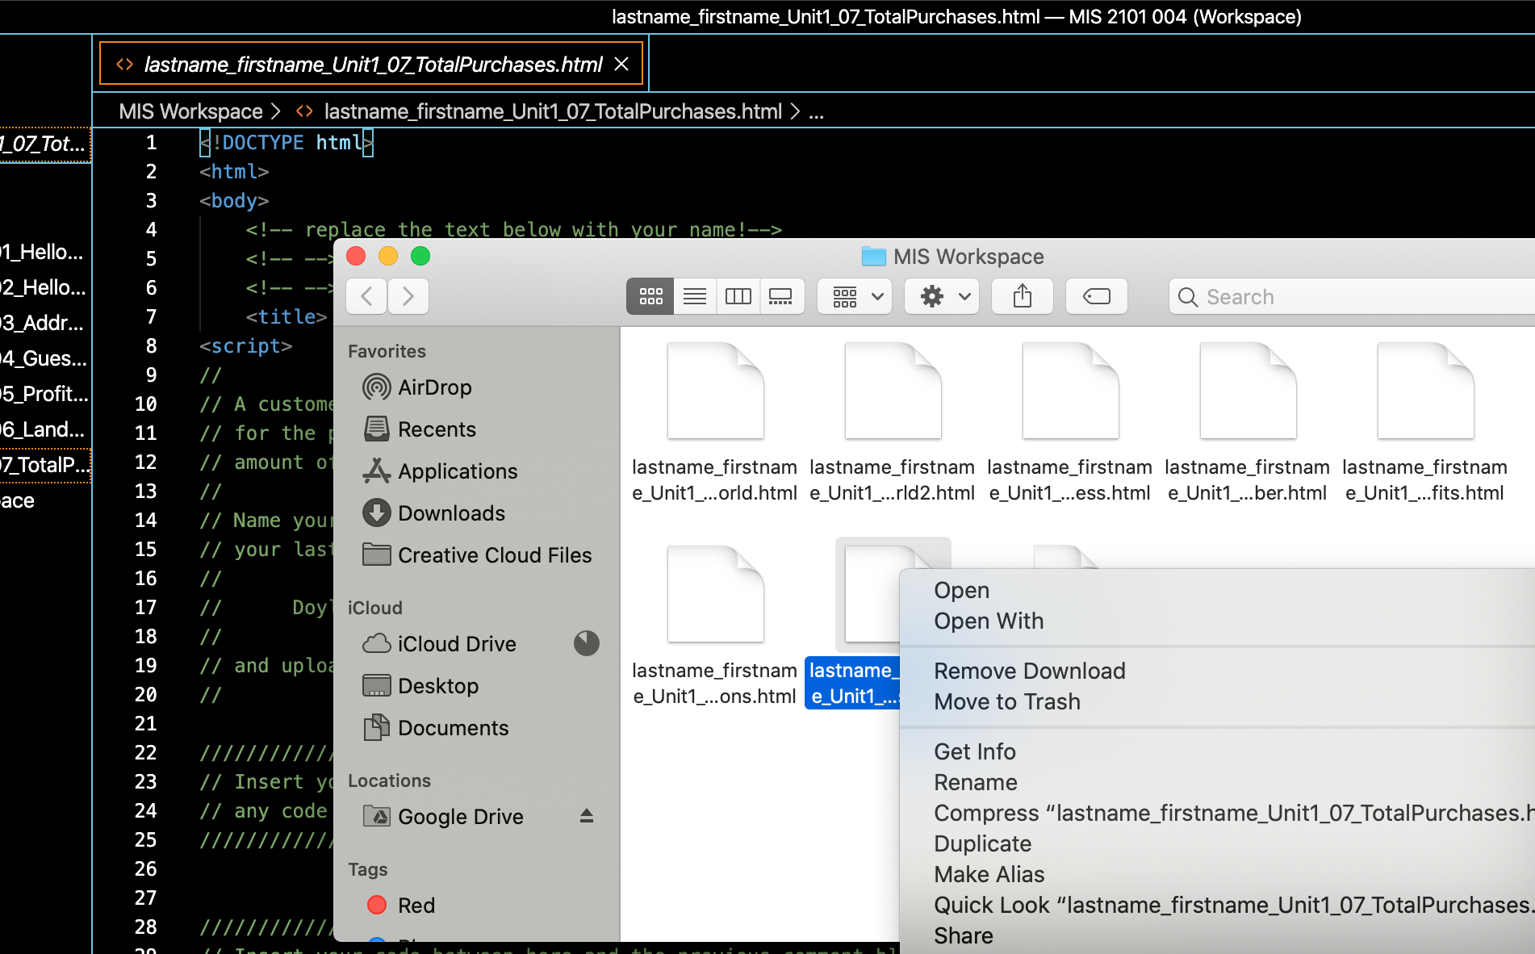
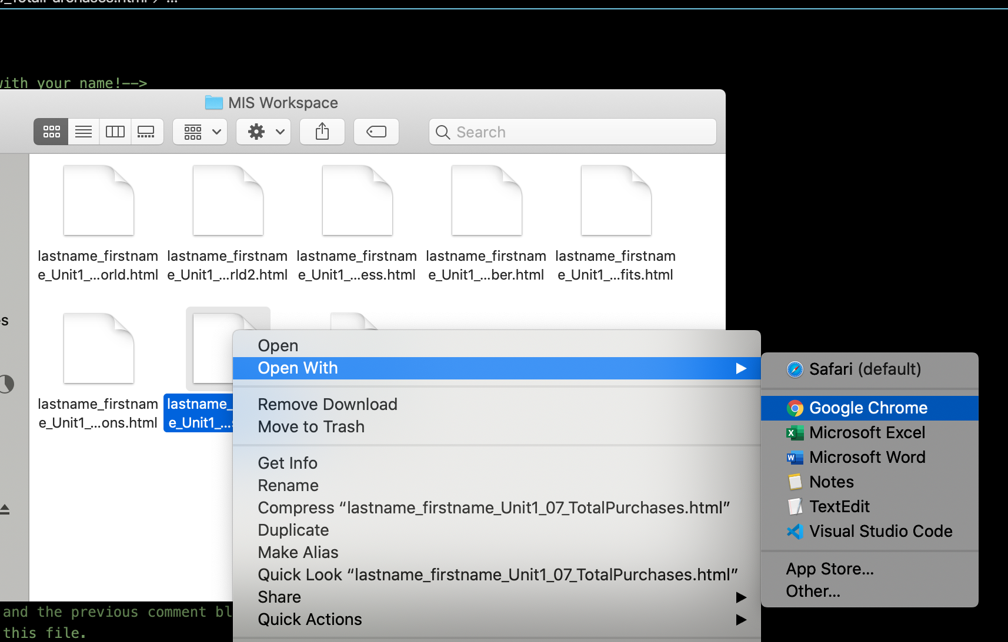
Special Message for Mac Users, Continued
After selecting View in Finder, do Open With Google Chrome

Slide 19
Working with the .html file
The html files that you will write Javascript in reside on your computer in a folder. This folder is also used as the workspace for VS Code.
While in the folder, the file is edited by VS Code, and read by Google Chrome. After every edit you have to reload it in Chrome.
You can do this by hitting the reload button, or by re-opening it while you are in VS Code.
Save your file after every edit! Ctrl-C (Windows) or Command-C (Mac).
Must reload file in
browser after every edit
VS Code
Editor
Google Chrome
Browser
.html
File
File stays in folder

Slide 20
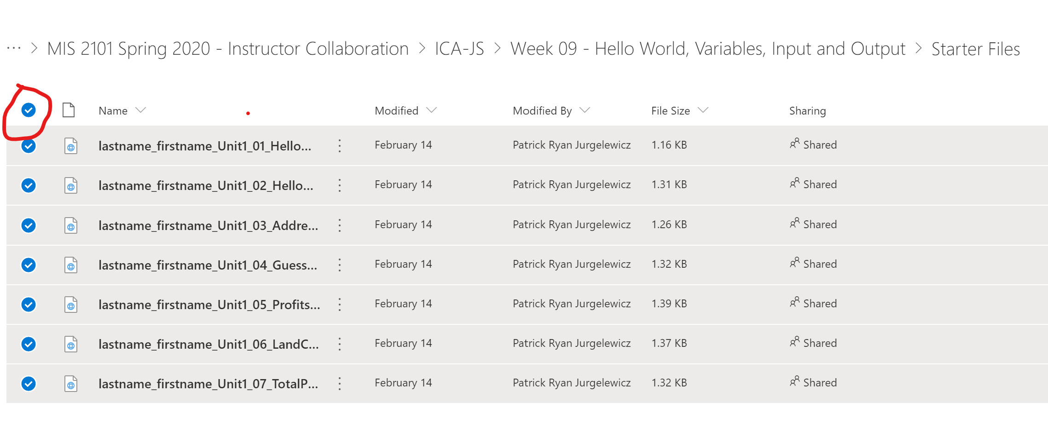
Coding Files AKA Starter Files
From the main course menu, click on Activities and select In-Class Activities.
Scroll to the bottom of the page, and click on the Coding Files for this week.
Mouse-over Name, and a radio button will magically appear. Click on it, and all files will be selected.
Select download, and place them somewhere on your computer where you can easily find them.

Slide 21
Coding Files AKA Starter Files, Continued
When you download the coding files, they will be embedded in a zip file.
A zip file is essentially a folder with files. The folder has been compressed so that it doesn’t take up much space
You can look at a file inside a zip file, you can for instance open a .html file in Google Chrome.
HOWEVER, you cannot save a file that is stored inside a zip file.
So, in order to edit the coding files, you will have to copy them from the zip file and place them in a folder on your computer:
Select all the files in the zip file, copy them, and paste them in a sensibly named folder. E.g. “Week 10 Hello World Coding Files”

Slide 22
File Naming Convention: lastname_firstname_Unit1_01_HelloWorld.html Properly naming you file is very important, if it is improperly named then you will not receive the points for your assignments and challenges.
FOX
MIS

